Slide 1
Lec 13 Bernoulli process

Slide 2
Stochastic process is a mathematical model of a probabilistic experiment that evolves in time and generates a sequence of numerical values
Examples of stochastic process can be used to model: 1) sequence of scores in a football game 2) sequence of failure times of a machine etc
Each numerical value in the sequence is modeled by a random variable, so a stochastic process is simply a sequence of random variables
We are still dealing with a single basic experiment that involves outcomes governed by a probability law, and random variables that inherit their probabilistic properties from that law
However, stochastic processes involve some change in emphasis over our earlier models. In particular: 1) we tend to focus on the dependencies in the sequence of values generated by the process (how future depends on past)
We are often interested in long-term averages, involving the entire sequence of generated values (fraction of time machine is working)
We sometimes wish to characterize the likelihood or frequency of certain boundary events (all circuits of telephone system become simult busy)

Slide 3
There are wide variety of stochastic processes, but in this book, we will only discuss 2 major categories
1) Arrival-type processes: occurrence that have the character of an arrival, such as message receptions at a receiver, customer purchases at a store.
We will focus on models in which the interarrival times are independent random variables
When arrival times occur in discrete time and the interarrival times are geometrically distributed- this is the Bernoulli process
When arrivals occur in continuous time, the interarrival times are exponentially distributed- this is the Poisson process
2) Markov processes: here we look at experiments that evolve in time and in which the future evolution exhibits a probabilistic dependence on the past (e.g the future daily prices of a stock are dependent on past prices).
However, in a Markov process we assume a very special type of dependence: the next value depends on past values only through the current value

Slide 4

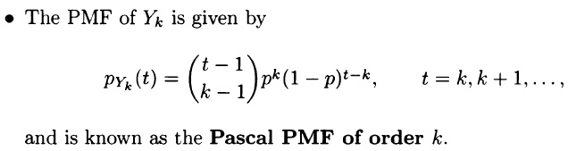
Bernoulli process can be visualized as a sequence of independent coin tosses, where the probability of heads in each toss is a fixed number p
We define Bernoulli process as a sequence X1, X2… of independent Bernoulli random variables Xi with P(Xi=1)=p, meaning success at the ith trial
Given an arrival process, one is often interested in random variables such as the number of arrivals within certain time period, or the time until the 1st arrival
Number of successes in n independent trials is modeled as Binomial r.v
Time of the 1st success is modeled as geometric r.v
Bernoulli process has the property of memorylessn and indep

Slide 5




We will concentrate on the special case where n is large, but p is small, so that the mean np has a moderate value
A situation of this type arises when one passes from discrete to continuous time
Mathematically, we can address situations of this kind, by letting n grow while simultaneously decreasing p, in a manner that keeps the product np at a constant value lyamda
In the limit, it turns out that the formula for the binomial PMF simplifies to the Poisson PMF
e is maximum return one can make with continuous compounding
Of 100% growth rate
This can also generalize to the arbitrary number periods and rates

Slide 6
Poisson Process
Poisson process is a continuous-time analog of the Bernoulli process and applies to situations where there is no way of dividing time into discrete periods
For example when modeling number of traffic accidents, if we use Bernoulli process model, within a sec we can only put 1 or 0, but during that second more than 1 accidents may be involved
One way around this difficulty is to choose the lengths of a time period to be very small, so that probability of 2 or more accidents become negligible
We consider a limiting situation where the length of the time period becomes 0 and work with a continuous-time model
We consider an arrival process that evolves in continuous time, in the sense that any real number t is a possible arrival time.

Slide 7

Definition of the Poisson Process
Arrival process is called a Poisson process with rate lyamda if it has the following properties:
1) Time-homogeneity- probability of P(k, tou) of k arrivals is the same for all intervals of the same length tou
2) Independence – number of arrivals during a particular interval is independent of the history of arrivals outside this interval
3) Small interval probabilities -

Slide 8
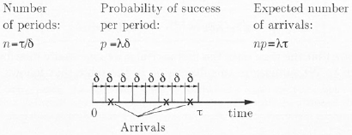
Number of arrivals in an interval
Let us consider a fixed time interval of length r, and partition it into
Periods of length epsilon, where epsilon is very small number
The process being studied can be approximated by a Bernoulli process, with the approximation becoming more and more accurate as eps becomes smaller
The probability P(k, tou) of k arrivals
in time tou is approximately the same
as the binomial prob of k successes
in n=tou/eps independent Bernoulli
trials with success prob p= lyamda*eps at each trial
While keeping the length tou of the interval fixed, we let the period length eps decrease to 0, we then note that the number n of periods goes to infinity, while the product np remains constant and equal to lyam*tou

Slide 9

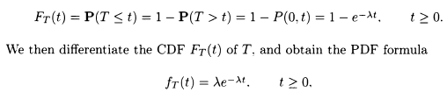
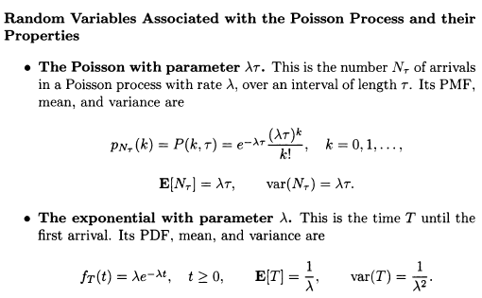
Under these circumstances, binomial PMF converges to a Poisson PMF with parameter lyam*tou
Using our earlier formulas for the mean and variance of the Poisson PMF we obtain
Time until the 1st arrival is exponent
Distributed with parameter lyamda

Slide 10
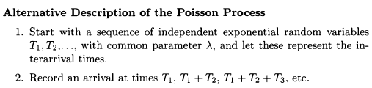
Interarrival times
Yk – time of the kth arrival, Tk-- kth Interarrival time, Tk=Yk- Yk-1
T1, T2, T3- independent exponential random variables

Slide 11



The kth arrival time, Yk= T1+ T2+…+ Tk, Earlang distribution
To evaluate the PDF f_Yk of Yk, we argue that for a small epsilon, the product
approximates the probability that the kth arrival occurs between times y and y+ eps.

Slide 12
Splitting and merging of Poisson Processes
Each arrival is kept with probability p and discarded with probability 1-p, independent of what happens to other arrivals, the result of the splitting turns out to be a Poisson process with rate lyamda*p
Alternatively, we can start with 2 independent Poisson processes, with rates lyamda_1 and lyamda_2 and merge them by recording an arrival whenever an arrival occurs in either process.
Summary: Bernoulli process vs Poisson process
Interarrival times (time until 1st arrival): Geometric vs exponential
Number of arrivals in n time: Binomial vs Poisson
K’th arrival time: Pascal vs Earlang

