Slide 1
Markov chains

Slide 2
New state = f(old state, noise or randomness)
It describes the evolution of some process or variables but in the presence of some noise, so that the motion itself is a bit random
It is general framework, so that you can describe any process with it
Markov assumption: the past has no bearing into the future, the only information that affects the probability is your current state
The goal is to make predictions about the possible next point the state will reach in given amount of time
We won’t be able to tell the exact location, but we can identify the possible cases and assign the probabilities
2 good facts about the generic example: 1) probabilities converge, that is not dependent on number of steps probability of moving from one state to the other is the same 2) probabilities does not depend on initial state

Slide 3

We 1st consider discrete-time Markov chains, in which the state changes at certain discrete time instants, indexed by an integer variable n
At each time step n, the state of the chain is denoted by Xn, and belongs to a finite set S of possible states, called the state space
We will assume that S=1,2,..m
Markov chain is described in terms of its transition probabilities pij, whenever the state happens to be i, there is probability pij that the next state is equal to j
The key assumption underlying Markov chains is that the transition probabilities pij apply whenever state i is visited, no matter what happened in the past, and no matter how state i was reached. Mathematically:
For all times n and for all states i,j. Transition probabilities sum to 1

Slide 4

Specification of Markov models. A Markov chain model is specified by:
Set of states S=1,2…m
Set of possible transitions, those pairs (i,j) for which pij>0
Numerical values of those pij that are positive
Markov chain specified by this model is a sequence of random variables X0, X1, X2… that take values in S and which satisfy
All of the elements of a Markov chain model can be encoded in a transition probability matrix, which is 2D array

Slide 5

Probability of a path
P(Xo=i0, X1=i1, Xn=i_n)=P(Xo=i0)*pio_i1*pi1_i2*…*pin-1_in
We just 2 use laws here: Bayes rule and Markov property
n-step transition probabilities
Many Markov chain problems require the calculation of the probability law of the state at some future time, conditioned on the current state
This probability law is captured by the n-step transition probabilities
is the probability that the state after n time
periods will be j, given that the current state is I
Chapman-Kolmogorov equation us used to calculate the n-step transition probabilities, starting with

Slide 6
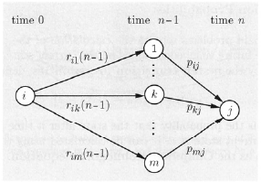
Basically, we want to calculate the probability that
We go from ith to jth state in n time steps
Formula tells that we go from i to k in n-1 timesteps
And then in 1 step from k to j. Also there are m ways to
Go to j in 1 time step
Rij(n) can be obtained by multiplication of matrix of (n-1)-step transition probabilities rij(n-1), with the one-step transition probability matrix, thus, the n-step transition probability matrix is the n-th power of the transition probability matrix
Absorbing state, states that are infinitely repeated, once reached

Slide 7

State i is recurrent if: starting from i, and from wherever you can go, there is a way of returning to I
We say that i is recurrent if for all j that belong to A(i) (set of states that are accessible from i), I is also accessible from j
Thus, from any future state, there is always some probability of returning to I, and given enough time, this is certain to happen
By repeating this argument, if a recurrent state is visited once, it is certain to be revisited an infinite number of times
A state is called transient if it is not recurrent, thus, a state I is transient if there is a state j that is accessible from i, but i is not accessible from j
If i is a recurrent state, the set of states that are accessible from i form a recurrent class, meaning that states in A(i) are all accessible from each other and no state outside is accessible from them
Markov chain can be decomposed into recurrent and transient states
Decomposition provides a powerful conceptual tool for reasoning about Markov chains and visualizing the evolution of their state

Slide 8
For the purpose of understanding long-term behavior of Markov chains, it is important to analyze chains that consist of a single recurrent class
For the purpose of understanding short-term behavior, it is also important to analyze the mechanism by which any particular class of recurrent states is entered starting from a given transient state
Periodicity
A recurrent class is said to be periodic if its states can be grouped in d>1 disjoint subsets s1, s2…sd so that all transitions from one subset lead to the next subset
Thus, in periodic recurrent class, we move through the sequence of subsets in order, and after d steps, we end up in the same subset
Given a periodic recurrent class, a positive time n, and a state i in the class, there must exist 1 or more states j for which rij(n)=0, the reason is that starting from I, only one the sets Sk is possible at time n

Slide 9
Thus a way to verify aperiodicity of a given recurrent class R, is to check whether there is a special time n>=1 and a special state within R from which all states in R can be reached in n steps, rij(n)>0 for all j
Converse is also true. If a recurrent class R is aperiodic, then there exists a time n such that rij(n)>0 for every i and j in R

Slide 10
Markov chains lec 2- book 7.3

Slide 11
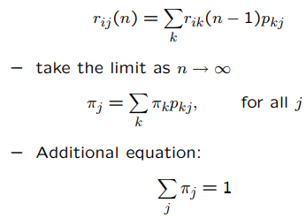
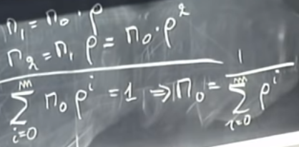
The states in a recurrent class are periodic if they can be grouped into d>1 groups so that all transitions from one group lead to the next group
Then state probabilities cannot converge to 1 value, it fluctuates between 2 values depending whether we are in odd or even numbered state
If some state in a recurrent class has transition to itself then this class cannot be periodic
For transition probability rij(n) to converge and does not depend on initial value it should consist of single recurrent class without periodicity
If we plug infinite into n r_ik converges to pi_ik (steady state prob
Of state k, so we will have j equations and j unknowns, however
As pi can be 0 we need one more condition which is on the right
And says that sum of pi_s should add to 1

Slide 12
Book 7.3

Slide 13


Steady state behaviour
In Markov chain models, we are often interested in long-term state occupancy behaviour, that is, in the n-step transition probabilities rij(n) when n is very large
If there are 2 or more classes of recurrent states, it is clear that the limiting values of rij(n) must depend on the initial state
Asymptotic behaviour of a multiclass chain can be understood in terms of the asymptotic behaviour of a single-class chain
Even for chains with a single recurrent class, the r_ij(n) may fail to converge, it state is periodic so there we will analyse whether n is even or odd
Thus, we assert that for every state j, the probability rij(n) being at state j, approaches a limiting value that is independent of the initial state I, provided we exclude the 2 situations (multiple recurrent classes and a periodic class)
The limiting value is denoted by pi_j, and is called the steady-state probability of j
Steady-State Convergence theorem: 3 properties of converged probabilities pi_j
1) For each j for all i; 2) 3) Trans Recur

Slide 14



The steady-state probabilities sum to 1 and form a probability distribution on the state space, called the stationary distribution of the chain
Using the total probability theorem, we have
Balance equations
Steady-state probabilities as expected state frequencies
For a Markov chain with a single class which is aperiodic, the steady-state probabilities satisfy where v_ij(n) is the expected value of the number of visits to state j within the 1st n transitions, starting from state I
Based on interpretation, pi_j is the long term expected fraction of time that the state is equal to j
Each time that state j is visited, there is probability p_jk that the next transition takes us to state k
We conclude that can be viewed as the long-term expected fraction of transitions that move the state from j to k

Slide 15


Q_jk(n) is the expected number of transitions that take
Us from state j to k
Given the frequency interpretation of the balance eq.
Has an intuitive meaning
It expresses the fact that the expected frequency of visits to j is equal to the sum of the expected frequencies of transitions that lead to j

Slide 16
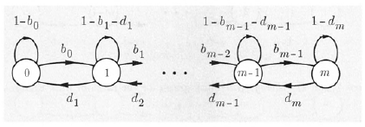


Birth-death processes
Birth-death process is a Markov chain in which the states are linearly arranged and transitions can only occur to a neighbouring state, or else leave the state unchanged
Local balance law tells
rho=b/d

Slide 17


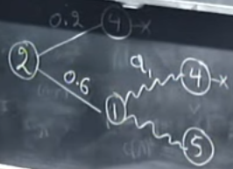

Markov chains 7.4
Assuming a single class of recurrent states then, meaning that probabilities of settling to some states converge to some value
Probability of reaching to j’s state at n’s transition when n is large enough converges to some value and it is independent of initial state P(Xn=j)=pj
We need to understand when randomness takes over the initial state
If transition probabilities are low we need a lot of trials for randomness to dominate because initial conditions will matter a lot
We calculate Pi_B for different values of B and want to achieve pi_B of 0.01, so we find out that B (given my and lyamda) is approximately 106
ai is absorption probability and i refers to the initial state
Probability of ending up at some state equals to the sum of
Probabilities of different ways that this event can happen
Probability of ending up at 4 given that we started at i is sum
Of probabilities where we can go from i and reach 4

Slide 18
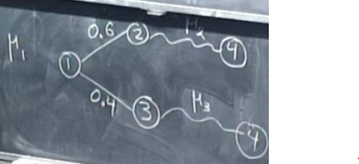

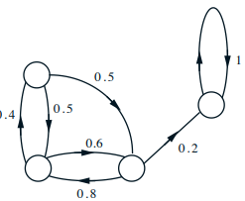
Now we are interested in estimating how many transitions it is needed to get absorbed into a recurrent state
So it is a random variable, lets call it my_i (i indicating where we started) and we are interested in finding its expected value
So if we start at 1, after 1 transition the expected time
For absorption is 0.6*myu2+0.4*my_3 +1=my_1
So we have linear equations that tie
Together different my’s
If we have 2 recurrent groups, for estimation of expected
Number of steps before absorption we can lump them together
If we don’t have any transient states but only 1 recurrent group
And we are interested in estimating in how many transitions we can go from state i to state S, we can assume S is an absorbing state by deleting rows going from S

Slide 19

7.4 absorption probabilities and expected time to absorption (book)
If there are several recurrent states, we are interested in the absorption probabilities of each of the recurrent states
ai= P( Xn eventually becomes equal to the absorbing state s/ X0=i)
Absorption probabilities can be obtained by solving a system of linear equations
A is prob of eventually reaching state s, given
we start at i

Slide 20
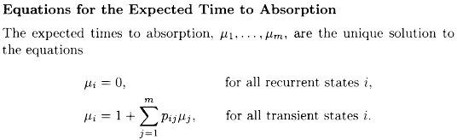
Expected time to absorption
Expected number of steps until a recurrent state is entered (absorption event), starting from a particular transient state
We can derive equations for the my_i by using the total expectation theorem, i.e time to absorption starting from a transient state i is equal to 1 + the expected time to absorption starting from the next state, which is j, with pr pij

Slide 21


Mean 1st passage and recurrence times
The idea used to calculate the expected time to absorption can also be used to calculate the expected time to reach a particular recurrent state, starting from any other state
We denote ti, the mean 1st passage time from state i to state s, defined by
We may consider a new Markov chain which is identical to the original, except that the special state s is converted into an absorbing state pss=1
We then compute ti as the expected number of steps to absorption starting from i, using the formulas given earlier

Slide 22

Mean recurrence time of special state s, defined as
We can obtain , once we have the 1st passage times ti, by using the eq.

