Slide 1
Unit 4

Slide 2




To measure the avg height of penguins, we can measure the height of N penguins and divide by N
This will be an estimate of expected value - sample mean
Expected value is the mean over entire population, sample mean is the avg over smaller sample
Expected value is a number, however sample mean is a random variable
As n goes to inf, sample mean should get close to expected value
Markov inequality: say we have a random variable X that takes nonnegative values. Then E[X]= sum over all x’s x*px(x)
If we take values of only specific x’s that are greater than a then E[X]>=
So x is greater or equal to a, thus we can plug a into x
And sum of probabilities of x’s that are greater/equal than a is P(X>=a)
Markov inequality gives upper bound for probability of random variable being equal or greater some constant. If E[x] is small then P(X>=a) is also small

Slide 3






We can apply Markov’s inequality to another random variable (X-myu)^2
LHS is var(X): RHS is
Interpretation is that if variance is small then probability of x being far away from avg is also small
We can do the similar derivation for the case of continuous random variable
This is just eq. of the variance:
If we interrupt this integral in the following way
(x-myu) is greater or equal to c, so we can replace it with c and take out of integration as it is const we get c^2*(P(X<my-c))+ P (X>my+c) )
So, overall we get
If we rearrange the equation, we get
So Markov inequality: Chebyshev Ineq.

Slide 4

Convergence means say with increasing terms in a sequence, we will eventually enter some region around a, say a+/- epsilon and stay there
Law of large numbers is a theorem that describes the result of performing the same experiment a large number of times
According to the LLN, the avg of results obtained from a large number of trials should be close to the expected value and will tend to become closer to the expected value as more trials are performed
Given a series of random variables Yi all having the same finite mean and variance, the average of their sum, converges to the avg of Yi
This is known as a weak law of large numbers
Yi are all independently and identically distributed r.v with same my and var

Slide 5


Sequence of random variables means an arrangement of random variables
So, the sequence of random variables mean the sequence of realizations of random variable: xi, xi+1, xi+2
If you actually do the die-rolling you'll get a sequence of numbers, perhaps 4,3,6,1,1,4,2
Example of converging sequence xn=1/n, then as n grows xn -> 0
Now instead of numbers, we think about distribution of a random variable
So, it means distribution of a random variable gets inside some interval as n grows larger, so that probability of falling outside of band converges to 0
So that means probability distribution of random variables is dynamic
However, convergence of random variable, does not imply anything about
The expected value or variance, so although tail disappears, it still affects the expected value and variance if is still high

Slide 6

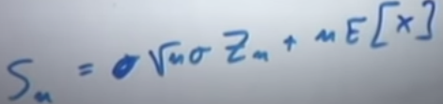

Central limit theorem
We look at Sn=X1+X2+…+Xn which has mean of n*my and variance= n*sigma^2
So mean and variance of Sn grows as we involve more X’s
If we divide Sn by n, we get mean of myu and variance of
However, if we divide Sn by sqrt(n), the variance is sigma^2 and it is const
Now we consider a case when we subtract from Sn its mean and divide by its std and thus we get a r.v with 0 mean and 1 std
In the limit Z becomes a variable with std norm distrib

Slide 7
Central limit theorem
It is a statement that CDF of sum of large number of independent and identically distributed random variables approach cdf of normal variable
In general with n=15 we can reach good approximations and use normal curve
It depends heavily on distribution of x’s
However, it can also approximate the PMF of binomial with 0.5 correction

Slide 8


Book
Limit theorems are related to the asymptotic behaviour of sequence of random variables
Let’s discuss a case when we have a sequence of i.i.d r.v X1,X2… With
Let Sn=X1+…+Xn be the sum of the 1st n of them
Limit theorems are mostly concerned with the properties of Sn and related random variables as n becomes large
As X’s are independent var(Sn)=var(X1)+..= as n increases, variance of Sn increases and does not converge to any value
However, situation is different if we divide Sn by n, that is sample mean
that means variance of Mn decreases to 0 as n increases, and the value of Mn must be very close to mean, meaning that sample mean Mn (ran. Var) converges to the true mean (number)

Slide 9

We will now consider a quantity which is intermediate between Sn and Mn
We 1st subtract from Sn, to obtain the 0 mean r.v. Sn-n*my and then divide by to form a r.v. With
Distribution of Zn neither spreads nor shrinks to a point, since the mean and variance of Zn remain unchanged as n increases
The CLT is concerned with the asymptotic shape of the distribution of Zn and asserts that it becomes the standard normal distribution
Limit theorems are useful for several reasons:
1) Conceptually, they provide an interpretation of expectations (as well as probabilities) in terms of a long sequence of identical independent exper(s)
2) They allow for an approximate analysis of the properties of r.v such as Sn, contrasted with an exact analysis which would require a formula for the PMF or PDF of Sn
3) They play a major role in inference and statistics, in presence of large data

Slide 10
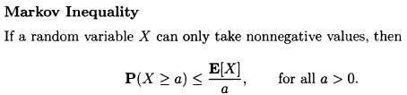

Markov and Chebyshev inequalities
These inequalities use the mean and the variance of a random variable to draw conclusions on the probabilities of certain events
They are useful in situations where exact values or bounds for the mean and variance of random variable X are easily computable, but the distribution of X is either unavailable or hard to calculate
Markov inequality, loosely speaking, asserts that if a nonnegative random variable has a small mean, then the probability that it takes a large value must also be small
Derivation:

Slide 11
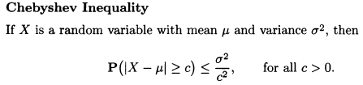


Chebyshev inequality
Loosely speaking, it asserts that if a random variable has small variance, then the probability that it takes a value far from its mean is also small, also Chebyshev inequality does not require the random variable to be nonnegative
To derive Chebyshev inequality, we
Consider the nonnegative r.v
And apply the Markov ineq with a=c^2
We obtain then and then we use
and get Chebyshev ineq.
There is also an alternative view of ineq
The Cheb. Inequality tends to be more powerful than the Markov ineq (in a sense that the bounds it provides are more accurate), because it also uses info on the variance of X. Still the mean and var of r.v are only a rough summary of its properties, and we can’t expect the bounds to be close approx. of probabil.

Slide 12



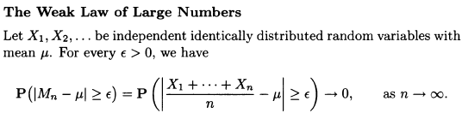
The weak law of large numbers
The weak law of large numbers asserts that the sample mean of a large number of independent identically distributed random variables is very close to the true mean, with high probability
In Chebyshev inequality if we let n grow large it approaches to 0, thus Mn approaches myu
The WLL states that for
Large n, the bulk of distrib
Of Mn is concentrated
Near mean

Slide 13
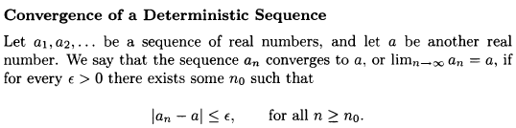
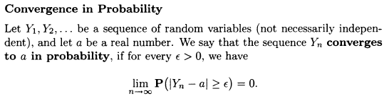
Convergence in probability
We can interpret the weak law of large numbers as stating that Mn converges to mean
We now talk about convergence of sequence M1, M2, M3 …
Chebyshev inequality implies that if all Yn have the same mean my and var(Yn) converges to 0, then Yn converges to my in probability
If the r.v. Y1, Y2 have a PMF or PDF and converge in probability to a, then according to convergence, almost all of the PMF or PDF of Yn is concentrated within eps of a for large values of n
So for every eps>0, and for sigm>0, there exists such n0, such that (above), where epsilon can be though as accuracy level, sigma- confidence interval

Slide 14


Central limit theorem (book)
According to WLL, the distribution of the sample mean
Is increasingly concentrated in the near vicinity of the true mean myu., and its variance tends to 0
On the other hand the var of sum increases to infinity, and distrib Sn also does not converge to anything meaningful
We can construct another distribution by subtracting from Sn its mean which is n*my and dividing by its std which is sigma*sqrt(n), so that we got distribution with 0 mean and std or variance of 1
The CLT asserts that the distribution of this scaled random variable approaches normal distribution

Slide 15
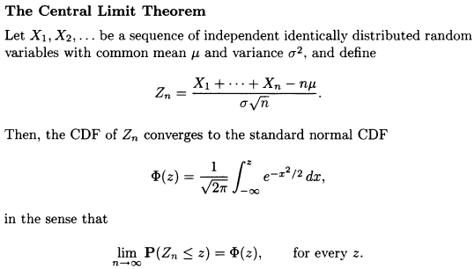
CLT places no requirement on distribution of X
, which could be discrete, continuous, mixed
CLT is of tremendous importance for several
Reasons, both conceptual and practical:
On a conceptual side, it indicates that the
Sum of a large number of indep r.v is approx. normal.
As such, it applies to many situations in which a random effect is the sum of a large number of small but independent random factors
2) On a practical, CLT eliminates the need for detailed probabilistic models, and for tedious manipulations of PMFs and PDFs. Rather it allows the calculation of certain probabilities by simply referring to the normal CDF table, requiring knowledge of only means and variances
So CLT allows us to calculate probabilities related to Zn, as if Zn were normal and since normality is preserved under linear transformations, this is equivalent to treating Sn as a random variable with mean n*my and variance n*sigma^2

Slide 16
The normal approximation is increasingly accurate as n tends to infinity, but in practice we are faced with specific and finite values of n
It would be useful to know how large n should be before the approximation can be trusted, but there are no simple and general guidelines
Much depends on whether the distribution of the Xi is close to normal and whether it is symmetric or not
For example if Xi are uniform, then S8 is already very close to normal, but if Xi are exponential, a significantly larger n will be needed before the distribution of Sn is close to a normal one

Slide 17


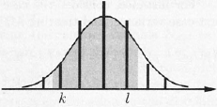
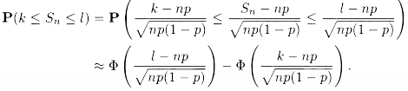
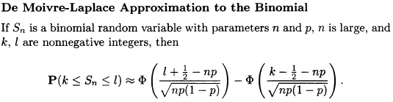
De Moivre-Laplace approximation to the Binomial
Binomial r.v Sn with parameters n and p can be viewed as the sum of n independent Bernoulli random variables X1…Xn with common parameter p
We are now interested in estimating the probability of the event
Approximation of this form is equiv
to treating Sn as a normal r.v with mean np and variance np(1-p)
More accurate approximation may be possible if we replace k and l by k-1/2 and l+1/2 respectively

Slide 18
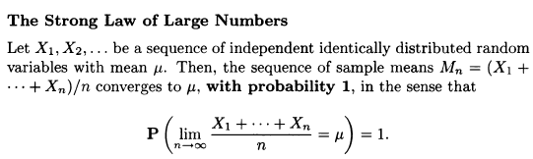

The Strong law of large numbers
The strong law of large numbers is similar to the weak law in that is also deals with the convergence of the sample mean to true mean, it is different, however, because it refers to another type of convergence
We can think of like we are doing an
Infinitely long experiment and generate
A sequence of values, one value for each
One of the random variables in the sequence X1, X2, and thus it is best to think of the sample space as a set of infinite sequences ( x1, x2…) of real numbers, any such sequence is a possible outcome of the experiment
If we consider the set A, consisting of a sequence (x1, x2 …) whose long term average is my
The SLL states that all of the probability is concentrated on this particular subset of the sample space

Slide 19
The difference between the weak and the strong law is subtle and deserves close scrutiny
The weak law states that the probability of a significant deviation from mean goes to zero as n approaches infinity, still for any finite n, there is probability can be positive and Mn can deviate from mean signif.
The weak law provides no conclusive info on the number of such deviations, but strong law does
For any given eps>0, the probability that the difference between Mn and mean will exceed eps an infinite number of times is equal to 0
We have often talked intuitively about the probability of an event A as the frequency with which it occurs in an infinitely long sequence of indep trials
The strong law backs this intuition and establishes that the long-term frequency of occurrence of A is indeed equal to P(A), with essential certainty

Slide 20
Summary of Chapter
On a conceptual side, the explored laws put a firm ground for the interpretation of probability as relative frequency in a large number of independent trials
On a practical side, they allow the approximate calculation of probabilities in models that involve sums of independent random variables
We discussed 3 major laws that take the form of limit theorems
Weak Law of large numbers – indicates that the sample mean is very likely to be close to the true mean, as the sample size increases. It is based on Cheb ineq
Central limit theorem- asserts that the sum of a large number of indep r.v is approximately normal
Strong law of large numbers – makes more emphatic connection of probabilities and relative frequencies, and is often an important tool in theoretical studies

Slide 21
Weak vs strong law of large numbers
In real life and applied statistics, there is not much of a difference. Roughly speaking, what both the strong and weak law of large numbers state is that the more times you repeat a random experiment the closer and closer the average of the empirical results get to the expected value of the random variable. The weak law tells you that you can get as close as you wish to the expected value provided you repeat the experiment a LARGE number of times. But it doesn’t say anything about your empirical average being the SAME as the expected value in the limit. This is the substantial difference between both, the strong law tells you that not only can you approach as much as you wish, but also that the empirical average is EQUAL to the expected value in the limit (as n approaches infinity). As I said before, in most practical situations (if not all) the weak law justifies the notion of frequency and allows us to make some useful predictions
The weak law guarantees that the probability that the sample mean is far away from the true average goes to zero. The strong law, on the other hand, guarantees that events of the form "the sample mean is far away from the true average" eventually stop happening.

Slide 22
CLT vs LL
The law of large numbers states that the sample mean of independent and identically distributed observations converges to a certain value. The central limit theorem describes the distribution of the difference between the sample mean and that value
The Central Limit Theorem says that when we add independent random variables their (normalised) sum will tend to a normal distribution, whereas LL states that the sample average converges to the Expected Value of the RV as n tends to infinity. Again IID RVs are assumed.

