Slide 1
Classical statistical inference

Slide 2

Lecture
The problem is the same as in Bayesian framework: we have some parameter of interest theta, we do some measurement that involves also noise and estimate X
Our goal is to make an estimate on theta based on X
The main difference from Bayesian approach is that we do not assume any prior on theta, and theta is not a r.v. but a constant
Here px(x;theta) means different thing, that is it does not mean X/theta but distribution of X with some unknown parameter theta
Different probabilistic models (e.g. distribution of X is normal with different means, theta’s) and we are trying to make a decision which one is correct model
Theta_hat, that is the estimate of theta is random, because X is random and distribution of X is affected by theta, so theta_hat is affected by theta
Maximum likelihood estimation is essentially similar to MAP in Bayesian world, except with additional assumption that theta is constant (prior is from uniform distribution)

Slide 3
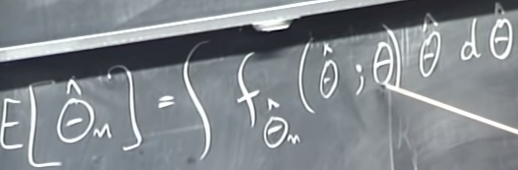
Continued
Expected value of estimator is calculated in the
Following way: its pdf will be function of both
Theta_hat and X and as X is dependent on theta
So it will depend on theta
ML estimates are generally biased, but under some conditions they will turn out to be asymptotically unbiased
That is, in probability ML converges to true parameter
All theta_hats are estimated under particular use of some theta, that is we have different estimators for each theta
So, we have 2 estimators: sample mean and ML and in some examples they coincide

Slide 4
Confidence interval
There is parameter that we do not know, we get data and based on data we construct the interval (which is dependent on data, so it is random), so the interval has some probability of containing the true parameter
So, statement of Cis is about intervals not theta itself, because theta itself is not random

Slide 5
Book 8.1 Intro
In present chapter we adopt fundamentally different philosophy, we view the unknown parameter theta as a deterministic (not random) but unknown quantity
The observation X is random and its distribution px (x,theta) or fx(x,theta) depends on value of theta
Thus, instead of working within a single probabilistic model, we will be dealing simultaneously with multiple candidate models, one model for each possible value of theta
In this context, a good hypothesis testing or estimation procedure will be one that possesses certain desirable properties under every candidate model, that is for every possible value of theta

Slide 6
Classical parameter estimation
Maximum likelihood estimator, may be viewed as the classical counterpart of the Bayesian MAP estimator
Topics in 8.1: 1) properties of estimators 2) maximum likelihood estimation 3) estimation of the mean and variance of a r.v. 4) confidence intervals
Properties of estimators
Given observations X=(X1,…Xn) an estimator is a r.v. of the form
As distribution of X depends on theta, the same is true for distrib of theta_hat
Realized value of theta_hat is called an estimate
Sometimes, when we are interested in the role of the number of observations n, we use the notation for an estimator, and it is then appropriate to view as a sequence of estimators (one for each value of n)

Slide 7
Terminology regarding estimators
Let be an estimator of an unknown parameter theta, that is, a function of n observations X1…Xn whose distributions depend on theta
The estimation error, defined as
The bias of the estimator, is the expected value of estimation error
The expected value, variance and the bias of theta_hat, depend on theta, while the estimation error depends in addition on the observations
Estimator is unbiased if for every possible value of theta
Estimator is asymptotically unbiased if for every possible value of theta
Estimator is called consistent if the sequence converges to the true value of the parameter theta, in probability, for every possible value of theta

Slide 8
Properties continued
An estimator, being a function of the random observations, cannot be expected to be exactly equal to the unknown value theta
Thus, the estimation error will be generally nonzero
On the other hand, if the average estimation error is 0, for every possible value of theta, then we have an unbiased estimator, and this is a desirable property
Asymptotic unbiasedness only requires that the estimator become unbiased as the number n of observations increases
Beside the bias, we are usually interested in the size of the estimation error
This is captured my mean sq. error , which is related to the bias and the variance of estimator

Slide 9

Maximum likelihood estimation
Let the vector of observations X=(X1,…,Xn) be described by a joint PMF
Whose form depends on an unknown parameter theta
Suppose we observe a particular value , then a ML estimate is a value of the parameter that maximizes the numerical function
that is
In this context, is referred as likelihood function
If X’s are independent, we maximize
Having observed the value x of X,
is not the probability that the unknown parameter is equal to theta, instead it is the probability that the observed value x can arise when the parameter is equal to theta
So, question is what is the value of theta under which the obser are most likely to arise

Slide 10


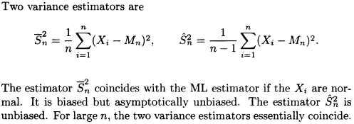
Estimation of the mean and variance of a random var.
We now discuss the simple but important problem of estimating the mean and the variance of a probability distribution
However, in this case, estimators here do not require knowledge of the distributions
Suppose that the observations X1…, Xn are i.i.d with an unknown common mean. The most natural estimation of theta is the sample mean:
This estimator is unbiased and consistent

Slide 11




Confidence intervals
Often, besides the numerical value provided by an estimate, we are often interested in constructing a so-called confidence interval
Roughly speaking, this is an interval that contains theta with a certain high probability for every possible value of theta
For a precise definition, we 1st fix a desired confidence level
Where alpha is typically a small number
We then replace the point estimator by a lower estimator and upper
Estimator , designed so that and
For every possible value of theta, also upper and lower boundaries are functions of observations, and hence they are r.v. whose distrib depend on

Slide 12
Confidence interval interpretation
We may be tempted to describe the concept of a 95% confidence interval by a statement such as ‘true parameter lies in the confidence interval with probability 0.95’
This statement is ambiguous because e.g. suppose that after the observations are obtained the conf. interval turns out to be [-2.3, 4.1]
We cannot say that theta lies in this interval with probability 0.95, because this statement does not involve any r.v.; after all, in the class.app theta is const
Instead, the random entity in the phrase is the confidence interval
For a concrete interpretation, say theta is fixed and we construct a conf. interval many times, using the same statis procedure (each time we obtain an indep. Collection of n observations and construct 95% conf. interval)
We then expect that about 95% of these conf. intervals will include theta, this should be true regardless of what the value of theta is

Slide 13



Confidence intervals based on estimator variance approximations
Suppose that the observations Xi are i.i.d with mean theta and variance v, that are unknown
We may estimate theta with the sample mean
And estimate v with the unbiased estimator
We may estimate the variance v/n of the sample mean by
Then, for a given alpha, we may use these estimates and the central limit theorem to construct an (1-alpha) confidence interval
So, with this approach, there are 2 different approx.
First, we are treating as if it were a normal r.v. ; the 2nd , we are replacing the true variance v/n of by its estimate
So, overall we can use 1) unbiased estimator for variance from sample variance 2) analytical expressions if distrib is known 3) conservative estimates

Slide 14


Lecture 24: Linear regression; Binary hypothesis testing
Conceptually, ML estimator is the same as MAP Bayesian estimator, in which prior is uniform
Phisophically, however, they are different: classical- pick theta under which the probability of data occurring is maximized vs Bayesian-pick the most likely value of theta
Constructing a CI for sample mean involves CLT (which states when i.i.d random variables are added, their properly normalized sums tend to Normal d (n should be large enough, although we need to approx. about true sigma, either by using sample variance or upper bound)
Linear regression, may also be viewed as probabilistic model
so, we can find likelihood function.
W is Gaussian, so and wi=yi-theta_0-theta1*x1, and as Y and Xs are independent we have following for joint PDF of Ws
And we seek to maximize this quantity under theta0 and theta_1
We can max log of expression or minimize the expr inside without – sign
So, Linear reg makes implicit assumption of normal random noise

Slide 15

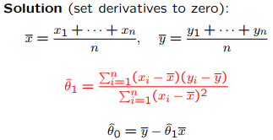
Linear regression
Once we came up with a model we need to find parameters theta_0 and theta_1 and we do this by
Interpretation of the mode is as following, we assume a
Model where W is independent of X, with 0 mean
this model is also linear, because
we add variables in linear fashion
So when asked about linearity of a model, check parameters
Not data points

Slide 16
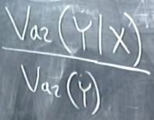
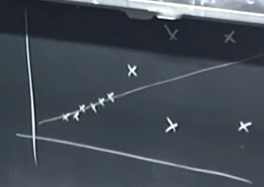
The world of regression
In practice, in addition to estimating parameters of regression say theta0 and 1, we can also find confidence intervals for the parameters
We might also want to estimate the standard error (estimate the std/variance of r.v. representing random noise (W), so that we know with what accuracy we can model the phenomena, because if var(w) is high, then our model’s predictability is affected badly
this can show how much of variability in y is represented by x, if x is good explanatory variable then var(Y/X) should be low, that is knowing x, gives us good clues on Y (R^2 is good measure of explanatory power)
Like, we can decompose variability of Y to explanatory variables
Common pitfalls associated with LR
Heteroskedasticity – W is different at different Xs; that is W is not
Identically distributed, but var(W) is dependent on Xi (so LR will find
Model based on data with more errors, so based on them, which is not right
2) Multicollinearity- correlated multiple explan variables (1st and 2nd SAT scores)

Slide 17
Pitfalls while using regression
2) Multicollinearity- parameters will be very sensitive to data (special tests need to be done to check for this issue)
3) Drawing causal relations between variables (even with good models), it just indicates the close association

Slide 18
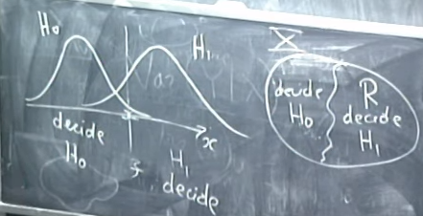



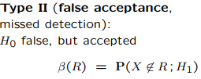
Hypothesis testing
Instead of trying to estimate continuous variables, we have 2 alternative hypotheses on distrib of X, and want to make decision which hyp is correct
Null vs alternative hypothesis (H0 vs H1)
We classify Xs to 2 groups
There are 2 types of error can be made while
Doing hypothesis testing, selecting H0, when H1 is
True and vice versa (min alpha and beta), but there is a trade-off (by moving threshold

Slide 19
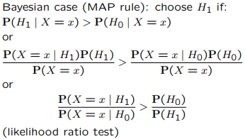
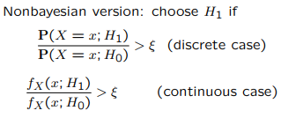

Likelihood ratio test
In Bayesian case we use priors (LHS) to set the
Threshold
In non-Bayesian case, we do not have priors, so we
Can’t use this ratio, but we keep the same structure
And estimate eps in some other ways
Way of choosing threshold eps is a trade off the 2 types of error, so to choose eps we fix one of the errors that’s is for example
That is place X (vertical line) so that alpha=c (some value) and b is
Whatever what it turns to be

Slide 20

Linear regression book
Linear regression approach chooses the parameter estimates that minimize the sum of the squared residuals
To derive the formulas for the LR estimates of thetas,
We observe that once the data are given, the sum of the squared residuals is a quadratic function of theta0 and 1
To perform the minimization, we set to 0 the partial derivatives with respect to thetas and obtain 2 linear equations
The least squares formulation can be justified on the basis of probabilistic considerations in several different ways based on different set of assumptions:

Slide 21



Justification of the least squares formulation
1) Maximum likelihood (linear model, normal noise)
Here we maximize fy(y;theta); given theta 0,1 and w as normal noise with mean 0 and variance sigma, we model y as normal variable with mean
And variance sigma^2. Then likelihood func. Is
To maximize fy we need to minimize the exp inside exp (to find thetas)
Thus, LR estimates can be viewed as ML estimates within suitable linear/normal ass.
2) Approximate Bayesian linear LMS estimation (under possibly a nonlinear model)
3) Approximate Bayesian LMS estimation (linear model)
Pairs (Xi,Yi) be random and i.i.d. and we make addit assumption that the pairs satisfy a linear model of the form so we want to find thetas that maximize fy/x . We know that minimizes the mean sq. error
Under our assumptions, thus parameters theta0,1 minimize
over all theta0,1 and by WLL as n-inf this is

Slide 22




Bayesian linear regression
We may model x1..xn as given numbers and y1…yn as the observed values of a vector Y=(Y1…Yn) of random variables that obey
Then we seek to find ftheta/y which is fy/theta*ftheta
We assume W1…Wn, theta1,2 are i.i.d r.v. with mean 0 and know variance sigma^2
We may now derive a Bayesian estimator based on the MAP approach and the assumption that theta0,1 and W1,…,Wn are normal random variables
We maximize over theta0,1 the posterior PDF By Bayes’ rule, the posterior PDF is
The numerator to be maximized is
So, we need to minimize the expression:
MAP estimates of theta0,1 are

Slide 23
Practical considerations
1) Heteroskedasticity- variable variance of W, depending on xi. Solution is to use less weight on i’s where variance of Wi is large
2) Nonlinearity - linear model cannot be used to represent non-linear relationships. We should instead use non-linear models
3) Multicollinearity - dependent expl. Variables, use only one of them instead
4) Overfitting - large number of parameters with little data. Good rule of thumb is 5 times more data points than parameter (10 times is more preferable)
5) Causality- strong linear relationship between x and y does not mean causal relationship, as there could be another variable z that causes both

Slide 24
9.3 book Binary hypothesis testing
Here we investigate the problem of choosing between 2 hypotheses, but unlike the Bayesian formulation, we will assume no prior probabilities
We may view this is an inference problem where the parameter theta takes just 2 values, but consistent with historical usage, we will forgo the theta notation and denote the 2 hypotheses as H0 and H1
In traditional statistics language, hypothesis H0 is often called the null hypothesis and H1 the alternative hypothesis, making Ho to play the role of a default model, to be proved or disproved on the basis of available data
The available observation is a vector X=(X1,…,Xn) of random variables whose distribution depends on the hypothesis
and to denote the PMF or PDF of the vector X, under hypothesis Hj
We want to find a decision rule that maps the realized values x of the observation to one of the 2 hypotheses

Slide 25

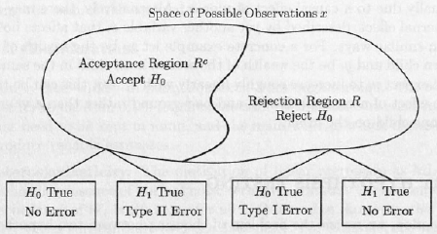
Hypothesis testing continued
We observe data and
Under each assumed model
We calculate the probabilities and then decide which of the 2 hypotheses are true
Any decision rule can be represented by a partition of the set of all possible values of the observation vector X=(X1,…,Xn) into 2 subsets: a set R, called the rejection region and its complement, Rc, called the acceptance region
Thus, the choice of a decision rule is equivalent to choosing the rejection region
For particular choice of the rejection region R,
There are 2 possible types of errors:
Reject Ho even though Ho is true- type 1 error
Or false rejection
2) Accept Ho even though Ho is false- type 2 error
or false acceptance

Slide 26



Hypothesis testing
To motivate a particular form of a rejection region, we draw analogy with Bayesian hypothesis testing, involving 2 hypotheses with respective prior probabilities
Then, overall probability of error is minimized by using the MAP rule: given the observed value x of X declare theta=theta1 to be true if
Ptheta(theta1/x)>ptheta(theta2/x)
This decision rule can be rewritten as follows: define the likelihood ratio L(x)
And declare to be true of the realized value x of the obs.
Vector X satisfies where
In non-Bayesian case likelihood ratio L(x) is defined similar to the Bayesian case where the critical value eps remains free to be chosen on the basis of other considerations, special case when eps=1 corresp to ML rule

Slide 27
Hypothesis testing exercise
1st we are given p(x,H0) and p(x,H1) that is probability of observing each observation under both hypotheses (models)
Then we write out for equation for decision making that is P(H0/x) and P(H1/x)
Which equals to P(x,H0)*p(H0) and P(x,H1)*p(H1) and compare them to see which is greater, so that we minimize the error
We rearrange this equation to form and compare with eps
And based on chosen value of eps we decide on null or alt hypothesis
By changing values of eps we can manipulate the values of type 1 and type 2 errors
Procedure for likelihood ratio test: 1) Start with a target value alpha for the false rejection probability 2) Choose eps such that you achieve alpha 3) Once the value x of X is observed, reject H0 if L(x)>eps

Slide 28
Neyman-Pearson Lemma
So far, the use of a LRT has been motivated through an analogy with Bayesian inference. However, we will now provide a stronger justification: for a given false rejection probability, the LRT offers the smallest possible false acceptance probability
Consider a particular choice of eps in the LRT, which results in error probabilities
Suppose that some test other than LRT, with
Rejected region R, achieves a smaller or equal false rejection probability
Then,

Slide 29
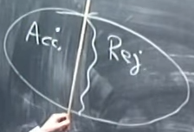


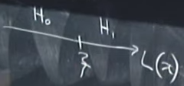
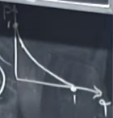
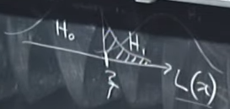

Lecture 25 Testing composite hypotheses (Significance testing)
In hypothesis testing we aim to divide the Xs (observations) into 2 parts- rejected (R) and accepted (A) regions, so we need to come up with criteria: 1) shape of dividing curve and 2) its location for division
We choose the region by specifying eps so that alpha (type 1 error is 0.05)
So by choosing eps (corresponding to some alpha) we have decision criteria
To the right of eps under the distrib of H0 we have alpha
Trade off between alpha and betta, is best done by LRT
So, the procedure is : 1) Find L(x) by writing out PDFs of
Random variables under H0 and H1 and simplify and it and bring it to the form then
Under specified alpha which determines the value of eps (like q_alpha) either accept or reject the null hypothesis, after computing the distribution of Xi’s
So, in this way we have a rule for rejecting or accept the null hypothesis

Slide 30

Checking validity of assumed PDF/CDF
Ways of checking whether underlying distribution is normal (is our assumption correct)
1) 1st way is plotting a histogram
2) Kolmogorov-Smirnov test (form CDF from empirical data and compare it to assumed CDF)
We check how close empirical and modeled CDF by calculating the maximum distance between CDF curves and compare it with some threshold and based on that comparison either accept or reject H0
We need a way of deciding on value of threshold based on desired level, and for that there exist tables

Slide 31
9.4 Significance testing book
Hypothesis testing problems encountered in realistic settings do not always involve 2 well-specified alternatives, so the methodology in the preceding section (L(x)>eps, based on P(X:H1)/P(X:H0) cannot be applied
The purpose of this section is to introduce an approach to this more general class of problems
We caution, however that a unique or universal methodology is not available, and that there is a significant element of judgement and art that comes into play
For motivation, consider problems such as: 1) A coin or a die is tossed repeatedly and independently. Is the coin/die fair? 2) 2 different drug treatments are delivered to 2 different groups of patients with the same disease. Is the 1st treatment more effective than the 2nd?
In a hypothesis testing setting, we have a default hypothesis, called the null hypothesis (H0), and we wish to determine on the basis of the obs X=(X1...Xn)
Whether the null hypothesis should be rejected or not

Slide 32
Example
Say we want to test whether a coin is fair or not? For that we tossed it 1000 times. Let theta be the unknown probability of heads at each toss. So we want to know whether theta=0.5 or not? X1…Xn are Ber(p) p:(0,1); S=X1+…Xn
We propose a decision rule that is number of heads is significantly higher or lower than the mean under p=0.5 , where eps is a suitable critical value, to be determined
We then choose the critical value eps so that probability of false rejection is equal to a given value alpha
Significance testing methodology based on data is as following: 1) Choose a statistic S, that is a scalar random variable that will summarize data (e.g avg)
2) Determine the shape of the rejected region by specifying the set of values of S for which H0 will be reject as function of yet to be determ eps (condition for S)
3) Choose significance level alpha 4) Choose eps so that type 1 error=alpha

Slide 33
Continued
Given value of alpha, if the hypothesis H0 ends up being rejected, one says that H0 is rejected at the alpha significance level
It does not mean that the probability of H0 being true is less than alpha, rather it means that when this particular methodology is used, we will have false rejections a fraction alpha of the time
Rejecting a hypothesis at the 1% signif level means that the obs. Data are highly unusual under the model associated with H0, such that this data would arise only 1% of the time under H0, and thus provide strong evid against H0
Quite often, statisticians skip parts on specifying alpha and choosing corresponding eps, instead once they calculate the realized value s of S, they determine and report an associated p-value = min(alpha) H0 would be rejected at the alpha signif level.
Equivalently, the p-value is the value of alpha for which s would be exactly at the threshold between rejection and non-rejection
Thus, null hypothesis would be rejected at 5% signif level, if p-value <0.05

