Slide 1
Double integrals

Slide 2

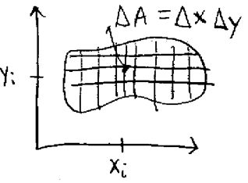

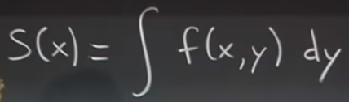
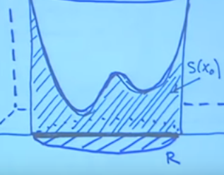

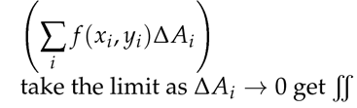
Double integral
We can plot a graph of multivariable function, surface in space
Double integral in this case will be the volume below the graph
We can define the region R in multivariable function (surface) by specifying the range of Xs and Ys and integrate would be the volume under that region
We cut region into many small pieces with area delta_A
To compute the integral we can take slices A in yz plane and
add the Areas by varying the x, so the volume will be
for given x
So overall eq is below:

Slide 3
Continued
So there are 2 ways of thinking about double integral: 1) 1st it is when we divide the area under the surface into dA and multiply by the value of function at each point and then sum those volumes
2nd is to slice the volume under the graph into many areas either in xz or yz planes and then sum them
In the yz plane case we first find the area (as function of x) by integrating function dy and then integrating areas by dx, and it is vice versa in xz plane case
When the bounds are not rectangle, we need to be careful about finding the limits for the integration
Also, again, we need to be careful when switching order of integrals, like we should draw graphs and see how the bounds look like

Slide 4


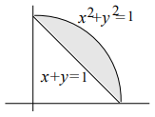
Procedure for finding bounds of integral
We want to evaluate integral over the region R
Let’s say we have dydx
In this case 1st we hold x constant and see how y varies in positive
Direction. It enters from y=1-x and leaves at y=sqrt(1-x^2)
And then we see how x changes from its lowest to the highest value
In dxdy case it is different: 1) we hold y constant, then x enters at x=1-y and leaves x=sqrt(1-y^2) and lowest and highest y are in range 0 and 1
Overall, we can say that numerical values will be in outer integral, variable bounds in inner integral

Slide 5
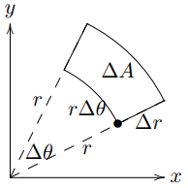
Polar coordinates
We can express points in space using also polar coordinates
X=rcos(o), Y=rsin(o)
So, we can integrate a region in plane using coordinates r and theta
dA would not be equal to r*theta, since it increases as r increases, dA=rdrd(o)

Slide 6





Applications of double integral
1) Finding an area of a region: so we should some little dA’s
We can think of it also as finding a volume of region with constant height 1
2) Finding average value of f in R- like weighted avg, we just multiply the value of function to its multiplier, which is (dA/A)
Weighted avg formula, we weight by densities and divide by M
3) Center of mass of planar object
4) Moment of inertia- defines how hard it is to impart a translation motion
dI=R^2 (distance wrt to some axsis)dm

Slide 7

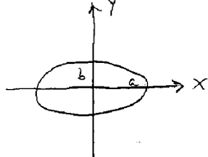




Change of the variables
We have the formula for the ellipse
We want to find the area of an ellipse A
It has the following form: we integrate dA over the given region
In order to change variables we need to find scaling
Factor between dx and du, dy and dv and also redefine
The region for integration
In general, we want to change the variables when 1) we want to
Simplify the integrand or 2) to simplify the bounds of integral
We could have linear expressions between x and u, y and v
But also non-linear expressions, and there we cant express dA’= k* dA, because k will be a function of x and y, it wont be constant

Slide 8





Change of variables, Jacobian
Jacobian is a scaling factor of linear transformation

Slide 9

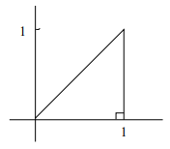




Procedure for changing variables in integral
Change dydx to dudv by using Jacobian
Change the expression inside the integral
Change the limits of integration
Methods for changing the limits of integration:
Draw the limits of integration in new coordinate system
Let’s examine the 2nd and 3rd methods by looking at example
The boundaries are the 3 lines y=x (v=0); y=0; x=1
2) In the 1st method you solve system of equations
by using boundary values and exp for u,v
Find 3 equations and draw them in u-v coordinate plane and find limits

