Slide 1
Vector fields and line integrals

Slide 2
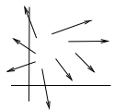
Vector fields
F(vector)=M*i+N*j, where M and are function of x and y
At each point F is a vector, that depends on x and y
The set of points (x, y) for which F is defined is called the domain of F.
To visualize the function F(x, y), at each point (x0, y0) in the domain we place the corresponding vector F(x0, y0) so that its tail is at (x0, y0)
What we get ,is called, a vector field
Conversely, given a vector field in a region of the xy-plane, it determines a vector function of the type (1), by expressing each vector of the field in terms of its i and j components
We say the vector field F is continuous in some region of the plane if both M(x, y) and N(x, y) are continuous functions in that region. The intuitive picture of a continuous vector field is that the vectors associated to points sufficiently near (x0, y0) should have direction and magnitude very close to that of F(x0, y0)

Slide 3

Vector fields
We say F is differentiable in some region if M and N are differentiable, that is, if all the partial derivatives exist
We say F is continuously differentiable in the region if all these partial derivatives are themselves continuous there
Where do vector fields arise in science and engineering?- gradient vector fields: w = f(x, y) is a vector field, since both partial derivatives are functions of x and y
When trying to find the expression of vector in i-j form, we first think how to write coordinates x and y so that condition is satisfied ( like it should point radially outward) and also about length of the vector.
For example if it is given that it should be of length c, but in terms of x and y, we have length r, we should multiply this expression by c/r

Slide 4

Flow and velocity fields
Velocity field v(x, y) , where the vector v(x,y) gives the direction of flow at points x and y and its magnitude gives the speed of the flow
Flow field - F = δ(x, y) * v(x, y), where δ(x, y)- density of the fluid at point x,y; magnitude of F gives us the rate of fluid Flow across the line perpendicular to the fluid flow direction
Example: describe the following forcé field
Its length is r/r^2, and it points radially outwards with decreasing magnitude
F is the flow field for a source of magnitude 2π at the origin
At each point P on circle, the rate of mass transport is 1/r (magnitude of F), whereas mass transport rate across circle is 2*(pi)*(r) * 1/r = 2* pi
This shows that in one second, 2π mass flows out through every circle centered at the origin,
This is flow field for a source of magnitude 2π at the origin, we can imagine supply of 2π units of mass per sec at the point (0,0)

Slide 5
We know that |F| = δ |v| = 1/r. Two important cases are:
If density is constant (incompressible fluid), then velocity decreases, as we flow outward
If it is compressible then velocity is constant and density decreases as we flow outwards

Slide 6



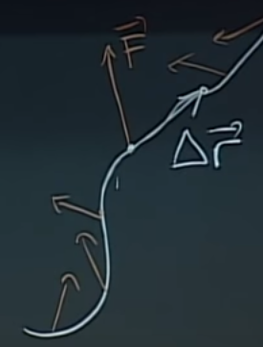
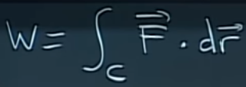
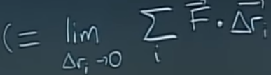
Work and line integrals
In physics, work is the product of force and displacement. A force is said to do work if, when acting, there is a movement of the point of application in the direction of the force.
A=F*d (dot product of force and displacement vector)
Work quantifies how much energy you need to provide to perform this motion
Our object moves in complex trajectory, and force is not const
In that case, we cut the trajectory to little pieces, so that we
Have vector and for each part we have force
So we do the dot product and sum them

Slide 7


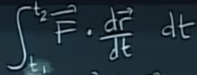

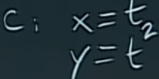

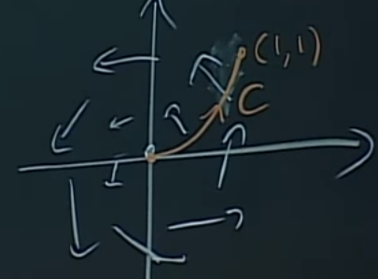
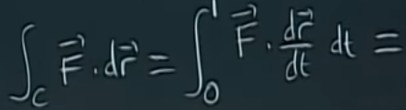

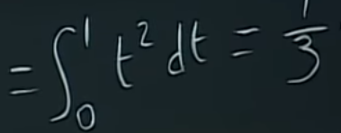
So, overall we have =
Example:
Curve looks like as on the right
F=-y*i+x*j=-t^2*i+t*j; dr/dt= 1,2t

Slide 8








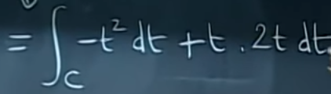
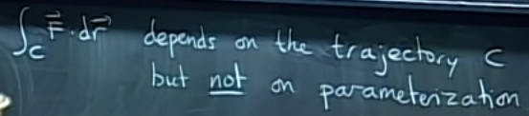
Another way of doing line integral
A
If we will integrate only wrt to x we will have an expression with y’s
So the trick is to have only x or y or t, so that you have a number at the end
So it becomes,
As
So the main trick is to express x and y wrt to the same variable

Slide 9

Properties and notation of line integrals
They are independent of parametrization.
If you reverse direction on the curve, then the line integral changes sign
−C means the same curve traversed in the opposite dir

Slide 10
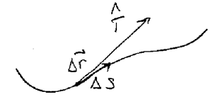


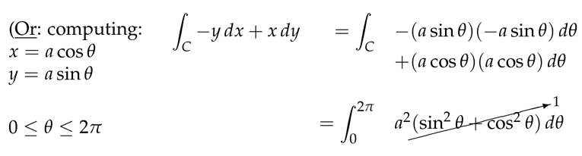

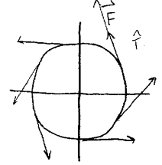
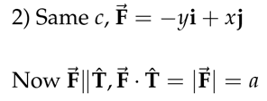

Geometric approach
If we take very small piece of trajectory, then
Will be tangent to the trajectory and with length of
And with dir of unit tangent vector
So,

Slide 11


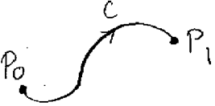
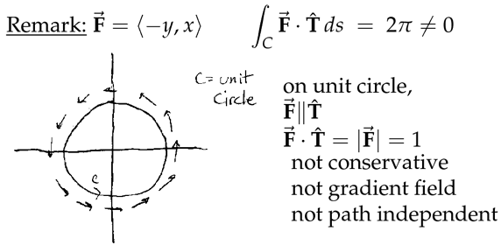
3 forms of line integral
Fundamental theorem of calculus for line integrals
If you integrate the derivative of function from say a to b, it equals to f(b)-f(a)
Similar occurs for the case of line integrals

Slide 12

Gradient fields
We say if F=delta_F. then integral of F along curve C, equals to the difference of potentials, thus it is path-independent
If the curve is closed, the it is said to be conservative and line integral is 0
Now we discuss the testing whether the field F(M,N) is a vector or not
If F is grad field then F(M,N); M=fx and N=fy, so fxy should be eq to fyx; My=Nx, also we add the condition that F should be differentiable everywhere
Converse is not always true, i.e if My=Nx it does not mean that F is gradient field
But important assumption to check is that F should be defined everywhere
Essentially, there 2 ways to check whether some field is conservative or not, the 1st is to equate My and Nx and see whether they are equal or not, but considering the field is defined and differentiable everywhere;
The 2nd way is to integrate the field along some closed curve and check whether it integrates to 0

Slide 13
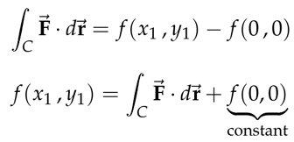
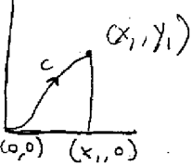
Fundamental theorem for line integrals
It is similar to fundamental theorem of calculus
It says that when evaluating line integrals in the gradient field, it equals to the difference of potentials at the end points
Methods for finding the potential if the field is identified as gradient (i.e finding the function from gradient)
One way is to use the line integrals along some path
We integrate the gradient function and add constant c
Using antiderivatives.
1st integrate wrt to x or y then take derivative wrt to x or y
and equate this to fx or fy and find the unknown

Slide 14
If F is gradient then My=Nx; converse is true if F is defined in entire plane
Curl(F)=Nx-My
So another definition of conservativeness may include condition Curl(F)=0
Curl measures rotation component of motion, if there is no rotation then curl(F) is 0
Curl measures 2x angular velocity of rotational component of a velocity field
Curl of a force field measures torque exerted on a test object

