Slide 1
Fundamentals of statistics Review: Units 1-7

Slide 2
Unit 0: Linear Algebra and probability review
Unit 1: Introduction to statistics and probability
Unit 2: Foundations of Inference
Unit 3: Methods of estimation
Unit 4: Hypothesis testing
Unit 5: Bayesian statistics
Unit 6: Linear Regression
Unit 7: Generalized linear models
Unit 8: Principal Component Analysis

Slide 3
Overview of units 1,2,3
Unit 1: Introduction to statistics
Lecture 1: What is statistics
Lecture 2: Probability redux
Unit 2: Foundations of inference ( estimation, confidence intervals, hypothesis testing)
Lecture 3: Parametric Statistical models
Lecture 4: Parametric estimation and confidence intervals
Lecture 5: Delta Method and confidence intervals
Lecture 6: Intro to hypothesis testing, type 1 and type 2 errors
Lecture 7: Levels and p-values
Units 3: Methods of estimation
Lecture 8: Total variation distance, Kullback-Leibler divergence
Lecture 9: Introduction to MLE estimation
Lecture 10: Covariance matrices, Multivariate Statistics and Fisher information
Lecture 11: Method of moments
Lecture 12: M:estimation

Slide 4





Key equations for unit 1
Law of large numbers: sample mean -> E[X] as n grows
CLT: properly scaled sum of i.i.d. r.v is normal r.v.
Hoeffding’s inequality, when n is not large enough to apply CLT
Markov’s Chebyshev’s ineq
Addition, multiplication and division of r.v. is possible if distribution is converging in probability; if in distrib we can use Slutsky’s theorem, one of distrib conv to number
Continuous mapping theorem: if f is continuous function, f(X)=f(Xn)

Slide 5






Unit 2 review
Trinity of statistical inference: estimation, confidence intervals, hypothesis testing
Goal of statistics is to learn the distribution of X based on a lot of data, prob is reverse
Definition of statistical model; types of statistical models (param, non-param, semi-param; identifiability of parameter of a statistical model, def of statistic, estimator
Jensen’s inequality: if function f() is convex then E[f(x)]>=f(E[X])
Bias and variance of estimator:
Consistent estimator is the one that conv to true parameter as n -> infinity
CLT: Confidence interval: mu^+/- q*std/sqrt(n)
4 options to replace var of pop in conf int: 1) sample var 2) solve eq 3) an exp 4) cons b
Delta method
Procedure for constructing a CI: 1) determine parameter of interest (mu, var etc) 2) come up with estimator 3) find asymptotic var (use CLT) 4) Construct CI

Slide 6
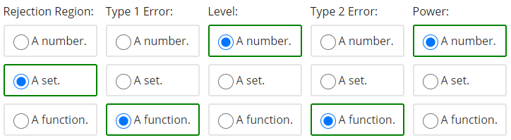
Unit 2 review continued
Procedure for hypothesis testing: 1) formula a question as a test, by specifying null (decide whether to do 1 sided or 2 sided tests) and alternative hypothesis (conditions for test 2)
Assumptions for hypothesis test: 1) model generating PDF 2) 1 vs 2 sided test
Definitions for terms in HT: 1) type 1 error- H0 is true but we reject 2) type 2 error- H1 is true but we reject 3) Power of test: 1- type 1 error (worst case alpha) 4) Level of a test: worst case alpha 5) test statistic – indicator function deciding whether we should reject or accept null 6) rejection region - set of all X’s that lead to rejection of H0 7) p-value: without specifying alpha, finding probability of observing particular X

Slide 7












Unit 3 review
Total variation distance
KL divergence
Min(KL)=max MLE
Semi-definiteness (required for concavity)
Multivariate CLT here X, mu are vector and we have cov matrix
Multivariate delta method
Fisher information is needed to computer asymp var of MLE
CLT for MLE estimator
Method of moments
MLE vs MoM
1.MLE is more accurate
2. MLE gives good results of model is misspec 3)easy computation for MoM, but diff map (M-1)

Slide 8






Unit 3 review continued
In M-estimation, the goal is to find the minimizer mu*
In M-estimation no need to specify model, we need to specify function and based on function we find mean, median and quantile
Asymptotic normality for M-estim
Huber Loss function for abs(x)
Mean sq. error
Theorem for MLE (CLT form) applies when 1) parameter is identifiable 2) Fisher information is invertible 3) support of PDF does not depend on parameter of PDF
Asymptotic variance of MLE and Method of moments estimator is the same

Slide 9
Midterm 1
ALL MLE estimators are asymptotically normal? –they are normal if certain technical conditions are satisfied. One technical condition that is often violated is that the support of the distributions depend on the parameters being estimated e.g. estimating theta when X1…Xn come from Unif[0,theta]
Confidence interval should not include the parameter itself (Ber(p) and it includes p)
Sample space of a statistical model E should not depend on its parameter
Fisher information is only computed for n=1

Slide 10
Overview of units 4 and 5
Unit 4: Hypothesis testing
Lecture 13: Chi Squared Distribution, T-test
Lecture 14: Wald’s test, likelihood ratio test, implicit hypothesis test
Lecture 15: Goodness of Fit Test for discrete distributions
Lecture 16: Goodness of Fit Tests Continued: Kolgomorov - Smirnov test, Kolgomorov – Lilliefors test, Quantile-Quantile plots
Unit 5: Bayesian statistics
Lecture 17: Introduction to Bayesian Statistics
Lecture 18: Jeffreys Prior and Bayesian Confidence Interval

Slide 11



Unit 4 review
Hypothesis testing terminology: 1) H0 and Ha 2) type 1 and type 2 errors 3) level (alpha) and power (1-alpha) of a test 4) p-values and our tests were based on CLT, so were asympt, key laws were CLT, LLN and Slutsky’s theorem (sample var -> var, when n large)
Now, we want to talk about cases when sample size is small – non asymp tests, if n<30, we cannot use Slutsky, so when we use sample var instead of var, then we get t-distrib
Xd (Chi-sq) distrib with d degrees of freedom (sum of squares of d standard normal r.v.) with mean=d, variance=2d
3rd moment-skewness (0 if sym); 4th moment – kurtosis (heaviness of tails; for Z -> 3)
Cochran’s theorem – if X1…Xn are gaussian then sample mean and sample var – indep for all n’s, and
For one sample t-test, the number of deg of freedom for t distrib is n-1, for 2-sided we use WS equation, it should be min(n,m) < Nws < n+m
Adv: of student’s test: non-asympt, works when n-small; disadv: requires Xi- gaussian
Wald’s test for multidim parameter vector hyp. Test test is based on MLE, If estimator is consistent, we can plug both true and MLE theta

Slide 12




Unit 4 review
We said theta_MLE is close to theta_0 then the length of difference vector should be small (to find length we should find its norm
Wald’s test is about the length of this vector
Likelihood ratio test:
Above is implicit multid hypot test, in a way that hypothesis tells us g(theta) not theta
Likelihood ratio test L(H1)/L(Ho) >c , we take log of both sides and multiply by 2
Tests covered: 1) t-test (small sample, unknown variance, gaussian) 2) Wald’s test (multidimensional parameters, based on MLE, square MLE) 3) Likelihood ratio test (ratio of H1 to H0, log of both sides, multiply by 2) 4) Implicit hypothesis test (we are given info about g(theta0) not theta_0 itself)
5) Kolgomorov-Smirnov 6) Kolgomorov-Lilliefors 7) QQ

Slide 13




Unit 4 review
Goodness of fit tests are non-parametric tests (Ha is everything else), e.g. H0 - X’s are i.i.d N(0,1), U(0,1) or PMF p1=0.3, p2=0.5, p3=0.2 (2-way table vs H0 proportions)
Question of interest is: Is this dataset drawn from a given distribution?
In parametric hypothesis testing we set H0 to some particular distribution in the family of certain prob distrib, so we limit what altern distrib can be, but in non-param (goodness of fit tests) we do not impose any limit
Basically to do goodness of fit test for PMF, we need to do hypothesis testing on vector-valued parameter, we can use Wald’s test (based on MLE), LR test (based on lik)
New distributions: categorical (more than 2 categories vs Bernoulli), multinomial vs binomial; likelihood of multinomial p_MLE:
Multinomial vs categorical
So for HT we can use MLE asymp normal, k-1 deg of F, as p’s sum to 1, thus not independent

Slide 14




Unit 4 review
Now if we square this and plug 1/var (1/(p*(1-p)) instead of FI, we get
We divide by p not p(1-p) (we get lower value of test statistics, more conservative)
Chi-sq vs Wald’s test; in Wald’s test elem of vec p are indep
Chi-square test is used to determine whether there is a statistically significant difference between the expected frequencies and the obs. frequencies in contingency table, Wald’s test is based on MLE to do hypothesis testing on param that are represented by a vector
Chi-sq
N is number of data points, d-dim of par; K+1 support
If we apply Wald’s test to HT param of categorical stat model
As sum of pi’s is 1, FI matrix would not be invertible, instead we use k-1 dim. Vector p, and apply Wald’s test and it turns out to be Chi-sq test (we need p^, I(p^))
New terminology: 1) empirical CDF 2) Kolgomorov-Smirnov 3) Kolgomorov-Lilliefors 4) QQ

Slide 15





Unit 4 review
Goodness of fit test (non-parametric) – data either comes from partic distrib or not
In discrete case (p=p0) we use Chi-sq test with k-1 deg Freedom; in contin case pdf instead of pmf, chi-sq does not work – becomes parametric test with inf deg of freed.
One option is to convert PDF into PMF by introducing bins and use Chi-sq test
Empirical CDF cdf fully character distr of X
Having found a way to estimate CDF by emp CDF, we want to measure how close the true and empirical CDFs are and what are fluct of distance given some number of obs.
Empirical CDF is consist estim of CDF, because by LLN E[X] and E[X] -> to CDF
Glivenko-Cantinelli theorem guarantees consistence
Fn is average of Bern. rand var. here variance is a func of t
Donsker’s theorem: uniform CLT; we can look q_alpha in tables
So, in discrete case we use Chi-sq, in contin Kolg-Smirnov
So, we should find sup, worst case t in R (comput hard), sup can only be achiev at obs points

Slide 16
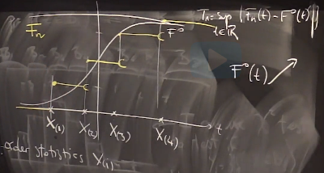




Unit 4 review
Sup is only ach at obs points, per each points 2 discr to check
So, in practice we compute Tn
As we can use
Then where or t=F^-1(x)
Inverse transform sampling: U=F(x); we randomly sample from uniform then F(x)=0.5
Then we use x=F^-1(0.5) to get quantile, F should be invertible
Kolgomorov-Lilliefors test- we use this test in cases when we do not know the true values of parameters, but we use estimators for those values, then they become biased and closer, so we need more convservative (lower) quantiles (everything is same as in KS test, but different quantiles to compare the Tn with)
QQ plot compared to earlier tests, which were based on test statistics and p-values, is a visual test, to test whether a particular distribution is close to another distribution
We can also use histograms, PDFs, CDFs, but using those it is hard to see departures
We use qq plots when N of obs is small (<50), if N is large, we can use t-test or KS

Slide 17
Unit 5 review
Bayesian interpretation of probability is degree of belief in an event, degree of belief can be based on prior knowledge, previous experiments, this is different to frequentist interpret. that views probability as limit of relative freq of an event after many trials
Bayesian methods use Bayes’ theorem to compute and update probabilities after obtaining new data, thus it allows to update probabilities using new info/data, computation is similar to freq case when doing inference, we just multiply by priors
In classical inference, model parameters and hypotheses are considered to be fixed, however, in Bayesian setting, probabilities are assigned to parameters (par are r.v.)
In Bayesian setting, on top of assuming data generating model, prior distributions should also be assigned, also parameters of distributions of prior, may themselves be assigned priors, leading to Bayesian hierarchical modeling, or priors may be interrelated, leading to Bayesian networks. Bayesian is the most effective when we have a lot of prior knowledge
A Bayesian network, is a probabilistic graphical model (a type of statistical model) that represents a set of variables and their conditional dependencies via a directed acyclic graph (DAG). Bayesian networks are ideal for taking an event that occurred and predicting the likelihood that any one of several possible known causes was the contributing factor.

Slide 18
Unit 5 review
Topic essentials: 1) Bayesian approach 2) choosing prior 3) Conjugate, non-conjugate priors 4) Jeffreys Prior, its intuition 5) Bayesian inference 6) Frequentist vs Bayesian methods
In Bayesian setting, we do not need to know a lot of tests, just priors, likelihood and posterior, but comput. more intensive (extra thing is prior), if we do not have much prior knowledge, we can use non-informat. priors, so that we can use Bayes t without having priors
In a sense, Bayesian inference amounts to having a likelihood function Ln(theta) that is weighted (vs equal weighting) by prior knowledge on what theta might be
Ways to incorporate our existing knowledge in frequentist approach 1) limit the set of possible values for parameter 2) choose more suitable probability model 3) choose more suitable procedure MLE, M-estimation or method of moments
Example: say we use Ber(p) for data, if we use frequentist approach we observe some data, find its mean and variance then normalize and construct CI, in Bayesian setting we may belief that p is likely to be close to 0.4 and incorporate this belief via priors (using beta distribution)
If posterior distribution is in the same family as prior, then prior is called conjugate prior
Ignore constants while using Bayes rule, at the end figure out distrib from PDF

Slide 19

Unit 5 review
Things we need to consider when choosing a prior:
1) whether we can reflect our knowledge with this prior (model is flexible enough, so that we can tweak parameters)
2) whether support of distribution is compatible (e.g. for Ber(p), should be in [0,1] )
3) easy of computation – compatibility of prior and likelihood
If we have no prior info we can use non-informative prior: improper (constant value) – does not integrate to 1; then posterior will have same form as likelihood
Jeffreys Prior is an attempt to incorporate frequentist ideas of likelihood in Bayesian framework, as well as idea of non-informative prior, here our choice for prior depends on observational data that is
Jeffreys prior has idea of invariance of parameterization, so does not matter if parametrize parameter as p or p^10 as long as it is same distribution
As JP is prop to FI, FI is high when var is low, so we put more weight to points that are easier to estimate (high FI)
When data becomes large, MLE and Bayesian approaches yield similar values as at some point data becomes so huge that it overwhelms the impact of prior

Slide 20
Unit 5 review
When Fisher information is high, the MLE variance is low , then the MLE estimate has less uncertainty, we are able to estimate it more precisely, this corresponds to the data giving more information about the parameter when the Jeffreys prior yields larger values.
The Fisher information can be taken as a proxy for how much, at a particular parameter value would equivalent shifts to the parameter influences the data
By the given interpretation for the Fisher information, this means that at these areas, a small change to theta will influence the data relatively more, or in other words, potential outcomes are more sensitive to slight changes in theta
For example if data is generated by Ber process then prior is
So, using Jeffreys priors we can consider only the data while selecting prior
This adjustment based on a quantitative measure of uncertainty facilitates accurate conversion between parametrizations, so scaling based on the square root of the Fisher information allows us to abstract from an artificial view imposed by a particular parametrization into a universal measuring stick of parameter impact.
All the randomness in Bayesian CI comes from randomness in prior, so if posterior has no randomness, then probability would be 0 or 1

Slide 21
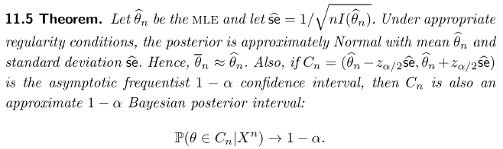
Insights from exercises
When n goes to infinity effect of prior in Bayesian posterior vanishes, so it becomes very close to likelihood, that is to MLE estimator
For U[0;theta] MLE is Xmax, and it is on the boundary. all the theorems establishing the asymptotic normality of the MLE require the satisfaction of some "regularity conditions" in addition to uniqueness. Roughly speaking, these regularity conditions require that the MLE was obtained as a stationary point of the likelihood function (not at a boundary point), and that the derivatives of the likelihood function at this point exist up to a sufficiently large order that you can take a reasonable Taylor approximation to it.
In the case of the MLE of the uniform distribution, the MLE occurs at a "boundary point" of the likelihood function, so the "regularity conditions" required for theorems asserting asymptotic normality do not hold. So far as I am aware, the MLE does not converge in distribution to the normal in this case.

Slide 22
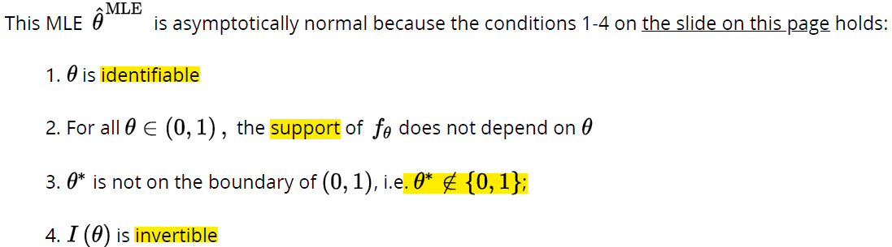
Midterm 2 insights
ALL

Slide 23
Insight from exercises
Write down canonical link form
Express mean through theta
Write pmf through theta, but substitute x*b to theta
Write down likelihood
Take derivative wrt to betai’s, find optimal values for beta’s
Theta=x*b; replace theta through mean, calculate mean given x and b

Slide 24
Overview of Units 6 and 7
Unit 6. Linear Regression
Lecture 19. Goal of Regression, theoretical and empirical linear regression solutions
Lecture 20. Multivariate linear regression
Recitations: 1) Hypothesis testing for linear regression 2) Multiple hypothesis testing and Bonferroni correction 3) Ridge regression
Unit 7. Generalized Linear models
Lecture 21: Introduction to generalized linear models; exponential families
Lecture 22: GLM: Link functions and the Canonical link function
Recitations: 1) Poisson and Gamma Generalized Linear models 2) Hypothesis test for logistic regression
Unit 8. Principal Component Analysis
Preparation exercises for principal component analysis
Lecture 23: Principal Component Analysis
Recitations: Principal Component Regression

Slide 25


Review unit 6
Goals of regression: 1) identify whether there is a relationship between X and Y (hypothesis test for coefficient) 2) Error bars around predictions (var(Y)) 3) Error bars around coefficients (var for coeff)
Modeling assumptions in regression: 1) X and Y’s are iid 2) X and Y have some joint distrib, from which we can determ they have some relationship or indep
We are usually interested in predicting value of Y at particular value of X, so Y/X
Finding conditional distribution is hard, instead we determine some statistics of that distribution like mean, median, quantile, variance etc
Regression function is E[Y/X=x], as we do not always have a point at particular x, we use neighboring points… actually when we do regression, we get information from all the points to estimate E[Y/X=x] at 1 point
Our aim is to find f(x)=E[Y/X=x], we can fit many functions of this type, our choice here is
Having chosen linear function for regression, we find it by minimizing the squared distance between Y and Y^ we find a and b by taking derivatives and equating to 0

Slide 26





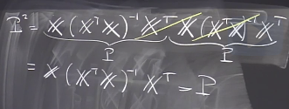
Review unit 6
Clearly, the points will not lie exactly on the fitted line, as Y=aX+b+e, var(Y/X=x)=var(e) , so var(Y)>0 as var ( e) >0, and noise e should satisfy and
In practice we estimate a* and b* from data by min, so we have
In multivariate case, X is a vector 1st term in X vector is 1
Linear indep c1v1+c2v2!=0; span – smallest subspace cont. the set, rank is dim of span
Matrix calculus is similar to scalar calculus, except we need to be aware of dimension match. LSE=min (Y-X*b)^2; we need to find b, so 2*X’(Y-X*b)=0; X’Y=X’Xb;
We get system of p linear equations, to solve, we invert it, important that X’X is invertib
So it should have rank p (n>=p), if n<p, then b is not unique
Geometric intuition: Y’ is the orthogonal projection of Y onto column space of X, that is hyperplane formed by X*beta, to find projection of Y onto X*beta, we write X*b=PY, and substituting expression for b we then have P is
To verify that P is projection matrix, we check P^2=P

Slide 27

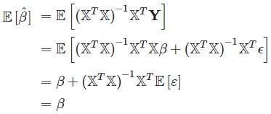
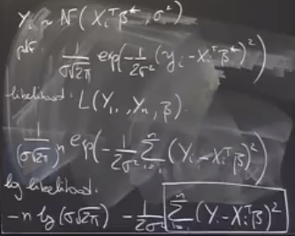


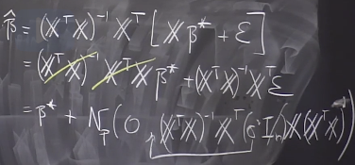



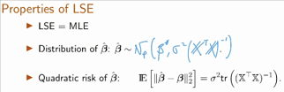


Review unit 6
In deterministic design for LR, we assume that the design matrix X is deterministic, so only random component is e
To make an inference (confidence regions, tests), we need more assumptions: 1) design matrix has rank p 2) errors are iid and var(e)=const 3) noise is N(o, sigma^2)
So, having made these assumptions we can find elements of
Vector b by using MLE and it comes down to LSE,
That is to maximize MLE, we need to minimize
so, for Gaussian noise LSE=MLE
Distribution of beta* which

Slide 28
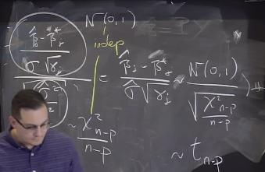
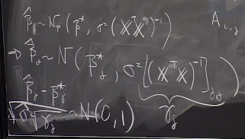


Review unit 6
Significance tests on beta^, here by testing specific beta_j, we can see whether the variable xj has any impact on prediction
So, to do hypothesis test, we need the distrib of beta^ and normalize it ( as we do not know its variance, we will plug its unbiased estimator
We get t distribution – (N/sqrt(Chi))
With test-statistic
If we do hypothesis test for several
Betas at the same time, and considering
They are independent, and all for the same level alpha, by chance we may reject H0, to make this analysis correct we need to reduce quantiles, so that it considers the number of variables in the test (if more than 1 variable, q_alpha should be reduced), so level is a/m, where a is desired level alpha, m is the number of hypotheses
Linear regression is about correlations, not causality, random Gaussian noise assumption, we can test this assumption using Kolgomorov - Smirnov test

Slide 29
Review unit 7
GLMs are generalization of ordinary linear regression that allows for response variables that have error distribution models other than a normal distribution
GLM generalizes linear regression by allowing the linear model to be related to the response variable via a link function, it is formulated as a way of unifying other statistical models, including linear, logistic and Poisson regression
GLMs allow response variables to have arbitrary distributions (rather than only normal) and for an arbitrary function of the response variable (via link function) to vary linearly with the predicted values, so non-linearity and non-normality
GLM g(Y)=X*beta has 3 components: 1) linear predictor (X*beta) 2) link function g links E[Y] and linear combination of X’s (X*beta) 3) probability distribution for Y
The most basic regression model and the one most commonly used is linear regression, this requires: a) dependent variable to be continuous b) relationship to be linear 3) errors to be independent and normal
Although GLM generalizes LR, the cost is that it becomes harder to find MLE
We will assume some model for noise/Y, depend on that we will choose the link function

Slide 30


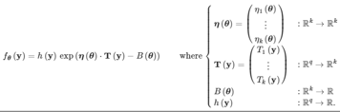

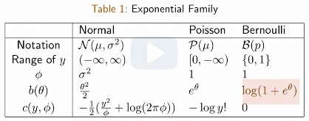


Review unit 7
Family of distribution with k-dimensional parameter, is said to be k-parameter exponential family on , if there exists real valued functions
and
When we have 1 parameter in distribution, we
Call exponential family canonical, it has slightly diff
Form
In canonical form :
Exponential family is a parametric set of probability distributions of certain form, this certain form is chosen for mathematical convenience, as well as for generality
They include normal, exponential, gamma, Bernoulli, poisson etc and not include uniform, student’s t etc; Whereas for linear models we assumed Y/X=x to be normal and E[Y/X=x] to be linear, for GLM Y/X=x is exponential and E[Y/X=x]=f(x’b)

Slide 31
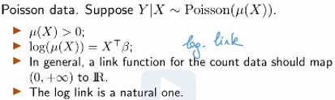

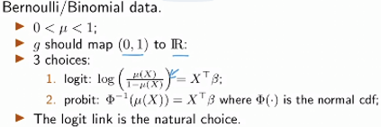
Review unit 7
We are interested in picking the link function given certain distribution from exponential family (shape of specific exp depends on shape factors b, c, phi)
When using MLE for exponential family, we maximize MLE wrt to theta and we want this theta to depend on the actual x, whereas beta is parameter of interest and needs to appear in the likelihood function to use in MLE
Link function g relates the linear predictor X’b to mean mu and it needs to be cont and diff
Link functions are used to make sure f(mu) has range in real line for linear g(mu)=1
Poisson – input +R, output entire R – log function
Bernoulli: input 0,1- output entire R –probit(inv CDF)
Or logit
Link function for given distribution can have many
Forms, but canonical link func needs to be precise, on
Top mapping to entire R, it should also cons the distrib
Of Y given x, so need to cons both link func, rand comp

Slide 32




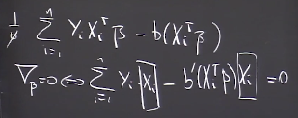

Review unit 7
Procedure for getting canonical link function: 1) write down distribution in canonical exponential form that uses b 2) take derivative of b and invert this function 3) this inverted function will be the canonical link function. 1)Mu=b’ 2) g(mu)=theta 3) g(b’(theta))=theta, so g=b’^-1
If we know the link function, the random component and the fact that Y is a member of canonical exponential family, then we know everything we need about conditional distribution of Y given X; so we can write the likelihood of Y/X, it is going to be a function of the only unknown parameter beta, once getting data, we estimate beta with MLE
Log likelihood for exponential families:
For canonical link function h= identity
And theta=X’*beta and b(theta) from exp family
Now we want to find MLE, so we should take gradient wrt to beta, equate it to 0 and to make sure that it is maximizer, so 2nd derivative/hessian matrix is negative
Gradient Hessian: b’’ is var so +, X’X is +, phi is +
and we have - in front, so overall expression is negative - concave

Slide 33



Review unit 7
In GLMs we 1) specify some distribution for Yi, then express some function (link) of mean of Yi through linear function of Xi’s
Exponential family form makes easier to think about GLMs and have common canonical form, so that it is easier to find canonical link function through b’^-1
To find beta’s through MLE: 1) write down PMF for given distribution in canonical form 2) identify theta and b(theta) 3) use to express mean of distrib through theta
4) Use this substitution to write PMF/PDF to find MLE and use theta=X*beta
To find MLE find dl/dbeta=0; then find dl^2/dbeta^2 prove it is concave
To find confidence interval for beta^, we use and normalize it by multiplying to I^0.5, so that we have N(0,1)
If we want to test 2 or more beta’s simultaneously, we can use either separate hypothesis tests or Chi-squared test
But how to estimate FI^0.5, we can use estimator for FI, as FI is defined through expect values, we can replace those with avgs and in place of beta’s we insert MLE estim for b
Adv of using canonical setup for GLM is that it leads to concave loss function

Slide 34
Review unit 8
PCA is the technique for reducing the dimensionality of high-dimensional datasets, increasing interpretability but at the same time minimizing information loss (change of basis)
It does so by creating new uncorrelated variables that maximize variance (preserve statist info)
Finding such new variables/principal components (linear functions of those in origin dataset), reduces to solving an eigenvalue/ eigenvector problem and the new variables are defined by the dataset at hand, not a priori, hence making PCA an adaptive data analysis technique
Main applications of PCA: 1) data compression to speed up training 2) visualization
The 1st principal component can be defined as direction that maximizes the variance of the projected data, ith component can be taken as a direction orthogonal to the 1st i-1 principal components that maximizes the variance of the projected data
Principal components are eigenvectors of the data’s covariance matrix or SVD of data matrix
Spectral theorem/eigen decomposition is a result when a matrix can be diagonalized, this is useful because computations involving diagonalizable matrix can be reduced to much simpler computations involving the corresponding diagonal matrix ( in terms of eigenvectors/values)
Eigenvectors are the vectors that the linear transf (matrix A) merely shrinks or elongates and the amount by which it is done is my lambda

Slide 35





Review unit 8
Covariance equation:
If X is a random vector in Rd, then covariance matrix is
Matrix H is orthogonal projection matrix, if H is symmetric and H^2=H
By multiplying by u, we give direction to scalar
u is a fixed unit vector, then this describes the empirical variance in our data in the direction of u (empirical variance of the projected dataset)
Another way is to project all Xi’s onto u and calculate their variance
Orthogonal matrix is a real square matrix whose col and rows are orthogonal unit vectors
P’*P=P*P’=I; P’=P^-1; det(P) is either 1 or -1
A is d*d symmetric matrix and A=P*D*P’, where P is orthogonal matrix, D is diagonal matrix, matrix P contains eigenvectors of P [v1 v2 …] and D eigenvalues [l1 l2..]
Matrix is positive definite if all of its eigenvalues are positive or (cov mat >=0)
PCA procedure: diagonalize cov matrix; select eigenvectors, whose eigenvalues are largest and project data onto those eigenvectors and visualize the dataset
SVD exists for both sq and rect matrices, eigendec only for square; right/left pseud inv for SVD

Slide 36

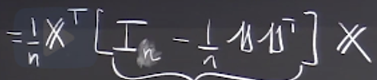






Review unit 8
X is n*d design matrix, n copies of d-dimensional random vector
PCA attempts to find low-dim representation of data while preserving the cov structure
Cov matrix: empir cov mat
X*beta^ is the orthogonal proj of Y onto the col space of X
Emprical cov matrix also = where H is sym and proj mat
Matrix H is removing mean of coordinates from each coordinate,
so it is projecting on the set of vectors whose avg coordinate is 0
As H^2=H and H’=H we can write as then
So, overall operation is to apply H to cols, that is remove avg and then find inner product
is a variance of where those are projections onto the line spanned by u
an affine space is what is left of a vector space after you've forgotten which point is the origin (or, in the words of the French mathematician Marcel Berger, "An affine space is nothing more than a vector space whose origin we try to forget about, by adding translations to the linear maps

Slide 37


Review unit 8
If is 0, this means that all of the points lie on the line perp to u (variance in u dir =0)
measure the variance in direction of u (we project all points onto u and calculate var)
If this quantity is large, then direction of u explains well the spread of samples
If x is eigenvect then var in this dir is less than or = to max eig_v
When we decompose a covariance matrix using eigen decomposition, eigenvalues correspond to variances of vectors that are projections of X onto eigenvectors
Any real square and symmetric matrix A in has spectral decomposition
Where P contains eigenvectors and D eigenvalues, matrix A if cov m then it is positive semi-definite
PCA projects data into lower dim space by keeping orthogonal directions that discriminate well the points of the cloud, directions that ha a lot of variance are the ones that have a lot info
Columns of orthogonal matrix are orthogonal to each other, meaning they represent a basis
So, we project data into different coordinate system and each eigenvalue is variance of those datapoints in that direction
So, we have n*d matrix, we want n*3, we find covariance matrix of data, that is variance in each direction and cov in 2 diff directions and then decompose this matrix into new basis

Slide 38





Review unit 8
Eigen values then represent how much var we have in each direction, so with less basis vectors we retain almost the same variance (information) in data
It is important to normalize data before applying PCA so that the PCA is not influenced by variables which have higher range of values; diadv of PCA: loss in interpretability, as 1st comp are loaded
PCA tries to look at all possible directions along which we can project data and picks the one that has the largest variance and then repeats this step by finding next direction that is orthogonal to earlier ones
So PCA in summary: 1) input X1..Xn in Rd 2) compute empirical cov matrix S 3) decompose S and find eigenvalues and eigenvectors 4) keep only k of out of d eigenvectors 5) project data onto that basis projection of Xi onto span of [v1…vk] ; Pk=(v1…vk) in R d*k
Choosing k: 1) take k where there is an inflection point in eig_v vs k plot 2) define
A criterion: take k such that proportion of var explained is some alpha (0,1)
Or combine, pick based on scree plot, then see how much var is explained
There is some inconsistency in applying PCA… in statistics PCA is used for estimation, that is given points in Rd how to estimate their cov matrix.. When n>>d empir cov matrix is consistent estim or pop cov matrix, however, in those cases we do not apply PCA, we apply when d>>n

Slide 39
Review unit 8
So, these 2 do not align.. The way around it is sparse PCA, that allows to select directions that have a lot of zeros in them, here we try to find directions aligned with original variables so that we can interpret these directions
In actual PCA, principal dir will be a linear comb. of all the genes that we had in the 1st place, but if we do sparce PCA, this will allow us to keep very small numb of genes and say e.g. those 10 genes are the ones respons. for the PC1, those 5 for PC2, so we can interpret
One of the problem with LR in high dimensional setting is that there is matrix inversion step in finding optimal coefficients, and this matrix is not invertible if rank of n*p matrix is lower than p (so, no unique minimizer b*)
To address this, we can use PCR to lower the dimensionality, say from p to k and regress those variables onto y (this way matrix is invertible), then find coefficients of k-dim vector, pull it back to d-dimensional coef vector and see how each vector affects y
PCR is somewhat similar to ridge reg, both are for when p>>n
A scree plot always displays the eigenv in a downward curve, ordering the eigenvalues from larg to smallest. Accord to the scree test, the "elbow" of the graph where the eigenval seem to level off is found and factors or comp to the left of this point should be retained as signif.

