Slide 1
Introduction to statistics

Slide 2
WHAT IS STATISTICS-unit 1 part 1
Content of the course
Relationship between probability theory and statistics
Build a model for independent observations of a binary response variable
Class offers an in-depth introduction to the theoretical foundations of statistical methods that are useful in many applications.
At the end of this class, you will be able to
From a real-life situation, formulate a statistical problem in mathematical terms
Understand the role of mathematics in the design and analysis of statistical methods;
Select appropriate statistical methods for your problem
Understand the implications and limitations of various methods

Slide 3
Review: probability and randomness
The ultimate goal of statistics is to extrapolate from small or relatively large dataset to infinity
The big component is to understand the random process present within data
The science of randomness is probability
Statistics says give me some data and I will tell you smth about the process
There are some things that we do not understand, this is typically things that are not accessible and we do not have in our dataset
Sometimes deterministic but too complex phenomenon is modeled as (statistical modeling): complicated process=simple process + random noise
The less weight the random noise has, the more accurate our model is
Good modeling consists in choosing (plausible) simple process and noise distribution

Slide 4


Statistics vs probability
Statistics (from data getting to know the data generating (random) process is reverse engineering the probability (theoretical, inherent random process)
Probabilistic problem, because we are given all relevant parameters and are trying to compute corresponding derived probabilities
Statistical problem, because we are trying to estimate an underlying probabilistic parameter from data
Thus, in probability we are trying to calculate the number based on given probability (parameter of distribution), but in statistics given the outcome, the number of interest, we are trying to infer the underlying parameter (of distribution)

Slide 5

Determining significance and enough number
For example, we want to estimate some population proportion, p
We get for example 100 samples and estimate that p_hat=0.6
The question is 100 enough? Is p=0.6 statistically significant
Another question is given 100 sample points is 0.6 or 0.7 enough?
So, we want to know the accuracy of estimator, p_hat
In order to answer this question, we propose a statistical model that describes/approximates well the experiment
We think of the Ri’s as random variables, so that p_hat is also a random variable and we need to understand its fluctuation

Slide 6

Why probability
We need to understand probabilistic aspects of the distribution of the random var.
Specifically, we need to be able to answer questions such as:
Is the expected value of p_hat close to the unknown p?
Does p_hat take values close to p with high probability?
Is the variance of p_hat large? Does p_hat fluctuate a lot?
We need probabilistic tools! Most of them are about average of indep r.vs
Averages of random variables are essentially controlled by 2 major tools
One is the law of large numbers (i.i.d Xis if n is large, sample mean -> population mean) and the other is Central Limit theorem (sum of indep r.v. are added, their properly normalized sum tends toward a normal distribution)

Slide 7
Unit 1 2nd part: Probability redux
Objectives
Statements of strong/weak law of large numb and CLT and how to apply them
Apply Hoeffding’s inequality (equiv of CLT) to the sample means of bounded i.i.d r.vs
PDF and properties of Gaussian distribution
Use Gaussian probability tables to obtain probabilities and quantiles
Distinguish between convergence almost surely, conv in probability and convergence in distribution and understand that these notions are from strongest to weakest
Determine convergence of sums and products of sequences that converge almost surely or in probability
Apply Slutsky’s theorem to the sum and product of a sequence that converges in distribution and another that converges in probability to a constant
Use the continuous mapping theorem to determine convergence of sequences of a function of random variables

Slide 8
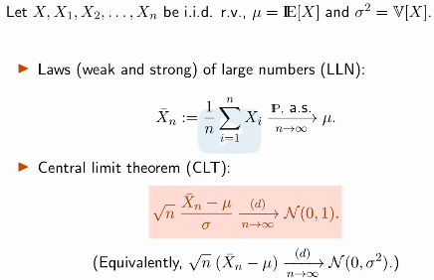
2 probability tools: Law of large numbers and CLT
The thing that arises often in statistics are expected values and we often replace expected values with averages
The thing that justifies us from doing this is thing that says that averages are close to expectations- Law of Large numbers
Essentially, Law of large numbers which
Has 2 forms (strong-convergence for sure,
Weak-convergence in probability), says
That as n increases, we are close and close
To expected values, but what it does not
Tell is given n how close we are and here
Comes CLT
Important question to ask is at what value of n, CLT applies and for this class n>=30

Slide 9
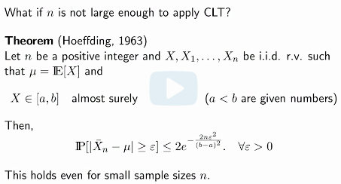
Hoeffding’s inequality
What if n is not large enough to apply CLT
We have Hoeffding’s ineq for that
This is similar to CLT that is we place some
Bound on how far the estimate for mean can
get from true mean, however, we place
Some additional restrictions, such as bounds on r.v. (thus we eliminate e.g Gaussians and exponential r.v.)
As n increases RHS gets close to 0 very quickly, so this is tight inequality
It holds even when n=1

Slide 10
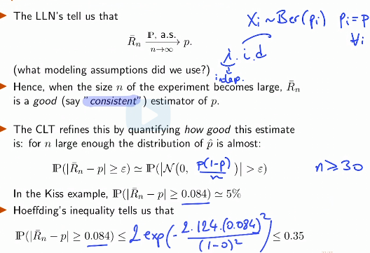
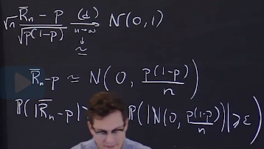

Consequences
LLN tells us that avg converges to E[X]
As n gets large
Assumptions used here are X’s are i.i.d.
CLT refines this statement into inequality
Thus, quantifying how good the estimate is
So, to quantify the probability of P(Rn-p)>eps, we find the distribution of Rn-p and to find that we use CLT, that is distribution and just rescale the variance to 1
Hoeffding’s ineq is more conservative than CLT 35 vs 5

Slide 11
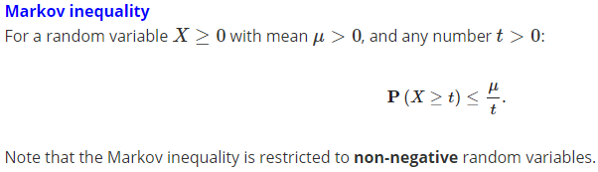
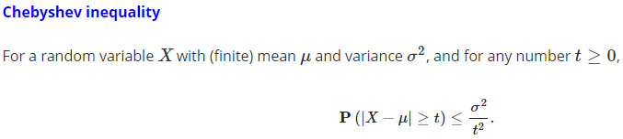
Markov and Chebyshev’s inequality
We have seen 2 other inequalities which are upper bounds on P(X>=t) based on mean and variance of X
When Markov inequality is applied to , we obtain Chebyshev’s inequality
Markov inequality is also used in the proof of Hoeffding’s inequality

Slide 12


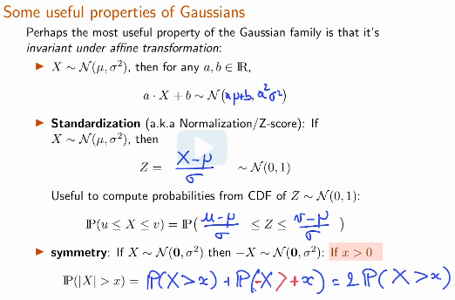
Gaussian distribution
Because of the CLT, the Gaussian (normal) distribution is ubiquitous in stats
On the right, we can see its PDF and properties
Although it is not unbounded, the tails in PDF decay
Very fast, so distribution looks lying almost like finite interval
Useful properties of Gaussian:
Standardization, symmetry

Slide 13
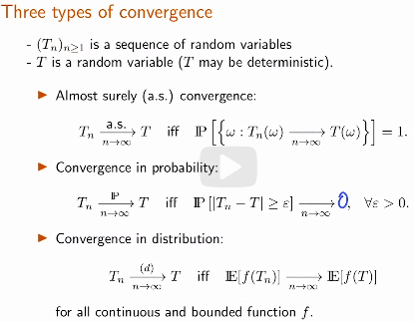
Modes of convergence
Convergence almost surely (strong Law of large numbers), convergence in probability (weak law of large numbers), and in distribution (CLT)
Almost sure convergence can be thought of as similar to the convergence in limits in sequences (converges no matter what the outcome is)
WLL is similar to strong one, basically saying
That probability of difference between r.v. T and
Tn is converging to 0 as n gets large
Overall, WLL and SLL are similar, but conv in
Distribution has different nature
It does not say anything about r.v. itself, it just
Says smth about some aspect (distribution) of it

Slide 14
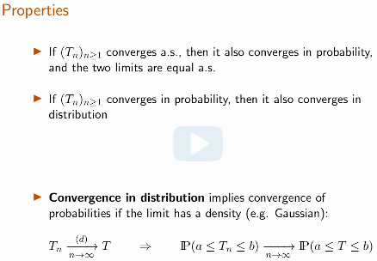


Properties of convergence
Hierarchical nature of convergence
Following two notions for convergence
In distribution are equivalent:

Slide 15
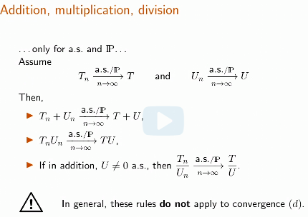
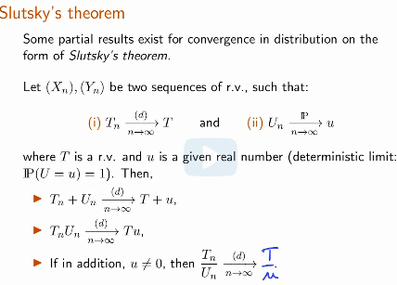
Addition, multiplication, division, Slutsky’s theorem
If sequence of r.v. converge for sure or in prob we can add, multiply and divide them
However, if they converge in distribution, we cannot do those operations
Slutsky’s theorem allows doing this if one of r.v. converge in probability to some real number

Slide 16
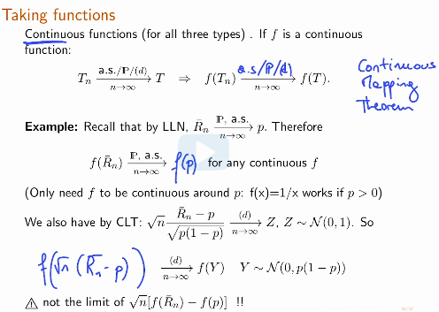
Continuous mapping theorem
If f is continuous function, then
Applying function equates to
Applying function to its limit

