Slide 1
Unit 8 Principal component analysis

Slide 2
https://royalsocietypublishing.org/doi/10.1098/rsta.2015.0202#d3e345
Large datasets are increasingly common and are often difficult to interpret. Many techniques have been developed for this purpose, (PCA) is one of the oldest and most widely used. (PCA) is a technique for reducing the dimensionality of such datasets, increasing interpretability but at the same time minimizing information loss. It does so by creating new uncorrelated variables that successively maximize variance (preserve statistical information). Finding such new variables, the principal components, reduces to solving an eigenvalue/eigenvector problem, and the new variables are defined by the dataset at hand, not a priori, hence making PCA an adaptive data analysis technique. It is adaptive in another sense too, since variants of the technique have been developed that are tailored to various different data types and structures.
This means that ‘preserving as much variability as possible’ translates into finding new variables that are linear functions of those in the original dataset, that successively maximize variance and that are uncorrelated with each other. Finding such new variables, the principal components (PCs), reduces to solving an eigenvalue/eigenvector problem.
Although for inferential purposes a multivariate normal (Gaussian) distribution of the dataset is usually assumed, PCA as a descriptive tool needs no distributional assumptions and, as such, is very much an adaptive exploratory method which can be used on numerical data of various types.
Main applications: 1) Data compression to speed up training 2) Visualization

Slide 3
Wikipedia
PCA is the process of computing the principal components and using them to perform a change of basis on the data, sometimes using only the first few principal comp and ignoring the rest.
PCA is used in exploratory data analysis (visualization) and for making predictive models. It is commonly used for dimensionality reduction by projecting each data point onto only the first few principal components to obtain lower-dim data, while preserving as much of the data's variation as possible. The first principal component can equivalently be defined as a direction that maximizes the variance of the projected data. The ith principal component can be taken as a direction orthogonal to the first i-1 principal components that maximizes the variance of the projected data
From either objective, it can be shown that the principal components are eigenvectors of the data's covariance matrix. Thus, the principal components are often computed by eigen decomposition of the data covariance matrix or SVD of the data matrix
Spectral theorem is a result about when a matrix can be diagonalized. This is extremely useful because computations involving a diagonalizable matrix can often be reduced to much simpler computations involving the corresponding diagonal matrix.
In linear algebra, eigen decomposition or sometimes spectral decomposition is the factorization of a matrix into a canonical form, whereby the matrix is represented in terms of its eigenvalues and eigenvectors. Only diagonalizable matrices can be factorized in this way.
Non-zero vector v of dimension N is an eigenvector of square N*N matrix A, if it satisfies the linear eq, where lambda – eigenvalue of v. This means that eigenvectors are the vectors that the linear transformation A merely shrinks or elongates, and the amount by which it is done is by lambda

Slide 4
Objectives
To visualize higher dimens data, we project it to lower dimens space and then visualize it, but keeping as much info in the data as possible, this makes PCA – the most used technique
Reducing the number of variables of a data set naturally comes at the expense of accuracy, but the trick in dimensionality reduction is to trade a little accuracy for simplicity. Because smaller data sets are easier to explore and visualize and make analyzing data much easier and faster for machine learning algorithms without extraneous variables to process.
Objectives
Review how to compute the expectation and covariance matrix of a random vector.
Compute the empirical mean and empirical covariance matrix of a vector data set.
Compute the variance in a given direction of a random vector.
Compute the empirical variance in a given direction of a vector-valued sample.
Describe the fundamental properties of projection matrices .
State the decomposition theorem for symmetric matrices.

Slide 5




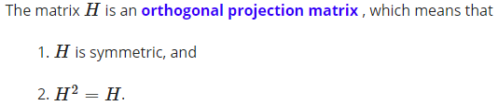

Preparation exercises for PCA
X and y are column vectors; x*y’ is matrix then and it is not symmetric but x*x’is
and E[(X-E[X])*(Y-E[Y])]
If X is a random vector in Rd, then covariance matrix is
Covariance matrix can also be expressed as
(trans(X))/n
We are interested in direction of unit vectors
Projection of vector x onto unit vector u=(u*x)*u, where ux is scalar then when we multiply by u, we make it vector,
If vector is not a unit vector, then we have:

Slide 6






Preparation exercises for PCA
We are given data, then empirical covariance matrix of dataset
u is a fixed unit vector, then this describes the empirical variance in our data in the direction of u ( empirical var of the projected dataset)
X is a random vector in Rd [X1 X2 … Xd]’ with cov matrix sigma, then u’*sigma*u is the variance in direction of u (if u is [1 0 … 0] then we just take var(X1), if it is mixed, like u=[1 0 0 1] then we add var and covariance it is mixed direction)
Another way is to project all Xi’s onto u and calculate their variance

Slide 7

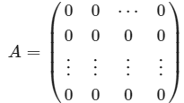


Preparation exercises for PCA
Orthogonal matrix is a real square matrix whose columns and rows are orthogonal unit vectors (rows and columns are unit vectors and their dot product is 0) P’*P=P*P’=I; P^-1=P’
Det(P) is either 1 or -1
A is d*d symmetric matrix and A=P*D*P’, where P is orthogonal matrix, D is diagonal matrix, matrix P contains eigenvectors of P [v1 v2 …] and D eigenvalues [l1 l2..]
A*v1=lambda1*v1, we prove this by writing A=P*D*P’
Matrix is positive definite if all of its eigenvalues are positive or
The columns of P (eigenvectors) are unit vectors
Eigenvectors can be all 0 and be equal
Covariance matrix is 1) symmetric matrix (A’=A) 2) positive semidefinite, as
Since this expression equals to variance and variance is always non-negative
When we get into principal component analysis (PCA) in the next lecture, our general strategy will be to diagonalize the (empirical covariance) matrix, and select the eigenvectors whose eigenvalues are the largest as axes on which to visualize our data set or point cloud.

Slide 8
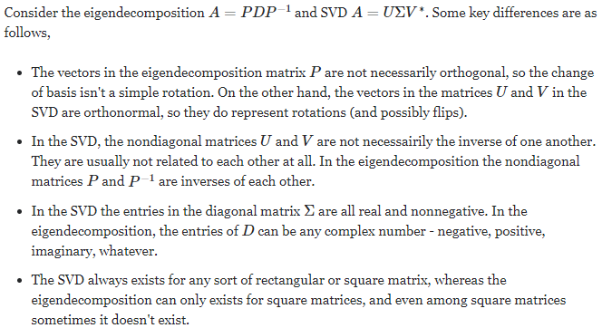
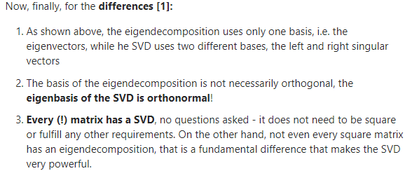
Preparation for exercises
a

Slide 9
Objectives
Understand the need for dimensionality reduction .
Know how the empirical covariance matrix is used as a tool for dimensionality reduction.
Understand spectral decomposition (without proof) of positive semi-definite matrices.
Understand the role played by eigenvalues and eigenvectors in principal component analysis (PCA) .
Use the PCA algorithm for dimensionality reduction.
Use heuristics to determine the number of dimensions one must retain after performing PCA.

Slide 10

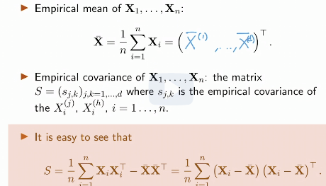

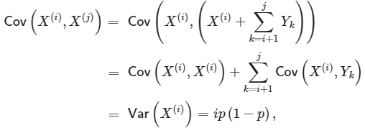

Introduction
Let X be a d-dimensional vector and X1…Xn be n independent copies of X
We stack these independent copies as rows to design matrix, so that n*d matrix
Goals of PCA: 1) reduce complexity so that to visualize
PCA attempts to find a low-dimensional representation of the data while preserving the covariance structure of our point cloud as accurately as possible
We assume that X has finite 2nd moment
Mean of vector is the mean of its coordinates
Covariance matrix:
Cov(A,B)=cov(A,C+D)=cov(A,C)+cov(A,D)
Cov: empirical cov

Slide 11


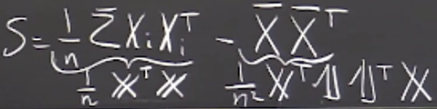
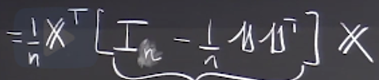




Geometric View of Empirical Covariance
S=1/n*sum(Xi*Xi’)-X_bar*X_bar’
It also equals to
Where H is symmetric and projection matrix (H^2=H)
Matrix H is removing mean of coord from each coord
So, H is projecting on the set of vectors whose avg coordinate is 0 (so it is projecting onto a subspace v, where average of coordinates of v equals to 0)
Symmetric matrix: P=P’
Orthogonal matrix: P’=P^-1 (rows and cols are orthog
Unit vectors, dot products=0)

Slide 12



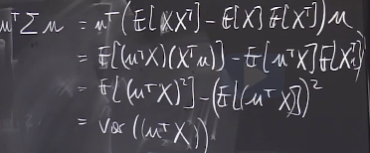


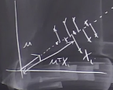


Statistics in the Empirical Covariance Matrix
as H^2=H and H=H’ we can write this as and this also can
Be written as and we can remove transposes, so
So, overall operation is to apply H to columns, that is removing average and finding inner product
Let’s see what is… it turns out that it is
Variance of where those are the projections
Onto the line spanned by u
As determinant of orthogonal matrix is 1 or -1, then hitting by orthog
Matrix either leaves the volume unchanged (rotation) or multiplies by -1 (reflection)
Quadratic form: where, A is n*n symmetric matrix

Slide 13
Affine space
In mathematics, an affine space is a geometric structure that generalizes some of the properties of Euclidean spaces in such a way that these are independent of the concepts of distance and measure of angles, keeping only the prop related to parallelism and ratio of lengths for parallel line segments
In an affine space, there is no distinguished point that serves as an origin. Hence, no vector has a fixed origin and no vector can be uniquely associated to a point. In an affine space, there are instead displacement vectors, also called translation vectors or simply translations, between two points of the space. Thus it makes sense to subtract two points of the space, giving a translation vector, but it does not make sense to add two points of the space. Likewise, it makes sense to add a displac. vector to a point of an affine space, resulting in a new point translated from the starting point by that vector.
Any vector space may be considered as an affine space, and this amounts to forgetting the special role played by the zero vector. In this case, the elements of the vector space may be viewed either as points of the affine space or as displacement vectors or translations. When considered as a point, the zero vector is called the origin. Adding a fixed vector to the elements of a linear subspace of a vector space produces an affine subspace. One commonly says that this affine subspace has been obtained by translating (away from the origin) the linear subspace by the translation vector.
an affine space is what is left of a vector space after you've forgotten which point is the origin (or, in the words of the French mathematician Marcel Berger, "An affine space is nothing more than a vector space whose origin we try to forget about, by adding translations to the linear maps

Slide 14

The Principle of Principal Component Analysis
If is 0, this means that all of the points lie on the line perp to vector u
So, PCA tries to find directions along which there is max or close to 0 variation (that is by using this feature we do not distinguish between points, that is they are redundant)
measures how spread the points are in direction u
If it equals to 0, then all Xi’s are in an affine subspace orthogonal to u
If =0, then X is almost surely in an affine subspace, orthogonal to u
If is large with u being unit vector, then direction of u explains well the spread of sample
If matrix is positive semidefinite, then its eigenvalues are non-negative
If x is eigenvector
Trace of matrix equals to the sum of its eigenvalues

Slide 15



Review of an Important Concept in Linear Algebra - Spectral Decomposition of Positive Semi-Definite Matrices
When we decompose a matrix (covariance matrix) using spectral/eigen decomposition, eigenvalues correspond to variances of vectors that are projections of X onto eigenvectors
Covariance matrix and sample covariance matrix S are positive semi-definite
Any real symmetric matrix A has spectral decomposition
Where P is d*d orthogonal matrix and D is diagonal matrix
The diagonal elements of D are the eigenvalues of A and the columns of P
Are the corresponding eigenvectors of A
Matrix A is semi-definite positive if all its eigenvalues are non-negative

Slide 16
Spectral Decomposition and Principal Component Analysis
Let’s say X1,…,Xn makes a cloud of n points in R^d (n points in d dimensions)
In practice, if d is large (>3), it becomes impossible to represent the cloud on picture
We are interested in question whether it is possible to project the cloud onto a linear subspace of dimension d’<d, by keeping as much information as possible?
PCA does this by keeping as much covariance structure as possible by keeping orthogonal directions that discriminate well the points of the cloud
Direction that has a lot of variance is the direction that has a lot of information
Columns of orthogonal matrix, containing eigenvectors, are orthogonal to each other, meaning they represent a basis
If the dot product is zero, then the two vectors are linearly independent. However, the converse isn't true: two linearly independent vectors can have a non-zero dot product.
Eigen decomposition is not unique, because we can shuffle eigenvectors and eigenvalues

Slide 17
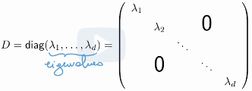


Spectral Decomposition and Principal Component Analysis
We can write covariance matrix S as where P [v1…vn] is an orthogonal
Matrix, where vi’s are unit vectors and orthogonal
D is diagonal matrix of eigenvalues
Where eigenvalues are variances of , that is eigenvalues are variances of projections of X’s onto eigenvectors
P contains eigenvectors, and by applying this projection matrix, we project each Xj onto basis made up of eigenvectors (new coordinate system)
As we did this transformation, cov matrix now is diagonal, so new coordinates are independent
Applying the orthogonal matrix P’ can be thought of as changing the coordinate system of dataset, as det of orthogonal matrix is either 1 or -1, it results in rotation, without changing length

Slide 18
Intuition behind PCA (in my own words)
Say we have n data points each having d variables, we want to reduce the dimensionality of dataset from d to say 2 or 3, but keeping covariance structure as much as possible
So, we find covariance matrix (it includes both variance in all directions and covariance in 2 directions) of data points and get d*d matrix, we then decompose this covariance matrix into eigenvectors matrix and eigenvalues diagonal matrix
Eigenvectors represent new basis for covariance matrix and eigenvalues represent variance in each direction
Intuition: we project our data into new subspace where our basis vectors are linearly independent, so that with less basis vectors we retain almost the same variance (info) in data
it is suggested to normalize your data before applying PCA so that the PCA is not influenced by variables which are high in magnitude.
Disadvantage: 1) loss in interpretability, as most variability is loaded into 1st 2 variables

Slide 19






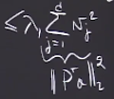





Largest Eigenvalues and the Principal Directions
So, each lambda (eigenvalue) measures the spread of the data in the direction of vj
In particular, v1 is the direction of maximal variance
Indeed, v1 maximizes the empirical covariance of
It is saying, look at all possible directions along which you can project your data and pick the one that has the largest variance, it just says, eigenvector assoc with the largest eigenvalue is actually the one that maximizes the sample var when we project to this direction
Proof: For any unit vector a, we show that with equality if a=v1
A’Sa= if replace (P’a)’ with v, then we have v’*D*v, which equals to
[ v ] [ diag] [v] =
So, rather than searching through all directions, spectral decomposition is allowing us to get the directions maximizing variance all at once (these eigenvect are called principal directions)
Idea of the PCA: Find out the collection of orthogonal directions in which the cloud is much spread out, hence the k orthogonal directions in which the cloud is the most spread out corresponds exactly to the eigenvectors associated with k largest values of S
We find 1st eigenvector, then 2nd that is perp to 1st one

Slide 20

PCA Algorithm and Choice of New Number of Dimensions
When you compute SVD of symmetric matrix it is same as spectral (eigen) decomposition
SVD works also for rectangular matrices
PCA intuition: 1) based on decomposition of covariance matrix, find out new orthogonal bases 2) keep only k of them 3) project data onto new basis
1) Input X1…Xn: cloud of n points in dimension d
2) Step 1: Compute the empirical covariance matrix S
3) Step 2: Compute the spectral decomposition S=PDP’, where D=diag(l1,..., ld) with
And P=(v1…vd) is an orthogonal matrix, containing eigenvalues
4) Step 3: Choose k<d and set Pk=(v1…vk) in R d*k
5) Output Y1…Yn, where projection of Xi onto span of [v1…vk]

Slide 21


How do we choose k in PCA (number of dimensions retained)
1) Experimental rule: Take k where there is an inflection point in the sequence
Scree plot
2) Define a criterion: Take k such that proportion of variance explained is
For some alpha (0,1) that determines the approximation error tolerated
is called the variance explained by the PCA, whereas is the total var
So, by using PCA we keep only some principal components, which incorporate all other features, but we lose the meaning of features
Practical way of choosing k is to make scree plot, pick k, then see how much var is retained at this value of k

Slide 22
Principal component regression
In statistics, principal component regression (PCR) is a regression analysis technique that is based on principal component analysis (PCA). More specifically, PCR is used for estimating the unknown regression coefficients in a standard linear regression model.
In PCR, instead of regressing the dependent variable on the explanatory variables directly, the principal components of the explanatory variables are used as regressors. One typically uses only a subset of all the principal components for regression, making PCR a kind of regularized procedure and also a type of shrinkage estimator.
Often the principal components with higher variances (the ones based on eigenvectors corresponding to the higher eigenvalues of the sample variance-covariance matrix of the explanatory variables) are selected as regressors. However, for the purpose of predicting the outcome, the principal components with low variances may also be important, in some cases even more important.^{[1]}
One major use of PCR lies in overcoming the multicollinearity problem which arises when two or more of the explanatory variables are close to being collinear.^{[2]} PCR can aptly deal with such situations by excluding some of the low-variance principal components in the regression step. In addition, by usually regressing on only a subset of all the principal components, PCR can result in dimension reduction through substantially lowering the effective number of parameters characterizing the underlying model. This can be particularly useful in settings with high-dimensional covariates. Also, through appropriate selection of the principal components to be used for regression, PCR can lead to efficient prediction of the outcome based on the assumed model.

Slide 23
Principal component analysis – beyond practice
PCA is an algo that reduces the dimensions of a cloud of points and keeps its covariance structure as much as possible
In practice this algo is used for cloud of points that are not necessarily random
In statistics, PCA can be used for estimation, that is given iid X1…Xn random vectors in Rd, how to estimate their population covariance matrix sigma (if n>>d, then empirical cov matrix S is consistent estimator), however, in many applications n<<d and solution is sparse PCA
Best use of PCA, when there are large number of redundancies (multicollinearity) in data, that is sigma as having structure that it generates points that are elongated among small number of dimensions and fairly flat among most of the directions, justifies use of PCA
When n goes to infinity, but d is fixed, the empirical covariance matrix is consistent estimator of covariance matrix, and eigenvectors estimated will be close to true eigenvectors
However, in many applications where we would want to use PCA is d>>n settings, dimension is larger than number of data points, so that theory does not align well with practice
There is a way around this, called sparse PCA, that allows to select directions that have a lot of zeros in them

Slide 24
Principal component analysis – beyond practice
There is a way around this, called sparse PCA, that allows to select directions that have a lot of zeros in them
Sparse PCA is saying that we are trying to find principal directions aligned with directions of original variables, so that we can interpret these principal directions
In actual PCA, principal directions will be a linear combination of pretty much all the genes that we had in the 1st place, we if we do sparse PCA, this will allows us to keep very small number of genes and say for example, those 10 genes are the ones that are responsible for the PC1, and those 5 genes are the ones that responsible for PC2 and we can interpret what is going on there
If we have diagonal matrix with only some eigenvalues >0 and the rest is close to 0, that means the data is close to living in a k-dim subspace, that is the k-dimensional linear span of the 1st k eigenvectors, in this case theory will also be aligned with practice
Then we can perform a test on whether the small eigenvalues are actually legitimately equal to 0, or are they significantly different from 0, for that we need to understand the distribution of eigenvalues, if we want to compute a p-value
So, if it is known beforehand that sigma is low rank, we can find S and replace it with S’, where we replace small eigenvalues with 0, then theoretical analysis would lead to an optimal choice of tuning parameter k

Slide 25
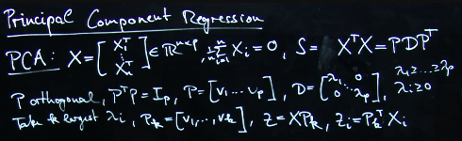
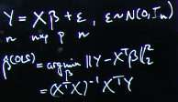

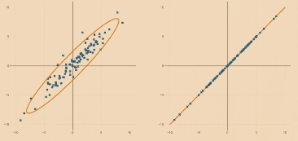
Recitation 28. Principal component regression
PCA: we have n p-dim data points, with mean 0,
we find its cov matrix and then project data onto new
k-dim eigen vector basis, then we have n*k matrix
One of the problems with LR in high-dim setting is that there is a matrix
inversion step in finding optimal coefficients, and this matrix is not invertible
(p*n n*p, so p*p matix but rank<p) if p>n (so no unique minimizer b*)
Idea of PCR (reg) is to use PCA to lower dimensionality, then we get
New points in new coordin say n*k and regress those onto y, once
Found k-dim coeff vector, pull it back to d-dim coeff vector and see
how each variable affects y
Lets summarize what we do in gamma: 1) project original matrix into smaller space 2) invert it there 3) pull it back by projecting it back to original space with Pk and Pk’ (so we can invert it as we are low dim space, low rank), but price is that we lose the effect of separate variables, that is their effects are combined (PCR is somewhat similar to ridge reg, both are for when p>>n)
As P’=P^-1, by applying 1st P and then P’, we project and reverse that projection

Slide 26
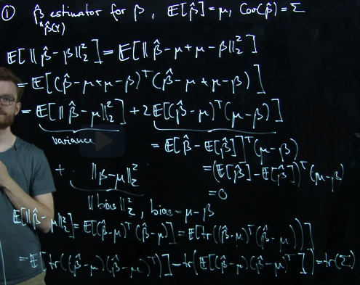
Recitation 28. Principal component regression
We want to compare quadratic risks of
Ordinary least sq estimator and principal least
Squares estimator: b^ vs sigma^
Here, we estimate quadratic risk of b^
Quad risk= E[(b^-b)^2]= var(b^-b)+E^2(b^-b)
Which equals to variance +bias^2
Here instead of scalars we have vectors
So, at the end we got that variance of estim
Equals to trace of covariance matrix
Estimator of some parameter is always a
Random variable, so that we can take its
Expectation, variance, find its distribution, perform tests on it

Slide 27



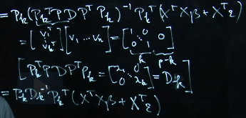




Recitation 28. Principal component regression
Now we want to compute quad risk of gamma (P*b) – PCR
We obtain expression for gamma PCR, from OLS and by
Substituting expression for Y=Xb+e, we explore what P’k*P would be, ideally it is identity if their dimensions are aligned but P is d*d, so have [I] k*k and p-k columns with 0s, and on the right of D we have the transpose of this expression, then we hit this by D and its transp
We get diagonal matrix k*k (like I*D*I but with zeros in identity) and inverting it
Is like just inverting diag elements
So we have and we want its
E[X] , the right part involving eps has E[X]=0, so we
Need only left part
Cov(Xa)=Xcov(a)*X’

Slide 28
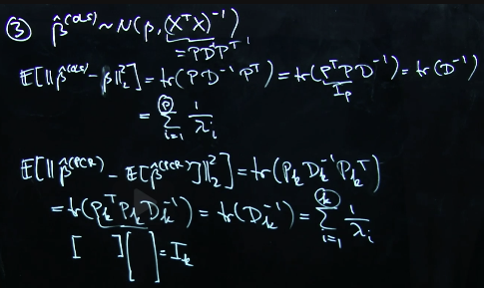
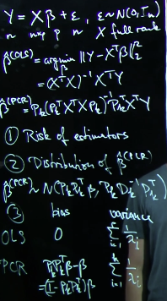
Recitation 28. Principal component regression
Here we compare quadratic risk of 2 estimators
That is both bias and variance

Slide 29

Recitation 28. Principal component regression
Now, we look at ridge regression estimator and here our estimator is minimizer of objective function that includes also regularization parameter
Idea of ridge reg is to add a little bit identity matrix to make sure that it is invertible
We calculate expected value and variance of ridge regression estimator

Slide 30
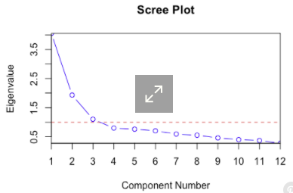
Scree plot
In multivariate statistics, a scree plot is a line plot of the eigenvalues of factors or principal components in an analysis. The scree plot is used to determine
the number of factors to retain in an exploratory factor analysis
(FA) or principal components to keep in a PCA. The procedure of
finding statist signif factors or components using a scree plot is
also known as a scree test.
A scree plot always displays the eigenv in a downward curve, ordering the eigenvalues from larg to smallest. Accord to the scree test, the "elbow" of the graph where the eigenval seem to level off is found and factors or comp to the left of this point should be retained as signif.]
This test is sometimes criticized for its subjectivity. Scree plots can have multiple "elbows" that make it difficult to know the correct number of factors or comp to retain, making the test unreliable. There is also no standard for the scaling of the x and y axes, which means that different statistical programs can produce different plots from the same data.^{[4]}
The test has also been criticized for producing too few factors or components for factor retention.

Slide 31
Review unit 8
PCA is the technique for reducing the dimensionality of high-dimensional datasets, increasing interpretability but at the same time minimizing information loss (change of basis)
It does so by creating new uncorrelated variables that maximize variance (preserve statist info)
Finding such new variables/principal components (linear functions of those in origin dataset), reduces to solving an eigenvalue/ eigenvector problem and the new variables are defined by the dataset at hand, not a priori, hence making PCA an adaptive data analysis technique
Main applications of PCA: 1) data compression to speed up training 2) visualization
The 1st principal component can be defined as direction that maximizes the variance of the projected data, ith component can be taken as a direction orthogonal to the 1st i-1 principal components that maximizes the variance of the projected data
Principal components are eigenvectors of the data’s covariance matrix or SVD of data matrix
Spectral theorem/eigen decomposition is a result when a matrix can be diagonalized, this is useful because computations involving diagonalizable matrix can be reduced to much simpler computations involving the corresponding diagonal matrix ( in terms of eigenvectors/values)
Eigenvectors are the vectors that the linear transf (matrix A) merely shrinks or elongates and the amount by which it is done is my lambda

Slide 32
Review unit 8
Covariance equation:
If X is a random vector in Rd, then covariance matrix is
Matrix H is orthogonal projection matrix, if H is symmetric and H^2=H
By multiplying by u, we give direction to scalar
u is a fixed unit vector, then this describes the empirical variance in our data in the direction of u (empirical variance of the projected dataset)
Another way is to project all Xi’s onto u and calculate their variance
Orthogonal matrix is a real square matrix whose col and rows are orthogonal unit vectors
P’*P=P*P’=I; P’=P^-1; det(P) is either 1 or -1
A is d*d symmetric matrix and A=P*D*P’, where P is orthogonal matrix, D is diagonal matrix, matrix P contains eigenvectors of P [v1 v2 …] and D eigenvalues [l1 l2..]
Matrix is positive definite if all of its eigenvalues are positive or (cov mat >=0)
PCA procedure: diagonalize cov matrix; select eigenvectors, whose eigenvalues are largest and project data onto those eigenvectors and visualize the dataset
SVD exists for both sq and rect matrices, eigendec only for square; right/left pseud inv for SVD

Slide 33
Review unit 8
X is n*d design matrix, n copies of d-dimensional random vector
PCA attempts to find low-dim representation of data while preserving the cov structure
Cov matrix: empir cov mat
X*beta^ is the orthogonal proj of Y onto the col space of X
Emprical cov matrix also = where H is sym and proj mat
Matrix H is removing mean of coordinates from each coordinate,
so it is projecting on the set of vectors whose avg coordinate is 0
As H^2=H and H’=H we can write as then
So, overall operation is to apply H to cols, that is remove avg and then find inner product
is a variance of where those are projections onto the line spanned by u
an affine space is what is left of a vector space after you've forgotten which point is the origin (or, in the words of the French mathematician Marcel Berger, "An affine space is nothing more than a vector space whose origin we try to forget about, by adding translations to the linear maps

Slide 34
Review unit 8
If is 0, this means that all of the points lie on the line perp to u (variance in u dir =0)
measure the variance in direction of u (we project all points onto u and calculate var)
If this quantity is large, then direction of u explains well the spread of samples
If x is eigenvect then var in this dir is less than or = to max eig_v
When we decompose a covariance matrix using eigen decomposition, eigenvalues correspond to variances of vectors that are projections of X onto eigenvectors
Any real square and symmetric matrix A in has spectral decomposition
Where P contains eigenvectors and D eigenvalues, matrix A if cov m then it is positive semi-definite
PCA projects data into lower dim space by keeping orthogonal directions that discriminate well the points of the cloud, directions that ha a lot of variance are the ones that have a lot info
Columns of orthogonal matrix are orthogonal to each other, meaning they represent a basis
So, we project data into different coordinate system and each eigenvalue is variance of those datapoints in that direction
So, we have n*d matrix, we want n*3, we find covariance matrix of data, that is variance in each direction and cov in 2 diff directions and then decompose this matrix into new basis

Slide 35
Review unit 8
Eigen values then represent how much var we have in each direction, so with less basis vectors we retain almost the same variance (information) in data
It is important to normalize data before applying PCA so that the PCA is not influenced by variables which have higher range of values; diadv of PCA: loss in interpretability, as 1st comp are loaded
PCA tries to look at all possible directions along which we can project data and picks the one that has the largest variance and then repeats this step by finding next direction that is orthogonal to earlier ones
So PCA in summary: 1) input X1..Xn in Rd 2) compute empirical cov matrix S 3) decompose S and find eigenvalues and eigenvectors 4) keep only k of out of d eigenvectors 5) project data onto that basis projection of Xi onto span of [v1…vk] ; Pk=(v1…vk) in R d*k
Choosing k: 1) take k where there is an inflection point in eig_v vs k plot 2) define
A criterion: take k such that proportion of var explained is some alpha (0,1)
Or combine, pick based on scree plot, then see how much var is explained
There is some inconsistency in applying PCA… in statistics PCA is used for estimation, that is given points in Rd how to estimate their cov matrix.. When n>>d empir cov matrix is consistent estim or pop cov matrix, however, in those cases we do not apply PCA, we apply when d>>n

Slide 36
Review unit 8
So, these 2 do not align.. The way around it is sparse PCA, that allows to select directions that have a lot of zeros in them, here we try to find directions aligned with original variables so that we can interpret these directions
In actual PCA, principal dir will be a linear comb. of all the genes that we had in the 1st place, but if we do sparce PCA, this will allow us to keep very small numb of genes and say e.g. those 10 genes are the ones respons. for the PC1, those 5 for PC2, so we can interpret
One of the problem with LR in high dimensional setting is that there is matrix inversion step in finding optimal coefficients, and this matrix is not invertible if rank of n*p matrix is lower than p (so, no unique minimizer b*)
To address this, we can use PCR to lower the dimensionality, say from p to k and regress those variables onto y (this way matrix is invertible), then find coefficients of k-dim vector, pull it back to d-dimensional coef vector and see how each vector affects y
PCR is somewhat similar to ridge reg, both are for when p>>n
A scree plot always displays the eigenv in a downward curve, ordering the eigenvalues from larg to smallest. Accord to the scree test, the "elbow" of the graph where the eigenval seem to level off is found and factors or comp to the left of this point should be retained as signif.

