Slide 1
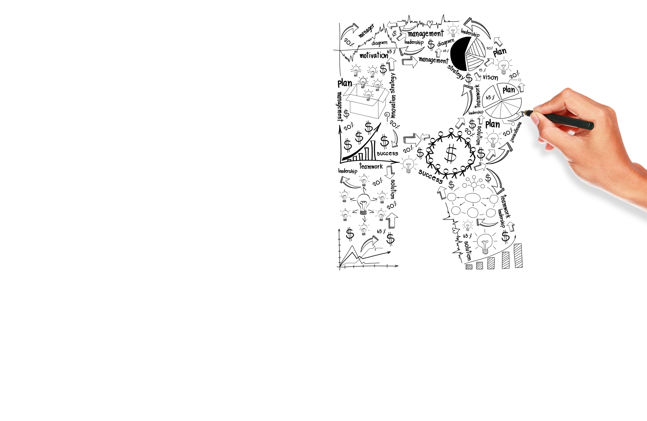


Suggested Script
Option 0.2

Slide 2
Sample Call Flow & Script - Step 1
Step 1 - Tagging Rep talks to the Gate Keeper - Hi this is [Tagging Rep] calling from Google on a recorded line. May I please speak with Mr. XXXX.
A call recording disclaimer is legally required for the US, UK/I, AU/NZ and most markets.
Call Recording Disclaimer: "Hi, this is [Tagging Rep] calling from Google or Tag Implementation team on a recorded line."

Slide 3
Sample Call Flow & Script - Step 2
Tagging Rep speaks to the Advertiser - “Hello Mr. XXXX this is [Tagging Rep] from Google or Tag Implementation team on a recorded line. I am calling to follow up on a conversation you had with <Google Sales Rep> about the implementation of <Conversion Tracking or Re-Marketing> is this is a good time to talk?"

Slide 4
Sample Call Flow & Script - Step 3
Tagging Rep sets an agenda - “Before we begin, I'd like to share with you the flow of this call.
Firstly, we will review your conversion tracking/re-marketing goals.
Secondly, I may need to e-mail you a code and/or do a screen share with you to better assist you with the implementation. Sounds good? “

Slide 5
Sample Call Flow & Script - Step 4
Tagging Rep initiates a screen share – “Hi Mr. XXXX - To help you navigate the installation of the code, I'd like to do a screen share using Webex. May I send you an e-mail with a link to the WebEx session?”

Slide 6
Sample Call Flow & Script - Step 5
The Tagging Reps set a clear timeline for the customer to implement the tracking code on their site.
The Tagging reps assist the advertisers to install the codes in case they don’t have the resources or capabilities to do so. This can be carried out by sending the following requirement list:
Access to pages with all valid credentials including access to the server.
Access to the CMS Tool. (CMS or Custom Implementation)
c. Document describing the site architecture, layers, API's & flow.

Slide 7
Conclusion
“Thank you, I look forward to speaking with you on (date and time). In the meantime, if you have any queries, please feel free to call me on (Regalix number), my name is <repeat name>. Alternatively, you could send me an email at (Regalix email address).
Okay, thank you so much for your time today. You have a good day/night.”

Slide 8
Voice Mail if Advertiser is not reachable
“Hi, this is a message for Mr. XXXX, your Google Account Manager XXXX, gave me your information and said you would be interested in setting google AdWords {conversion tracking/remarketing code} on your website. I’m sorry I missed you. I would like to reschedule a meeting with you. Please feel free to call me at 1-800-xxx-xxxx or you can also reply to the email I will send you. . I will also call back later in hopes of reaching you! Thanks so much!”

Slide 9
Thank you!

