Slide 1
Project 2: Heart Monitor
Maha Moussa

Slide 2
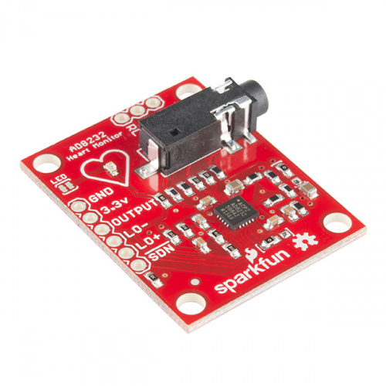
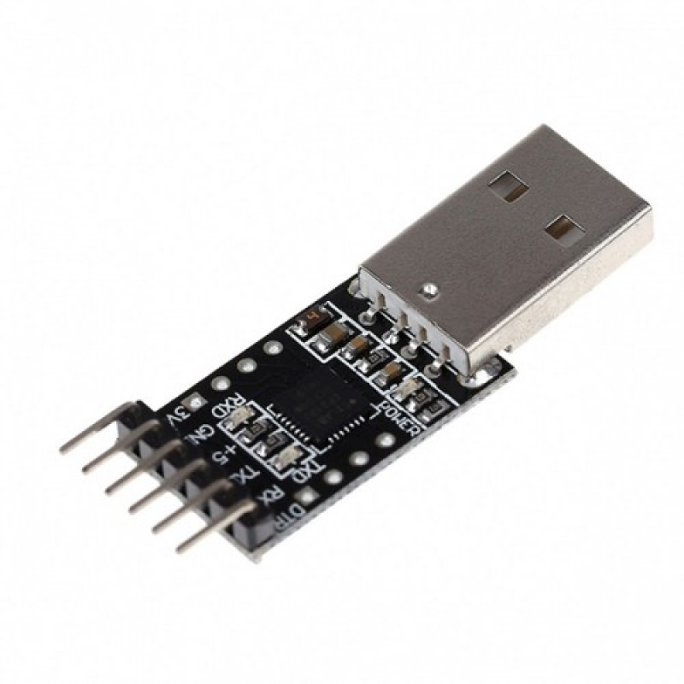
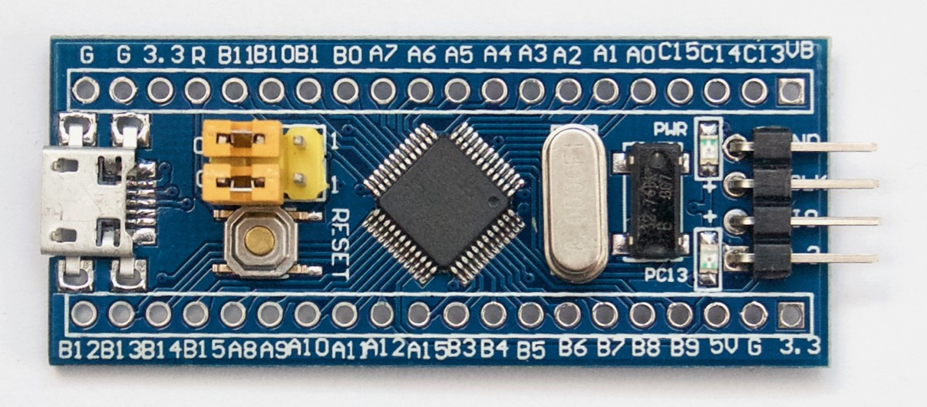
Components
AD8232 Heart Monitor
Blue pill, containing the ADC
Usb to TTL

Slide 3
User Input
Baud rate
Sampling rate
Com Port
command

Slide 4
Output
Graph of the one minute worth of data
Beats per minute

Slide 5
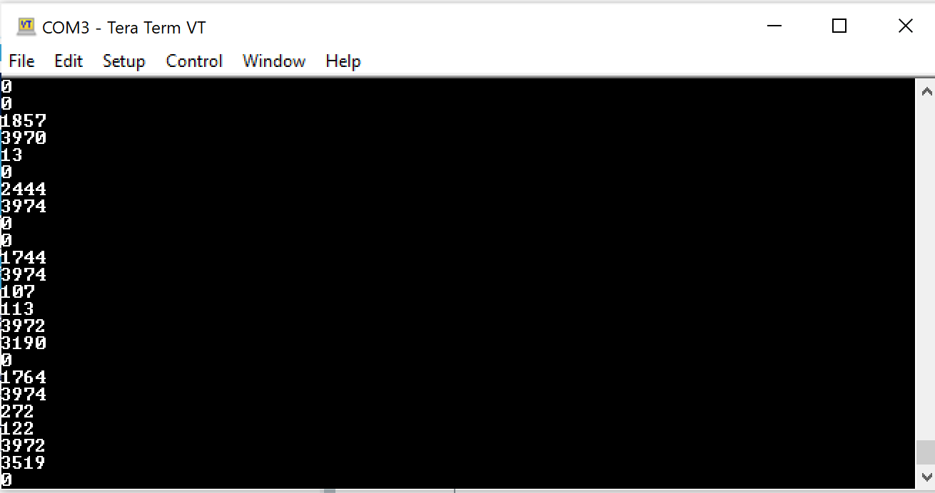
Done Previous Milestone:
The analog ECG signal was converted to digital using the ADC.
Sampled the data at a high sampling rate
Collected one minute worth of data
Data sent to the PC using Uart

Slide 6
Done this milestone
Taking user command as an input.
Taking baud rate, com port and sampling rate as input
Using interrupts instead of polling for the ADC
Real time graphing of the results
Reading the serial port using pyserial instead of using Tera Term
Finding the beat per minute

Slide 7
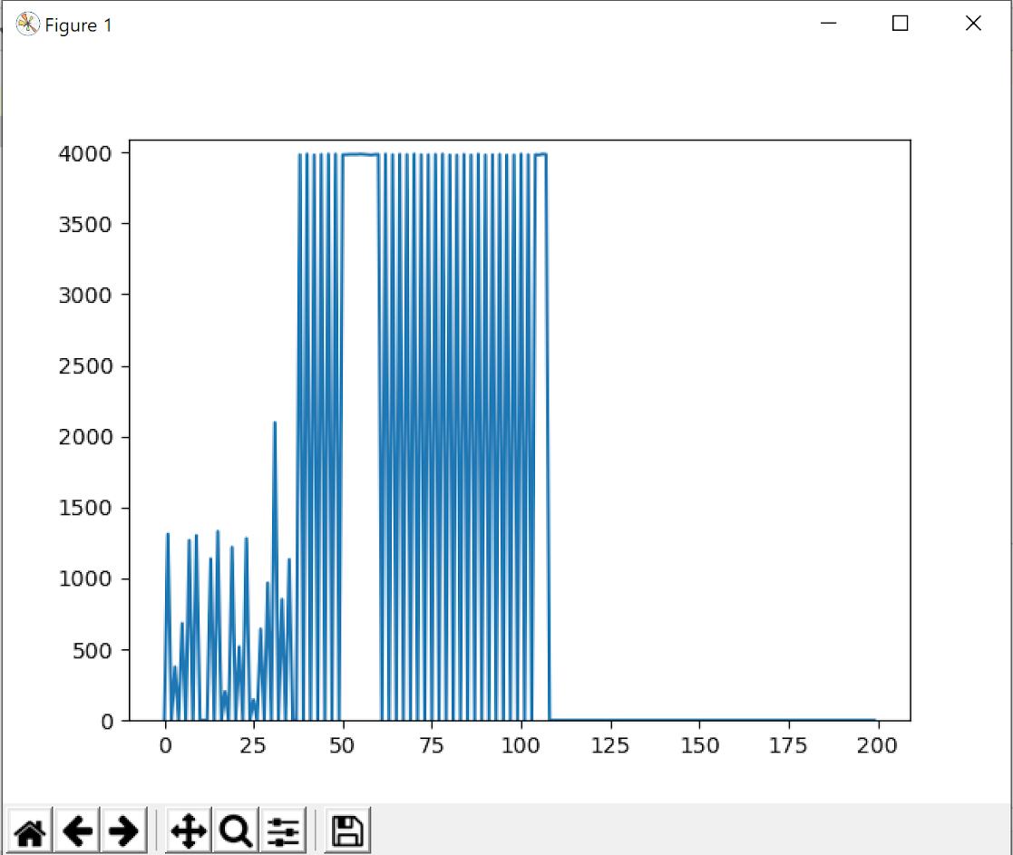
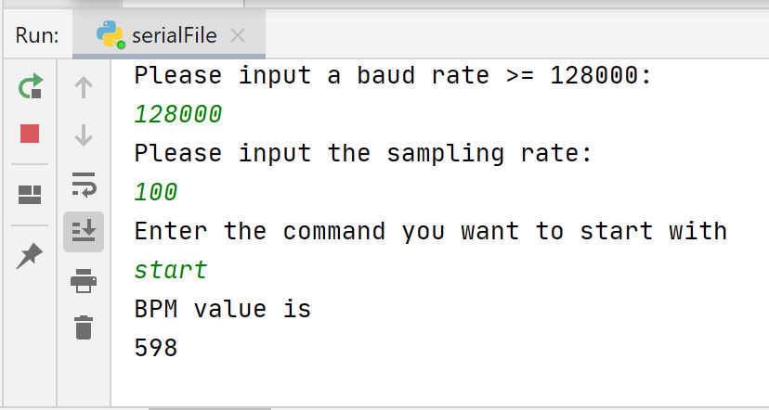
Results:
For 100 sampling rate:

Slide 8
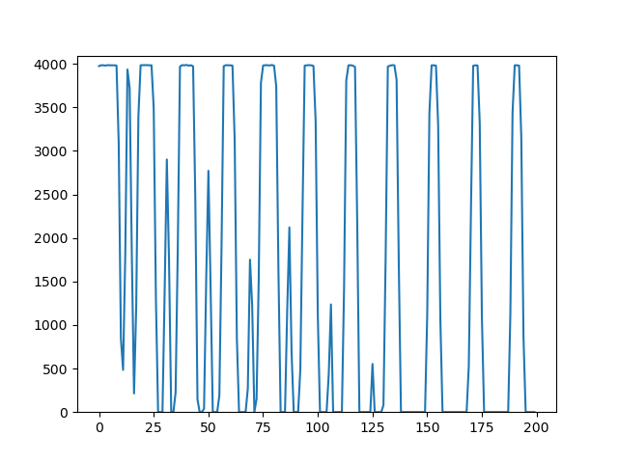
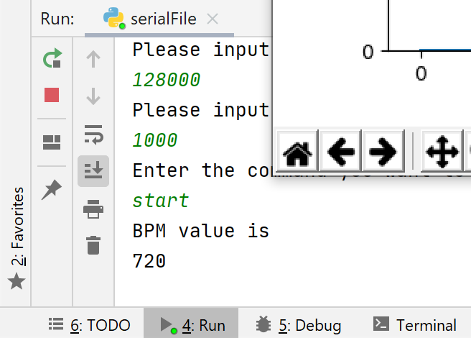
Results (cnt’d)
For 1000 sampling rate:

Slide 9
Main functions - C
void HAL_UART_RxCpltCallback(UART_HandleTypeDef* huart){
sscanf(rec_val, "%d", &input_rate);
if(input_rate>0x9){
GenerateRate();
flag = 1;
HAL_UART_AbortReceive_IT(&huart1);
}
else{
HAL_UART_Receive_IT(&huart1,(uint8_t*) rec_val, sizeof(rec_val));
}
}

Slide 10
Main functions (cnt’d)
void GenerateRate(){
if(input_rate>1000)
input_rate=1000;
gen_rate = (1000/input_rate);
sample_ticks=0;
}
SystemCoreClockUpdate();
returnCode= SysTick_Config(SystemCoreClock/1000);

Slide 11
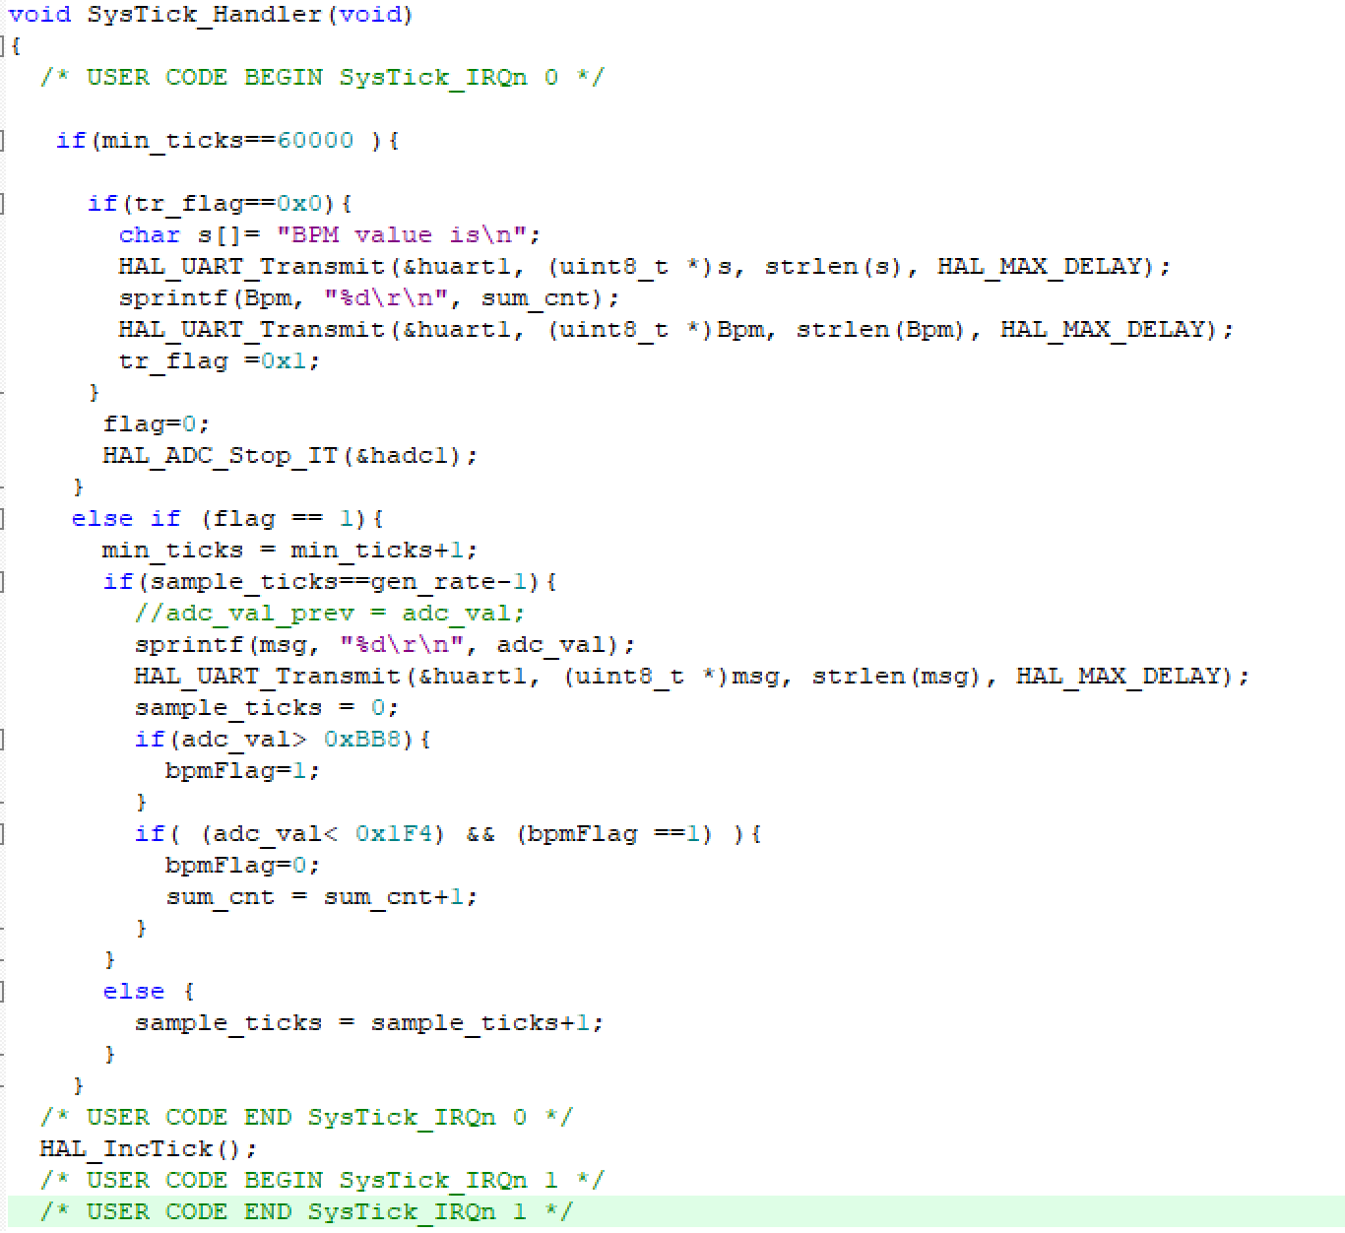
Main functions (cnt’d)

Slide 12
Main Functions - Python
def animate(i, ys, sampler):
temp_arr_2, stop = vals(sampler)
if stop == 1:
read = ser.readline()
read2 = read.decode('UTF-8')
read2 = read2.strip("\n")
if (len(read2) > 0 and len(read2) < 5):
read3 = int(read2)
print(read3)
ani.event_source.stop()
for x in temp_arr_2:
ys.append(x)
ys = ys[-x_len:]
line2.set_ydata(ys)
return line2

Slide 13
Main Functions - Python(cnt’d)
ax = fig.add_subplot(1, 1, 1)
xs = list(range(0, 200))
ys = [0] * x_len
ax.set_ylim(y_range)
line2, = ax.plot(xs, ys)
ani = animation.FuncAnimation(fig, animate, fargs=(ys,in_sampler ), interval=1)
plt.show()

Slide 14
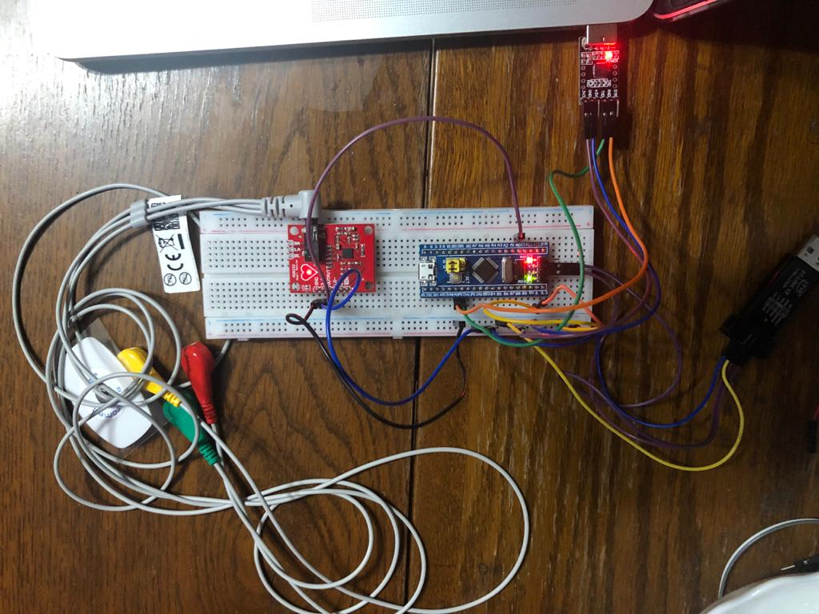
Connections

Slide 15
GitHub Link
https://github.com/mahamoussa/EmbeddedProject

Slide 16
Thank you!

