Slide 1

.

Slide 2
SNAKE GAME

Slide 3
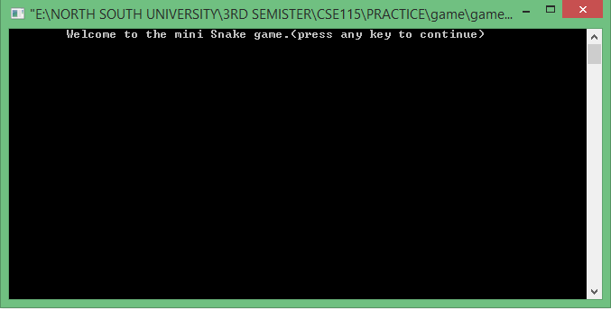
SNAKE GAME

Slide 4
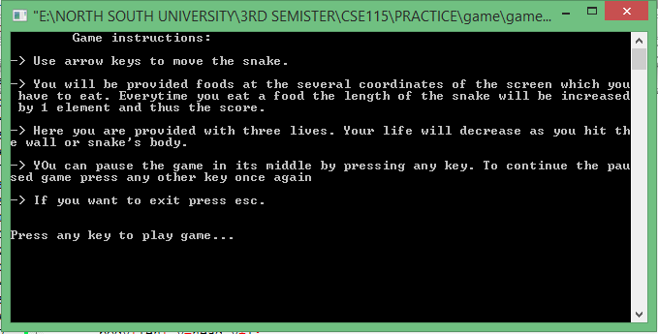
SNAKE GAME

Slide 5
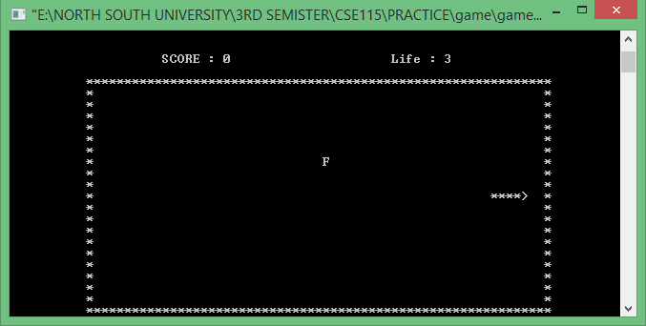
SNAKE GAME

Slide 6
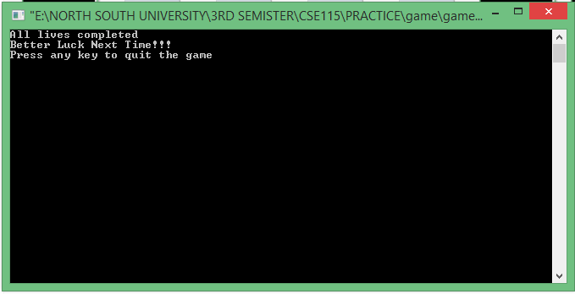
SNAKE GAME

Slide 7
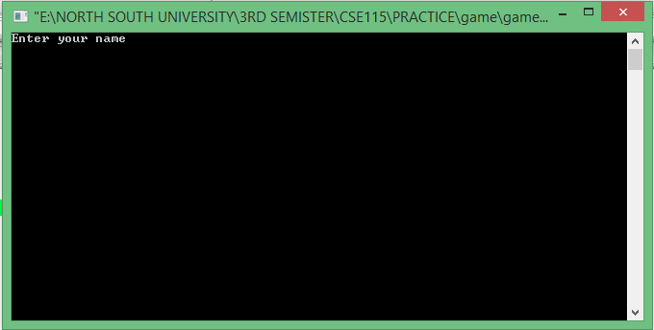
SNAKE GAME

Slide 8

SNAKE GAME

Slide 9
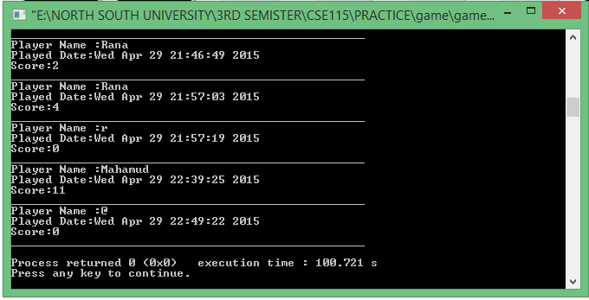
SNAKE GAME

Slide 10


