Slide 1

Cloud Native Workshop
From Monoliths to Microservices: Building and Running Modern Applications
By
Mahantesh Ambaljeri,
Distinguished Member of Technical Staff
Dell Technologies
Notes:
Welcome everyone. Today's goal: by the end of this half-day, you'll understand what cloud native means, why 98% of organizations have adopted it, and you'll have deployed real containers and Kubernetes workloads yourself in free browser-based labs — plus you'll leave with materials you can reuse in your own courses.

Slide 2




Today's Roadmap
Concepts → Architecture → Hands-On Labs → Teaching Toolkit
Part 1 · Foundations
Part 2 · Architecture
What cloud native is, why it won, and the four pillars
Containers, Kubernetes, CI/CD, GitOps — and monitoring & alerting
60 min
60 min
Part 3 · Hands-On Labs
Part 4 · Teaching Toolkit
Deploy real containers & K8s apps in free browser labs
Bringing cloud native into your curriculum + Q&A
75 min
30 min
Notes:
Walk through the four parts. Emphasize the labs are in free, browser-based environments — no installs, no credit cards — the same platforms they can use with their own students. Two short breaks: after Part 1 and after the labs.

Slide 3
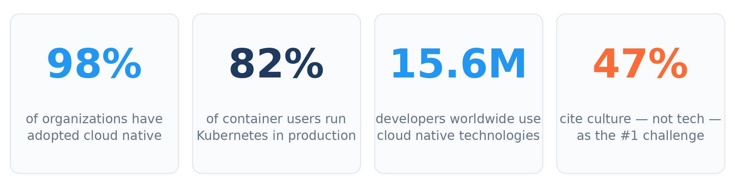

Why This Matters Now
Cloud Native Computing Foundation (CNCF) Annual Survey 2025 & State of Cloud Native Development
For educators: cloud native has moved from an elective niche to the default way software ships. Graduates who can reason about containers, Kubernetes, and CI/CD enter a market of 15.6M practitioners — and the #1 industry blocker is people, not technology.
Notes:
Key stats to say out loud: 98% adoption means cloud native is no longer optional knowledge. 82% of container users run Kubernetes in production — up from 66% in 2023. And the striking one for us as educators: 47% cite CULTURE, not technology, as the top challenge. That's a teaching and people problem — exactly our domain.

Slide 4





What Does “Cloud Native” Actually Mean?
CNCF definition (paraphrased):
Building and running scalable applications in dynamic environments — public, private, and hybrid clouds — using containers, microservices, declarative APIs, and automation.
The 4 C's
Cloud
elastic, on-demand infrastructure
Containers
Loosely coupled
portable packaging of apps
small services, independent teams
Clusters
Resilient & observable
orchestrated pools of machines
failure is expected, visible, survivable
Code
Frequent, low-risk change
everything declared & versioned
ship many times per week, safely
Notes:
Anchor the definition, then simplify: cloud native = designing software that ASSUMES the cloud, instead of software merely moved to the cloud. The 4 C's are a handy mnemonic for students: Cloud, Containers, Clusters, Code. ASK the room: who currently teaches anything touching one of these four?

Slide 5
How We Got Here: Two Decades of Abstraction
Each era traded control for speed and scale
Bare metal era
Virtualization & IaaS
Containers & orchestration
One app per server. Weeks to provision. “Pets” — named, nursed, irreplaceable.
VMs & cloud made machines rentable by the hour. Infrastructure became an API call.
Docker (2013) standardized packaging; Kubernetes (2015) standardized running at scale. “Cattle, not pets.”
Notes:
Great lecture framing for students: each hop up the timeline is an abstraction layer. Use the pets vs cattle analogy — it lands well. Pause on 2013/2015: Docker made packaging universal, Kubernetes made operating fleets universal. Today's era adds GitOps, platform engineering, and AI workloads on the same foundation.

Slide 6

The Four Pillars of Cloud Native
Microservices
Containers
Decompose apps into small, independently deployable services aligned to business capabilities. Compose via APIs.
Package each service with its dependencies into a portable, immutable unit that runs identically everywhere.
CI/CD Automation
DevOps Culture
Every change is built, tested, and deployed by a pipeline. 60% of orgs now deploy via a CI/CD platform.
Developers and operations share ownership. Culture is now the #1 adoption challenge (47%).
Notes:
These four pillars structure the rest of the workshop. Note the deliberate order: microservices is the ARCHITECTURE, containers the PACKAGING, CI/CD the DELIVERY, DevOps the PEOPLE. Most curricula teach the first three and skip the fourth — yet industry says the fourth is the hardest.

Slide 7
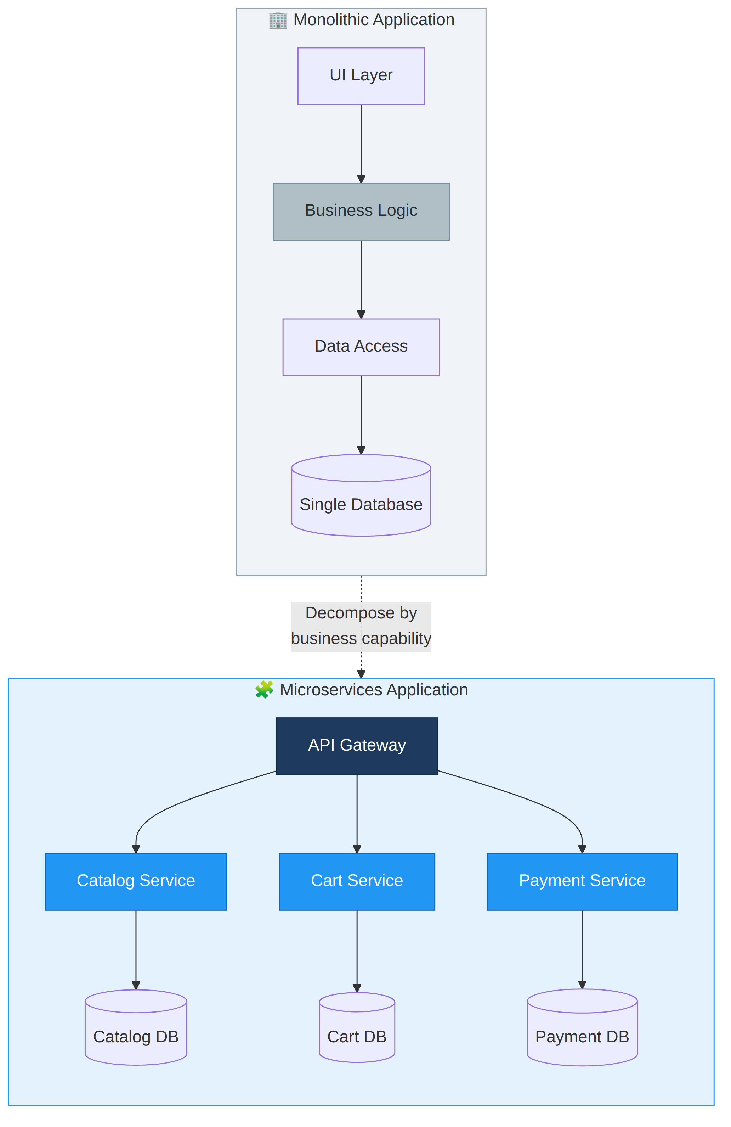

Pillar 1 · From Monolith to Microservices
Independent deployment
Update the cart service without touching payments — no release trains.
Independent scaling
Scale only the hot service. Orgs now run 2,341 containers on average.
Fault isolation
One failing service degrades gracefully instead of taking the whole app down.
Team autonomy
Small teams own a service end-to-end — Conway's Law used deliberately.
Trade-off: you inherit distributed-systems complexity — network calls, eventual consistency, observability needs.
Notes:
The diagram contrasts a single deployable with one DB versus services each owning their data. Stress the trade-off line at the bottom — microservices are NOT free. Good teaching exercise: give students a monolith description and ask them to draw service boundaries; there is no single right answer, and that discussion is the lesson.

Slide 8
Pillar 2 · Containers: The Shipping Revolution
What a container is
Container vs VM
An isolated process, not a mini-VM — shares the host kernel, starts in milliseconds
Built from a layered, immutable image: code + runtime + libraries + config
“Works on my machine” becomes “works on every machine”
Like standardized shipping containers: any cargo, any ship, any port
 | VM | Container
Boots in | minutes | milliseconds
Size | GBs | MBs
Isolation | hardware-level | process-level
Density | ~10s / host | ~100s / host
Guest OS | full OS each | shared kernel
Notes:
The shipping container analogy is the single best teaching device here — standardization decoupled cargo from transport, and Docker did the same for software. Correct the #1 misconception early: a container is NOT a lightweight VM, it's an isolated process. That distinction explains the entire right-hand table. This is exactly what Lab 1 makes tangible.

Slide 9
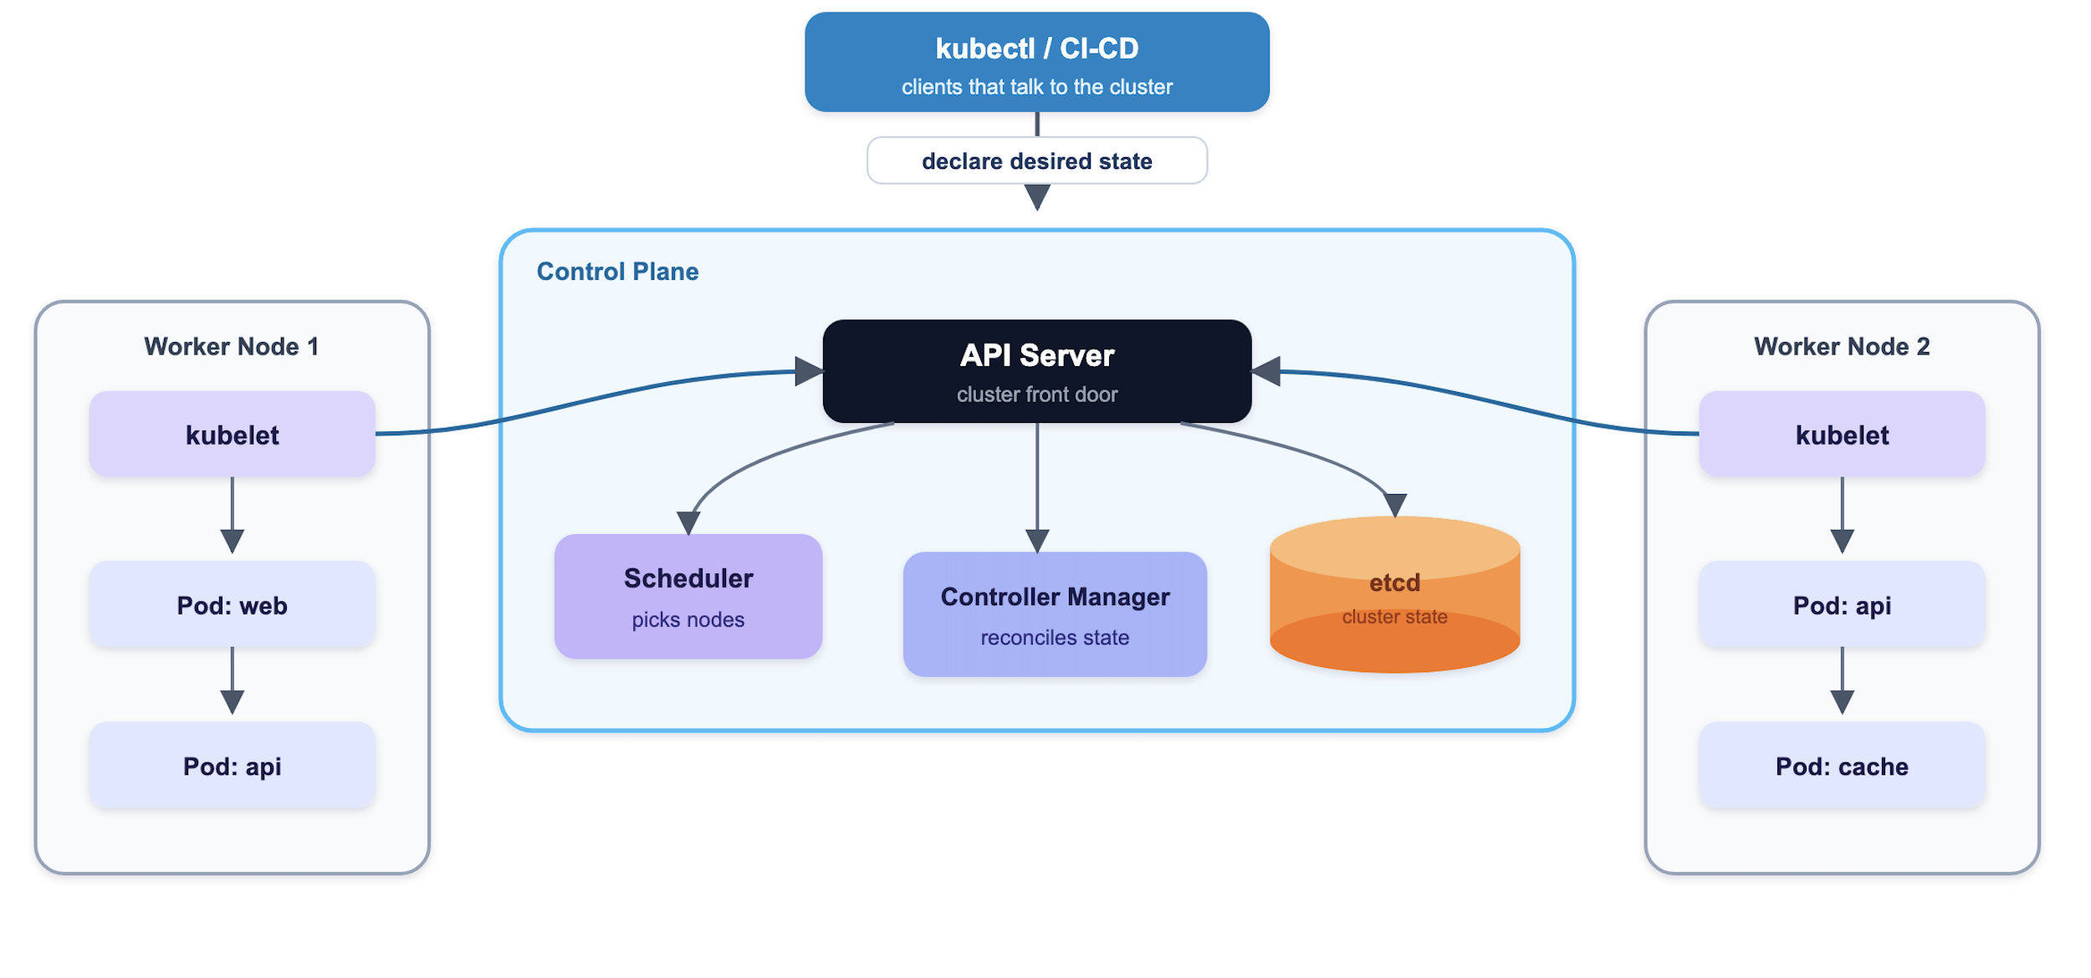
Pillar 2½ · Kubernetes: The Cluster Operating System
Animated walkthrough — plays in slideshow mode
Declarative
You declare desired state in YAML; controllers reconcile reality toward it, forever.
Self-healing
Pod dies? Rescheduled. Node dies? Workloads move. No 3 a.m. pages for restarts.
82% in production
The de facto standard — now also the platform for AI inference workloads (66%).
Control plane = the brain (API server, scheduler, etcd) · Worker nodes = the muscle (kubelet runs your pods)
In the labs you will run kubectl against a real cluster and watch this reconciliation loop happen live.
Notes:
The GIF spotlights one component at a time — narrate along with it: kubectl sends desired state to the API server, etcd stores it, scheduler picks nodes, kubelets make it real. The reconciliation loop is the deep idea worth a whole lecture: Kubernetes is a control theory system, comparable to a thermostat. DEMO cue: this animates in slideshow mode.

Slide 10
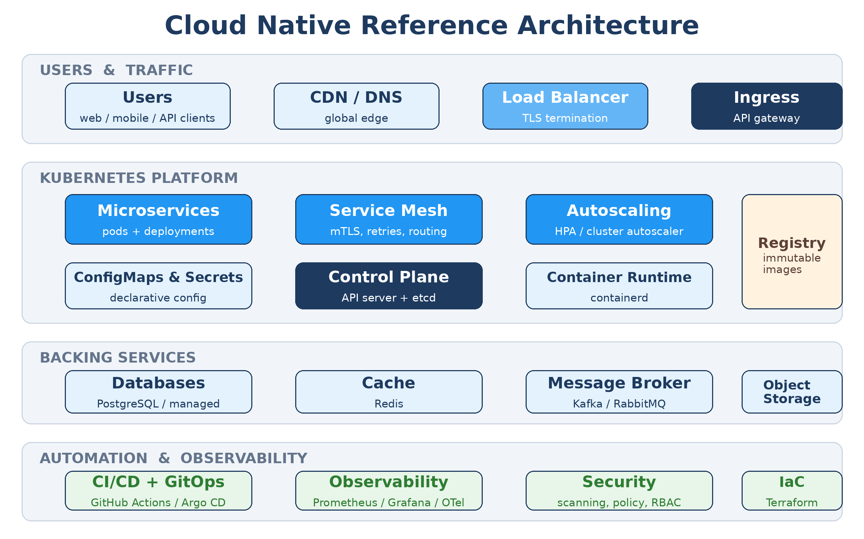
Putting It Together: Reference Architecture
Notes:
This is the poster included in your workshop kit as a printable handout. Walk top to bottom: traffic enters through LB and ingress; the Kubernetes platform runs microservices with a mesh, autoscaling, and declarative config; stateful backing services sit alongside; and the bottom layer — CI/CD, observability, security, IaC — is what makes it operable. Every lab today touches at least two of these layers.

Slide 11
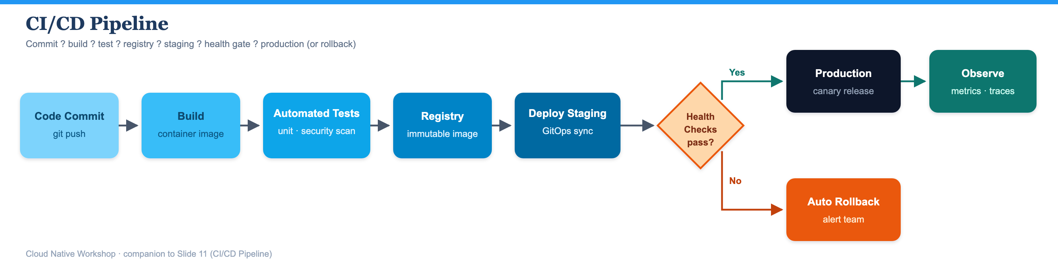

Pillar 3 · The CI/CD Pipeline
Animated walkthrough — every commit takes this journey
Build once, promote everywhere
Shift quality & security left
Progressive delivery
One immutable image moves through all environments — no environment-specific rebuilds.
Tests and vulnerability scans run on every commit, not the night before release.
Canary and blue-green releases expose changes to a slice of traffic first; rollback is automatic.
Result: 29% of organizations deploy multiple times a day; 38% automate 80–100% of releases.
Notes:
Narrate the animated pipeline stage by stage: commit, build, test+scan, registry, staging via GitOps, health gate, then either production (canary) or automatic rollback, with observability closing the loop. The gate is the teachable moment — failure is an EXPECTED, handled path, not an exception. Popular stacks: GitHub Actions (51%), Argo (45%), Jenkins (44%).

Slide 12
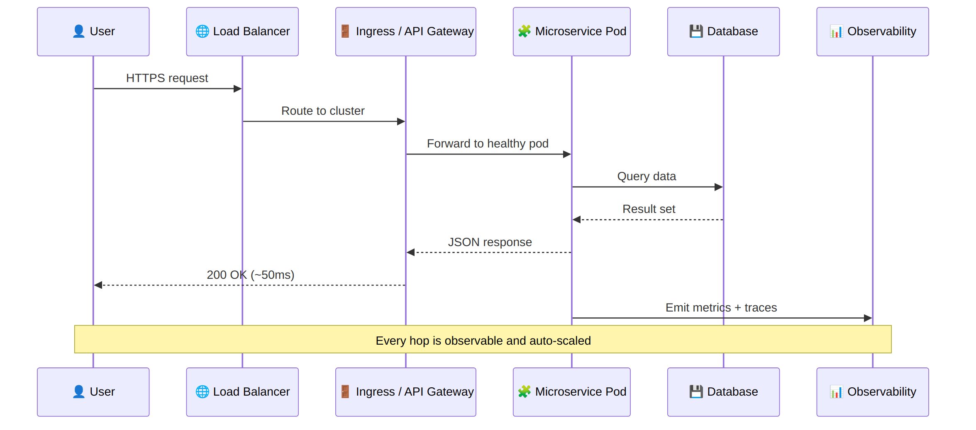
Anatomy of a Request in Production
Notice
The pod that answers is chosen at request time
Any pod can die mid-flight — retries hide it
Every hop emits metrics & traces automatically
Observability is not optional: with dozens of services, you cannot debug by reading one log file. Metrics (Prometheus), logs, and traces (OpenTelemetry — now the 2nd-highest-velocity CNCF project) are the flight recorder of a distributed system.
Notes:
Trace one request across the sequence diagram, left panel. Then land the observability point — a great classroom exercise is asking students how they would find a slow query when the request crosses five services. Answer: distributed tracing. Mention OpenTelemetry's rise and that ~20% of teams now also use continuous profiling.

Slide 13


Monitoring & Alerting: From Signals to Action
You can't operate what you can't see — and you can't scale what wakes humans needlessly
The Four Golden Signals
The Alerting Pipeline
Latency
Prometheus
how long requests take (p50/p95/p99)
scrapes /metrics from every pod & node
↓
Traffic
Alert rules
demand: requests per second
expressions over metrics: “error rate > 2% for 5m”
↓
Errors
Alertmanager
rate of failed requests
dedupes, groups, routes → Slack / PagerDuty / email
↓
Saturation
Grafana
how full: CPU, memory, queue depth
dashboards for humans; alerts for machines
Alert on symptoms, not causes — page a human for user-visible pain (golden signals); let Kubernetes auto-heal the rest. In Lab 2B you'll watch kubectl top, events, and a liveness probe do exactly that.
Notes:
Monitoring answers 'what is happening'; alerting decides 'who needs to act'. Walk the golden signals (from Google's SRE book) — they are what you page on. Then the pipeline: Prometheus pulls /metrics, rules evaluate continuously, Alertmanager dedupes and routes, Grafana is the human view. The philosophy line matters most: alert on SYMPTOMS (users hurting) not CAUSES (a pod restarted) — Kubernetes handles causes automatically, as Lab 2B demonstrates with probes, events, and kubectl top. Mention: this is the Observability layer of the reference architecture poster.

Slide 14
Pillar 4 · GitOps and the Culture Shift
GitOps in one sentence
The human side
Git is the single source of truth for BOTH application code and infrastructure; an agent (e.g. Argo CD) continuously syncs the cluster to match the repo.
47%
cite cultural change as the #1 adoption challenge — ahead of training (36%), security (36%), and complexity (34%)
Every change is a pull request — reviewed, versioned, auditable
Rollback = git revert
Drift is detected and corrected automatically
77% of organizations now practice GitOps to some degree
Shared ownership: “you build it, you run it”
Blameless postmortems over finger-pointing
Platform teams pave golden paths for developers
Notes:
GitOps resonates with academics instantly: it is version control applied to operations — reproducibility as a first-class value, like a lab notebook. Then pivot to culture: the industry's biggest bottleneck is now human, which is a strong argument for teaching teamwork, code review, and incident practice in courses, not just tools.

Slide 15
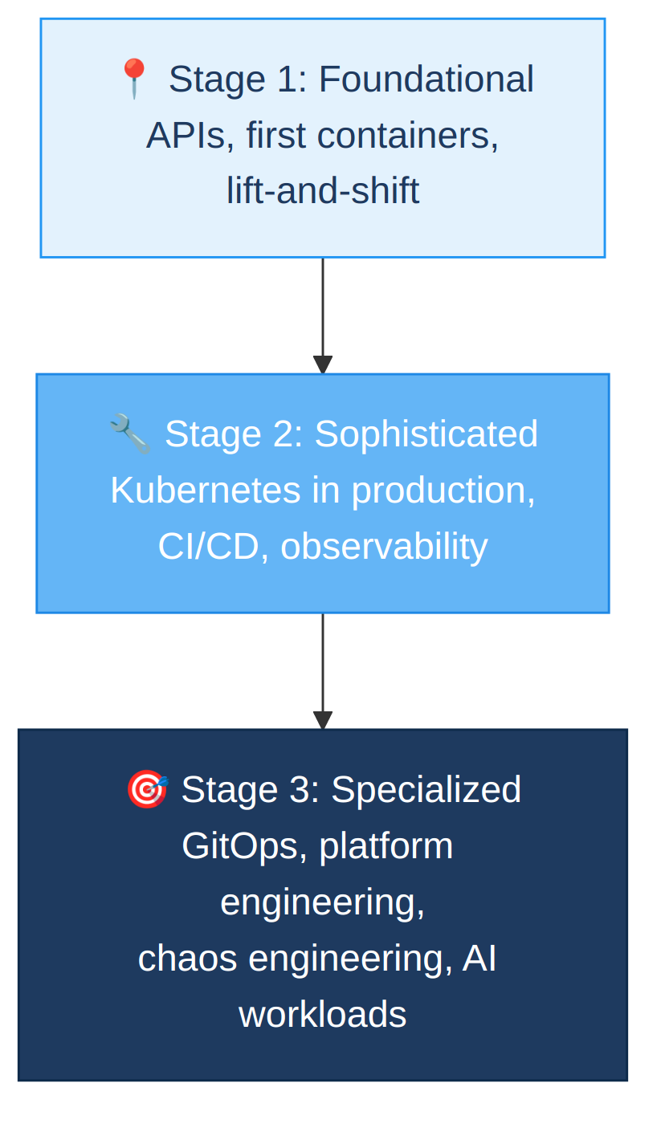
The Maturity Curve — Where Organizations Are
CNCF Annual Survey 2025, n=628 practitioners
Three-stage journey
Notes:
Two visuals: the bar chart shows adoption breadth; the staircase shows depth — foundational APIs and containers, then production Kubernetes with CI/CD and observability, then GitOps, platform engineering, and AI workloads. The K8s jump from 66% to 82% in two years is the headline. Frame for curriculum: aim to graduate students at stage 2 awareness with stage 1 hands-on skills.

Slide 16
Hands-On Labs · Free, Browser-Based, No Installs
85 minutes · full step-by-step lab guide in your kit
Lab 1 · Build & Ship It
Lab 2 · Run It on Kubernetes
Lab 3 · Automate End to End
Play with Docker
Killercoda (2-node)
GitHub Actions
Build the hello-cncf microservice, containerize it, and push the image to Docker Hub.
Deploy the SAME image: see load balancing via served_by, self-healing, probes, scaling.
Commit v2.0 → pipeline tests, builds, pushes → rolling update in YOUR cluster → rollback.
25 min
30 min
30 min
All three platforms are free for your students too — no credit card, no cloud account, no local installs.
Notes:
ONE application threads through all three labs: built in Lab 1, hosted and load-balanced in Lab 2 (the served_by field makes LB visible), updated end-to-end by the pipeline in Lab 3 (the version field makes rollouts visible). Logistics: pair people up — driver/navigator works well. Play with Docker and Killercoda need only a free account; sessions are time-boxed (4 hours / per-scenario) which is plenty. GitHub Actions needs a GitHub account. Circulate during labs; the lab guide has expected output after every command plus a troubleshooting table.

Slide 17


Bringing Cloud Native Into Your Curriculum
Where it fits
Software engineering (CI/CD, testing) · OS courses (namespaces, cgroups) · Networks (service discovery, load balancing) · Distributed systems (consensus, etcd) · Capstones (deploy for real)
Free student resources
CNCF landscape & KubeCon talks · Killercoda scenarios as graded labs · Play with Docker/K8s · GitHub Education pack · Official K8s tutorials & sandbox
Pedagogy that works
Break things on purpose (kill pods live) · Analogies first (shipping containers, thermostats) · Assess via pipelines — students submit a repo whose CI must pass
Your kit includes: this deck, lab guide, quiz, feedback form, printable posters, and a certificate template — all reusable in class.
Notes:
This is the faculty payoff slide — spend time here. ASK: which existing course of yours could absorb one cloud native lab without restructuring? The 'assessment via pipeline' idea usually sparks discussion: students submit repos and the CI pipeline IS the rubric — automated, objective, and identical to industry practice.

Slide 18

Common Misconceptions to Correct Early
“Cloud native = running in the cloud”
“Containers are lightweight VMs”
It's an architectural approach. A lifted-and-shifted VM in AWS is not cloud native; a well-built K8s app on-prem is.
They're isolated processes sharing the host kernel — that's why they start in milliseconds.
“Microservices are always better”
“Kubernetes replaces ops people”
They trade code complexity for distributed-systems complexity. Start monolith-first; split when team scale demands it.
It shifts ops work up the stack — platform engineering is one of the fastest-growing roles.
Notes:
These four misconceptions appear in nearly every classroom. The monolith-first advice surprises people after a workshop selling microservices — being honest about trade-offs builds credibility with students. Cite the pattern: many successful companies extracted microservices FROM a monolith once boundaries were understood, rather than starting distributed.

Slide 19
Field-Tested Best Practices
Do
Avoid
Build one immutable image; promote it through every environment
Declare everything as code — apps, infra, config, policy
Automate tests and security scans on every commit
Design for failure: health checks, retries, graceful degradation
Instrument observability from day one, not after the first outage
Splitting into microservices before you understand the domain
Hand-editing anything in production (“click-ops” drift)
Treating Kubernetes as a traditional server you SSH into
Skipping API/contract tests between services
Letting base images age — patch and rebuild continuously
Notes:
Run this as a quick self-audit for anyone already using these tools. Each 'avoid' item maps to a real failure mode covered earlier: drift breaks GitOps, aged images accumulate CVEs, missing contract tests cause the works-in-CI-fails-in-cluster pattern. These two lists make a good exam question bank.

Slide 20
Five Things to Remember
1
Cloud native is an approach, not a location — containers, microservices, automation, and declarative APIs.
2
Kubernetes is the cluster operating system: declare desired state; controllers reconcile reality — 82% run it in production.
3
CI/CD + GitOps make change boring: one immutable image, Git as source of truth, rollback as git revert.
4
The hardest part is people — 47% cite culture as the top challenge. Teach collaboration, not just tools.
5
Everything you used today is free for your students — Play with Docker, Killercoda, GitHub Actions.
Notes:
Recap slowly — one breath per point. Point 4 gets the orange dot on purpose: the human factor is the differentiator. End by connecting back to their role: as faculty, they shape the culture layer the industry says it's missing.

Slide 21
Keep Going: Resources & Next Steps
Learn
Practice
kubernetes.io/docs/tutorials · CNCF Landscape (landscape.cncf.io) · CNCF Annual Survey 2025 · 'The Twelve-Factor App'
killercoda.com · labs.play-with-docker.com · labs.play-with-k8s.com · GitHub Codespaces (60 free hrs/mo)
Credential
Community
KCNA (Kubernetes & Cloud Native Associate) — entry-level cert well suited to students · CKA for the ambitious
CNCF meetups & KubeCon (student discounts) · #kubernetes-users Slack · Your workshop kit: quiz, posters, certificate
Thank you! Questions? · Please fill in the feedback form in your workshop kit
Notes:
Close with a concrete next step: pick ONE — run Lab 1 with a class this term, or take the KCNA syllabus and map it to an existing course. Remind them the whole kit is theirs to reuse and adapt. Open the floor for Q&A (15 min budgeted).

