Slide 1
Tutorial on Subversion (SVN)

Slide 2
Outline
Introduction
Part I: Basic
Check out a working copy
Work in the working copy
Commit changes back to repository
Update working copy
Rename files
Delete files
Reviews changes
Create a repository

Slide 3
Outline
Part II: Working with revisions
Making revisions
Checkout a specific working copy by giving revision number
Check a specific version of a file
Compare different revisions of a file
Tagging a revision
Part III: Branching
Introduction
Branching and Switching
Merging
Removing a branch

Slide 4
Outline
Part IV: Recommended practice
Directory structure
Working flow

Slide 5
Introduction
Subversion (SVN)
open source version control system
manages files and directories, and the changes made to them, over time.
time machine
Why?
Avoid making mistakes (e.g. it was correct three days ago)
Collaboration
Documentation
http://svnbook.red-bean.com/en/1.7/index.html
http://tortoisesvn.net/docs/release/TortoiseSVN_en/index.html

Slide 6
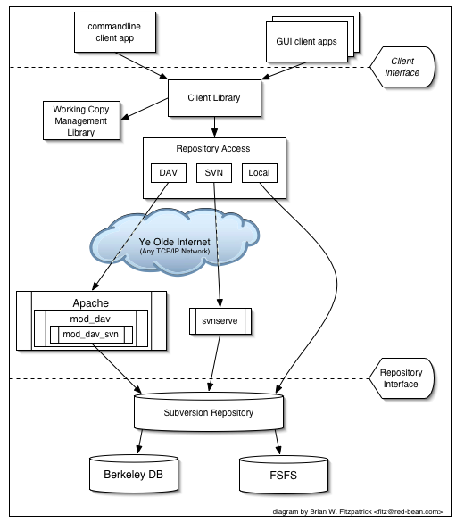
Subversion’s architecture
DAV: Distributed Authoring and Versioning
Repository: central store of that system's data
http://svnbook.red-bean.com/en/1.7/svn.intro.whatis.html

Slide 7
Definitions
Repository: central store of that system's data
working copy: a local copy of a particular version of a user's VCS-managed data upon which that user is free to work
All version control systems solve
how will the system allow users to share information, but prevent them from accidentally stepping on each other's feet? It's all too easy for users to accidentally overwrite each other's changes in the repository.

Slide 8
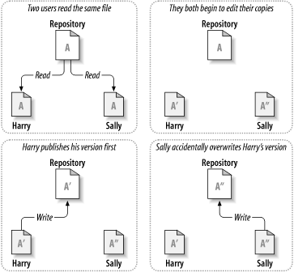
Problem to avoid
http://svnbook.red-bean.com/en/1.7/svn.basic.version-control-basics.html

Slide 9
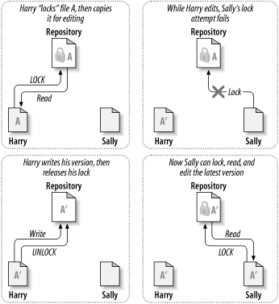
Solution #1: lock-modify-unlock

Slide 10
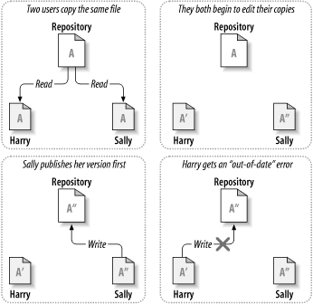
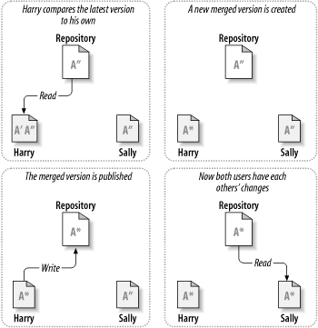
Solution #2: copy-modify-merge
Conflict!
This is modern version control practice!

Slide 11
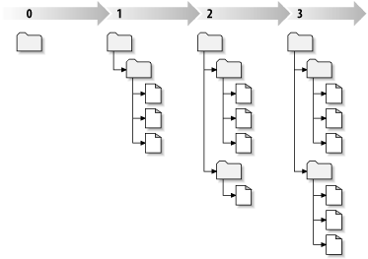
Repository changes over time
Sometimes, a specific repository is called a “tree”

Slide 12
Part I: Basics

Slide 13

LAB I-0: Checkout a working copy
TortoiseSVN
Official website: http://tortoisesvn.tigris.org/
Download: http://140.118.105.174/SVN/

Slide 14
Checkout a working copy
Create an empty folder “lab” on your desktop
Right click on the empty folder and choose SVN Checkout
Use the following URL as the repository http://140.118.105.174/svn/ymhsieh/svnlab
Now, the “lab” folder on your desktop is a working copy!
In the working copy, you will notice a .svn folder. The folder holds information about the working copy
Now you have successfully checked out a working copy!
Linux command line version:
mkdir lab
svn co http://140.118.105.174/svn/ymhsieh/svnlab lab

Slide 15
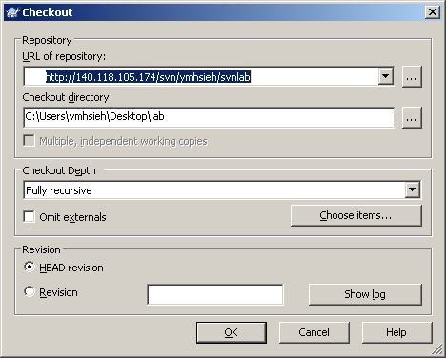
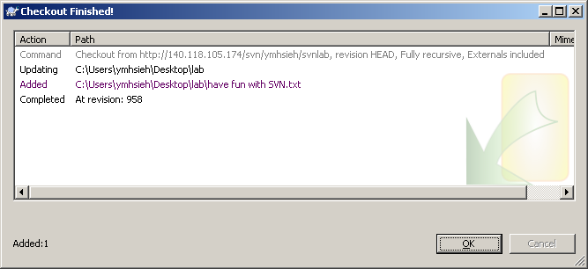
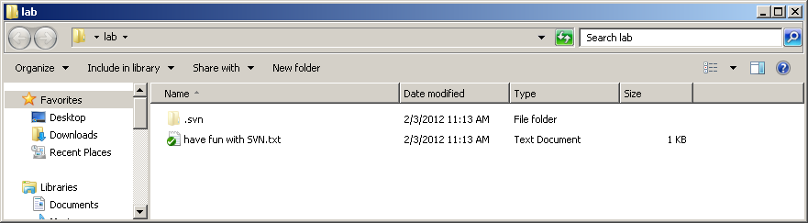

Slide 16
The working copy
It holds information about:
What revision your working copy is
A timestamp recording when the local copy was last updated by the repository.
A working file (a file in your working copy) can have four possible states:
Unchanged and current
Locally changed, and current
Unchanged, and out of date
Locally changed, and out of date

Slide 17
LAB I-1: Commit changes into repository
In your working copy, create a folder based on your username to SVN.
What is the state of this newly created folder?
Right click on the newly created folder, choose “TortoiseSVN” → “Add”
This simply marks your working copy that the folder should be added to the repository when “updating”
Right click on the “lab” or the working copy folder.
You should have noticed that there are two additional options not shown before: “SVN update” , and “SVN commit”.
choose “TortoiseSVN” → “SVN commit” to commit your changes in the working copy to the repository. Please have a habit of having of log messages when you do commit.
Note SVN commit is a strictly upload operation
cd lab
mkdir ymhsieh
svn add ymhsieh
svn ci

Slide 18
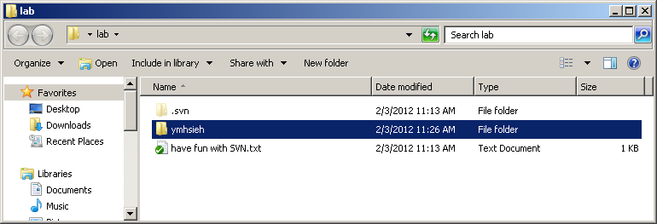
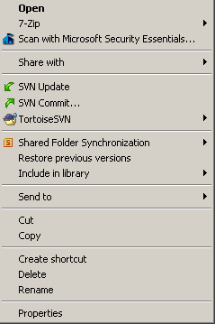
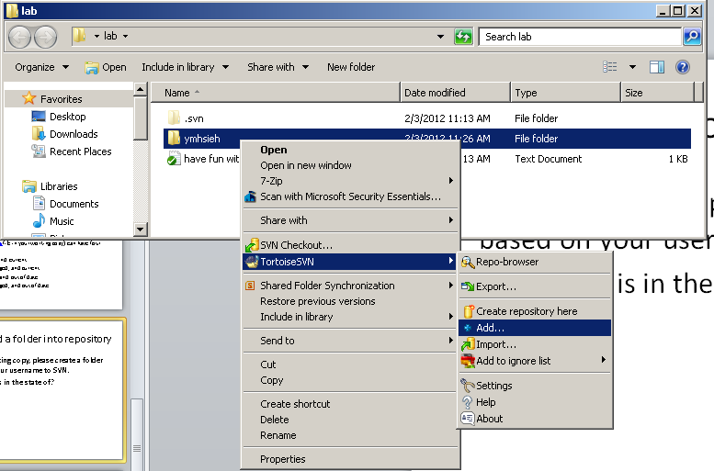
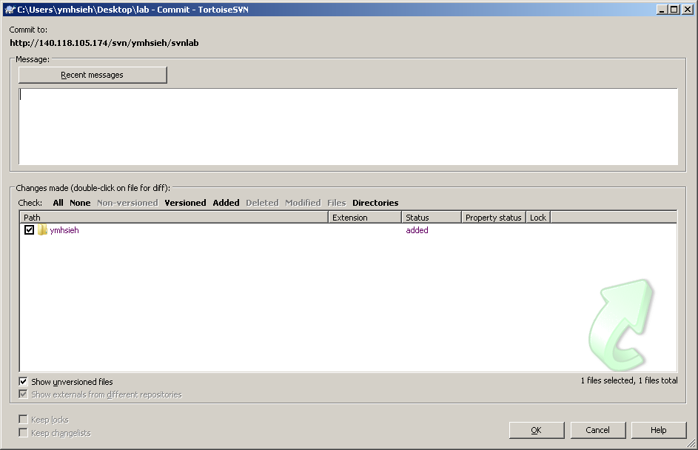

Slide 19
LAB I-2: Update working copy
Now, everyone’s working copy is different and out-of-sync with the repository because everyone has some (non-conflicting) modifications made and committed.
To bring your working copy up to date, right click on the folder containing your working copy, and choose “SVN Update”
Now your working copy should be in-sync with the repository.
cd lab
svn up

Slide 20
LAB I-3: Rename files
Try rename the folder (with your SVN username) you created in your working copy. Then, do a “SVN update”. → What happened?
To really rename a file/folder from repository, right-click on the file to be renamed (have fun with SVN.txt), choose “TortoiseSVN”→”Rename”.
The file/folder is renamed from your working copy after you do SVN Rename. But the repository doesn’t know about it yet.
Do a SVN Update, and the file/folder in the repository will be renamed.
svn ren ymhsieh ymhsieha
svn up

Slide 21
LAB I-4: Delete files
Try delete the folder (your SVN username) you created in your working copy. Then, do a “SVN update”. → What happened?
To really remove a file or a folder from repository, right-click on the file to be deleted (have fun with SVN.txt), choose “TortoiseSVN”→”Delete”.
The file/folder is immediately deleted from your working copy after you do SVN Delete. But the repository doesn’t know about it yet.
Do a SVN Update, and the file/folder in the repository will be deleted.
svn del ymhsieh
svn up

Slide 22
LAB I-5: Review changes
After you have worked on your working copy, usually you want to review what you have done before you commit your changes. There are two different kinds of review: status and differences
Add a new file hello.txt into svnlab folder. Right click on the svnlab folder and choose “TortoiseSVN”→”check for modifications”. You will then be given a list of files and folders that have status changes.
To have a detailed list of changes for artifacts inside a project, right click on the artifact (e.g. hello.txt) and choose “TortoiseSVN”→diff.
svn st
svn diff

Slide 23
LAB I-6: Import Files and Directories
Each of you have your own repository under http://140.118.105.174/svn/____ ← with your svn username
To get started, you need to import folders & files into your repository. This is done through import.
Create a new folder (svnlab) on your desktop. Name the folder anyway you like, and create a file helloSVN.txt in the folder.
Note this new folder (svnlab) is un-versioned.
Right click on the folder, choose “TortoiseSVN”→Import
Use http://140.118.105.174/svn/______/svnlab as the URL of repository
Note import immediately make changes to the repository. Once you have successfully imported the tree, you can erase your original tree immediately.
Note you cannot work in the un-versioned tree after you have imported it into repository. You have to do a checkout and then work in the working copy.
mkdir svnlab
vi svnlab/helloSVN.txt
svn import http://140.118.105.174/svn/_____/svnlab svnlab

Slide 24
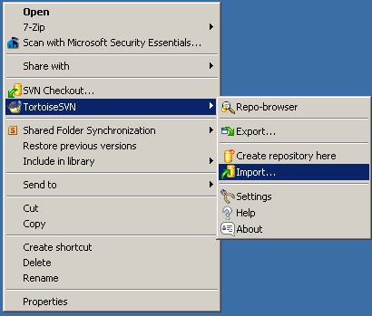
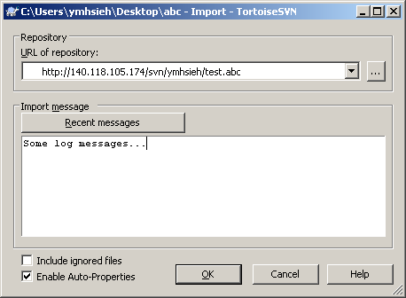

Slide 25
Summary of Part I
Checkout a working copy from repositories
Add artifacts to the working copy
Commit changes to the repository
Update working copy to be in-sync with repository
Remove artifacts from the repository
Rename artifacts in the repository
Review changes
Import trees

Slide 26
Part II: Working with Revisions

Slide 27
Part II: Working with revisions
So far, we have learned how to manipulate files as we do in file systems. This is not very exciting.
The advantage of using version control systems is that we can get the working copy at a given time, or so called revisions. Apple gave a cool name for this function in their MacOS: Time machine.
In the following labs:
Making three revisions of a folder
Checkout a specific working copy by giving a revision number
Update working copy or artifact to a specific revision
Compare different revisions of a file
Tagging a revision

Slide 28
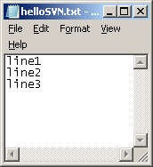
LAB II-0: Make three revisions
In the last lab, you have imported a svnlab folder in your own repository, and an empty file helloSVN.txt in the folder. (assuming revision 1)
Checkout the folder svnlab onto your desktop.
Add some text (e.g. line1) to helloSVN.txt, and then commit your changes. (assuming revision 2)
Add more text (e.g. line2) to helloSVN.txt, and then commit your changes. (assuming revision 3)
Add more text (e.g. line3) to helloSVN.txt, and then commit your changes. (assuming revision 4). Now the file has three lines.
vi svnlab/helloSVN.txt svn ci svnlab

Slide 29
Lab II-1: Checkout a specific revision of entire project
Create a new folder test
Right click on the folder, choose SVN Checkout, giving it appropriate URL: http://140.118.105.174/svn/_____/svnlab; check Revision, click on “Show Log” and specify the version (e.g. revision 3) you want to checkout. Then click on OK.
Now the folder test should be in the state of your specified revision (revision 3), and the file helloSVN.txt should have only two lines.
Now try to do a SVN Update on the folder. You should discover that the file is updated to the latest version (so called head version). SVN Update by default update files or folders to its latest version.
mkdir test
svn log http://140.118.105.174/svn/ymhsieh/svnlab
svn co -r 3 http://140.118.105.174/svn/ymhsieh/svnlab test
svn update test

Slide 30
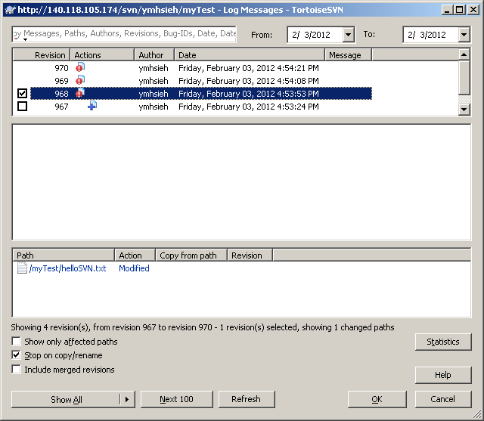
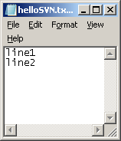
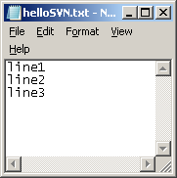

Slide 31
Lab II-2: Update an artifact to a specific revision
Right click on the file helloSVN.txt, choose “TortoiseSVN”→”Update to revision”
Check “Revision” and enter 1 (revision 1) and click on “OK”.
Now the file alone should be updated to revision 1 (thus empty).
In other words, we do not need to update the whole folder to a specific revision, you can update individual artifacts to different versions. They don’t have to be of the same revision number.
svn update -r 1 test/helloSVN.txt

Slide 32
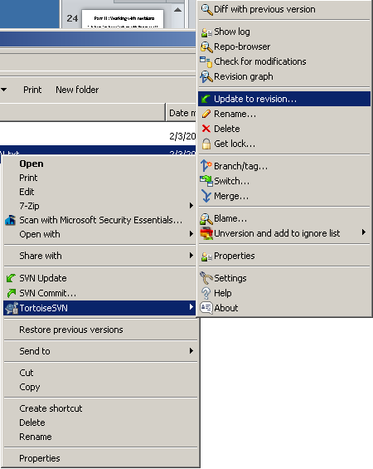

Slide 33
Lab II-3: Finding differences between revisions
Right click on the file “helloSVN.txt”, choose “TortoiseSVN”→Revision Graph. It shows you all revisions of the file.
CTRL-Left click on the two versions (e.g. 1 and 3) you want to find differences, choose “SVN” →compare revisions
The result window shows you how two revisions of a file differ.
A convenient way of finding changes to a file (by comparing with its previous version) can be found by right-clicking on the file (helloSVN.txt) and choose “Diff with previous version”. It compares working copy with its head version in the repository.
svn diff -r 1:3 test/helloSVN.txt
svn diff test/helloSVN.txt

Slide 34
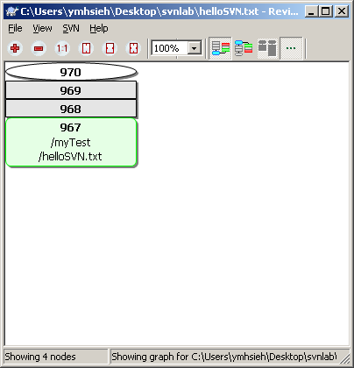
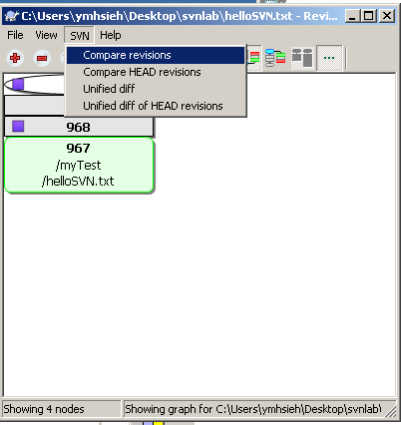
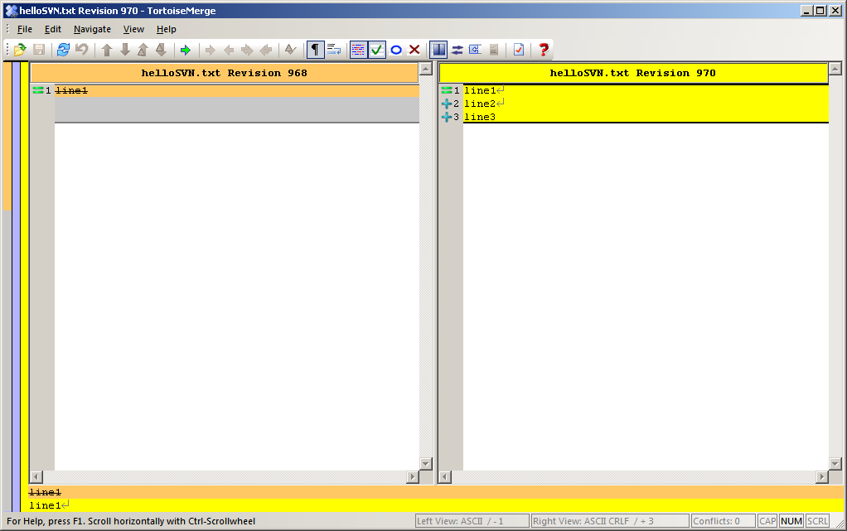

Slide 35
Tags
Tag is a snapshot of a project in time with text to describe. For example, “release 1.0” is easier to understand than revision 4822.
Tag is a way to create alternative form of revisions. Tags are text that are easier to remember and meaningful than just numbers.
It is recommended to create a folder named “tags” to store these tags.
Don’t worry about making tags, they are not wasting storage space, and they don’t make duplicates.

Slide 36
Lab II-4: Tag a project
First, create a tags folder in your working copy, and then commit all changes into repository.
Right click on the svnlab folder, choose “TortoiseSVN”→”Branch/tag”
Enter “/svnlab/tags/tag-0.1” in “To path:”
Enter some messages, and click on “OK”. Now you just tagged the current snapshot (revision 5?)
In the future, if you want to retrieve the snapshot, simply check out http://140.118.105.174/svn/_____/svnlab/tags/tag-0.1
mkdir svnlab/tags; svn add svnlab/tags; svn commit svnlab
svn copy svnlab http://140.118.105.174/svn/_____/svnlab/tags/tag-0.1

Slide 37
Summary
Making three revisions of a folder
Checkout a specific working copy by giving a revision number
Update working copy or artifact to a specific revision
Compare different revisions of a file
Tagging a revision

Slide 38
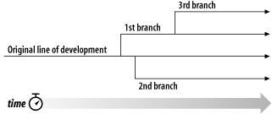
Part III: Branching
http://svnbook.red-bean.com/en/1.7/svn.branchmerge.whatis.html

Slide 39
Branches
For people working on large projects and collaborations, branches are often created.
To avoid issues associated with big changes
To keep track of different working versions
Common Branching Patterns
Release branches
Feature branches

Slide 40
Release Branches
Developers commit all new work to the trunk. Day-to-day changes are committed to /trunk: new features, bug fixes, and so on.
The trunk is copied to a “release” branch. When the team thinks the software is ready for release (say, a 1.0 release), /trunk might be copied to /branches/1.0.
Teams continue to work in parallel. One team begins rigorous testing of the release branch, while another team continues new work (say, for version 2.0) on /trunk. If bugs are discovered in either location, fixes are ported back and forth as necessary. At some point, however, even that process stops. The branch is “frozen” for final testing right before a release.
The branch is tagged and released. When testing is complete, /branches/1.0 is copied to /tags/1.0.0 as a reference snapshot. The tag is packaged and released to customers.
The branch is maintained over time. While work continues on /trunk for version 2.0, bug fixes continue to be ported from /trunk to /branches/1.0. When enough bug fixes have accumulated, management may decide to do a 1.0.1 release: /branches/1.0 is copied to /tags/1.0.1, and the tag is packaged and released.

Slide 41
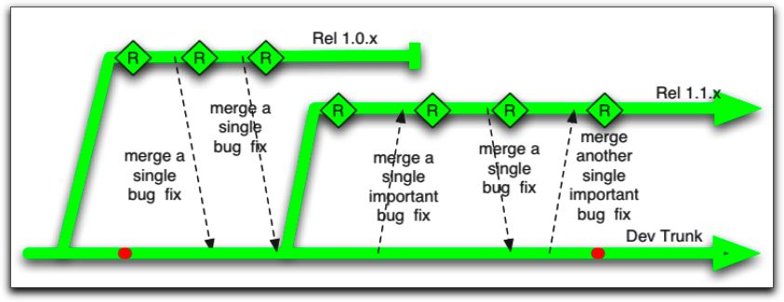
Release Branches
http://paulhammant.com/blog/branch_by_abstraction.html

Slide 42
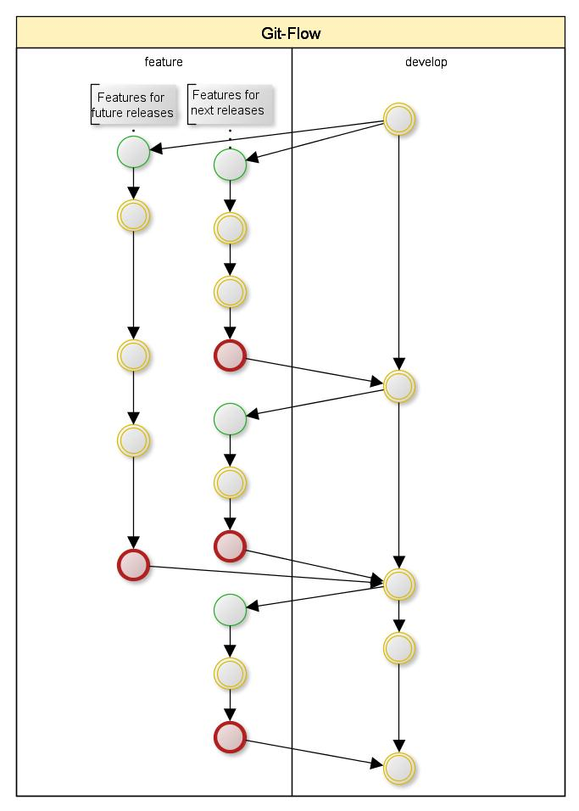
Feature Branches
A feature branch is a temporary branch created to work on a complex change without interfering with the stability of /trunk.
Feature/experimental branches are born, used for a while, merged back to the trunk, and then ultimately deleted. They have a finite span of usefulness.

Slide 43
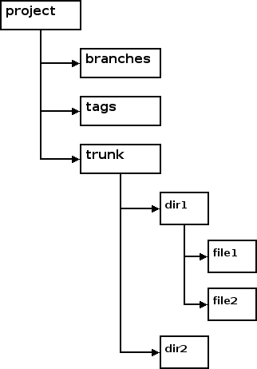
Recommended Directory Structure
For each of the project, it is recommended to have three folders:
trunk: holds the mainline of development
branch: holds branches of the project
Tags: holds tags of the project

Slide 44
Outline of LAB III
Creating recommended layout
Branching and switching
Merging
Removeing a branch

Slide 45
Lab III-0: Prepare recommended tree structure
We have already created tags for holding “tags” of the project “svnlab”. Please create and add “trunk” and “branches” in your working copy of svnlab, and then commit changes to the repository.
From now on for this “svnlab” project, you should work in your trunk folder, and occasionally make tags and branches.
mkdir svnlab/trunk
mkdir svnlab/branches
svn add svnlab/trunk
svn add svnlab/branches
svn ci svnlab

Slide 46
LAB III-1: Branching & Switching
Create a file “fun with branches.txt” in the “trunk” folder, add it and then commit changes to the repository.
Right click on the “trunk” folder, choose “TortoiseSVN” → “Branch/tag”, and put “/svnlab/branches/test-0.1” in the “To path:”, write some log messages, and click on “OK”.
The above command creates the branch, but the working copy still belongs to the trunk. To work on the branch, right-click on the “trunk” folder, choose “TortoiseSVN”→switch, enter “/svnlab/branches/test-0.1” in “To path:”, and click on “OK”. From now on, changes in the trunk folder of your working copy stays in the branch test-0.1. the switch can also be achieved by checking “Switch working copy to new branch/tag”
You may use “Revision Graph” to visualize brances.
We can now continue work in the trunk, but the trunk in the working copy belongs to the test-0.1 branch development.

Slide 47
LAB III-1: Branching and Switching
cd svnlab
vi trunk/fun with branches.txt
svn add “trunk/fun with branches.txt”
svn ci trunk
Export base=http://140.118.105.174/svn/___/svnlab
svn copy $base/trunk $base/branches/test-0.1
cd trunk
svn switch $base/branches/test-0.1

Slide 48
LAB III-2: Merging
Sometimes we need to merge two branches or branches with trunks (e.g. feature branches).
Let’s put some more files (test1.txt, test2.txt) into the “trunk” folder, and commit these changes to the repository.
Note the file is added after branching and switching.
In other words, this file belongs to the test-0.1 branch,. The main trunk does not have this file!
Let’s reintegrate changes in the test-0.1 branch into the main development trunk. Before we can do this, we first need to switch our trunk to the main development trunk. (TortoiseSVN→switch)
Right click on the “trunk” folder, choose “TortoiseSVN” → “Merge”. You will be given three different merge types. Let’s choose “merge two trees”. From: “http://.../svnlab/branches/test-0.1”, to: “http://.../svnlab/trunk”.

Slide 49
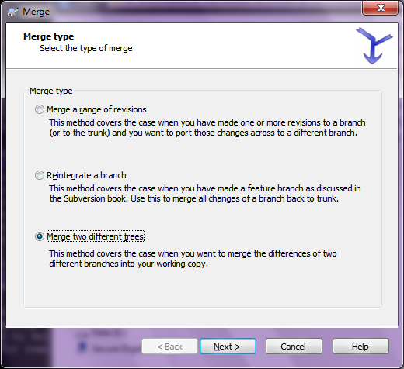
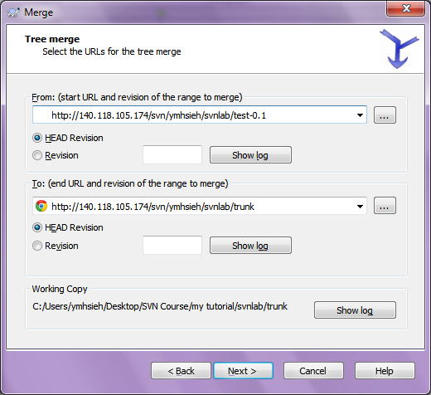

Slide 50
LAB III-3: removing a branch
Removing branches is often done for feature branches once they have reached maturity and have been integrated back to the trunk.
In the branches folder, find the branch (e.g. test-0.1) you want to delete.
Right click on the folder, choose “TortoiseSVN”→”Delete”
This is done in your working copy. Thus you need to commit changes to the repository.

Slide 51
Summary
Creating recommended layout
Branching and switching
Merging
Removeing a branch

Slide 52
Part IV: Recommended Practices

Slide 53
Directory structure
In your repository (http://140.118.105.174/svn/____/), create a folder for each of your project.
In each project’s folder, create “tags”, “branches”, and “trunk” folders.

Slide 54
Recommended Workflow
Update your working copy. This involves the use of the svn update command.
Make your changes. The most common changes that you'll make are edits to the contents of your existing files. But sometimes you need to add, remove, copy and move files and directories—the svn add, svn delete, svn copy, and svn move commands handle those sorts of structural changes within the working copy.
Review your changes. The svn status and svn diff commands are critical to reviewing the changes you've made in your working copy.
Fix your mistakes. Nobody's perfect, so as you review your changes, you may spot something that's not quite right. Sometimes the easiest way to fix a mistake is start all over again from scratch. The svn revert command restores a file or directory to its unmodified state.
http://svnbook.red-bean.com/en/1.7/svn.tour.cycle.html

Slide 55
Recommended Workflow
Resolve any conflicts (merge others' changes). In the time it takes you to make and review your changes, others might have made and published changes, too. You'll want to integrate their changes into your working copy to avoid the potential out-of-dateness scenarios when you attempt to publish your own. Again, the svn update command is the way to do this. If this results in local conflicts, you'll need to resolve those using the svn resolve command.
Publish (commit) your changes. The svn commit command transmits your changes to the repository where, if they are accepted, they create the newest versions of all the things you modified. Now others can see your work, too!
http://svnbook.red-bean.com/en/1.7/svn.tour.cycle.html

Slide 57
SVN Components
svn: The command-line client program
svnversion: A program for reporting the state (in terms of revisions of the items present) of a working copy
svnlook: A tool for directly inspecting a Subversion repository
svnadmin: A tool for creating, tweaking, or repairing a Subversion repository
mod_dav_svn: A plug-in module for the Apache HTTP Server, used to make your repository available to others over a network
svnserve: A custom standalone server program, runnable as a daemon process or invokable by SSH; another way to make your repository available to others over a network
svndumpfilter: A program for filtering Subversion repository dump streams
svnsync: A program for incrementally mirroring one repository to another over a network
svnrdump: A program for performing repository history dumps and loads over a network
http://svnbook.red-bean.com/en/1.7/svn.intro.whatis.html

