Slide 1
JDBC
Java Database Connectivity API
Harinath Mallepally

Slide 2
Basics
import java.sql.*;
Connection
Statement/PreparedStatement/CallableStatement
ResultSet

Slide 3
Procedures and functions
You can write logic at the database level.
Standard SQL doesn't support scope for programming logic. Procedures and functions are extensions to support logic.
for simpler logic we use functions. functions have a return type where as procedures do not.
procedures support IN, OUT, INOUT parameters. OUT parameters allow you to return multiple values.

Slide 4
procedure - steps
Default delimiter is ; because we use it in regular SQL statement and because stored procedure needs lot of regular SQL statements, we need to re-define default delimiter to something else, here we go for //
procedure has IN, OUT, INOUT parameters
See the java code on how to call a procedure

Slide 5
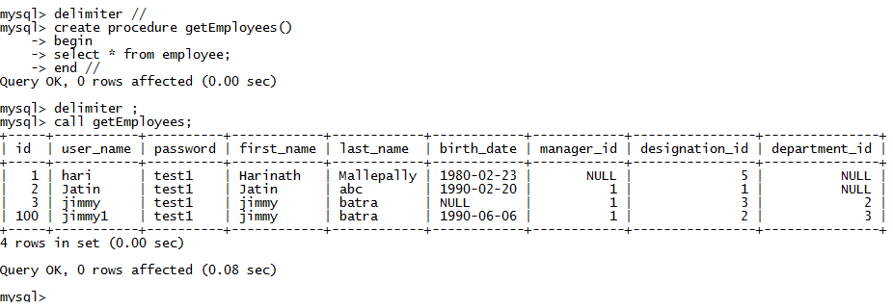
Procedure

Slide 6
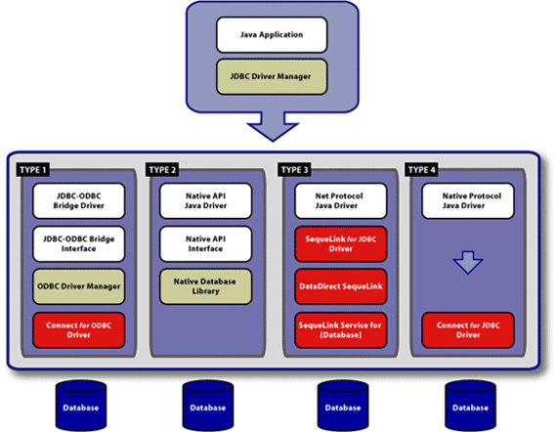
JDBC Drivers

Slide 7
