Slide 1
Chapter 2
Algorithm Analysis
Fall 2019

Slide 2
Algorithms
An algorithm is a set of steps to solve a problem.
More than one algorithm may be written to solve the same problem.
How good is each algorithm?
How do we determine which one is best?

Slide 3
Algorithms
For the same problem, one algorithm may take several days to finish, while another may only take several seconds.
So, it is not enough that an algorithm works correctly, it should also perform well.
An algorithm that is reading and processing input may work fine for small input sizes, but may take unacceptably long for large input sizes.

Slide 4
Math Background
O Big O. Upper bound (possibly equal).
Θ Theta. Growth rates are equal.
Ω Omega. Lower bound (possibly equal).
o Little o. Upper bound (not equal).

Slide 5
Math Background
O T(N) = O(f(N)) means that T(N) <= cf(N)
for some constant c and for N >= n₀.
Ω T(N) = Ω(f(N)) means that T(N) >= cf(N)
for some constant c and for N >= n₀.

Slide 6
Math Background
Θ T(N) = Θ(f(N)) means
T(N) = O(f(N)) and T(N) = Ω(f(N))
o T(N) = o(f(N)) means
T(N) = O(f(N)) and T(N) = Θ(f(N))

Slide 7
Math Background
These math definitions let us compare functions in terms of their growth rates.
For example, N³ grows at a faster rate than N². So N³ is an upper bound on N².
Thus, N² = O(N³).
There can be many upper bounds of a function, but we are most interested in the closest one. So, we would use N² = O(N²).

Slide 8
Math Background
g(n) = 2 N² can be classified as
either O(N² ) or Ω(N²) or Θ(N²).
Θ(N²) is the “tightest” description.
In algorithms analysis, typically we are concerned with how bad an algorithm may perform, which implies knowing an upper bound, so normally we use O rather than Θ.

Slide 9
Rules
Rule 1:
If T₁(N) = O(f(N)) and T₂(N) = O(g(N)), then
a) T₁(N) + T₂(N) = O(f(N) + g(N))
b) T₁(N) * T₂(N) = O(f(N) * g(N))
Rule 2:
If T(N) is a polynomial of degree k, then
T(N) = Θ(N^{k})
Rule 3:
log^{k}N = O(N) for any constant k.
( log^{k}N is the same as (log N)^{k} )

Slide 10
Style
In these notations, lower-order terms are ignored: 2N² + N + 5 is O(N²)
Why? Because the 2N² causes the function to grow at a quadratic rate. The N and 5 contribute some but the growth rate is quadratic.

Slide 11
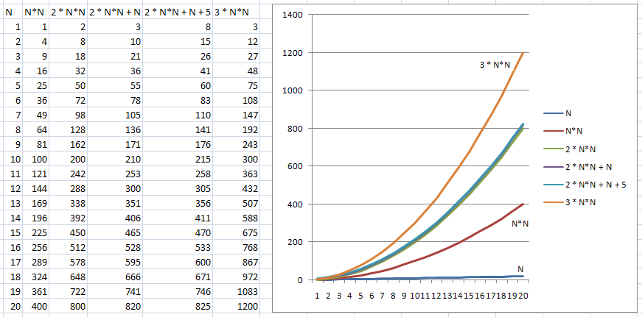

Slide 12
Examples
Consider these examples:
f(n) = 60n² + 5n + 1 O(n²)
f(n) = n(n+1)/2 O(n²)
f(n) = 4 O(1)
f(n) = n O(n)
f(n) = 3n + 1 O(n)
f(n) = 4log(n) O(log(n))

Slide 13
Common Functions
c Constant
log N Logarithmic
log² N Log-squared
N Linear
N log N
N² Quadratic
N³ Cubic
2^{N} Exponential

Slide 14
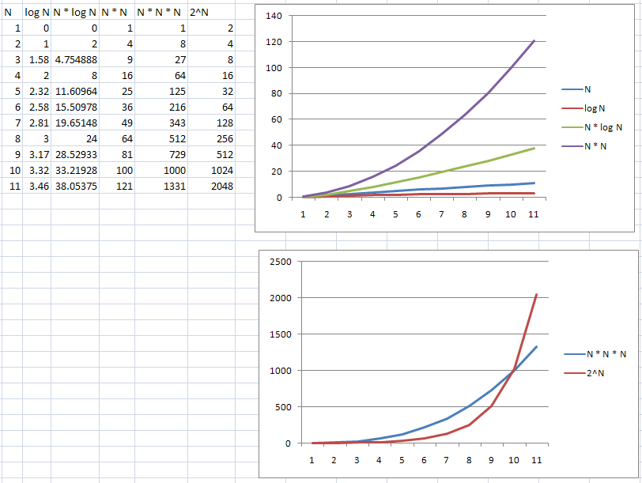

Slide 15
Relative Growth Rates
If we want to compare two functions, f(N) and g(N), to see which one grows faster, we can compute:
lim _{N->∞} f(N)/g(N)
If the limit is:
0: f(N) = o(g(N))
c: f(N) = Θ(g(N)) c ≠ 0
∞: g(N) = o(f(N))
If the limit is of indeterminate form (0/0 or ∞/∞), you can use L’Hôpital’s rule, which says the limit can be found by first taking the derivative of the numerator and denominator.

Slide 16
Model
To analyze algorithms, we use a conceptual model of a computer that is very simplified compared to an actual computer.
In this model, all operations take one unit of time, and it has infinite memory.
This makes the analysis focused on the algorithm, independent of any machine.
Of course, other factors may be important in an actual implementation.

Slide 17
What to Analyze
The most important thing to analyze is running time.
The size of the input is the main consideration.
We could analyze, best-case, worst-case, or average-case performance.
Typically we analyze worst-case performance since that tells us the limit of poor performance.
Best-case is less useful since it probably isn’t typical, and average-case is much more difficult to analyze since it may be hard to define what data would be considered average.

Slide 18
What to Analyze
We use Java code in the examples but the analysis really should be language-independent.
Notice that for small inputs, the difference between algorithms may not matter.
Also, in an actual setting, the time to read the input may be the bottleneck.

Slide 19
Running Time
public static int sum( int n )
{
int partialSum;
1 partialSum = 0; // 1 unit
2 for (int i=1; i<=n; i++) // 1+ (n+1) + n
3 partialSum += i * i * i ; // 4 units * n
4 return partialSum; // 1 unit
}
// 1 + (2n+2) + 4n + 1 = 6n+4, so the result is O(n)

Slide 20
Rules
Rule 1: For-loops. Number iterations (n) times the statements inside.
Rule 2: Nested for-loops. Statements inside times the product of loop sizes.
Analyze loops inside out.
Rule 3: Consecutive statements add (which means the maximum one is the one that counts).
Rule 4: If-else statements are the test plus the larger of the two branches.

Slide 21
Recursion
public static long factorial(int n)
{
if (n <= 1)
return 1;
else
return n * factorial( n – 1 );
}
O(N) because each call generates one more recursive call up to n times (like a for-loop).

Slide 22
Recursion
public static long fib(int n)
{
if (n <= 1)
return 1;
else
return fib( n – 1 ) + fib( n – 2);
}

Slide 23
T(0) = T(1) = 1 (compare and return is O(1) time)
T(N) = T(N-1) + T(N-2) + 2 (two for if and add)
T(2) = T(1) + T(0) + 2= 1 + 1 + 2 = 4
T(3) = T(2) + T(1) + 2 = 4 + 1 + 2 = 7
T(4) = T(3) + T(2) + 2 = 7 + 4 + 2 = 13
T(5) = T(4) + T(3) + 2 = 13 + 7 + 2 = 22
T(6) = T(5) + T(4) + 2 = 22 + 13 + 2 = 37
Almost doubles each time (exponential growth).

Slide 24
Recursion
In chapter 1 it was shown by induction that for the Fibonacci numbers, F(N) < (5/3)^{N}.
It can also be shown that F(N) >= (3/2)^{N}.
So, the Fibonacci numbers grow at an exponential rate.
Since T(N) >= F(N), we can conclude that the function’s running time is exponential.

Slide 25
Recursion
It should be noted that the function is doing a large amount of redundant work.
This is evident in the call tree shown on the next slide.
A simple loop can compute the Fibonacci list much more efficiently.

Slide 26
Fibonacci Calls for F(5)
F(5)
F(4)
F(3)
F(3)
F(2)
F(2)
F(1)
F(2)
F(1)
F(1)
F(0)
F(1)
F(0)
F(1)
F(0)

Slide 27
Maximum Subsequence Sum
Given a sequence of (possibly negative) integers A₁, A₂,…, A_{N}, find the maximum value of: ∑^{j}_{k=i} A_{k}
For convenience, the maximum subsequence sum is 0 if all the integers are negative.
Example: -2,11,-4,13,-5,-2
Answer is 20 (A₂ to A₄).

Slide 28
Maximum Subsequence Sum
The next slides will look at four solutions to this problem.
The solutions have O(N³), O(N²), O(NlogN) and O(N) running times.

Slide 29
O(N³) Solution
The solution on the next slide is O(N³).
We might guess this due to the three nested for loops.
A more rigorous approach is to look at the actual iterations as shown on the slide following the code.

Slide 30
public static int maxSubSum1(int [] a)
{
/* 1*/ int maxSum = 0;
/* 2*/ for( int i = 0; i < a.length; i++ )
/* 3*/ for( int j = i; j < a.length; j++ )
{
/* 4*/ int thisSum = 0;
/* 5*/ for( int k = i; k <= j; k++ )
/* 6*/ thisSum += a[ k ];
/* 7*/ if(thisSum > maxSum )
/* 8*/ maxSum = thisSum;
}
/* 9*/ return maxSum;
}
O(N³)

Slide 31





because sum i to j of 1 is j-i+1
because if j=i, then (i)-i+1 = 1
if j=i+1, then (i+1)-i+1=2
if j=i+2, then (i+2)-i+1=3
if j=N-1, then (N-1)-i+1=N-i
we see it is just summing the first N-i integers, so, use
because, see page 40.
O(N³)

Slide 32
O(N²) Solution
We can avoid O(N³) running time by removing the inner for-loop.
-2,11,-4,13,-5,-2
Notice that a loop summing values from i to j isn’t necessary, since we could accumulate this sum as j moves.
i
j

Slide 33
public static int maxSubSum2(int [] a)
{
/* 1*/ int maxSum = 0;
/* 2*/ for( int i = 0; i < a.length; i++ )
{
/* 3*/ int thisSum = 0;
/* 4*/ for(int j = i; j < a.length; j++)
{
/* 5*/ thisSum += a[ j ];
/* 6*/ if(thisSum > maxSum )
/* 7*/ maxSum = thisSum;
}
}
/* 8*/ return maxSum;
}
O(N²)

Slide 34
O(NLogN) Solution
Use recursion.
Split list in half.
For each half, find max sum.
Also find max sum that spans the center.
The maximum subsequence sum is the either in the left half, the right half, or spans the center.
Called a “Divide and Conquer” strategy.

Slide 35
-2,11,-4,13,-5,-2
Max sum is in left half, right half, or across the center.
How is the maximum subsequence sum of the left half found?
-2,11,-4

Slide 36
public static int maxSumRec(int [] a, int left,int right)
{
/* 1*/ if( left == right ) /* Base case */
/* 2*/ if( a[ left ] > 0 )
/* 3*/ return a[ left ];
else
/* 4*/ return 0;
/* 5*/ int center = ( left + right ) / 2;
/* 6*/ int maxLeftSum = maxSumRec( a, left, center);
/* 7*/ int maxRightSum = maxSumRec( a, center+1,right );
O(N log N)

Slide 37
// compute left sum
/*8*/ int maxLeftBorderSum = 0, leftBorderSum = 0;
/*9*/ for( int i = center; i >= left; i-- )
{
/*10*/ leftBorderSum += a[ i ];
/*11*/ if( leftBorderSum > maxLeftBorderSum )
/*12*/ maxLeftBorderSum = leftBorderSum;
}
// compute right sum
/*13*/ int maxRightBorderSum = 0; rightBorderSum = 0;
/*14*/ for( int j = center + 1; j <= right; j++ )
{
/*15*/ rightBorderSum += a[ j ];
/*16*/ if( rightBorderSum > maxRightBorderSum )
/*17*/ maxRightBorderSum = rightBorderSum;
}

Slide 38
/*18*/ return max3( maxLeftSum, maxRightSum,
maxLeftBorderSum + maxRightBorderSum );
}
// driver function
public static int maxSubSum3( int [] a )
{
return maxSubRec( a, 0, a.length - 1 );
}

Slide 39
-2,11,-4,13,-5,-2
max=20
-2,11,-4
13,-5,-2
max=11
max=13
-2,11
-4
13,-5
-2
max=11
max=13
-2
11
0
13
-5
0
0
11
13
0

Slide 40
O(NLogN) Solution
Analysis:
Let T(N) be the time for a problem of size N.
Then each recursive call is T(N/2).
Remaining work is O(N).
So, T(N) = 2T(N/2) + N
Let T(1) = 1
T(2) = 2T(1) + 2 = 2 + 2 = 4 = 2*2
T(4) = 2T(2) + 4 = 8 + 4 = 12 = 4*3
T(8) = 2T(4) + 8 = 24 + 8 = 32 = 8*4
T(16) = 2T(8) + 16 = 64 + 16 = 80 = 16*5
The pattern appears to be N(log N + 1)
So, O(NlogN)

Slide 41
O(N) Solution
Algorithm 2 used nested for-loops, checking forward subsequences in the list for each value of i.
-2,5,2,-8,13,-5,-2
One improvement we could make is to advance i if a[i] is negative, since it cannot start a solution, and likewise advance j if a[j] is negative since it cannot end a solution.
i
j

Slide 42
O(N) Solution
It can also be seen that if we advance j such that the subsequence sum from i to j turns negative, then we can advance the value of i to j+1.
This is because the subsequence starting from i to j-1 was positive and it was a[j] that made it negative.
Since a negative subsequence cannot be a prefix to a solution, it may be skipped.
-2,5,2,-8,13,-5,-2
i
j

Slide 43
O(N) Solution
With this insight, we see that the i-loop is not really needed, we can simply accumulate values as the j-index moves, discarding and starting a new sum whenever the current sum goes negative, and keeping the max sum as it moves.

Slide 44
public static int maxSubSum4(int [] a)
{
/* 1*/ int maxSum = 0, thisSum = 0;
/* 2*/ for( int j = 0; j < a.length; j++ )
{
/* 3*/ thisSum += a[ j ];
/* 4*/ if(thisSum > maxSum )
/* 5*/ maxSum = thisSum;
/* 6*/ else if (thisSum < 0)
/* 7*/ thisSum = 0;
}
/* 8*/ return maxSum;
}
O(N)

Slide 45
O(N) Solution
This algorithm makes a single pass through the data, and doesn’t require knowledge of past values (other than the running sum).
It also can give an answer for the sequence read thus far.
This kind of algorithm is called an “online” algorithm.
An online algorithm that runs in linear time and in constant space is about as good as possible.

Slide 46
Logarithms in Running Time
Divide and conquer solutions often run in O(NlogN) time.
An algorithm is O(logN) if (repeatedly) it takes constant time to reduce the problem size by a fraction.
An algorithm is O(N) if (repeatedly) it takes constant time to reduce the problem size by a constant.

Slide 47
Binary Search
Problem:
Given an integer X and integers A₀, A₁, …, A_{N-1}, which are presorted and already in memory, find i such that A_{i} = X, or return i = -1 if X is not in the input.
A linear search would scan the list looking for the value. O(N).
A binary search would split the problem into halves, and keep doing this until the value is found or determined not to be there.
A problem of size N can be split in half log N times with constant time work at each split.
So this algorithm is O(log N).

Slide 48
Looking for 78
16
1,3,6,10,17,33,45,49,52,64,76,78,82,90,91,97
8
52,64,76,78,82,90,91,97
4
52,64,76,78
2
76,78
1
78
For 16 elements, takes 4 steps. log₂16 = 4

Slide 49
public static <AnyType extends Comparable<? super AnyType>> int binarySearch(AnyType [] a, AnyType x )
{
/* 1*/ int low = 0, high = a.length - 1;
/* 2*/ while( low <= high )
{
/* 3*/ int mid = ( low + high ) / 2;
/* 4*/ if( a[ mid ].compareTo(x) < 0 )
/* 5*/ low = mid + 1;
/* 6*/ else if(a[ mid ].compareTo(x) > 0 )
/* 7*/ high = mid - 1;
else
/* 8*/ return mid; /* Found */
}
/* 9*/ return NOT_FOUND; // NOT_FOUND defined as -1
}

Slide 50
Euclid’s Algorithm
Finds greatest common divisor (gcd) of two values.
Compute gcd (M, N), assuming M >= N.
Recall: The gcd of two integers is the largest integer that divides both.
Example gcd(50,15) = 5.
Observe 50%15 = 5.
Example gcd(102,15)
102%15 = 12
15%12 = 3 answer is 3.

Slide 51
public static long gcd(long m, long n )
{
/* 1*/ while( n != 0 )
{
/* 2*/ long rem = m % n;
/* 3*/ m = n;
/* 4*/ n = rem;
}
/* 5*/ return m;
}
Pg 58

Slide 52
Analysis of Euclid’s algorithm:
After two iterations, the remainder is at most half of the original value.
Proof:
Consider two cases for N: N <= M/2 and N > M/2.
If N <= M/2, then M%N < M/2 (has to be because it is the remainder of dividing by N, and N is <= M/2, so the remainder must also be <= M/2).
If N > M/2, then M%N < M/2 (still has to be because it is the remainder).
So, the remainder is always < M/2.
It takes two iterations for this remainder to move into m.
Therefore, the running time is 2 log N, which is O(log N).

Slide 53
Exponentiation
How to compute X^{N} efficiently?
Could use N-1 multiplies, O(N).
A recursive approach uses:
Even N: X^{N} = X^{N/2} * X^{N/2}
Odd N: X^{N} = X^{(N-1)/2} * X^{(N-1)/2} * X

Slide 54
Exponentiation
Computing pow(x, n/2) * pow(x, n/2) would not be good because we are doing two recursive calls.
However, since x^{n/2} * x^{n/2} = (x*x)^{n/2}, we can compute with one call as pow(x*x, n/2).
This cuts the problem in half each time, giving a log number of cuts.
Since each cut takes either one or two multiplies, at worst it is 2 log n, or O(log n) running time.

Slide 55
public static long pow( long x, long n )
{
/* 1*/ if( n == 0 )
/* 2*/ return 1;
/* 3*/ if( n == 1 )
/* 4*/ return x;
/* 5*/ if( isEven( n ) )
/* 6*/ return pow( x * x, n / 2 );
else
/* 7*/ return pow( x * x, n / 2 ) * x;
}

Slide 56
Compute
2¹²
Even
2¹² normally takes 11 multiplies, but here it is done with just 4.
(2*2)⁶
Even
(4*4)³
Odd
(16*16) * 16
4096

Slide 57
End of Slides

