Slide 1
Hyperparameter Sensitivity Trends Across Dataset Types
UCI Machine Learning Repository Analysis
CSIT332 - Principles of Machine Learning

Slide 2
Project Overview
• Objective: Analyze how different classifiers respond to hyperparameter changes across diverse datasets
• Datasets Analyzed: 5 UCI ML datasets: Census Income, Chronic Kidney Disease, Energy Efficiency, Thyroid Disease, Wholesale Customers
• Classifiers Tested: 6 algorithms: KNN, Logistic Regression, SVM, MLP, Decision Tree, Naive Bayes
• Methodology: GridSearchCV with 3-fold cross-validation to measure variance in accuracy across hyperparameter combinations
• Key Metric: Variance of accuracy scores - higher variance = more sensitive to hyperparameter tuning

Slide 3
Methodology: Measuring Hyperparameter Sensitivity
1. Define comprehensive hyperparameter grids for each classifier
2. GridSearchCV tests all combinations (28 for KNN, 48 for Logistic Regression, etc.)
3. Record cross-validation accuracy for each combination
4. Calculate variance, standard deviation, and range of accuracy scores
5. Rank classifiers by sensitivity (variance) for each dataset
Variance = measure of spread in accuracy scores

Slide 4
Key Findings

Slide 5
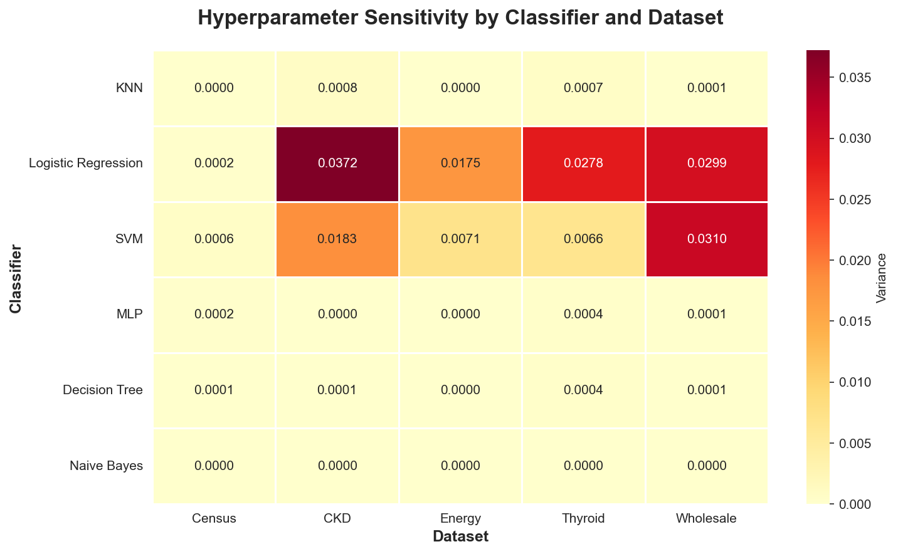
Sensitivity Heatmap Across All Datasets

Slide 6
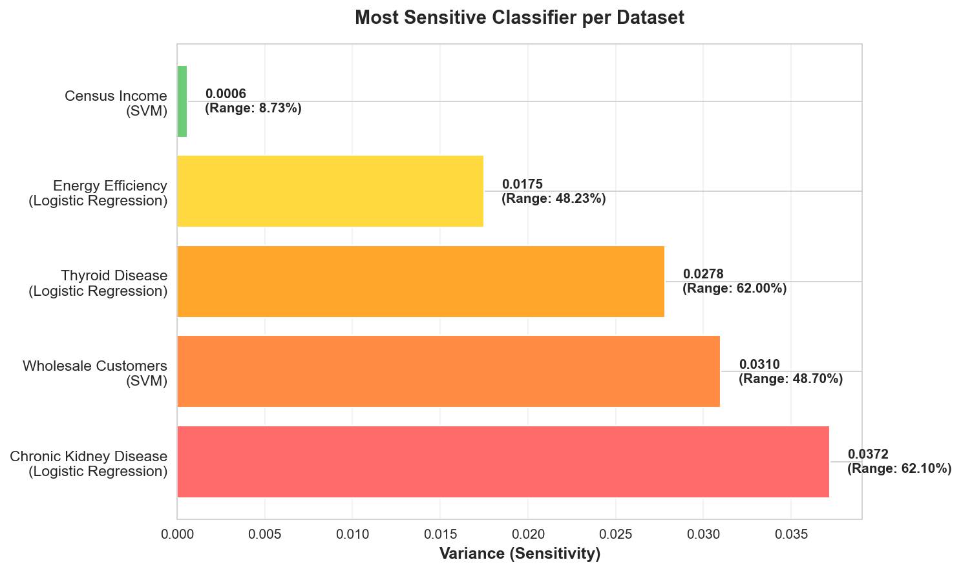
Most Sensitive Classifiers (Require Careful Tuning)

Slide 7
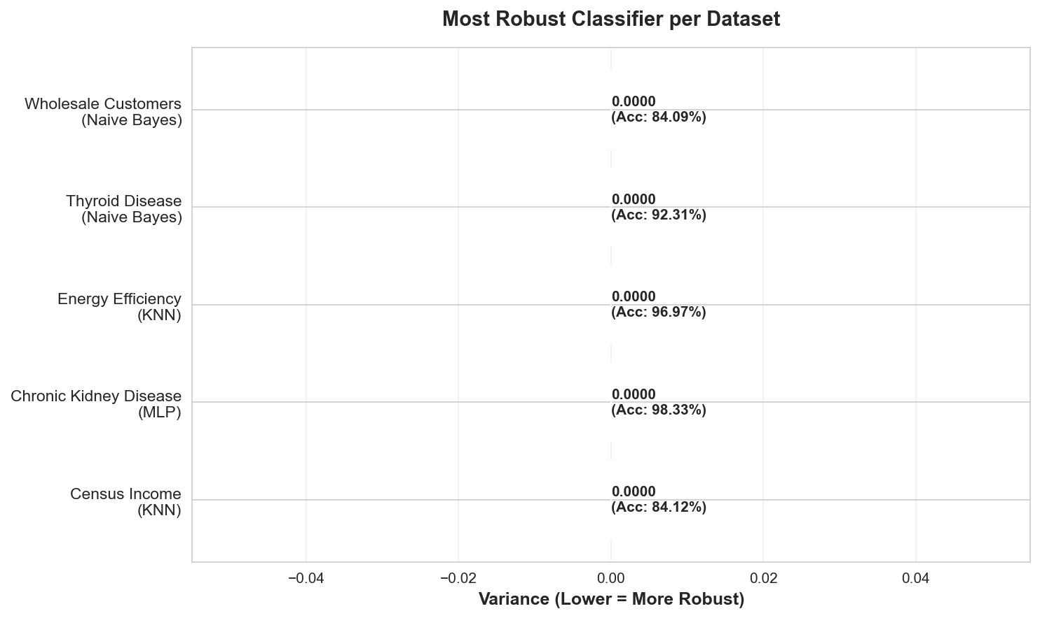
Most Robust Classifiers (Work Well with Defaults)

Slide 8
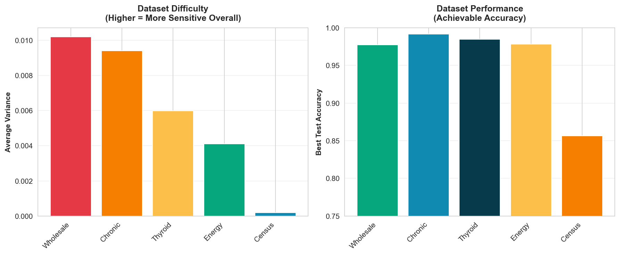
Key Insights by Dataset

Slide 9
Practical Recommendations
• For Medical Datasets (CKD, Thyroid):
Logistic Regression & SVM are HIGHLY sensitive - invest time in hyperparameter tuning. MLP and Naive Bayes are robust alternatives.
• For Demographic Data (Census):
SVM shows highest sensitivity. All classifiers perform reasonably well with defaults except for SVM.
• For Physical/Engineering Data (Energy):
Logistic Regression and SVM need careful tuning. Tree-based methods are more forgiving.
• For Business Data (Wholesale):
SVM and Logistic Regression again show highest sensitivity. Consider MLP for robust performance.
• General Rule:
Naive Bayes consistently shows near-zero variance - excellent starting point for baseline models!

Slide 10
Conclusions
✓ Logistic Regression and SVM consistently show highest hyperparameter sensitivity across datasets
✓ Naive Bayes is remarkably robust - almost zero variance in all cases
✓ MLP shows very low sensitivity despite complex architecture
✓ Medical datasets (CKD, Thyroid) require more careful tuning than other domains
✓ Hyperparameter sensitivity varies significantly by dataset type
✓ Understanding sensitivity helps practitioners allocate tuning effort effectively
Key Takeaway: Dataset characteristics significantly impact hyperparameter sensitivity!

Slide 11
Thank You!
Questions?
Hyperparameter Sensitivity Analysis Complete

