Slide 1


Infra-Bazzar (Buy-Sell Infra Material)
C-DAC ADVANCED COMPUTING TRAINING
SCHOOL ATC,NETCOM JAIPUR
Under Guidance of
Miss. Prajakta Patil Mam
PGDAC Batch : Mar 2022
BY:
1.Kiran Namdev Mahanor.
2.Mayur Sharad Warke.
3.Mayur Chandrakant Chougule.
4.Arshadali Ayub Mulla.
5.Devansh Shrivastava.

Slide 2
CONTENT
INTRODUCTION
PROBLEM DEFINAITION
OBJECTIVES
TOOLS AND PLATFORM USED
ANALYSIS
SOFTWARE ENGINEERING APPROCH
SYSTEM DESIGN
TESTING
ADAVANTAGES AND DISADVANTAGES

Slide 3
INTRODUCTION
. Customer get many benefits via online shopping this helps e-commerce companies to build long- lasting and profitable relationship with their customers. For making strong relationship with these users, it is very important to focus on the customer as a whole and making sense of a flood of real-time information that goes well beyond demographics or shopping behavior. There are two entities who will have the access to the system. One is the admin and another one will be the registered user.
Admin can add product details, view all the order details and can also view the sales of the products. User need to register with basic registration details to generate a valid username and password. After the user logins, it can view all the products that are recommended on the homepage compiled by the system based on user’s information. From the recommended products, the user can even further view its details and then if interested to buy, the system gives add to cart option for purchasing the product.

Slide 4
PROBLEM DEFINAITION
The idea behind this project is to provide online platform for customer as well as seller to sell the infrastructure materials so we are going to provide this platform for connecting customer as with seller. Due to COVID pandemic situation small shop business almost stopped and using this website small scale business will grow and our ultimate goal is provide best solution dynamic website for easy selling and buying.
We have tried our best to make the complicated process of Infrastructure materials selling and buying as simple as possible using Structured & Modular technique & Menu oriented interface. We have tried to design the software in such a way that the user may not have any difficulty in using this package & further expansion is possible without much effort. Even though we cannot claim that this work to be entirely exhaustive, the main purpose of our exercise is to perform each activity in online way rather than manually which is time consuming.

Slide 5
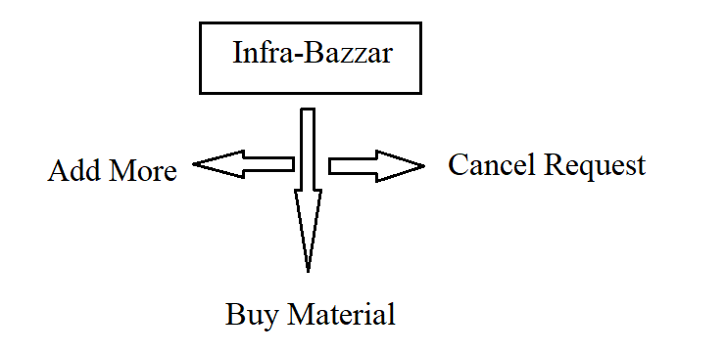
Need of Infra-Bazzar A few factors that direct us to develop a new system are given below -: 1) Faster System 2) Accuracy 3) Reliability 4) Informative 5) Reservations.

Slide 6
OBJECTIVES
To develop a system to management of Infra-Material, this will perform all the functions with a click of mouse button’s
To develop a system that has good management of data along with integrity and minimizing redundancy.
To develop a system that will be user friendly in all possible ways.
To provide better customer support for needy Customer.

Slide 7
TOOLS AND PLATFORM USED
Programming Languages:- In programming language we have Java, Spring Boot, MySQL etc.
Relational Database: -MYSQL
Software Requirements
HARDWARE SPECIFICATIONS
Processor : Intel Pentium or more
Ram : 128 MB or more
Cache : 512 KB
Hard disk : 16 GB hard disk recommended
Operating System | Windows
Front End | HTML, CSS, BootStrap
Back End | JAVA Spring Boot

Slide 8
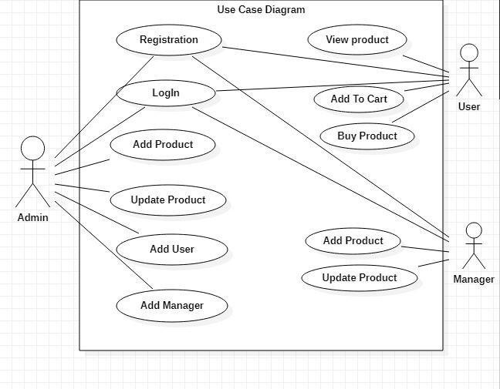
ANALYSIS Modeling For Infra-Bazzar

Slide 9
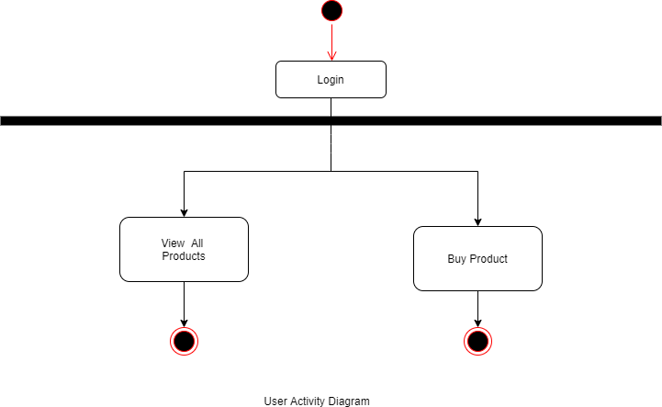
Log In
User Name
Verificaion
Success
Password Verification
Verification
Fail

Slide 10
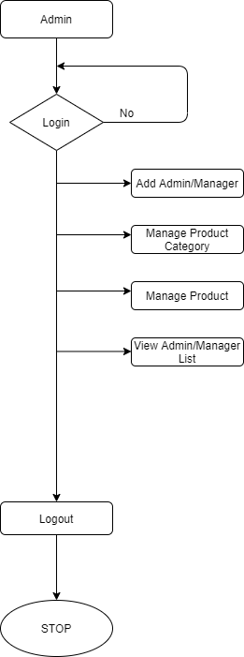
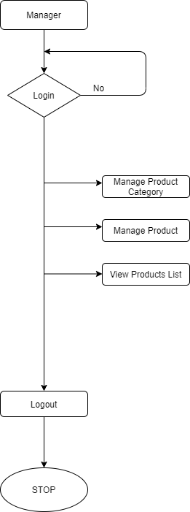
Data Flow Diagram for Admin And Manager

Slide 11
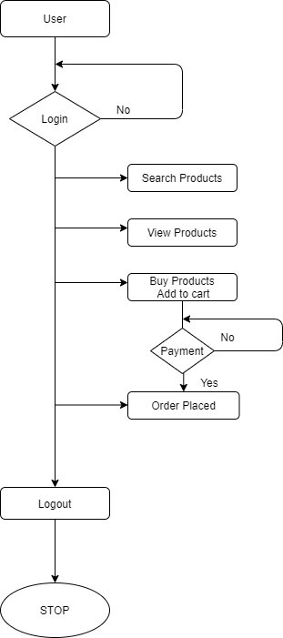
Data Flow Diagram for User

Slide 12
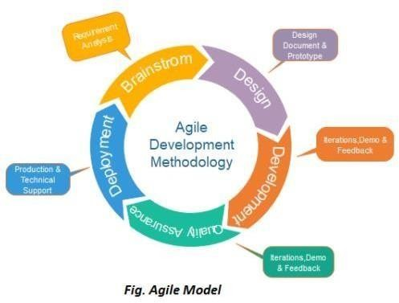
SOFTWARE ENGINEERING APPROACH
The meaning of Agile is swift or versatile. “Agile process model" refers to a software development approach based on iterative development. Agile methods break tasks into smaller iterations, or parts do not directly involve long term planning. The project scope and requirements are laid down at the beginning of the development process. Plans regarding the number of iterations, the duration and the scope of each iteration are clearly defined in advance
Following are the phases in the Agile model are as follows:

Slide 13
SYSTEM DESIGN
The process of system design can be divided into three stages. They are:
Structure design (already discussed)
Database design
Interface design
As we know that system design is a solution to “How to approach to the creation of new system”. It provides the understudying and procedural details necessary for implementing the system. The steps involved during system design were as follow: -
LOGICAL AND PHYSICAL DESIGN
The current physical system was thoroughly reviewed from point of view how the data flow, what are file contents, its volumes and frequency etc.
After this input, output specifications security & control specification were prepared. It was also decided that how physical information will flow through the system and a physical design walkthrough

Slide 14
SYSTEM DESIGN
OUTPUT DESIGN
The format of outputs is designed in such a way that it is simple to read and interpret In the present output we have clearly labeled title it contains date and time and all the fields are clearly mentioned (labeled).
INPUT DESIGN
.Input should be as simple as possible. It is design to reduce possibility of incorrect data being enter and the need of system user are considered with this view of mind several human factor is evaluated.
SCREEN DESIGN
The screen design for inputting the inputs were also panned as the format of inputs.

Slide 15
TESTING
Software Testing
Software testing is a process of verifying and validating that a software application or program. Software testing
1. Meets the business and technical requirements that guided its design and development, and
2. Works as expected.
Software testing also identifies important defects, flaws, or errors in the application code that must be fixed. The modifier “important” in the previous sentence is, well, important because defects must be categorized by severity.

Slide 16
Testing methods Software testing methods are traditionally divided into black box testing and white box testing. These two approaches are used to describe the point of view that a test engineer takes when designing test cases. Specification-based testing: Specification-based testing aims to test the functionality of software according to the applicable requirements. Thus, the tester inputs data into, and only sees the output from, the test object. This level of testing usually requires thorough test cases to be provided to the tester, who then can simply verify that for a given input, the output value (or behavior), either "is" or "is not" the same as the expected value specified in the test case

Slide 17
Black box testing Black box testing treats the software as a "black box"—without any knowledge of internal implementation. Black box testing methods include: equivalence partitioning, boundary value analysis, all-pairs testing, fuzz testing, model-based testing, traceability matrix, exploratory testing and specification-based testing.

Slide 18
Advantages & Disadvantages The black box tester has no "bonds" with the code, and a tester's perception is very simple: a code must have bugs. Using the principle, Ask and you shall receive," black box testers find bugs where programmers do not. But, on the other hand, black box testing has been said to be "like a walk in a dark labyrinth without a flashlight," because the tester doesn't know how the software being tested was actually constructed. As a result, there are situations (1) a tester writes many test cases to check something that could have been tested by only one test case. (2) some parts of the back-end are not tested at all. Therefore, black box testing has the advantage of "an unaffiliated opinion," on the one hand, and the disadvantage of "blind exploring," on the other.

Slide 19
THANK YOU....

