Slide 1
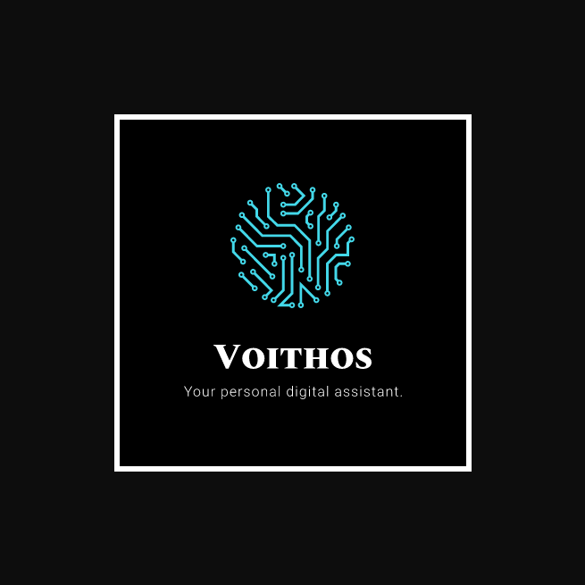
Voithos Assistant Project (Project VAPr)
-ais-v

Slide 2
Our Vision for The Voithos Assistant Programme
A secondary, aim behind applying for the Voithos Project is to delocalize the market for consumer grade personal assistants.
Voithos would not only offer the features that every other major assistant out there does, but it would also enable the front-end user to have a greater control of their privacy.
There will be no paid services or unnecessary ads.
The service will only be supported by donations and ‘Intelligent Ads’
Personalised Ads? NO. It’s different.
We also plan to expand the assistant to fields beyond personal uses.
With this project as the foundation, we aim to develop a commercial artificial intelligence based environment.

Slide 3
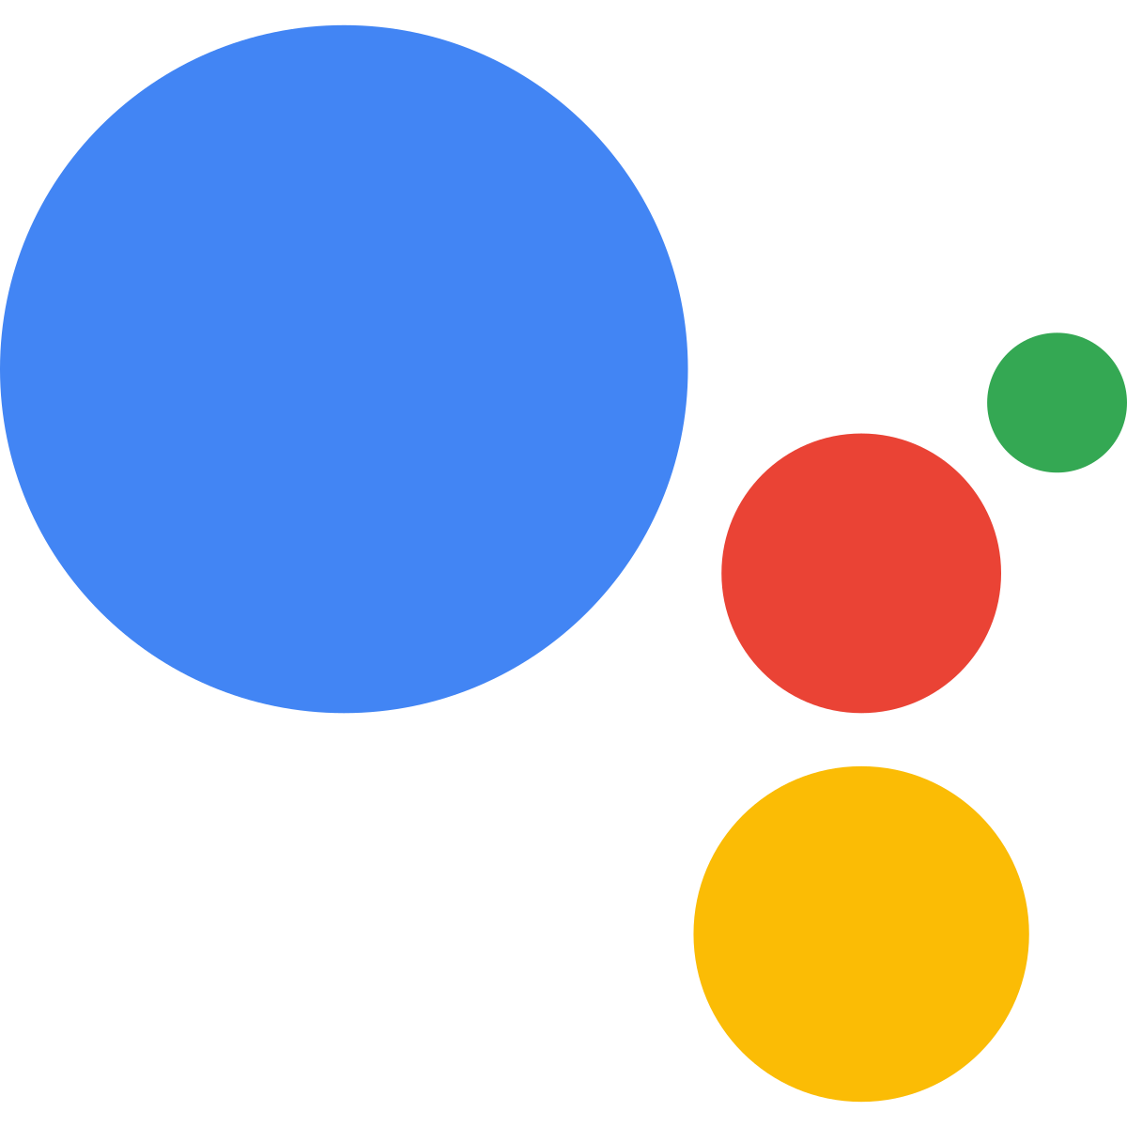

Too accustomed to your old assistant? No problem, we got you covered.
Ezee Switch Technology
The Ezee Switch technology can transfer all your personalized settings and data from your old assistant to the new one.
You just have to tell your assistant to retrieve your data from your device. We don’t store your data at multiple places only to sell it out later.

Slide 4
Analytics for the Voithos Assistant
Our analysis shows a very promising future for the project leading to growth for both us and the partner companies

Slide 5
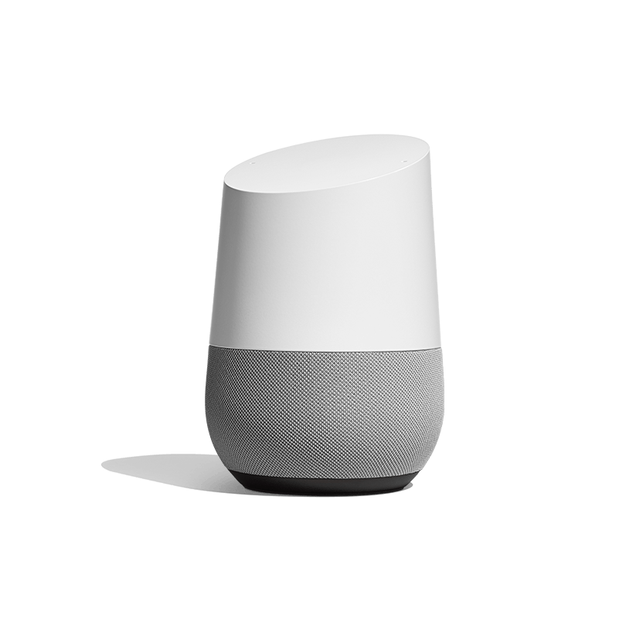
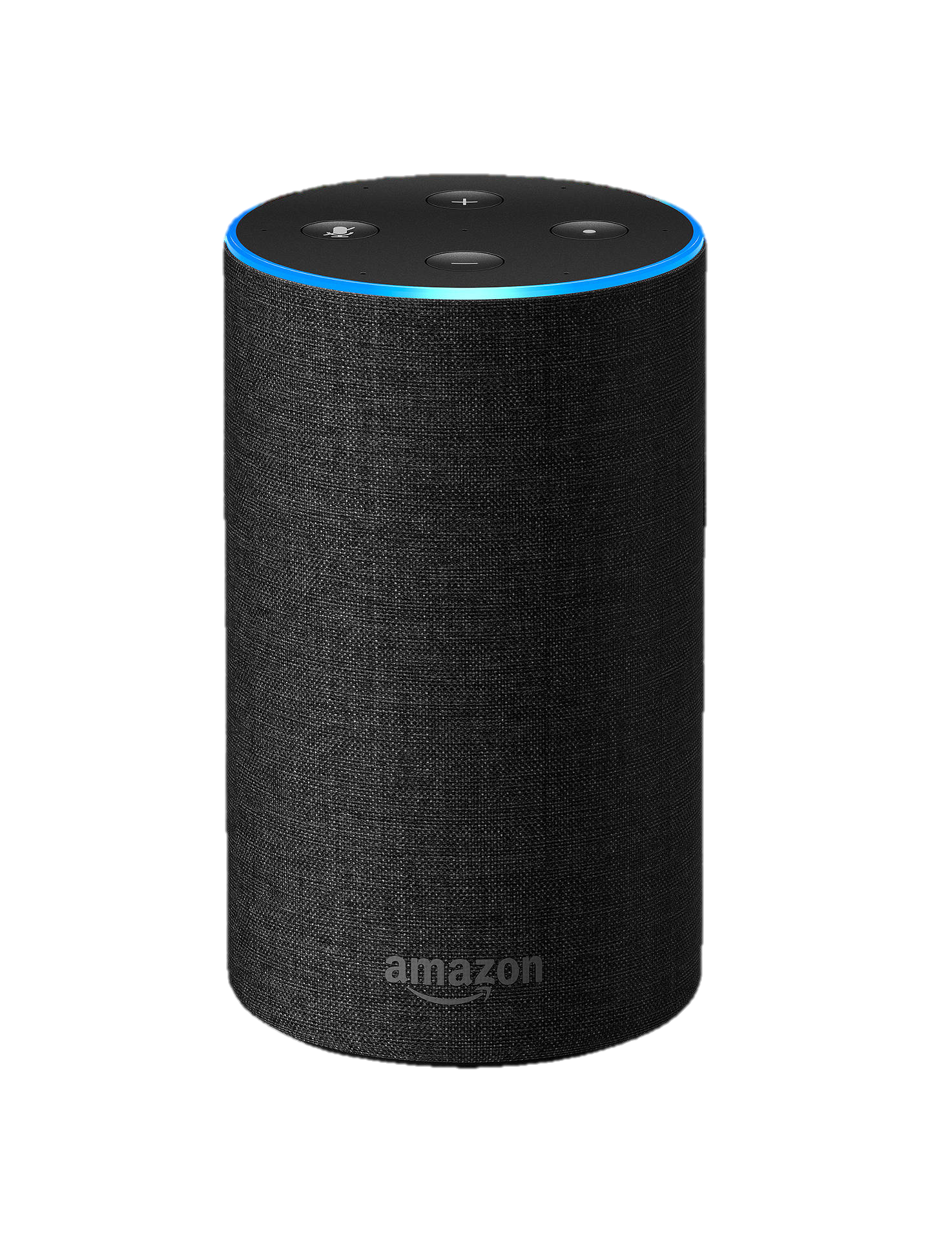
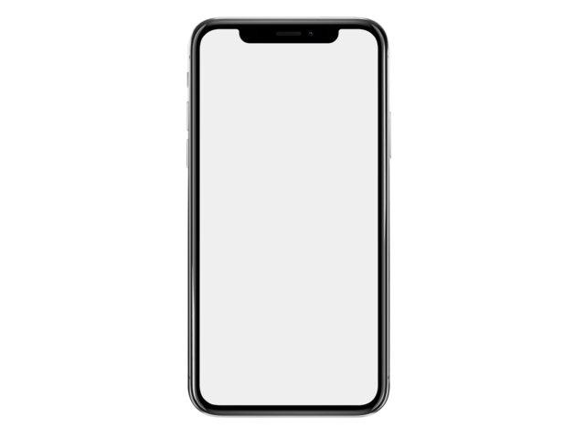
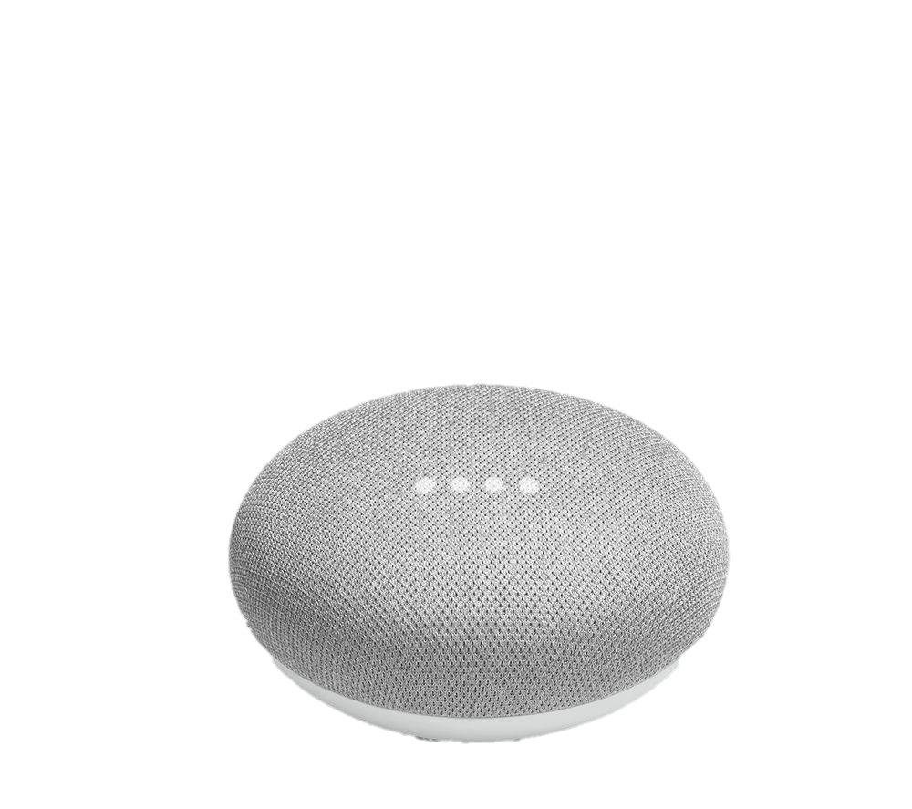
We like to keep it simple. No extra speakers.
We don’ tell you to buy our stuff for a better experience.
Why waste your hard-earned money when you can invest it at better places?
Besides, your phone can do it all. From dimming lights to playing your favorite melodies at bedtime, our assistant can do it all, ONLY WITH THE PHONE
This stuff? Seriously??

Slide 6


Official Partners
(Because it is about trust…)

