Slide 2
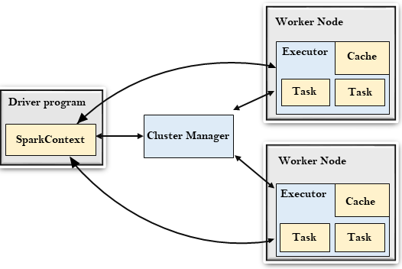

Slide 3
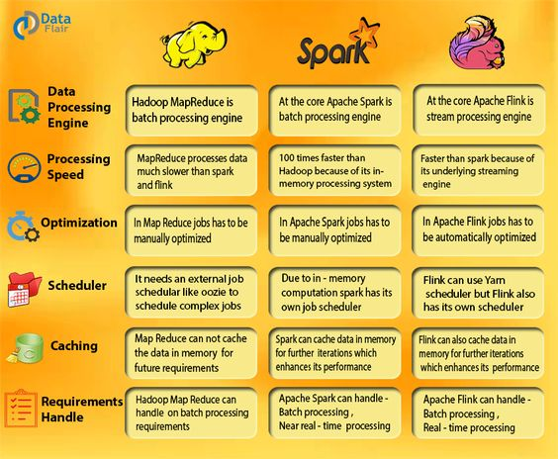
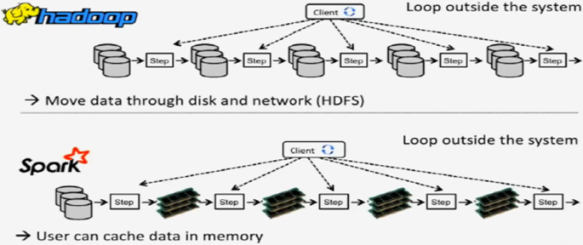

Slide 4
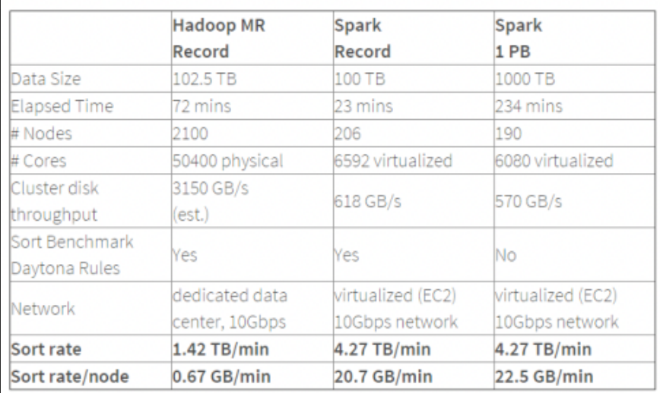
WORLD RECORD

Slide 5
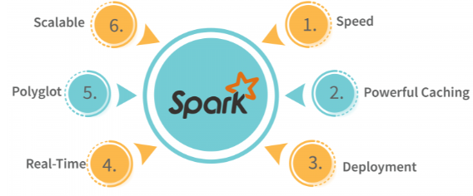
Speed: Spark performs up to 100 times faster than MapReduce for processing large amounts of data. It is also able to divide the data into chunks in a controlled way.
Powerful Caching: Powerful caching and disk persistence capabilities are offered by a simple programming layer.
Deployment: Mesos, Hadoop via YARN, or Spark’s own cluster manager can all be used to deploy it.
Real-Time: Because of its in-memory processing, it offers real-time computation and low latency.
Polyglot: In addition to Java, Scala, Python, and R, Spark also supports all four of these languages. You can write Spark code in any one of these languages. Spark also provides a command-line interface in Scala and Python

Slide 6
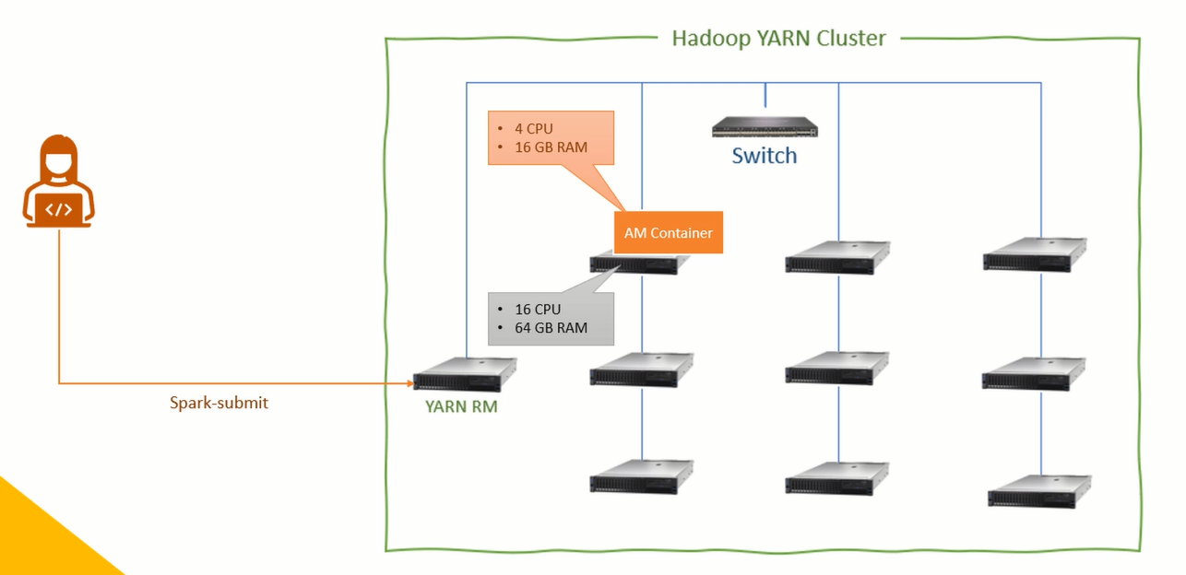
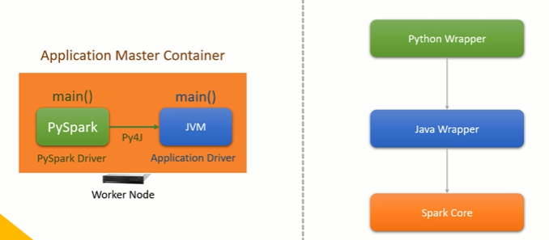

Slide 7
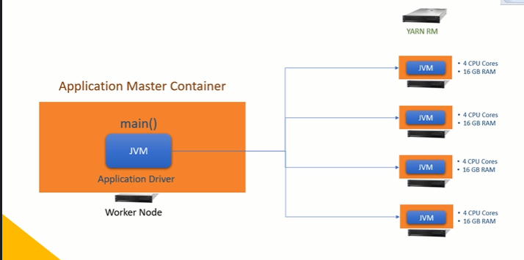
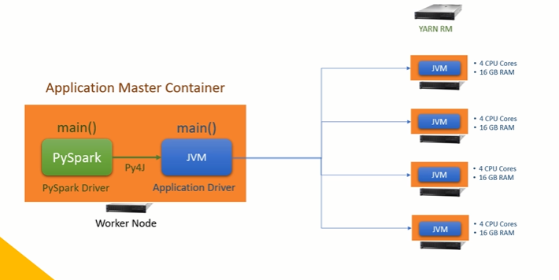
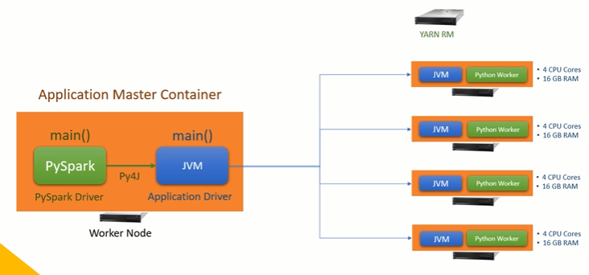

Slide 8
