Slide 1
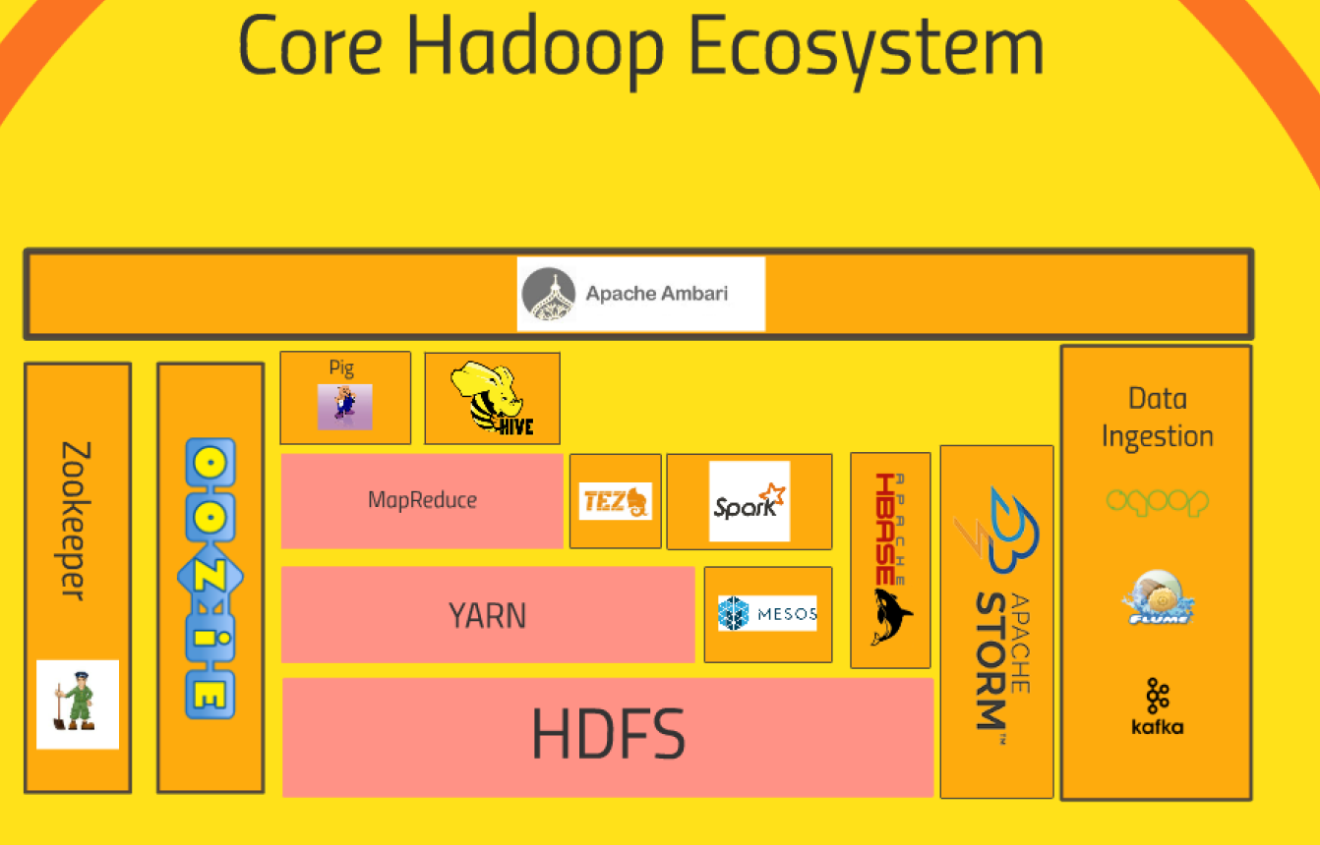
YET ANOTHER RESOURCE NEGOTIATOR
HADOOP DISTRIBUTED FILE SYSTEM

Slide 2

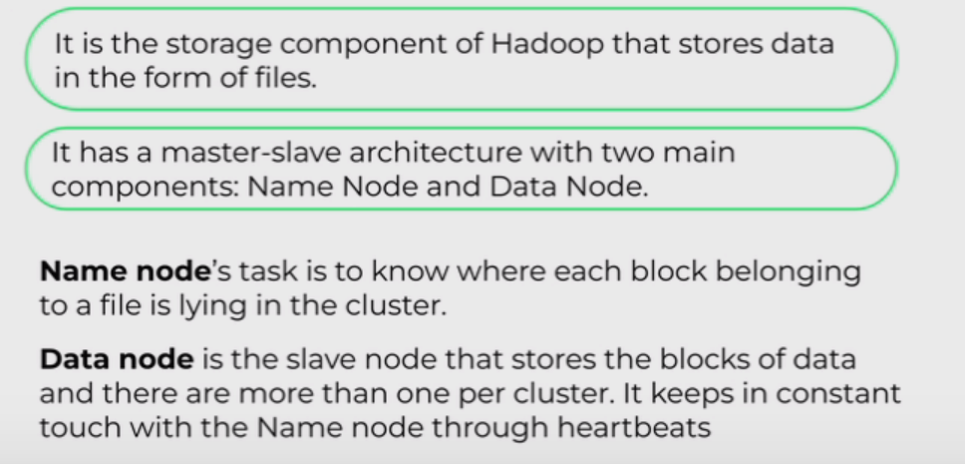
What are the benefits of using HDFS?
There are five main advantages to using HDFS, including:
Cost effectiveness. The DataNodes that store the data rely on inexpensive off-the-shelf hardware, which cuts storage costs. Also, because HDFS is open source, there's no licensing fee.
Large data set storage. HDFS stores a variety of data of any size -- from megabytes to petabytes -- and in any format, including structured and unstructured data.
Fast recovery from hardware failure. HDFS is designed to detect faults and automatically recover on its own.
Portability. HDFS is portable across all hardware platforms, and it is compatible with several operating systems, including Windows, Linux and Mac OS/X.
Streaming data access. HDFS is built for high data throughput, which is best for access to streaming data.

Slide 3
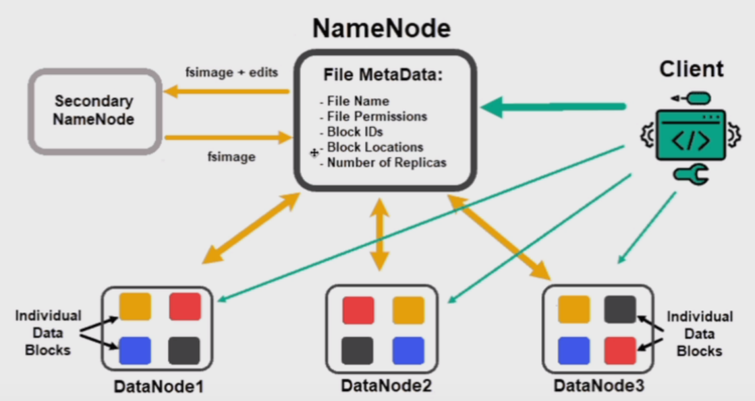

Slide 4
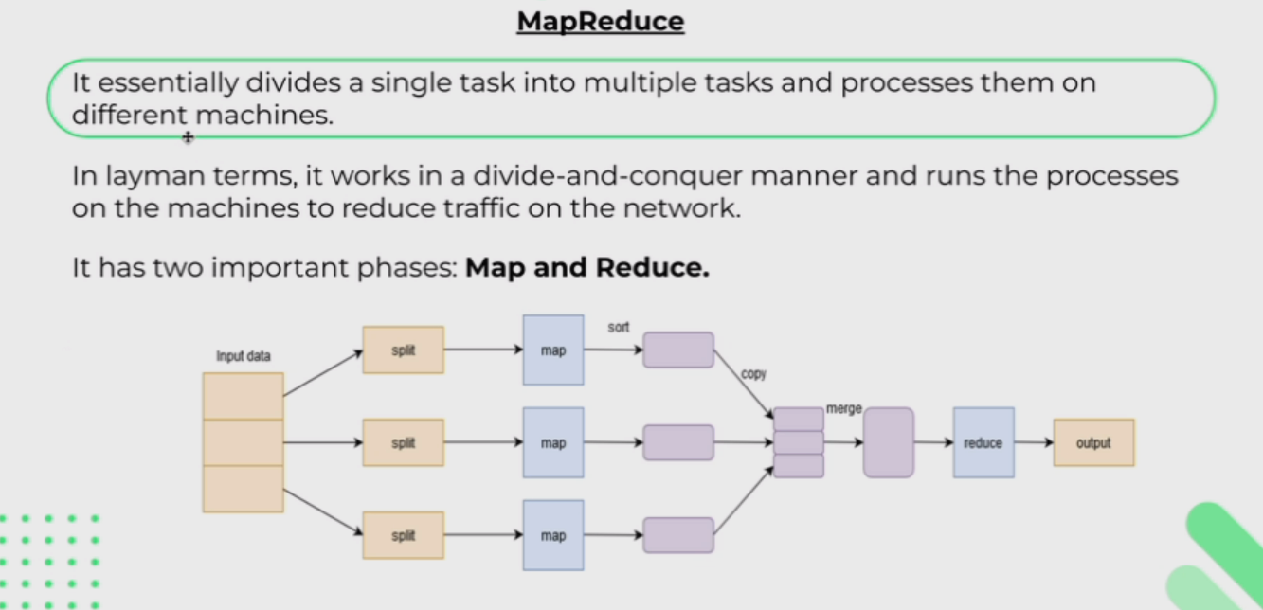

Slide 5
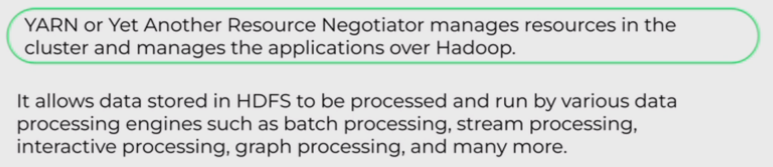
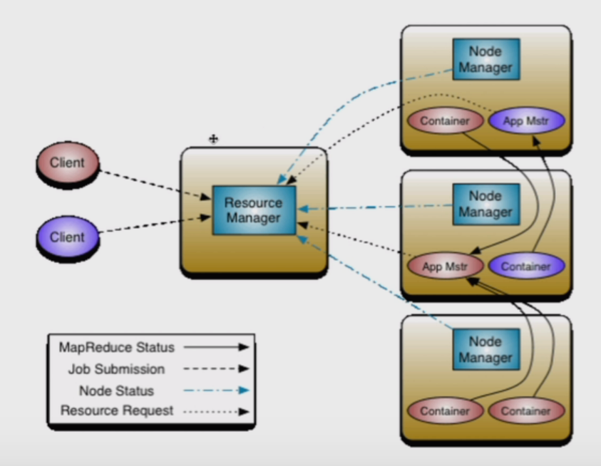

Slide 6


