Slide 1
DIGITAL PORTFOLIO:
~~~~~~~~~~~~~~~~~~~~~~~~~~~~~~~~~~~~~~~~~~~~~~~~~~~~~~~~~~~~~~~~~~~~~~~~~~~~
✨NAME :Mahalakshmi. V
✨REGISTER NO AND NM ID:346m24U09053
✨DEPARTMENT :BCA-’A’
✨COLLEGE AND UNIVERSITY NAME :*M. M. E. S Women’s art’s and science college Melvisharam/THIRUVALLUVAR UNIVERSITY.

Slide 2
1. Problem StatemENT
🫴The problem statement defines the issue or challenge that your project aims to solve.
🥰For example: 🫴“Create a user-friendly and visually appealing portfolio website to showcase my skills, projects, and experience as a web developer.”

Slide 3
2. Project Overview :
❤️ The project overview provides a brief description of your project, including its purpose, goals, and target audience.
❤️For example:"My portfolio website is designed to showcase my web development skills, projects, and experience to potential employers, clients, and collaborators.
❤️The website will feature a clean and modern design, easy navigation, and interactive elements to engage visitors."

Slide 4
3. End Users:
🔥The end users section identifies the target audience for your project.
🔥 For example:"The target audience for my portfolio website includes:Potential employersClientsCollaboratorsPeers and industry professionals“

Slide 5
4.❤️Tools and TechnologiesThe tools and technologies section lists the software, programming languages, frameworks, and libraries used to build your project.
❤️For example:"The tools and technologies used to build my portfolio website
include:
❤️ HTML5CSS3JavaScriptReactBootstrapGitHub Pages"

Slide 6
5.Portfolio Design and Layout:
💖portfolio design and layout section describes the visual design and layout of your website.
💖For example: "My portfolio website features a modern and minimalist design with a focus on showcasing my projects and skills.
💖The layout is clean and easy to navigate, with a responsive design that adapts to different screen sizes and devices."

Slide 7
6. Features and Functionality:
🖤The features and functionality section lists the key features and functionalities of your website.
🖤For example:"My portfolio website includes the following features and functionalities:Project showcase with images and descriptionsSkills and experience sectionContact form and social media linksResponsive design for mobile and tablet devicesInteractive elements such as animations and
transitio

Slide 8
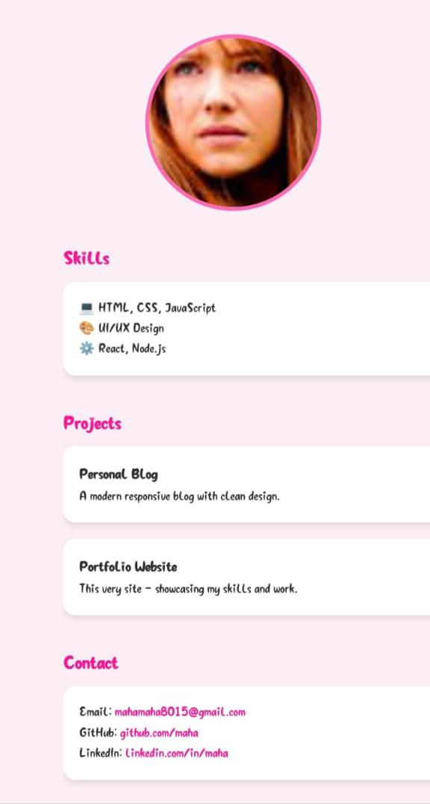
7.The Result and Screenshot:
🐿️The result and screenshot section showcases the final result of your project, including screenshots or images of your website.
🐿️ For example:"Here is a screenshot of my portfolio website's homepage:[Insert screenshot]

Slide 9
8. Conclusion:
💗The conclusion section summarizes the key takeaways from your project and reflects on what you learned or achieved.
💗For example:"In conclusion, my portfolio website is a successful showcase of my web development skills and experience.
💗 I learned a lot about designing and building a responsive website, and I'm proud of the final result.“

Slide 10
9. GitHub Link:
🐣 The GitHub link section provides a link to your project's GitHub repository.
🐣For example:"You can view the source code for my portfolio website on GitHub: https://github.com/your-username/your-repo-name“

Slide 11
Thank you ✨

