Slide 1
NUTRITION AGENT
CAPSTONE PROJECT
Presented By:
Student name : MAHAPRASAD SAHOO
College Name : GITA AUTONOMOUS COLLEGE, BHUBANESWAR
Department : Master in Computer Applications (MCA)

Slide 2
OUTLINE
Problem Statement
Technology used
Wow factor
End users
Result
Conclusion
Git-hub Link
Future scope
IBM Certifications

Slide 3
PROBLEM STATEMENT
In today’s health-conscious world, individuals seek personalized nutrition guidance tailored to their goals, medical needs, and cultural preferences. However, most existing tools provide generic diet plans that fail to consider key factors like food allergies, chronic conditions (e.g., diabetes, hypertension), regional eating habits, and evolving fitness goals.
Moreover, these tools lack real-time adaptability, and users rarely receive explanations or justifications for the recommendations provided — making it difficult to trust or follow them consistently.
Meanwhile, dieticians and nutritionists face challenges in scaling personalized consultations due to time and resource limitations, leaving a large number of people underserved.
Proposed Solution: An AI-powered Nutrition Agent that uses Natural Language Processing (NLP) and Generative AI to interact with users via chat, understand their health profiles, preferences, and goals, and deliver personalized meal plans, intelligent food swaps, and contextual nutritional explanations — adapting dynamically to user feedback and daily needs.

Slide 4
TECHNOLOGY USED
The Nutrition Agent leverages advanced AI technologies and IBM Cloud services to deliver real-time, personalized dietary guidance through a chat interface. The key technologies used are:
1. IBM Cloud Lite Services
IBM Cloud Lite provides the cloud infrastructure for deploying and hosting the Nutrition Agent. It offers:
Scalable compute and storage resources
Access to IBM's AI models and services
Seamless integration with Watsonx and Granite foundation models
2. Natural Language Processing (NLP)
NLP is used to:
Understand user queries in natural language
Extract relevant information (e.g., dietary goals, food preferences, allergies)
Enable smooth and contextual conversations between the user and the AI agent
3. Retrieval-Augmented Generation (RAG)
While this project does not use a vector database, the RAG-inspired structure helps the agent:
Reason through multiple steps using structured flows
Simulate grounded responses by referencing pre-modeled dietary logic and prompts
Improve answer quality through task decomposition and response synthesis

Slide 5
4. IBM Granite Model – granite-3-3-8b-instruct
This instruction-tuned large language model is the core engine powering the Nutrition Agent. It enables:
High-quality, context-aware, and informative response generation
Reasoning and decision-making using the ReAct (Reasoning + Acting) framework
Support for diverse tasks like meal planning, food substitution, and fitness-related advice

Slide 6
IBM CLOUD SERVICES USED
The Nutrition Agent project utilizes key IBM Cloud services to develop, deploy, and manage the AI assistant effectively. These services provide the foundation for building a robust, scalable, and intelligent system.
1. IBM Cloud Watsonx AI Studio
Used to design and manage AI workflows
Allows integration of the Granite foundation model within prompt flows
Provides an interactive environment for experimentation, chaining, and testing of model outputs
2. IBM Cloud Watsonx AI Runtime
Executes the deployed Granite models in a scalable environment
Supports real-time inference of AI responses through APIs
Ensures low-latency, secure, and high-availability access to the model
3. IBM Cloud Agent Lab
Serves as the orchestration environment for deploying intelligent agents
Provides tooling for managing agent behavior, conversation flow, and debugging
Supports LangGraph integration for task-routing and logic chaining
4. IBM Granite Foundation Model (granite-3-3-8b-instruct)
The central AI model used for generating personalized meal plans, food swaps, and explanations
Trained and hosted within IBM’s trusted AI environment
Tuned for instruction-following, reasoning, and high-quality natural language generation

Slide 7
WOW FACTORS
This agent significantly improves access to personalized nutrition guidance, enabling users to make healthier choices effortlessly. It eliminates the need for manual meal planning and generic advice by offering intelligent, adaptive, and culturally relevant dietary suggestions.
Unique Features:
Context-aware Meal Planning : Generates daily meal plans tailored to user goals, medical conditions, and preferences.
Interactive Food Swaps with Explanations : Suggests healthier alternatives along with the reason behind each substitution.
Natural Language Conversation : Users can interact just like they would with a human dietician, using simple chat commands.
Real-Time Personalization : Adapts dynamically based on user feedback, likes/dislikes, and fitness goals.
Goal-Oriented Guidance : Supports use cases like weight loss, muscle gain, or lifestyle improvement with appropriate nutritional support.
No Appointment Needed : Offers 24/7 access to intelligent nutritional assistance — scalable and on-demand.

Slide 8
END USERS
The Nutrition Agent is designed to serve a wide range of individuals and institutions seeking intelligent, personalized nutrition guidance. Its adaptability and accessibility make it valuable for both personal and professional use.
1. Health-Conscious Individuals
People aiming to manage weight, improve fitness, or follow a healthier lifestyle
Users with specific dietary restrictions or medical conditions like diabetes, PCOS, or hypertension
2. Healthcare & Nutrition Professionals
Dieticians and nutritionists can use the agent as a support tool to scale personalized advice
Wellness coaches, fitness trainers, and lifestyle consultants
3. Educational Institutions
Schools and universities can integrate the agent into health awareness programs
Students studying dietetics, healthcare, or AI applications in health
4. Corporate Wellness Programs
HR departments can offer it as part of employee well-being initiatives
Companies promoting healthy living through internal platforms

Slide 9
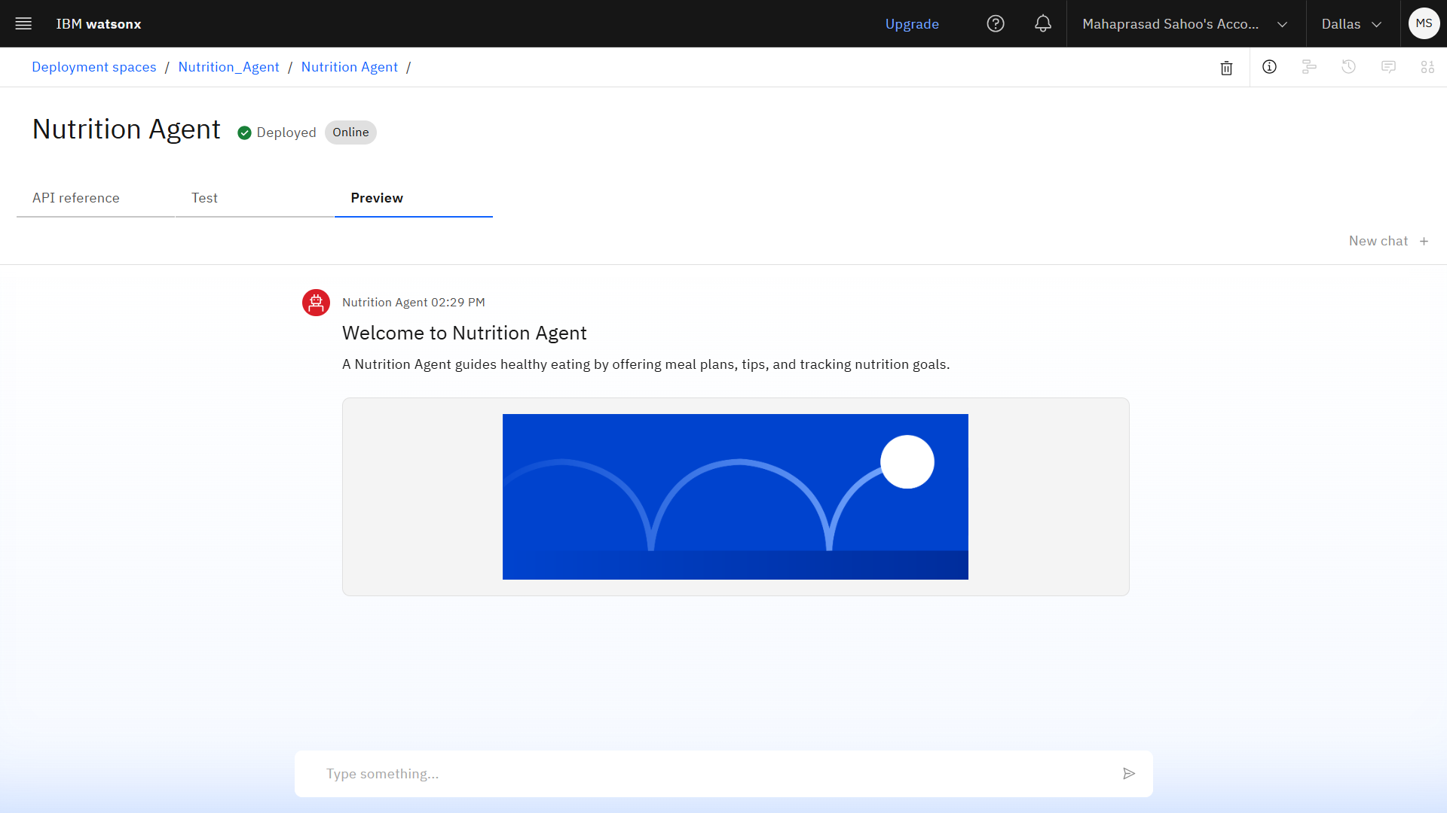
RESULTS

Slide 10
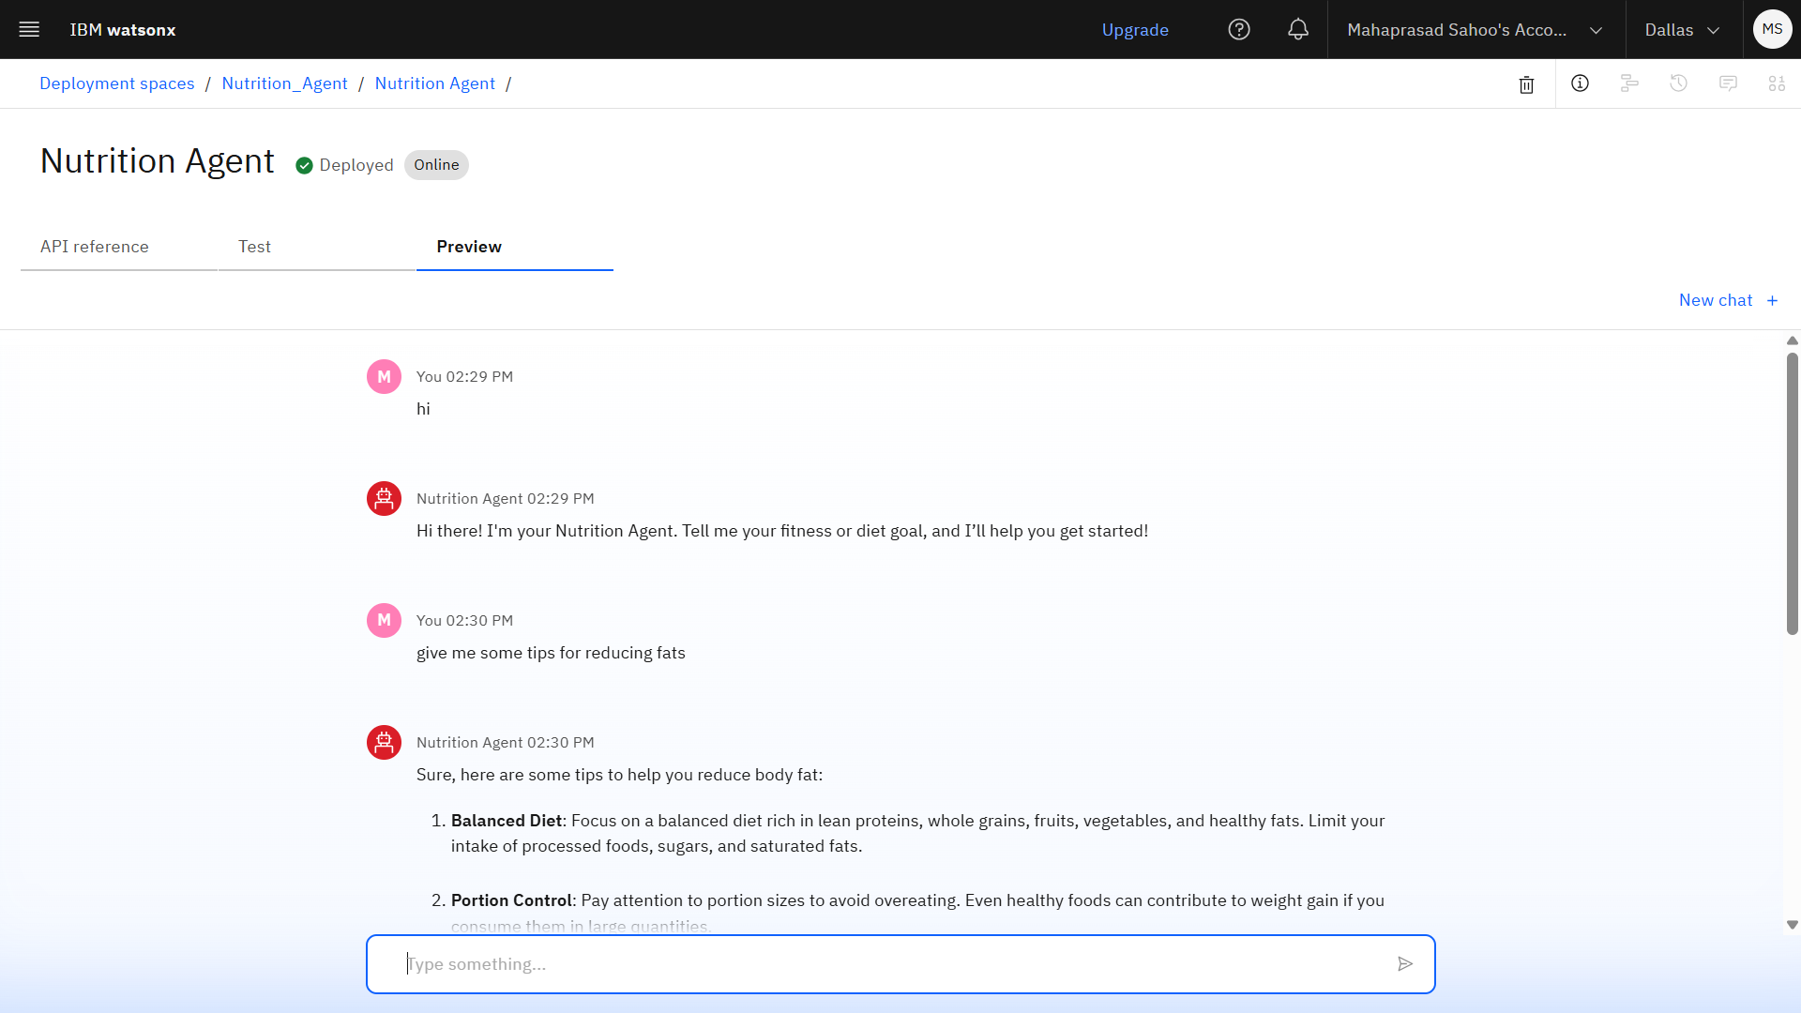
RESULTS

Slide 11
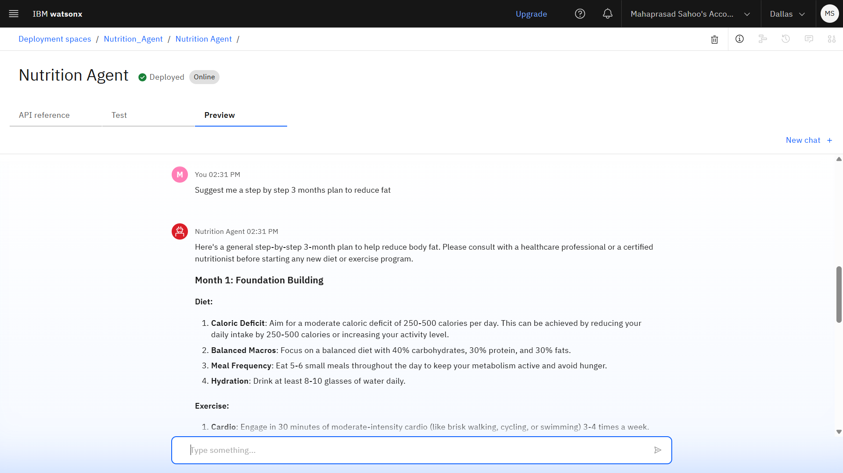
RESULTS

Slide 12
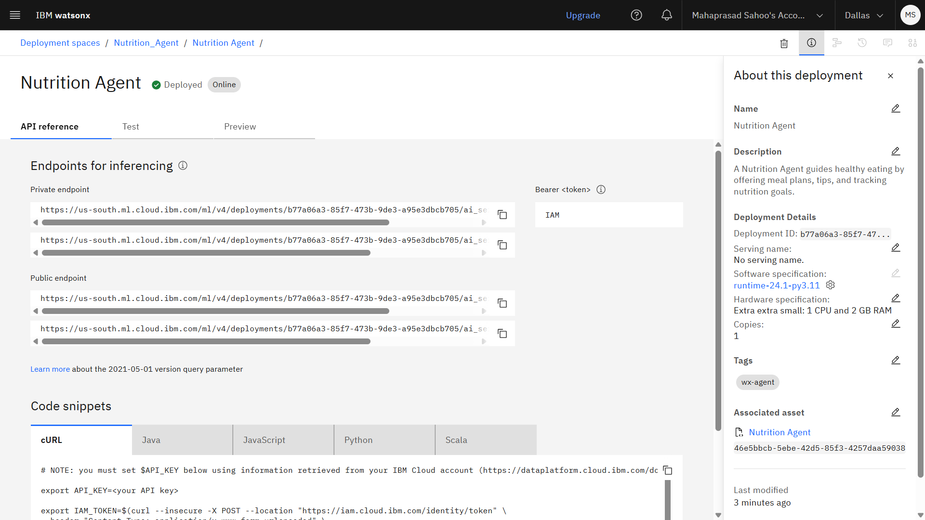
DEPLOYED AI AGENT

Slide 13
CONCLUSION
The Nutrition Agent demonstrates how generative AI can revolutionize the way individuals access and manage their nutritional health. By leveraging Natural Language Processing, instruction-tuned LLMs, and structured reasoning through Langraph and ReAct, the agent is capable of generating dynamic meal plans, healthy food alternatives, and goal-aligned dietary recommendations.
Unlike traditional diet applications, this system offers:
Personalized and adaptive responses tailored to user health profiles
Contextual explanations that help users understand why a suggestion is being made
A conversational, user-friendly experience without the need for scheduled consultations
It significantly reduces the time and cognitive load associated with manual diet tracking, while promoting healthy lifestyle choices through intelligent automation.
In the long term, this approach can enhance preventive healthcare, support chronic condition management, and make expert-level nutrition guidance accessible to all—scaling far beyond what human professionals can deliver alone.

Slide 14
FUTURE SCOPE
The Nutrition Agent can be further enhanced to support a wider range of user needs, technologies, and platforms. Potential future developments include:
Multilingual Support : Enable the agent to understand and respond in multiple regional and international languages to serve a broader audience.
Voice-Activated Nutrition Assistant : Integrate voice input/output to allow hands-free interaction, especially useful for visually impaired or busy users.
Real-Time Collaboration with Healthcare Providers : Enable data sharing with dieticians, fitness coaches, or doctors for integrated care and expert review.
Advanced Nutrition Gap Detection : Use AI to identify missing nutrients, unhealthy patterns, or risks in users’ diets, and suggest focused improvements.
Integration with Health and Fitness Platforms : Sync with apps like Fitbit, Google Fit, or Apple Health to adjust recommendations based on activity, vitals, and real-time biometrics.
AI-Assisted Diet Report Generation : Automatically generate weekly nutrition reports, calorie breakdowns, and recommendations for improvement based on ongoing usage.

Slide 15
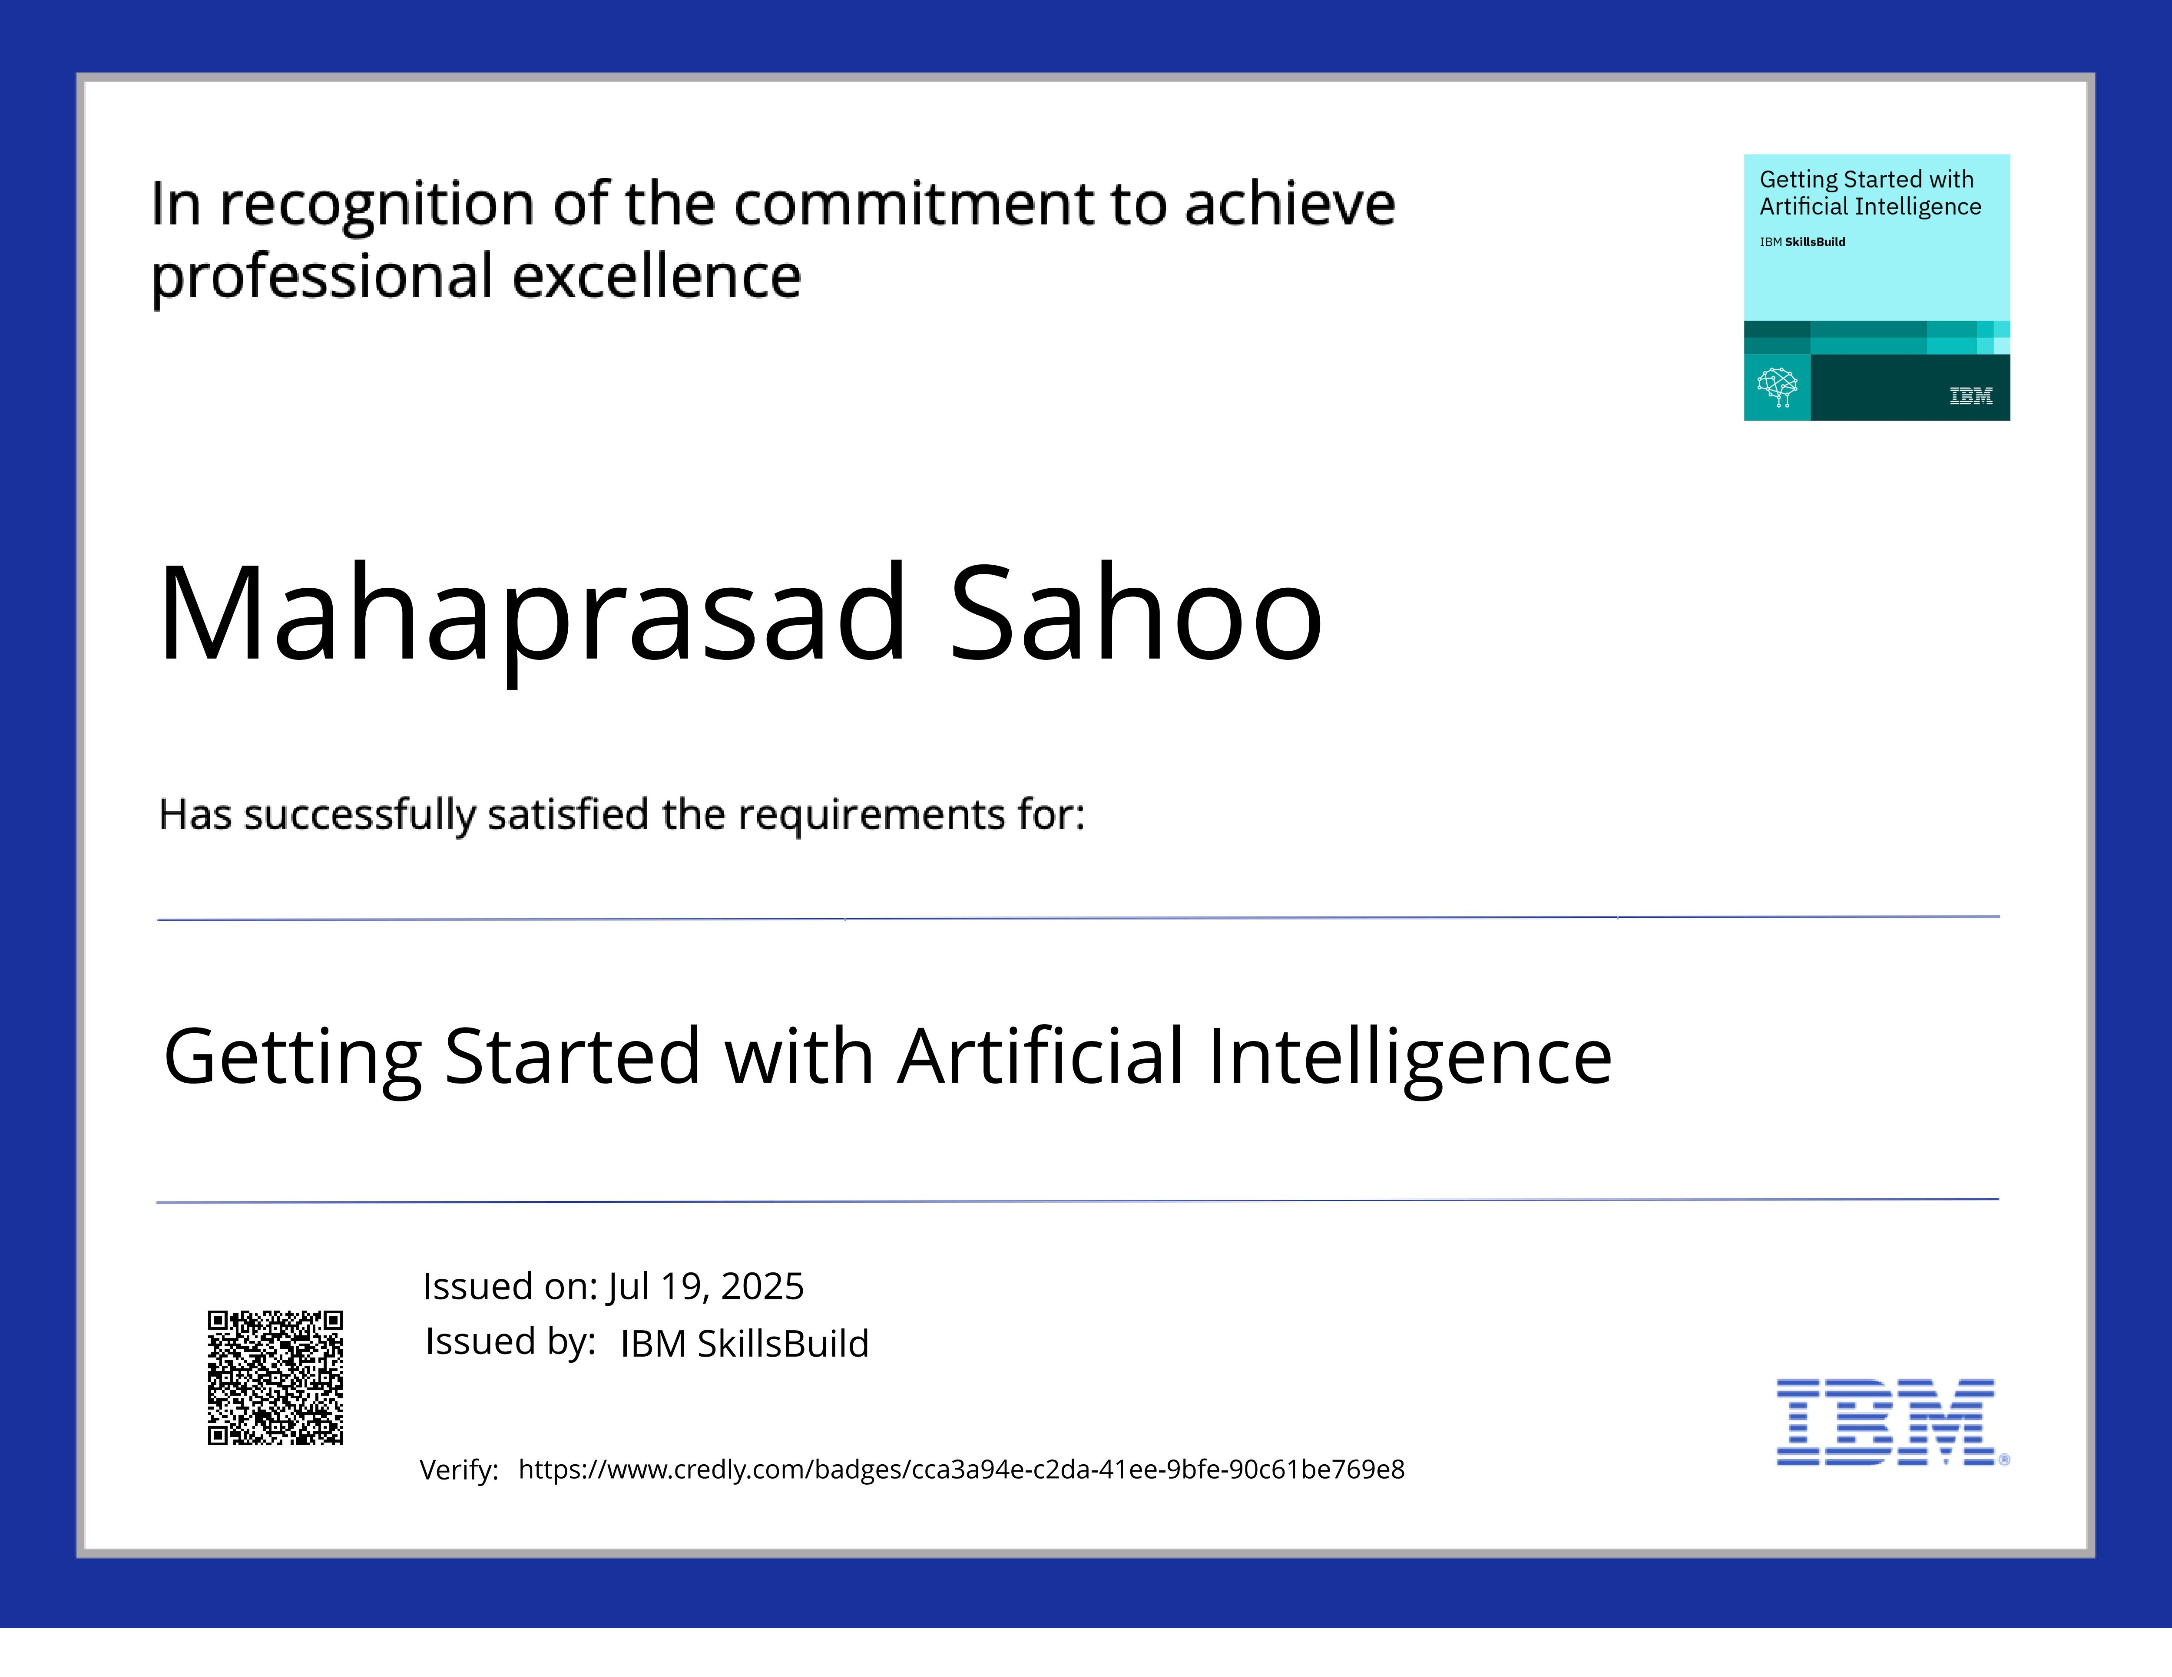
IBM CERTIFICATIONS
1. GETTING STARTED WITH AI

Slide 16
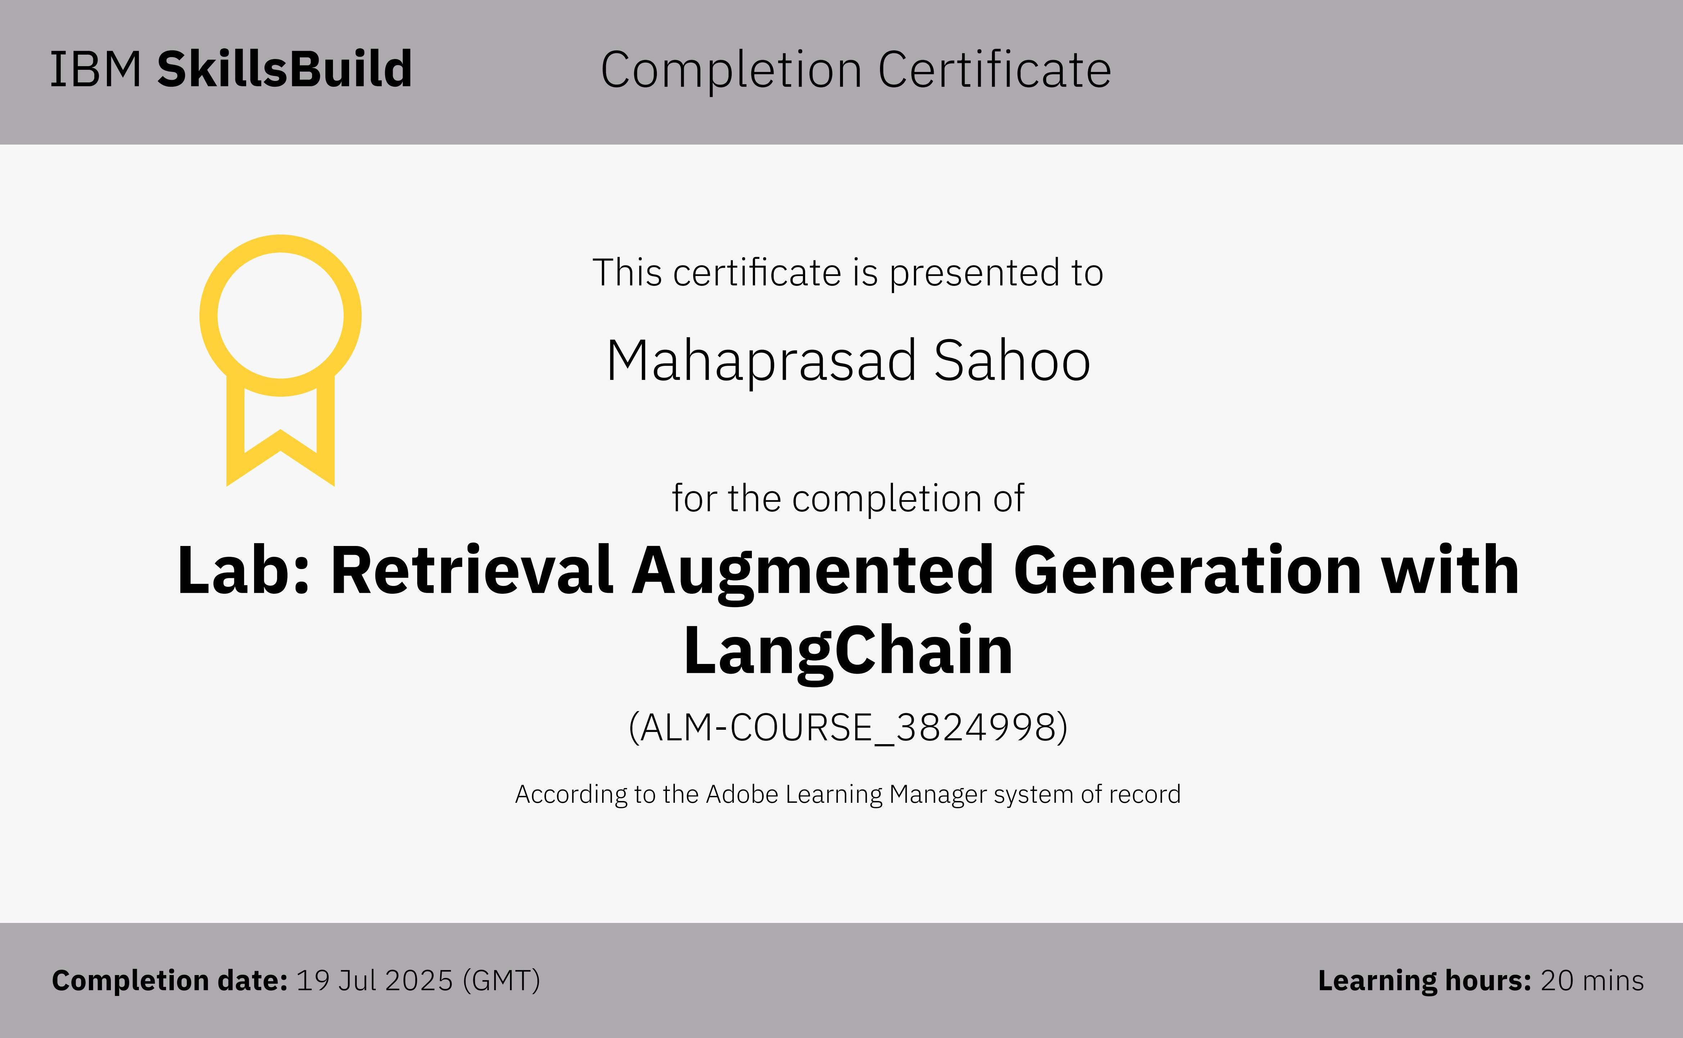
2. RAG LAB CERTIFICATE

Slide 17
GITHUB LINK
GitHub Repo Link : https://github.com/mahaprasadsahoo12/Nutrition_Agent

Slide 18
THANK YOU

