Slide 1
GYM MEMBERSHIP & FITNESS
ANALYTICS USING SQL
Analysis of Members, Memberships, Revenue, Attendance & Fitness Activity
Presented By: S.Maharaja Nadar

Slide 2
Project Introduction
• This project focuses on analyzing gym membership and fitness data using SQL.
• Understand member demographics, membership plans and status, gym revenue, attendance, workout preferences, activity levels and trainer information.
• Goal: Convert raw gym data into meaningful insights that help improve member engagement, retention and revenue.
2

Slide 3
Dataset Overview
Table | Records | Purpose
Members | 150 | Member details
Plans | 150 | Membership plan details
Memberships | 150 | Membership transactions
Attendance | 150 | Gym attendance & workouts
Trainers | 150 | Trainer information
Total | 750 | Records
4

Slide 4
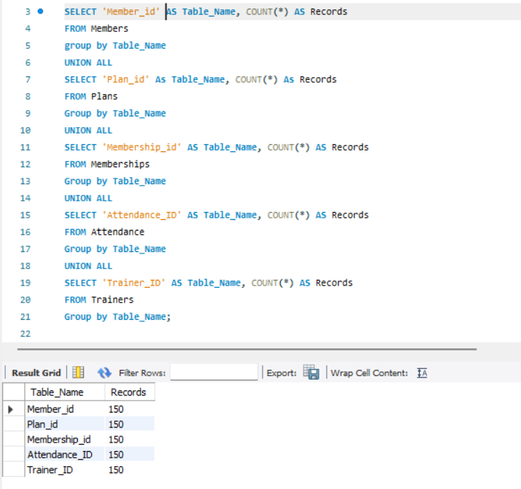

Slide 5
Member Analysis
150
Total Members
36.54 yrs
Average Age
Gender | Members
Male | 75
Female | 75
Fitness Level | Members
Beginner | 50
Intermediate | 50
Advanced | 50
• Equal distribution of male and female members.
• Equal distribution across Beginner, Intermediate and Advanced fitness levels.
6

Slide 6
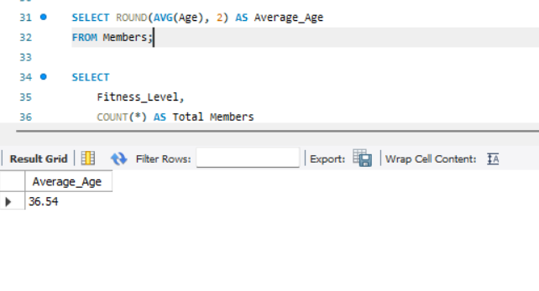
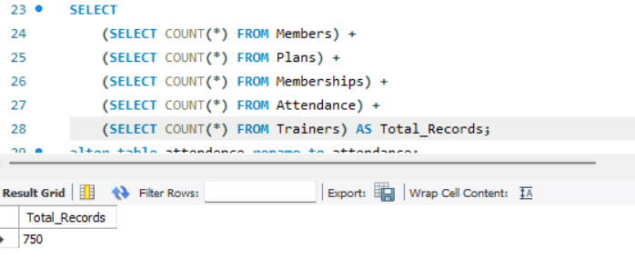
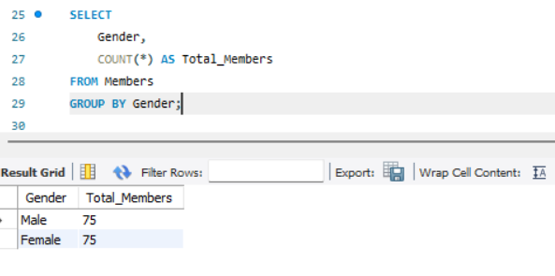
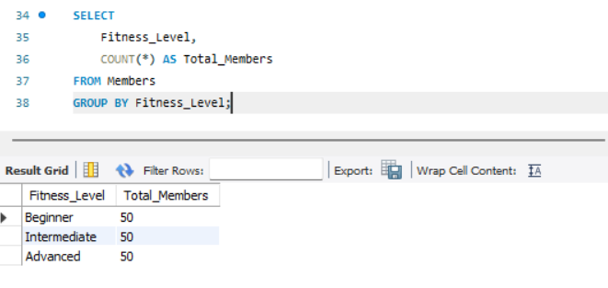

Slide 7
Membership Status Analysis
Membership Status | Count
Active | 90
Expired | 30
Cancelled | 30
Total | 150
60%
Active Membership Rate
• 60% of memberships are currently active.
• 40% are either expired or cancelled.
• Recommendation: Target expired and cancelled members with renewal offers and personalized plans.
7

Slide 8
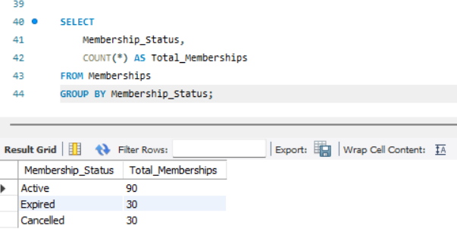
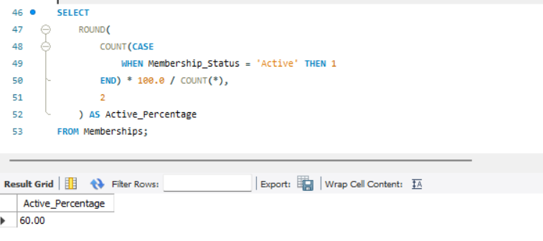

Slide 9
Revenue Analysis
₹9,22,350
Total Membership Revenue
₹6,149
Average Revenue / Membership
Payment Method | Transactions
UPI | 38
Credit Card | 38
Debit Card | 37
Cash | 37
• Revenue can be analyzed by membership plan, duration, payment method and month.
• UPI and Credit Card are the most frequently used payment methods.
8

Slide 10
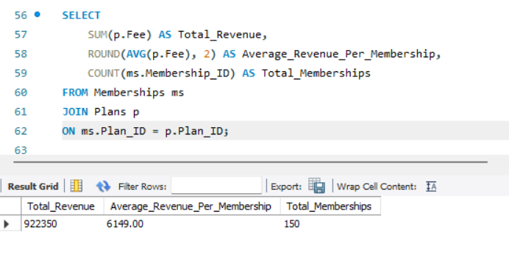
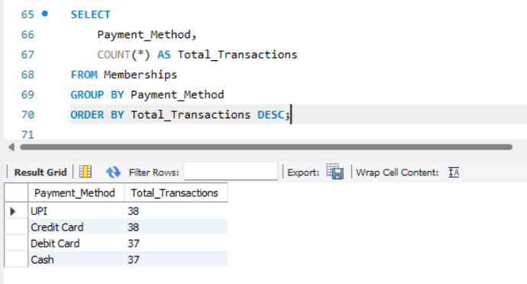

Slide 11
Attendance & Workout Analysis
150
Attendance Records
80.34 min
Average Workout Duration
Workout Type | Records
Strength Training | 30
Cardio | 30
Yoga | 30
Cross Training | 30
Weight Training | 30
• Workout participation is evenly distributed across all five workout types.
• Recommendation: Continue offering a variety of workout programs.
9

Slide 12
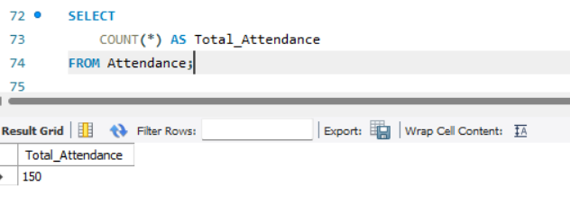
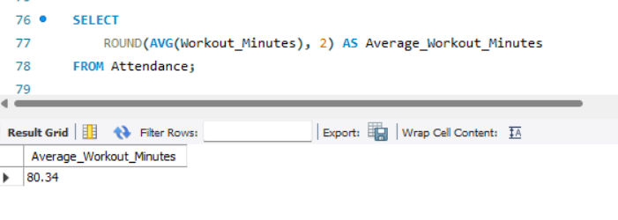
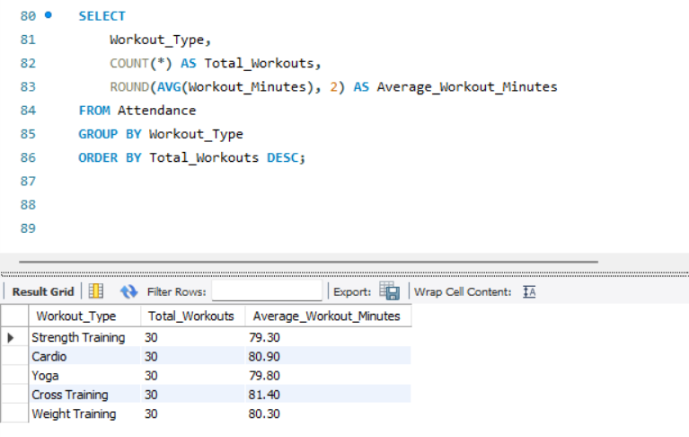

Slide 13
Member Engagement Analysis
Activity Level | Workout Duration | Members
Low Activity | ≤ 45 minutes | 10
Medium Activity | 46–90 minutes | 84
High Activity | > 90 minutes | 56
Total |  | 150
• Most members fall into the Medium Activity category.
• 56 members demonstrate high activity levels.
• Low-activity members can receive personalized fitness plans and trainer guidance.
10

Slide 14
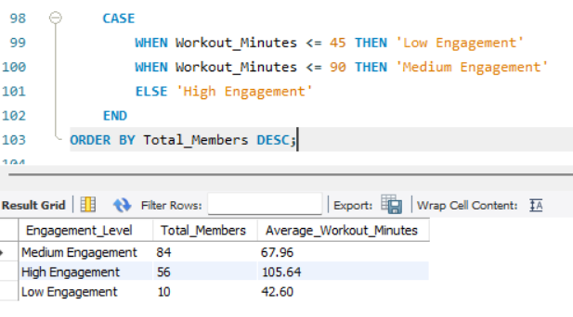

Slide 15
Trainer Analysis
150
Total Trainers
7.03 yrs
Average Experience
₹25,000
Highest Monthly Salary
Specialization | Trainers
Strength | 30
Cardio | 30
Yoga | 30
CrossFit | 30
Functional Training | 30
• Trainer specializations are evenly distributed across five major fitness areas.
• This provides a balanced range of expertise.
11

Slide 16
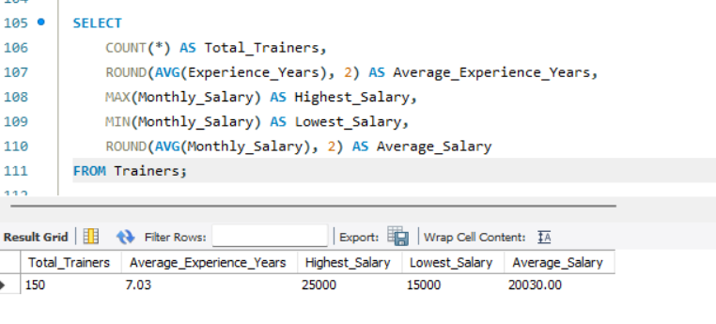
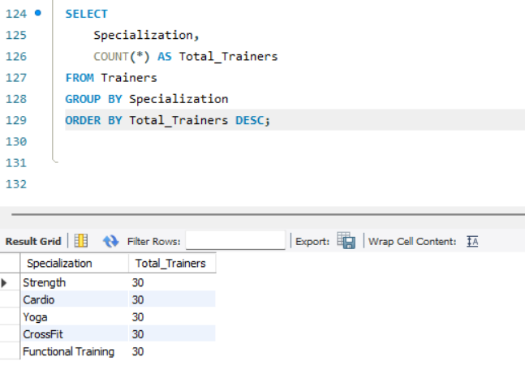

Slide 17
Key Findings
150
Members
90
Active Memberships
₹9,22,350
Revenue
80.34 min
Avg Workout
• Male and female members are equally distributed; average member age is 36.54 years.
• Active membership rate is 60%; 30 memberships are expired and 30 are cancelled.
• Average membership revenue is ₹6,149.
• 84 members are medium activity and 56 members are high activity.
13

Slide 18
Conclusion
• The Gym Membership & Fitness Analytics project demonstrates how SQL can analyze real-world business data.
• The project successfully analyzed member demographics, membership status, revenue, payment methods, attendance, workout preferences, member activity and trainer information.
• SQL transforms raw gym data into meaningful insights that support better business decisions, improve member engagement and increase revenue.
15

Slide 19
THANK YOU
Gym Membership & Fitness Analytics Using SQL
16

