Slide 1
Empowering Financial Security
Detecting Fraudulent Transactions using Advanced Machine Learning Techniques and Predictive Analytics
Presented by Sunil Maharana

Slide 2

Transforming Finance with Machine Learning: A Case Study of Our Predictive Model
Overview of Fraud Detection: This presentation highlights the application of machine learning in the financial sector, showcasing the development and impact of our predictive model on operational efficiency and strategic decision-making.
Importance in Financial Security: Machine learning enhances fraud detection in finance by improving accuracy, scalability, and speed. It automates processes, reduces false positives, adapts to new fraud tactics, aids regulatory compliance, and integrates with risk management, offering a comprehensive and efficient approach to preventing fraudulent transactions.
Photo by rupixen.com on Unsplash

Slide 3

Problem Statement
Definition of the Problem: Develop a machine learning model to detect potentially fraudulent transactions based on the provided features.
Objectives: Classify transactions as legitimate or potentially fraudulent based on features such as account age, payment method, transaction time, and category.
Photo by Manfred Vogel on Unsplash

Slide 4

Data Overview
Description of the Dataset: The dataset contains information about various transactions including account age, payment method, transaction time, and category. There are 8 columns and 38,662 rows.
Key Features: -
AccountAgeDays: Days since the account was created.
NumItems: Number of items associated with the account.
LocalTime: Local time of the transaction.
PaymentMethod: Method of payment (e.g., PayPal, store credit, credit card).
PaymentMethodAgeDays: Days since the payment method was linked to the account.
IsWeekend: Indicator if the transaction occurred on a weekend.
Category: Category of the transaction (e.g., electronics, shopping, food).
Label: Binary label indicating if the transaction is legitimate (0) or potentially fraudulent (1).

Slide 5
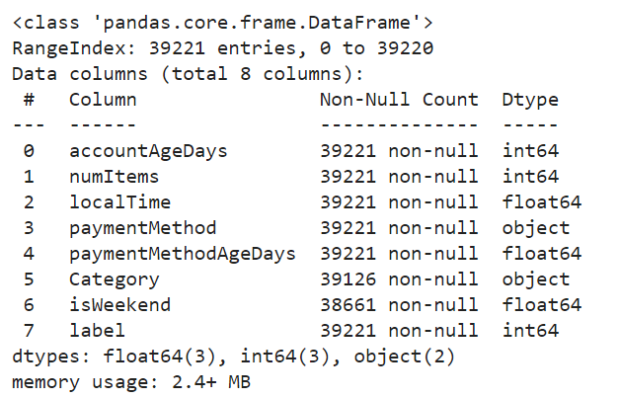
Data Overview
Description of the Dataset: The dataset contains information about various transactions including account age, payment method, transaction time, and category. There are 8 columns and 38,662 rows.
It has eight features.
‘paymentMethod’ & ‘Category’ are categorical feature
Remaining all features are of integer/float datatypes

Slide 6
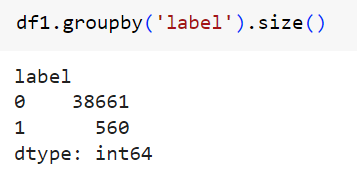
Data Distribution
Insights from Distributions:
The target feature ‘label’ is highly imbalanced. The imbalance ratio of 1:0 is 1:69 times.
Label is highly imbalanced. The imbalance ratio of 1:0 is almost 1:69. With such high imbalance and looking at the problem statement, where False Negative is more important than False Positive, we will be evaluating the models on the basis of their F2 score. And since the value of ‘1’ is only 560, while preprocessing, we will not be dropping any row where ‘label’ is ‘1’ and rather try to remove or impute any other feature where label is ‘1’.
Ratio of 0:1 is 69:1

Slide 7
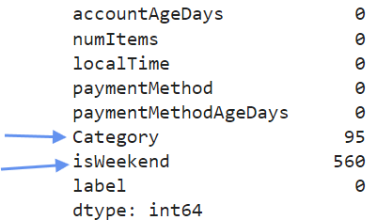
Handling Missing Values
Features with missing values:
Category: 95 rows
isWeekend: 560 rows

Slide 8
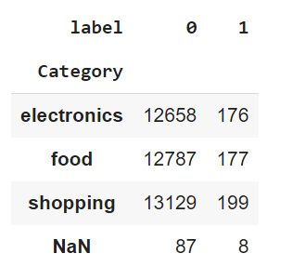
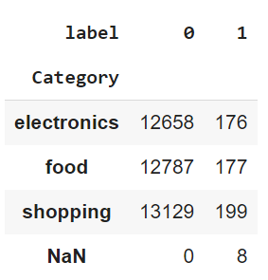
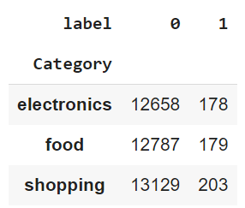
Removal & Imputation of NaN value in feature ‘Category’
We compared the NaN value of Category with ‘label’ features to check the relation between them.
We removed rows where NaN values of ‘Category’ features is where ‘label’ feature is 0.
We then imputed the 8 NaN values of ‘Category’ features where ‘label’ feature is 1 with the unique value of ‘Category’ feature i.e., ‘electronics’, ‘food’ & ‘shopping’.
However, since there were 8 NaN values, we imputed two with ‘electronics’, two more with ‘food’ and remaining 4 with ‘shopping’ because, the value count of ‘shopping’ is more compared to other two categories as evident in the distribution.

Slide 9
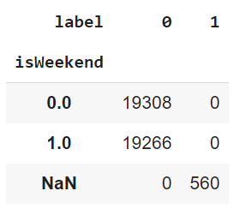
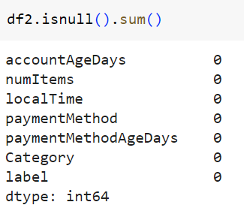
Removing feature ‘isWeekend’
Grouping ‘isWeekend’ feature with ‘label’ feature revealed an interesting fact as shown in the picture.
‘isWeekend’ has NaN value exactly of the amount 560 which is the total count of ‘1’ in feature ‘label’.
We can conclude with the given dataset, that the outcome ‘1’ is completely independent of feature ‘isWeekend’.
Hence, we will remove this feature from our data set
Thus, we conclude the process of handling missing values. Now our dataset doesn’t contain any missing values.

Slide 10
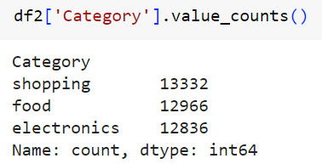
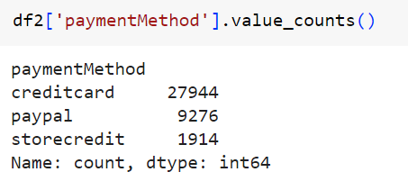
Handling Categorical Values
There are namely two categorical features present in our dataset.
paymentMethod
Category
The data distribution in ‘paymentMethod’ is shown in the picture
The data distribution in ‘Category’ is shown in the picture

Slide 11

Handling Categorical Values
We will impute numerical values against the respective categorical values in each of the features using WoE values.
WoE values indicate the strength of the relationship between each category of the "Category" feature and the likelihood of being a fraudalent transaction. Positive WoE values suggest that the transactoins are more likely to be fraud, while negative WoE values suggest the opposite. WoE encoding replaces the original categories with these WoE values, effectively transforming the categorical feature into a numerical representation that captures the relationship with the target variable.
Formula for WoE value is
Here, P+i is the proportion of positive instance and P-i is the proportion of negative instance of each category in a categorical feature.
We have created series of WoE for each categorical feature and mapped them for replacing them with their WoE values.

Slide 12
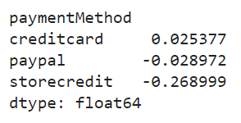
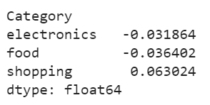
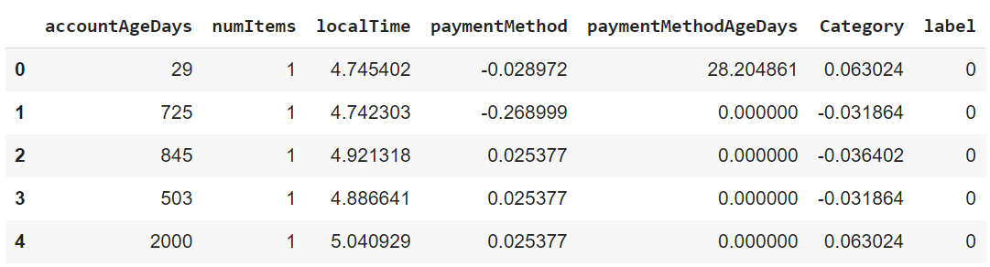
Handling Categorical Values
Woe Value of ‘Category’
WoE Values of ‘paymentMethod’
The final dataframe after imputing the WoE value looks like this where each of the categorical values of the dataset has been handled with their respective WoE values.

Slide 13
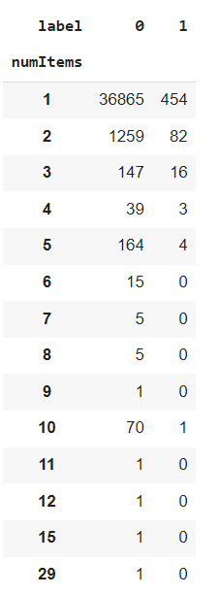
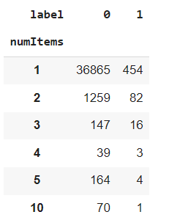
Handling feature ‘numItems’
Grouping this feature with the feature ‘label’ reveals that the value of ‘numItems’ greater than 5 doesn’t have any impact on the outcome of value ‘1’ in the ‘label’ feature except for the value 10.
Further, the value count of numItems greater than 5 is negligible as compared to the whole dataset.
Hence, we have removed all the rows where the value of ‘numItems’ is greated than 5 except value 10.
The remaining rows for the ‘numItems’ gives the following outcome when grouped with ‘label’

Slide 14
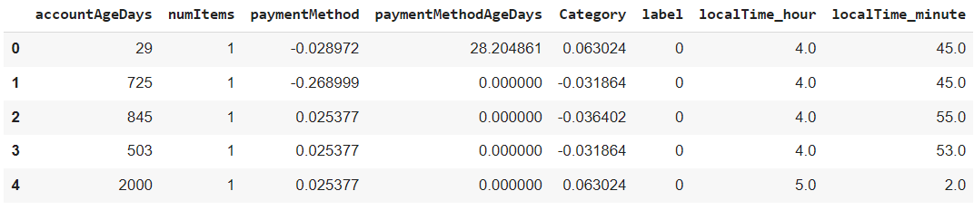
Feature Engineering ‘localTime’
Since ‘localTime’ has value float type and it is in 24 hour format, we have created two new features called ‘localTime_hour’ and ‘localTime_minute’.
Finally we dropped the feature ‘localTime’ from our dataset.
Below is how refined dataset looks like:

Slide 15
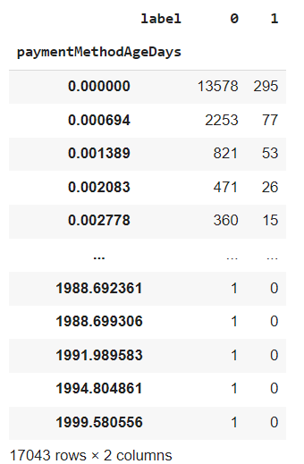
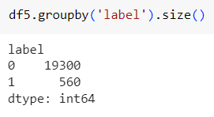
Trimming the dataset using feature ‘paymentMethodAgeDays’
Grouping this feature with ‘label’ revealed that most of the value count of ‘1’ in ‘label’ is missing in the unique values of ‘paymentMethodAgeDays’.
Further, those values where ‘1’ is present, their corresponding value count for ‘0’ is way to high compared their the ‘1’.
So, we can safely remove the rows where the value count of ‘1’ is 0 for any value in the ‘paymentMethodAgeDays’. Doing this will hep us curb the imbalance ratio also.
Hence, by doing this, we can clearly see, that we have reduced the imbalance ratio from 1:69 to approximately 1:34 between ‘0’ and ‘1’ in the label feature

Slide 16
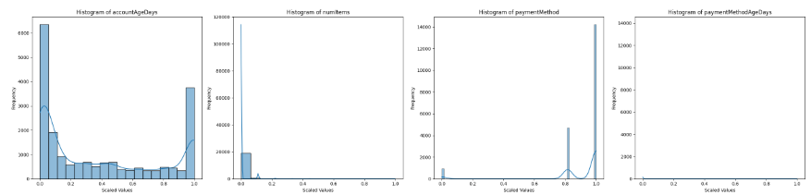
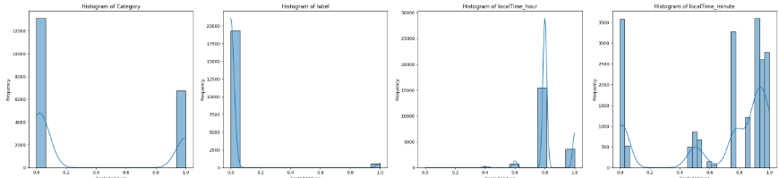
Feature scaling and checking data distribution
Since, we don’t want to assume any distribution first, we scale the data using MinMax Scaler and plot the histogram distribution.
Following were the findings by looking at the data:
All the independent features are not following any kind of pre-determined distribution.
So, we have to proceed further for training the model along with data without doing any kind of data transformation

Slide 17
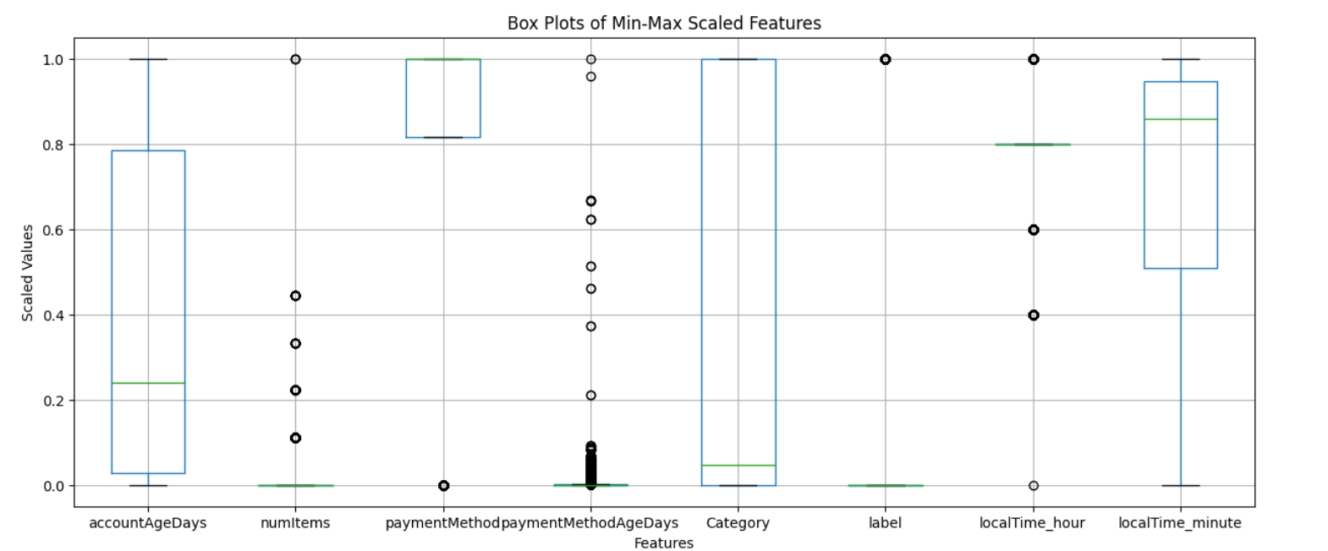
Checking Outliers
By plotting the box plot of all the scaled numerical features, we find that outliers exist in three features.
But, these outliers are negligible in comparison to our existing dataset.
Hence, we will move ahead without doing any kind of outlier handling.

Slide 18
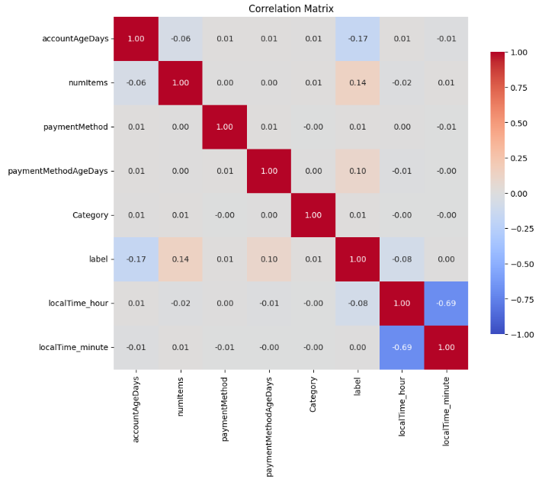
Correlation Analysis
Plotting the correlation matrix between all the scaled numerical features reveals the following points:
‘localTime_hour’ and ‘localTime_minute’ are highly negatively correlated with eachother with a coefficient of -0/69.
Hence, to avoid the multi-collinearity, reduce redudency, improve model performance and for creating clear insights during model traning, we will drop another feature out of these two.
This step will further helps in creating simpler model with higher interpretability and clearer insights from the data.

Slide 19
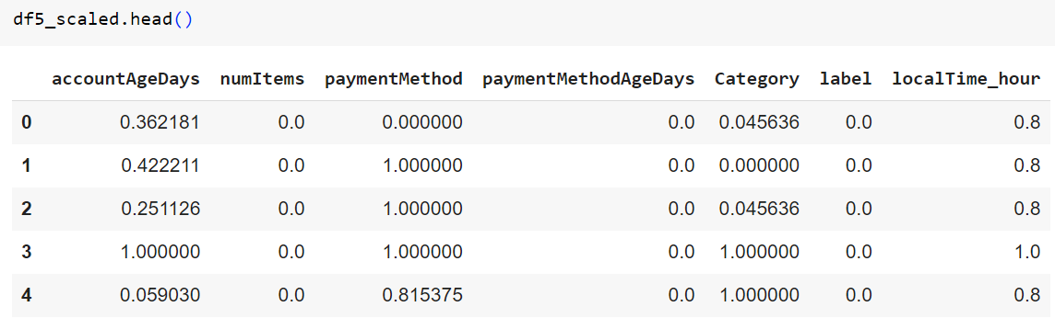
Final Dataset for training the Classification Models
We will store the independent features in dataframe ‘X’ and target feature in dataframe ‘y’
Now, we will proceed with the model training.

Slide 20
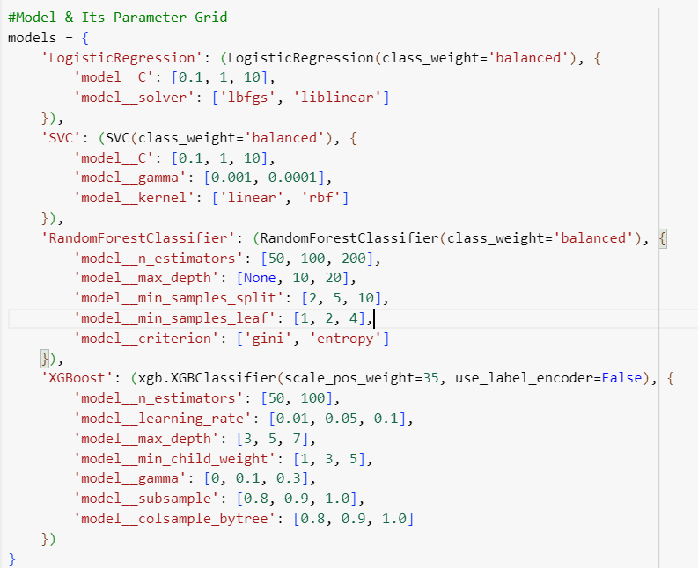
Algorithms Used for Training
Model and its Parameter Grid used for hyperparameter tuning
List of Algorithms:
Logistic Regression: A linear model for binary classification, estimating the probability of a class.
SVM: A model that finds the optimal hyperplane separating classes in feature space.
Random Forest Classifier: An ensemble method using multiple decision trees to improve classification accuracy and robustness.
XGB Classifier: A gradient boosting method that builds strong classifiers by combining weaker models sequentially.

Slide 21
Model Training and Validation
Since the data is still highly imbalanced, we have split the data using ‘train_test_split’ from ‘sklearn.model_selection’ library by keep the ‘stratify’ equal to ‘y’ so that the data can be evenly split between.
We split the train and test into a ratio of 80:20.
Since we are focusing more or reducing the False Negative, will set a custom scorer of beta 2 for the F score
For binary classification problems, especially when dealing with imbalanced datasets and focusing on the minority class, we are using average='binary'. This approach calculates the F2 score considering only the positive class (class 1). This is particularly useful for imbalanced datasets where the minority class is of greater interest.
f2_scorer = make_scorer(fbeta_score, beta=2, average='binary’) set the f2_scorer

Slide 22
Model Training and Validation
To further handle the imbalanced data, we have imported the SMOTE and NearMiss methods. SMOTE (Synthetic Minority Over Sampling Technique) and NearMiss oversample the minority class and undersample the majority class respectively and have added ‘sampling_strategy’ and ‘n_jobs’ parameter to each of them for creating custom range of synthetic values and parallel processing.
Finally, created a pipeline to pass the data set from SMOTE and NearMiss before their model training.
Done hyperparameter tuning of various models by looping them inside a for loop using GridSearchCV along with custom parameters for it. For example, instead of normal cross validation method with 5 folds, used StratifiedKFold for even distribution of data in each folds for handling the overfitting. Passed the scoring parameter to the custom made f2_scorer so that the data can be trained keeping the FN values under check.

Slide 23
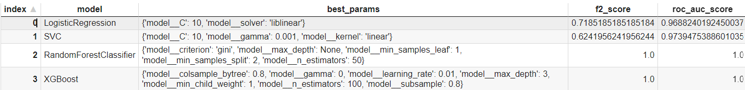
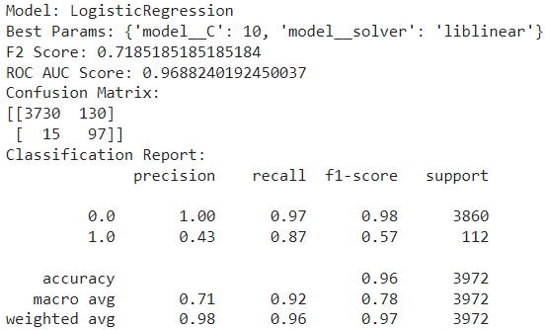
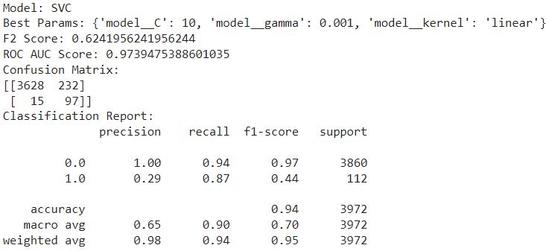
Model Selection
Results obtained from GridSearchCV is stored in the following dataframe:
Detailed reports for all the classification model are as follows:
Logistic Regression
SVC

Slide 24
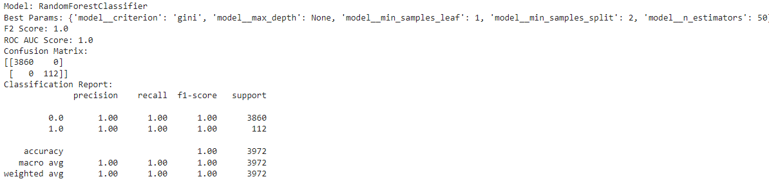
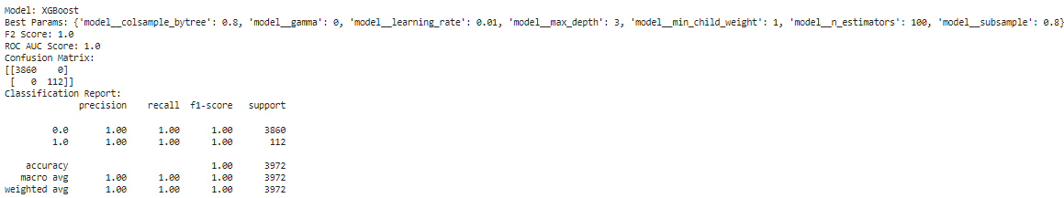
Model Selection
RFC
XGB

Slide 25

Model Selection
After going through all the results of the classifiers, it is clearly evident that the Ensemble Algorithms are better classification.
Hence, on top of that, we will be choosing the RandomForestClassifier and XGBClassifier for training with our dataset as per the parameters received through GridSearchCV.
This Photo by Unknown Author is licensed under CC BY

Slide 26

Performance Metrics for RFC and XGB
Accuracy: The accuracy of the model was 100%, indicating a high level of precision in identifying fraudulent transactions.
Precision, Recall, and F1-Score: Precision: 100%, Recall: 100%, F1-Score: 100%. These metrics demonstrate the model's ability to correctly identify fraudulent transactions while minimizing false positives and negatives.
ROC-AUC: The ROC-AUC score was 1, indicating a high level of overall performance in distinguishing between fraudulent and legitimate transactions.
Photo by DeepMind on Unsplash

Slide 27
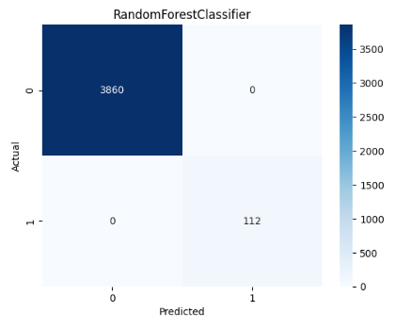
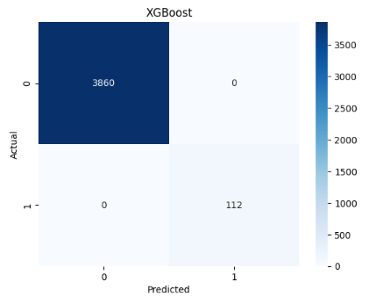
Confusion Matrix
Confusion Matrix Visualization: The confusion matrix shows the number of true positives, true negatives, false positives, and false negatives, providing insight into the model's performance.
Interpretation of Results: The high number of true positives and true negatives indicates that the model is effective at identifying fraudulent transactions, while the low number of false positives and false negatives shows minimal errors.
In our case, the FN and FP are 0 in both the classifiers. This indicate the issue of overfitting.

Slide 28

Key Insights
Significant Findings: Key findings include the importance of account age and payment method in predicting fraudulent transactions.
Even the major drawback is that the ‘label’ is ‘1’ for account age ‘1’ and it is ‘0’ for account age other than that. Hence, if the AccountAgeDays = 1, it is a fraud transaction and not if AccountAgeDays != 1
Photo by DeepMind on Unsplash

Slide 29

Conclusion
Summary of the Process: The project involved data exploration, feature engineering, model building, and evaluation to develop an effective fraud detection model.
Future Work and Improvements: Future improvements include exploring additional features, using more advanced algorithms, and further tuning the model to enhance performance.
Photo by Agence Olloweb on Unsplash

Slide 30


