Slide 1
Atomic Properties and Their Periodic Trends
Properties like valency, atomic and ionic radii, ionization enthalpy, electron gain enthalpy, electro-negativity are the properties related to individual atoms and are directly related to their electronic configurations.
The properties which are directly related to their electronic configuration and which show a regular gradation when we move from left to right in a period or from top to bottom in a group are called periodic properties.

Slide 2
Atomic Radius
Size of an atom is an important property of atom since many other physical and chemical properties of atom are related to it.
Atomic radius of an atom may be defined as :
The distance from the centre of the nucleus to the outermost shell containing electrons.
The distance from the centre of the nucleus to the point up to which the density of the electron cloud ( i.e. probability of finding electron) is maximum.
Difficulties in determining Atomic radius
Size of atom cannot be determined precisely.
Impossible to isolate an atom.
Probability distribution of electrons is appreciably affected by presence of other atoms.
Atomic radius changes when atom is present in different bonded state.

Slide 3
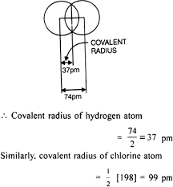
Types of atomic radii
Covalent Radius
Vander Waal’s radius
Metallic radius
Ionic radius
Atomic radii are measured by
either X-ray analysis or spectroscopic methods
Covalent Radius
It is defined as one half the distance between the nuclei of two covalently bonded atoms in a homonuclear molecule.
Thus, r covalent = ½ [ Internuclear distance between two atoms]
r covalent = ½ [ bond length]
Example: Internuclear distance of hydrogen molecule is 74pm
So, covalent radius of H atom is 74/2 = 37pm

Slide 4
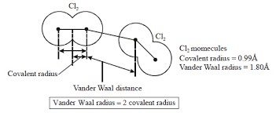
Vanderwaal’s Radius
It is defined as one-half of the distance between the nuclei of two identical non-bonded isolated atoms or two identical atoms belonging to two neighboring molecules of an element.
Also known as inert gas radii
Example : Inter-nuclear distance between two adjacent chlorine atoms is 360pm , so vander waals radius = 360/2
= 180pm
Vander Waal’s radii are always greater than covalent radii.

Slide 5
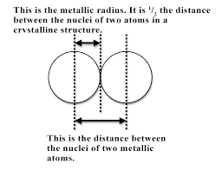
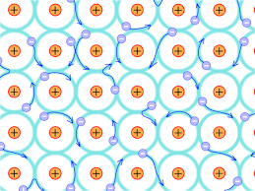
c) Metallic Radius
According to electron sea model, a metal lattice or a crystal consists of positive kernels or metal ions (left after the removal of valence electrons) arranged in a definite patterns in a sea of mobile electrons.
Thus, each kernel is simultaneously attracted by a number of mobile electrons and each mobile electron is attracted by positive kernels.
This simultaneous force of attraction between the mobile electrons and the positive kernels is called metallic bond.
It is defined as one half of the inter-nuclear distance between the two adjacent metal ions in the metallic lattice.

Slide 6
Variation of atomic radii in the periodic table
Variation along a period
The covalent and the Vanderwaal’s atomic radius decreases with the increase in atomic number as we move from left to right in a period.
Variation in atomic (covalent ) radii (pm) of the elements of second and third periods
Period 2 | Li | Be | B | C | N | O | F | Ne
Atomic radius | 152 | 111 | 88 | 77 | 70 | 74 | 72 | 160
Period 3 | Na | Mg | Al | Si | P | S | Cl | Ar
Atomic radius | 186 | 160 | 143 | 117 | 110 | 104 | 99 | 191
The alkali metals which are at extreme left of the periodic are large in size.
The halogens present in extreme right of the periodic table have smallest size.
The anomalous behavior of the size of oxygen is due to the greater inter-electronic repulsion which outweigh the effect of increased nuclear charge and hence atomic size increases for O.
Size of inert gases are however larger because in case of inert gases all the orbitals are completely filled and hence inter-electronic repulsion is maximum. And the atomic radius of inert are expressed in terms of Vanderwaal’s radius which is always greater.

Slide 7
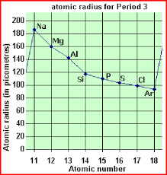
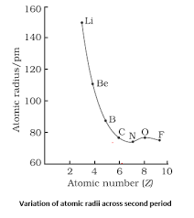

Slide 8
b) Variation within a group
The atomic radii of elements increases with the increase in atomic number as we move from top to bottom in a group.
Table: Increase in atomic radii (pm) of alkali metals and halogens
Alkali metals Group 1 | Atomic radius (pm) | Halogens (Group 17) | Atomic radius (pm)
Li | 152 | F | 72
Na | 186 | Cl | 99
K | 231 | Br | 114
Rb | 244 | I | 133
Cs | 262 | At | 140
As we move down a group , the principal quantum number (n) increases , a new energy shell is added at each succeeding element and valence electrons lie further away from the nucleus. Hence atomic radius increases.

Slide 9
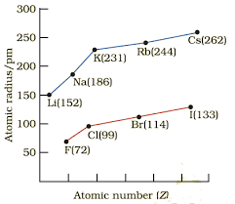
Variation of atomic radius with atomic number for alkali metals and halogens

Slide 10
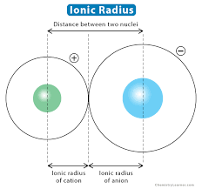
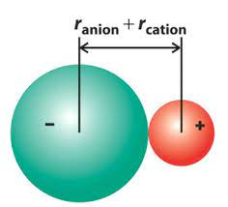
Ionic Radius
The ionic radii correspond to the radii of ions in the ionic crystals. Ions in turn are formed when neutral atoms lose or gain electrons.
A positive ion or cation is formed when a neutral atom loses one or more electrons while a negative ion is formed when a neutral atom gains one or more electrons.
Ionic radius may be defined as the effective distance from the centre of the nucleus of the ion up to which it exerts its influence on its electronic cloud.
Ionic radii is taken as the sum of the radii of two ions involved.

Slide 11
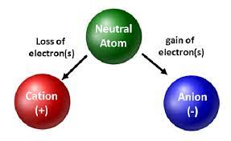
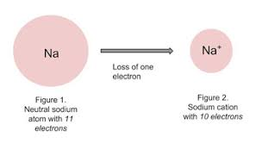
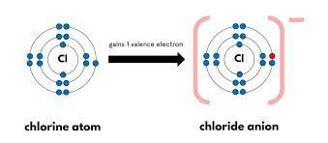
Example: The internuclear distance between Na+ and Cl- ions in sodium chloride crystal has been determined to be 276 pm from X ray analysis.
The study of ionic radii leads to two important generalizations:
The size of cation is smaller as compared to that of the parent atom.
The size of anion is larger in comparison with that of parent atom.

Slide 12
The size of cation is always smaller than that of parent atom due to
Decrease in number of shells
Increase in effective nuclear charge resulting in greater force of attraction.
Table : Comparative sizes of atoms and their cations
Element | Li | Na | K | Be | Mg | Al | Mn
Atomic radii (pm) | 152 | 186 | 231 | 111 | 160 | 143 | 126
Corresponding cations | Li⁺ | Na⁺ | K⁺ | Be²⁺ | Mg²⁺ | Al³⁺ | Mn⁴⁺
Ionic radii (pm) | 60 | 95 | 133 | 39 | 65 | 50 | 46
Variation of cationic radii along the group
Ionic radii of cation also increases as we move from top to bottom of the periodic table.

Slide 13
The size of anion is always larger than the corresponding atom mainly because of decrease in the effective nuclear charge i.e. lesser force of attraction by the nucleus on the electrons.
Comparative sizes of atoms and their anions
Atom | F | Cl | Br | I | O | S | N
Atomic radii (pm) | 72 | 99 | 114 | 133 | 74 | 102 | 75
Corresponding anion | F⁻ | Cl⁻ | Br⁻ | I⁻ | O²⁻ | S²⁻ | N³⁻
Ionic radii | 136 | 181 | 196 | 219 | 142 | 184 | 171
Variation of ionic radii within a group
Ionic radii also increases as we move down the group.

Slide 14
Iso-electronic ions or species
Ions of different elements which have the same number of electrons but different magnitude of the nuclear charge are called isoelectronic ions.
For example sulphide ion (S²⁻), Chloride ion (Cl⁻),Potassium ions (K⁺)are iso-electronic ions because each one of them has 18 electrons but have different nuclear charges i.e. +16, +17, and +19 respectively.
The nitride ion (N³⁻ ), oxide ion (O²⁻ ), Fluoride ion(F⁻) and Neon (Ne), sodium ion (Na⁺), Magnesium ion (Mg²⁺), Aluminium ion (Al³⁺) are all iso-electronic species since each one of them contains 10 electrons but have different nuclear charges of +7, +8, +9, +10, +12, and +13 respectively.

Slide 15
Variation of ionic size among iso-electronic ions
Ions | N³⁻ | O²⁻ | F⁻ | Na⁺ | Mg²⁺ | Al³
Nuclear Charge | +7 | +8 | +9 | +11 | +12 | +13
Ionic radius | 171 | 140 | 136 | 95 | 65 | 50
Ionic radius increase in the order:
Al³ < Mg<²⁺ < Na⁺ < F⁻ < O²⁻ < N³⁻
Ionic radii of iso-electronic ions decrease with the increase in the magnitude of nuclear charge.

Slide 16
Ionization Energy or Ionization Potential
The minimum amount of energy required to remove the most loosely bound electron from an isolated gaseous atom so as to convert it into a gaseous cation is called its ionization enthalpy (or energy).
It is represented by Δi H
It may be represented as
M(g) + Δi H M+ (g) + e- (g)
It is measured in units of electron volts (eV) per atom or kilo calories per mol (Kcal mol⁻¹ ) or Kilo Joules per mole (KJ mol⁻¹ ).
Successive Ionization Enthalpies
The energy required to remove the most loosely bound electron from the isolated gaseous atom is called first ionization enthalpy.
Denoted by M(g) + Δi H (1) M+ (g) + e- (g)
Similarly, the energies required to knock out second and third electrons are called second and third ionization energies respectively.
1 eV per atom = 23.06 kcalmol⁻¹ 96.49 kJmol⁻¹

Slide 17
M(g) + Δi H (2) M2+ (g) + e- (g)
M(g) + Δi H (3) M3+ (g) + e- (g)
For any element, First ionization energy< Second I.E. < Third I.E. Example: For aluminum the first I.E is 577 KJ mol⁻¹, while the second I.E. is 1795 KJ mol⁻¹ and third I.E is 2758 KJ mol⁻¹
Factors governing the Ionization Enthalpy
Effective Nuclear Charge
I.E. increases with increase in nuclear charge.
ii) Atomic radius
I.E decreases as atomic size increases.
iii) Screening effects of inner electrons
As shielding or screening effect of inner electron increases, the ionization energy decreases.

Slide 18
Penetration effect of the electrons
Ionization enthalpy increases with the increase in the penetration effect of electrons. Thus ionization energy will be more to knock out a s- electron than a p-electron of the same shell, which in turn will be more than that required to remove a d-electron and so on.
Within the same shell the penetration effect decreases in the order:
s> p>d>f
Effect of exactly half filled or completely filled orbitals
If an atom contains exactly half–filled or completely filled orbitals, then such an arrangement has extra stability. Therefore, the removal of an electron from such an atom requires more energy than expected.

Slide 19
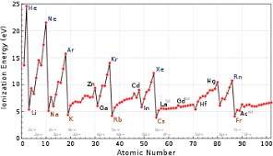
Variation of Ionization Enthalpy in the periodic table
Variation of I.E. along a period
In general, as we move from left to right in a period, the ionization enthalpy increases with increasing atomic numbers.

Slide 20
However some irregularities in this trend could be observed due to following reasons
Types of electron to be removed.
The extra stability of the exactly half-filled and completely filled electronic configurations.
In 2nd period there are two pairs of elements in which the variation of IE is abnormal
I.E of Be > B
IE of N > O
The higher value of I.E. of the first Be is greater than B due to greater stability of its valence shell electronic configuration. In B, it is easier to remove electrons from p orbital than in Be from s orbital because penetrating power of s orbital is greater than p orbital.
In nitrogen p orbital electrons are unpaired while in oxygen are paired. In pair, the repulsion increases energy and it is easier to remove electron from oxygen. Also nitrogen has half filled electronic configuration so I.E. is higher.

Slide 21
Variation of IE along group
I.E decreases as we move from top to bottom of the periodic table.
Atomic size increases on moving down the group, hence I.E decreases.
Shielding effects or screening effect of electrons increases.
The combined effect of the increase in the atomic size and the screening effect compensates the effect of increased nuclear charge, hence I.E. decreases as we move down the group.

Slide 22
Electron Affinity / Electron Gain Enthalpy
Electron affinity is the tendency of the atom to accept the incoming electron.
Just as energy is needed to remove an electron from an atom, energy is released when an electron is added to an isolated gaseous atom so as to convert it into a negative ion.
Electron gain enthalpy of an element maybe defined as the energy released when a neutral isolated gaseous atom accepts an extra electron to form the gaseous negative ion, i.e. anion. It is denoted by Δ eg H.
The process may be represented as:
X (g) + e⁻ X⁻ (g) ; Δ eg H
It may be measured in electron volt per atom or kJ per mole.
For majority of elements electron gain enthalpy is negative, i.e. energy is released during the process.

Slide 23
Successive Electron gain enthalpies
Like ionization enthalpies , second and higher electron gain enthalpies are also possible. However, after the addition of one electron , the atom becomes negatively charged and second electron is to be added to a negatively charged ion.
But this addition of second electron is opposed by electrostatic repulsion and hence the energy has to be supplied for the addition of second electron. Thus second electron gain enthalpy of an element is positive.
For example
First electron gain enthalpy
O (g) + e- (g) O⁻ (g); ΔHeg = -141 KJ mol⁻¹ (energy is released )
2. Second Electron gain enthalpy
O⁻(g) + e- (g) O⁻² (g); ΔHeg = + 780 KJ mol⁻¹ (energy is absorbed )

Slide 24
Factors affecting Electron gain enthalpy
Atomic Size
As the size of atom increases, the force of attraction between nucleus and the incoming electron decreases and hence electron affinity decreases.
ii) Electronic Configuration
Elements having exactly half-filled and completely filled orbitals are very stable. As a result energy has to be supplied to add an electron. Since they do not accept the additional electrons easily their electron affinity value is less.
iii) Nuclear charge
As the nuclear charge increases, the force of attraction between the nucleus and the incoming electron increases and hence the Electron affinity value , the tendency to add electron increases.

Slide 25
Successive electron gain enthalpy | Electron gain Enthalpy value (heat) (Final – Initial) Δ(H) | Electron Affinity (tendency to accept electron) | Heat release (Final – Initial) Δ(H)
First | Negative | Higher electron affinity | Exothermic (Incoming electron releases heat )
Second | Positive | Electron affinity decreases | Endothermic ( energy is to be supplied to the atom to add another electron)
Third | Positive | Electron enthalpy decreases | Endothermic ( More energy is to be supplied to the atom to add another electron)

Slide 26
Variation of electron affinity in the period
As we move across a period from left to right, the atomic size decreases and the nuclear charge increases. Both these factors tends to increase the attraction by the nucleus for the incoming electron and hence incoming electron releases energy and electron is added with ease.
Thus, Electron affinity increases as we move from left to right.
Variation of electron affinity in the group
Electron affinity decreases as we move down a group.
As we move down a group , both the atomic size and the nuclear charge increases. Thus , with the increase in the atomic size, the attraction of the nucleus for the incoming electrons decreases and hence electron affinity value decreases.

Slide 27
Some important trends in electron affinity
Halogens have the most higher value of Electron affinity.
They require one more electron to acquire the stable noble gas configuration, as a result they have strong tendency to accept additional electron and their electron affinity value is highest.
The electron affinity of F is however unexpectedly less than that of Cl due to its small size. Due to small size inter-electronic repulsion is high and hence the incoming electron is not excepted with the same ease.
Chlorine has the most higher electron affinity value i.e. it can easily accept the incoming electron.
Elements Mg, Be, N, P have exceptionally low electron affinity due to their stable electronic configuration.
The electron affinity of nobel gases is very less because of their maximum stability of full filled orbitals.

Slide 28
Electronegativity
Electronegativity of an element is the tendency of its atom to attract the shared pair of electrons towards itself in a covalent bond.
It is represented by χ.
It is the property of atom in the bonded state.
A number of scales have been devised to measure the electronegativity of the atoms. Pauling scale is the most important of these scales.
By arbitrarily assigning a value of 4.0 to flourine ( the element having the greatest ability to attract electrons), the electronegativity of other elements were calculated.

Slide 29
Factors Influencing Electronegativity
Atomic size
The smaller the size of an atom, greater is its tendency to attract shared pair of electron towards itself .
b) Effective nuclear attraction
The increase in the effective nuclear charge increases the attraction for the electrons and hence electronegativity increases.
Charge on atom
Cation attracts electron pair more towards itself while an anion attracts the electron pair less readily than its parent atom.
Higher the oxidation state of element , higher is its electronegativity.

Slide 30
Trends in groups and periods
Along the group
Electronegativity decreases from top to bottom in a group because size of atom increases and also the screening effect increases.
Along the period
The electronegativity value increases along a period from left to right. As we move from left to right the nuclear charge increases and atomic radius decreases thus increasing the electronegativity value.

Slide 31
Metallic Character
Metals have the tendency to lose electrons in the chemical reaction while non-metals have tendency to gain electrons.
Metallic character of an element increases the ability to be oxidised or to lose its electron. It also includes the ability to displace hydrogen from acids.
A few electrons in the valence shell, large atomic size, low effective nuclear charge and low ionization energy are the criteria for the increased electropositive character.
Periodic Trend of Metallic Character
Metallic character decreases as we move from left to right along a period.
Metallic character increases from top to bottom in a group.

