Slide 1
An Introduction to JavaScript

Slide 2
JavaScript was initially created to “make web pages alive”.
The programs in this language are called scripts. They can be written right in a web page’s HTML and run automatically as the page loads.
Scripts are provided and executed as plain text. They don’t need special preparation or compilation to run.
Java vs Javascript

Slide 3
Today, JavaScript can execute not only in the browser, but also on the server, or actually on any device that has a special program called the JavaScript engine.

Slide 4
Different engines have different “codenames”. For example:
V8 – in Chrome, Opera and Edge.
SpiderMonkey – in Firefox.
…There are other codenames like “Chakra” for IE, “JavaScriptCore”, “Nitro” and “SquirrelFish” for Safari, etc.

Slide 5
Developer console
Code is prone to errors. So, if something goes wrong in the script, we won’t see what’s broken and can’t fix it as in the browser, users don’t see errors by default.
To see errors and get a lot of other useful information about scripts, “developer tools” have been embedded in browsers.

Slide 6
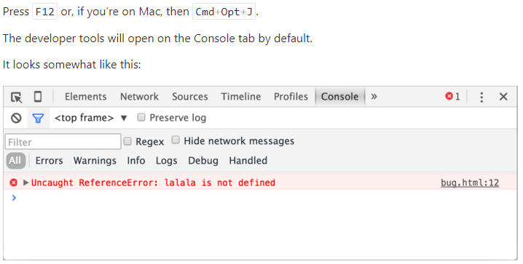

Slide 7
The <script> tag has a few attributes that are rarely used nowadays but can still be found in old code:
<script src="/path/to/script.js"></script> //External Scripts

Slide 8
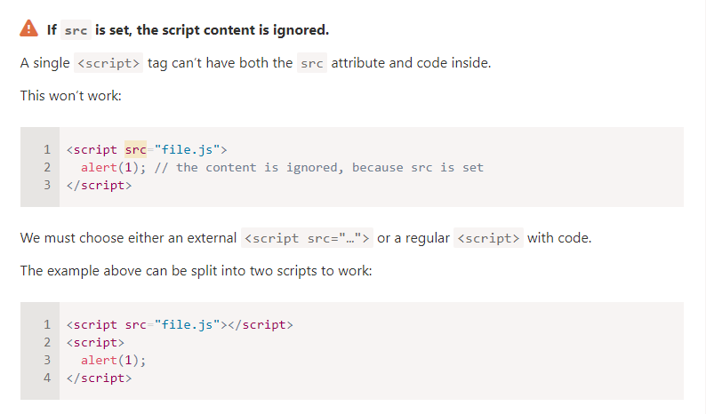

Slide 9
“use strict”
The directive looks like a string: "use strict" or 'use strict'. When it is located at the top of a script, the whole script works the “modern” way.

Slide 10
Javascript validations
required: Specifies whether a form field needs to be filled in before the form can be submitted.
minlength and maxlength: Specifies the minimum and maximum length of textual data (strings).
min and max: Specifies the minimum and maximum values of numerical input types.
type: Specifies whether the data needs to be a number, an email address, or some other specific preset type.
pattern: Specifies a regular expression that defines a pattern the entered data needs to follow.

Slide 11
If the data entered in a form field follows all of the rules specified by the above attributes, it is considered valid. If not, it is considered invalid.
When an element is valid, the following things are true:
The element matches the :valid CSS pseudo-class, which lets you apply a specific style to valid elements.
If the user tries to send the data, the browser will submit the form, provided there is nothing else stopping it from doing so (e.g., JavaScript).

Slide 12
When an element is invalid, the following things are true: The element matches the :invalid CSS pseudo-class, and sometimes other UI pseudo-classes (e.g., :out-of-range) depending on the error, which lets you apply a specific style to invalid elements. If the user tries to send the data, the browser will block the form and display an error message.

Slide 13
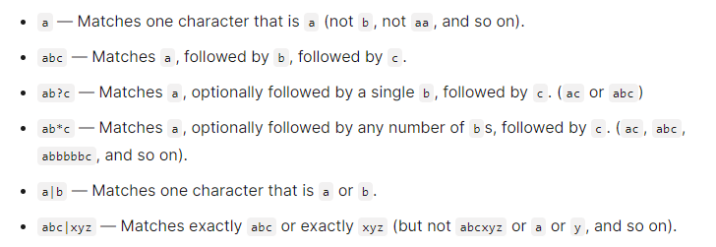
Validating against a regular expression

Slide 14
Interaction: alert, prompt, confirm
Prompt
The function prompt accepts two arguments:
result = prompt(title, [default]);
alert("Hello");
Txt to show to visitor
value for the input field.

Slide 15
JavaScript Functions
Functions are one of the fundamental building blocks in JavaScript.
function square(number) {
return number * number;
}

Slide 16
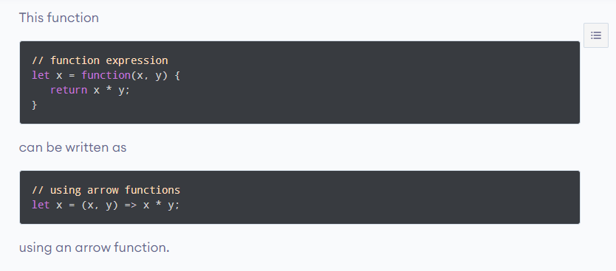

Slide 17
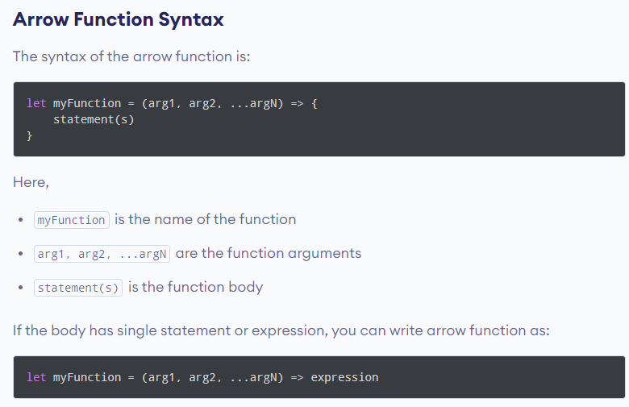

Slide 18
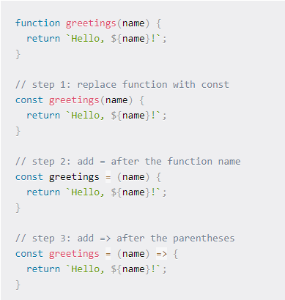

Slide 19
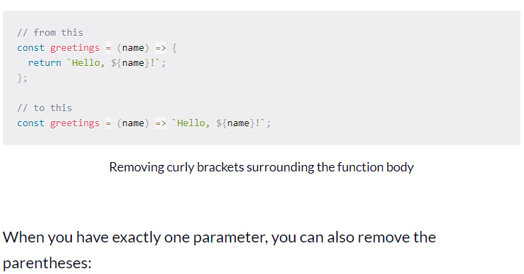

Slide 20
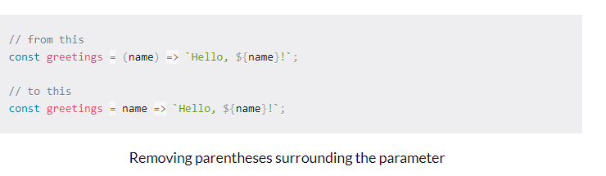

Slide 21
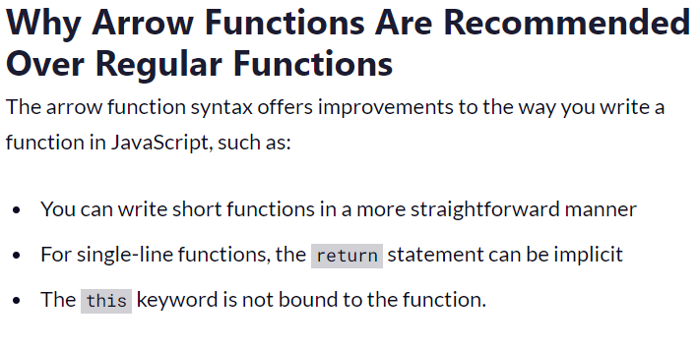

Slide 22
