Slide 1
Software Project Management
Dr. Ruqia Bibi
Assistant Professor
UIIT

Slide 2
Course Description
Provides an overview of the roles, responsibilities, and management methods of the Software project manager.
Most software Projects are developed in teams.
It is therefore vital that software engineers have detailed knowledge and skills to manage and work effectively in project teams.
This course assumes that the participants already have practical knowledge from project participations.
The course assumes a basic understanding of analysis techniques.

Slide 3
Learning Objectives
Key elements of the project management framework, including project stakeholders, the project management knowledge areas, common tools and techniques, and project success factors.
Understand the role of the project manager, what skills they need, and what the career field is like for information technology project managers.

Slide 4
Grading
Midterm 18
Final 30
Project 6
Quizzes & Assignments 6

Slide 5
Suggested Books
Software Project Management, Bob Huges and Mike Cotterell
Project management A Managerial Approach (3rd Edition), Jack R Meredith, Samuel J. Mantel, JR.
A Guide To Project Management Body Of Knowledge (2000 Edition), Project Management Institute Newtown Square, Pennsylvania USA

Slide 6
Facts and Figures
Only a third of all projects were successfully completed on time and on budget
(Standish Group’s CHAOS report-2015)
Only 40% of projects met schedule, budget and quality goals
(IBM Change Management Survey of 1500 executives)
50% of project management offices close within 3 years
(Association for Project Mgmt)

Slide 7
Facts and Figures
Some Disturbing Facts:
year | Type of survey | Facts | Source
2012 | Study on 5,400 large scale IT Projects | 45 percent over budget and 7 percent over time, while delivering 56 percent less value than predicted | Oxford University
2010 | Survey of 100 businesses | 50% of respondents also indicated that their project failed to consistently achieve what they set out to achieve | KPMG (New Zealand)
2009 | Survey of 1,500 change management executives | Only 40% of projects met schedule, budget and quality goals | IBM
Notes:
What does KPMG do exactly?
KPMG provides audit, tax and advisory services

Slide 8
Why software Project Fail
Why do software projects fail?
Not Sufficient Time
Often the deadline is decided prior to the project starting and is non-negotiable
Insufficient Budget
A "lowest price most successful candidate" policy - unrealistically low budget not based on the true requirements
Poor Communication
Old saying, "never assume anything". Good communication is vital for project success with the customer, users and especially the development team.
Does everyone in the team understand you?
Do they know exactly what's expected of them or have you assumed they know?
Do they communicate well with each other, with users and with other departments?

Slide 9

Software Project Management = Software + Project + Management

Slide 10
What is Software?
Software can be considered a product of engineering just like an airplane, automobile, television, or an other object that requires a high degree of skill to turn a raw material into a usable product.
But software is developed or engineered, not manufactured!
Software is a set of programs or data combined with its documentation which is helpful or even needed to run the application. (Hesse et al. 1984)

Slide 11
What is Software?
Taxonomies: (common classes exhibit common properties)
System software: Drivers, operating system components, compilers,
Application software: Stand-alone software for specific business need, transaction processing system
Scientific software: Stress analysis software, simulation software
Embedded software: Reside within a product or system, keypad control for microwave,
Product-line software: Word-processing, spread sheets
Artificial Intelligence software: Game playing, expert systems
Other Taxonomies…
Web Application OR Desktop Application
Notes:
System software
Drivers, operating system components, compilers, editors, etc.
Application software
Stand-alone software for specific business need, transaction processing system
Scientific software
Stress analysis software, simulation software

Slide 12
What is a Project?
Project Management Institute (PMI) definition: A project is a temporary endeavor undertaken to create a unique product or service.
Software project management is the art and science of planning and leading software projects. It is a sub-discipline of project management in which software projects are planned, implemented, monitored and controlled. [Wikipedia]

Slide 13
What is a Project?
A project is characterized as follows:
• a one-time effort is planned
• starting and ending dates are prescribed
• a project team is assembled
• schedule and budget are allocated
• well-defined objectives are established
• activities are defined, roles are identified, responsibilities are assigned, and authority is delegated
Software projects are temporary organizational units

Slide 14
What is a Project?
Temporary
It means that every project has a definite beginning and definite end
End is reached when project’s objectives have been achieved OR it is clear that objective will not be met. The project is terminated in such a situation
The term temporary does not apply to a project’s product or service (which is a lasting result)
Unique
It means that the product or service is different in some distinguishing way from all similar products or services
the process to create your project is unique, and therefore, the product of the project (the thing the project creates) is subsequently unique.
This is distinct from a program, which often uses an existing process and duplicates it over and over to produce a replicated product.
Example:
An assembly line is an example of a program, while building a skyscraper is an example of a project.

Slide 15
What is a Project?
Projects may involve a single person or thousands
Projects may be completed in hours, several months or years
Examples of projects; different situation
Developing a new product or service
Designing a new vehicle
Constructing a building
Running a campaign for political office
Implementing a new business procedure or process
And so on …
Are Projects cancelled sometime before achieving the objective...?

Slide 16
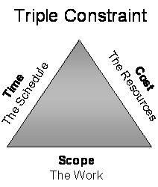
Triple Constraint
Every project is constrained in different ways by its scope, time and cost.
Notes:
Restriction---limitation

Slide 17
Triple Constraint--cont
Scope
What is to be accomplished? What product or service to be made?
Cost
What resources will it take to complete the project?
Time
What Time required to complete the project?

Slide 18
The defining characteristic of process vs. project is repeatability vs uniqueness
Process is a repetitive collection of interrelated tasks aimed at achieving a certain goal.
Project is a unique Endeavour with a beginning and an end undertaken to achieve a goal.
Notes:
Connected to one another.

Slide 19
Process Vs Project Management
Process management has emphasis on increasing "repeatability" of the tasks, efficiency (decreasing time needed, reducing cost), increasing quality (including consistency in quality).
Project management has emphasis on getting the thing done, achieving the end result. Higher efficiency is harder to achieve since it might require custom tools and methods that can only be developed if the project was turned into a repetitive process.
Notes:
Effectiveness: The achievement of objectives
Efficiency: The achievement of ends with least amount of resources
Effectiveness is about doing the right task, completing activities and achieving goals. Efficiency is about doing things in an optimal way, for example doing it the fastest or in the least expensive way. It could be the wrong thing, but it was done optimally.

Slide 20
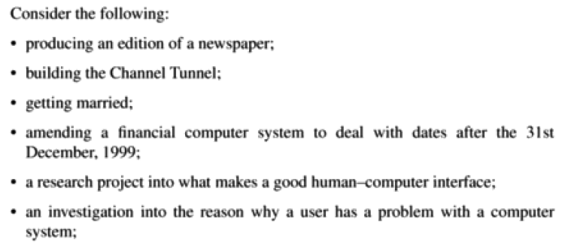
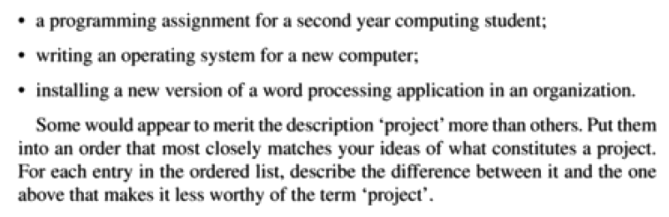
Activity

Slide 21
Software Project vs other projects
FP Brooks (1987) “No silver bullet: essence and accidents of SE”
Complexity
Conformity
Changeability
Invisibility

Slide 22
Complexity
No two parts are alike
Software systems have orders-of-magnitude more states
Scaling-up of a software entity is not merely a repetition of the same elements in larger sizes; it is necessarily an increase in the number of different elements
In most cases, the elements interact with each other in some nonlinear fashion, and the complexity of the whole increases much more than linearly.

Slide 23
Complexity--cont
From the complexity comes the difficulty:
communication among team members, which leads to product flaws, cost overruns and schedule delays
less understanding of all the possible states of the program and from that comes the unreliability

Slide 24
Changeability
The software entity is constantly subject to pressures for change. Of course, so are buildings, cars, computers But manufactured things are infrequently changed after manufacture.
software of a system embodies its function, and the function is the part that most feels the pressures of change
Buildings do in fact get changed, but the high costs of change, understood by all, serve to dampen the whims of the changes.

Slide 25
Invisibility
Software is invisible.
SPM can be seen as the process of making the invisible visible.

Slide 26
Conformity
Software developers have to conform to the requirements of human clients.
Individuals can be inconsistent, ineffective decision making, organizations, internal communication can exhibit remarkable “organizational stupidity”.

Slide 27
Management
What is Management?
Management is the art of getting things done through and with people in formally organized group.
Management involves following Functions/activities:
Planning- deciding what is to be done
Organizing- making arrangements
Staffing- selecting the right people for the job
Directing- giving instructions
Monitoring- checking on progress
Controlling- taking action to remedy hold-ups
Innovating- coming up with new solutions
Representing- liaising with users, suppliers, stakeholders etc.

Slide 28
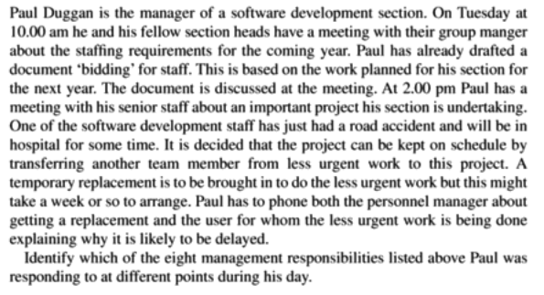
Activity

Slide 29
Project Management
It is the discipline of planning, organizing, and managing resources to bring about the successful completion of specific project goals and objectives
PMI*, Project Management Body of Knowledge
PMBOK® Guide Project management is “the application of knowledge, skills, tools, and techniques to project activities in order to meet project requirements”
*The Project Management Institute (PMI) is an international professional society. Their web site is www.pmi.org.

Slide 30
PMI * - PMBOK
The Project Management Body of Knowledge (PMBOK) is a collection of processes and knowledge areas generally accepted as best practice within the project management discipline.
Generally accepted means that it is applicable to most of the projects most of the time.

Slide 31
Software Project Management
Software Project management is the discipline of planning, organizing, and managing resources to bring about the successful completion of specific SOFTWARE project goals and objectives
Notes:
Temporary:
can be years
Result can be lasting
Team can be temporary
Finite duration
Ex: thousands of buildings, but each is unique
Scope s/b constant even as elaboration happens

Slide 32
Software Project Management
Management
Project Management
Software Project
Management

Slide 33
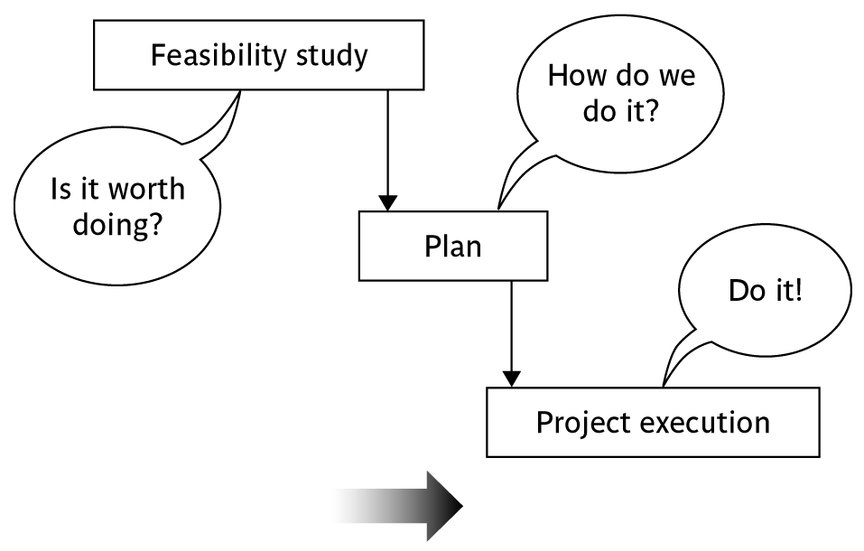
Activities covered by project management
Feasibility study
Is project technically feasible and worthwhile from a business point of view?
Planning
Only done if project is feasible
Execution
Implement plan, but plan may be changed as we go along
Notes:
There are two key points here.
Often you see something like ‘feasibility study’ being put as the first stage of development life cycle, and indeed it might be. However, the recommendation of the feasibility study might be not to carry out the proposed project. Planning of the project should therefore take place after the feasibility study (or as a part of the feasibility study perhaps). Clearly the feasibility study itself might need a plan.
All plans are to some extent provisional and subject to change. The key point is that the evolving plan allows us to control the project.

Slide 34
Traditional versus Modern Project Management
Projects are increasingly being based on either tailoring some existing product or reusing certain pre-built libraries.
Facilitating and accommodating client feedbacks
Facilitating customer participation in project development work
Incremental delivery of the product with evolving functionalities.
Notes:
Rather than making a long term project completion plan, the project manager now plans all incremental deliveries with evolving functionalities. This type of project management is often called Extreme project management.

Slide 35
Professional Bodies
Professional Organizations
Project Management Institute (PMI)*
Software Engineering Institute (SEI)
IEEE Software Engineering Group.
Certifications (offered by PMI)
PMP (Project Management Professional)
CAPM (Certified Associate in Project Management)
PMBOK – Project Management Body of Knowledge, published by PMI
Tools
MS Project
Primavera Project Manager
*The Project Management Institute (PMI) is an international professional society. Their web site is www.pmi.org.

Slide 36
References
PMBOK fifth edition Chapter 1

