Slide 1
Software Project Selection Methods

Slide 2
‘Step Wise’ - an overview
0.Select
project
1. Identify
project objectives
2. Identify project
infrastructure
3. Analyse
project
characteristics
Review
4. Identify products
and activities
5. Estimate effort
for activity
Lower
level
detail
For each
activity
6. Identify activity
risks
10. Lower level
planning
7. Allocate
resources
9. Execute plan
8. Review/ publicize
plan

Slide 3
Selection of project
Technical Assessment
  Technical Assessment of a proposed system consists of evaluating the required functionality against the hardware/software available.
Cost benefit analysis
  Most common way of carrying out an economic assessment of a proposed system is by comparing the expected costs of development and operation of the system with the benefits of having it in place

Slide 4
Cost benefit analysis
it is usually necessary to ask whether or not the project under consideration is the best of a number of options
  There might be more candidate projects than can be undertaken at any one time and, in any case, projects will need to be prioritized so that any limited resources may be allocated effectively.
Standard way of evaluating the economic benefits of any project is to carry out a cost benefit analysis, which consists of two steps.
  Identifying and estimating all of the costs and benefits of carrying out the project and operating the system.
    These include the development costs of the system, the operating costs and the benefits that are expected to accrue from the operation of the new system.
  Expressing these costs and benefits in common units
    We need to evaluate the net benefit, that is, the difference between the total benefit accruing from the system

Slide 5
CBA
It is helpful to categorize costs according to where they originate in the life of the project.
  Development costs:
    Include the salaries and other employment costs of the staff involved in the development project and all associated costs.
  Setup costs:
    Include the costs of putting the system into place.
      These consist mainly of the costs of any new hardware and additional equipment, but will also include costs of file conversion, and staff training.
  Operational costs:
    Consist of the costs of operating the system once it has been installed.

Slide 6
CBA Evaluation Techniques
Consider proceeding with a project only where the benefits outweigh the costs.
Decide on a consistent and standardized approach for measuring benefits for the criteria.
  For instance, for financial return you could use one or more of the following:
    Net Profit
    Payback period
    Net present value (NPV)
    Return on investment (ROI)
    Internal rate of return (IRR)
    Other forms of cost/benefit analysis
Notes:
a financial gain, especially the difference between the amount earned and the amount spent in buying.

Slide 7
Net Profit
Net profit
  The net profit of a project is the difference between the total costs and the total income over the life of the project.
  Net profit = Total income – Total costs
    Advantage: simple to use
    Disadvantage: ignores the timing of the cash flow

Slide 8
Financial Return methods
Payback period
  Payback period is the amount of time it takes a company to regain its initial investment in the cost of producing a product or service.
  Payback period = Time taken to pay back the initial investment
    Advantage: simple to calculate, not sensitive to small forecasting errors
    Disadvantage: ignores any income (or expenditure) after the payback period
Notes:
profit from an investment equal to the initial outlay.

Slide 9


Time Value of Money
A Dollar sitting in your wallet is worth more today than the same dollar tomorrow.
Can you tell Why?
Depreciation.
Money grows over time when it earns interest.
So, the time value of money brings us to the concept of
  Future Value of Money
  Present Value of Money

Slide 10
Present Value
Present value states that an amount of money today is worth more than the same amount in the future.
In other words, present value shows that money received in the future is not worth as much as an equal amount received today.
Receiving $1,000 today is worth more than $1,000 five years from now. Why?
  An investor can invest the $1,000 today and presumably earn a rate of return over the next five years. Present value takes into account any interest rate an investment might earn.

Slide 11
Discount Rate for Finding Present Value
The discount rate is the relevant interest rate that mathematically increases future value in nominal or absolute terms.
Notes:
Small
complete

Slide 12
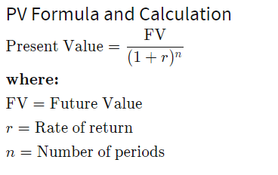
PV Formula and Calculation
Present Value

Slide 13
STEPS
Input the future amount that you expect to receive in the numerator of the formula.
Determine the interest rate that you expect to receive between now and the future and plug the rate as a decimal in place of "r" in the denominator.
Input the time period as the exponent "n" in the denominator. So, if you want to calculate the present value of an amount you expect to receive in three years, you would plug the number three in for "n" in the denominator.

Slide 14
Future Value
Future value (FV) is the value of a current asset at a specified date in the future based on an assumed rate of growth.
Present value (PV) is the current value of a future sum of money or stream of cash flows given a specified rate of return. Present value takes the future value and applies a discount rate or the interest rate that could be earned if invested.
  Future value tells you what an investment is worth in the future while the present value tells you how much you'd need in today's dollars to earn a specific amount in the future.

Slide 15
Present value intra-year discounting
Problem 1: Present value intra-year discounting
What is the present value of $1,000 received in two years if the interest rate is?
(a) 12% per year discounted annually
Solution:
1,000 / (1 + 0.12) ²
Answer: $797.19
Notes:
Refers to processes which occur on a time scale of less than 1 year but more than 1 month.
within

Slide 16
b) 12% per year discounted semi-annually
Solution:
1,000 / (1 + 0.12/2) ^{2*2}
Answer: $792.09
(c) 12% per year discounted daily
Solution:
1,000 / (1 + 0.12/365) ^{2*365}
Answer: $786.66
Notes:
Twice a year

Slide 17
Present value of a single amount
Problem 2: Present value of a single amount
You have just won a $1 million lottery. This new lottery, however, will pay out the award 60 years from today. What is the present value of your award based on a 16% p.a. interest rate?
Solution:
1,000,000 / (1 + 0.16) ⁶⁰
Answer: $135.68

Slide 18
Using present value formula
Problem 3: Using present value formula
$7,000 for 10 years from now at 7% is worth how much today?
Solution:
7,000 / (1 + 0.07) ¹⁰
Answer: $3,558.45

Slide 19
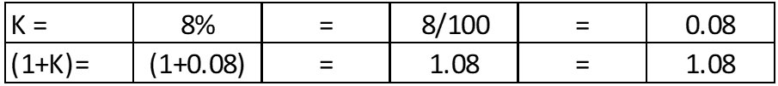
Calculate the Future Value
Example: If $ 100 dollars is invested in a bank today may earn 8% per year. what is the future value of the $ 100 dollars for 1st, 5th and 15th year?
FV = PV (1 + r)^{n}
PV = 100
n = 1
n = 5
n = 15
K=r = 8%
FV = ? When n =1, n=5, n=15
After 1 year(n=1): FV = 100 X (1.08)¹ = 100*1.08 = $108
After 5 years (n=5): FV = 100 X (1.08)⁵ = 100*1.08*1.08*1.08*1.08*1.08 = $146.93
After 15 years (n=15): FV = 100 X (1.08)¹⁵ = $317.22

Slide 20
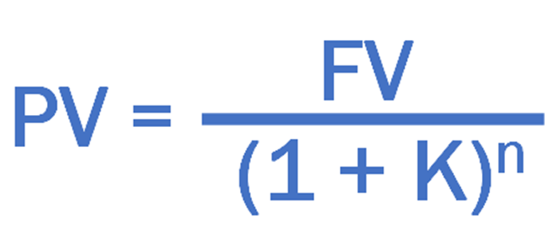
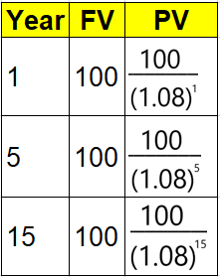
Calculate the Present Value
Example
If $ 100 dollars is to be received after 1 year, what is the present value of $100 dollars today?
If $ 100 dollars is to be received after 5 years, what is the present value of $100 dollars today?
If $ 100 dollars is to be received after 15 years, what is the present value of $100 dollars today?
Note: Discounted rate is 8% per year.
FV = 100
n = 1
n = 5
n = 15
K = 8%
PV = ? for n =1, n=5, n=15
The Present value of $ 100 to be received after 1 year is $93 dollars today.
The Present value of $ 100 to be received after 5 years is $68 dollars today.
The Present value of $ 100 to be received after 15 year is $32 dollars today.

Slide 21
Net Present Value Analysis
Net Present Value (NPV) = “Present Value of all cash inflows – Present Value of all cash outflow”
Example: Salary Slip
Net Salary = Gross Salary – Deductions
Similarly, The Present Value of all cash inflows is the Gross Present Value
and if you deduct cash outflows it becomes your Net Present Value.
  Projects with a positive NPV should be considered if financial value is a key criterion. The higher the NPV, the better
If | It means | Then
NPV > 0 | the investment would add value to the firm | the project should be accepted
NPV < 0 | the investment would subtract value from the firm | the project should be rejected
NPV = 0 | the investment would neither gain nor lose value for the firm | the project could be accepted as this project adds no monetary value. Decision should be based on other criteria, e.g. strategic positioning.

Slide 22

Example1: Calculating NPV
A sum of $ 400,000 dollars invested today in an IT project may give a series of below cash inflows in future:
$ 70,000 in year 1
$ 120,000 in year 2
$ 140,000 in year 3
$ 140,000 in year 4
$ 40,000 in year 5
If Opportunity cost of capital is 8% per annum, then should we accept or reject the project?
Solution:
Step 1: Calculate the PV value of year 1, year2, year3, year4, and year5
Step 2: Sum up the PV of all years
Step3: NPV = Present value of all cash inflows – Present value of all cash outflow.
Step 4: If NPV is positive, Accept the project, if not Reject the project.

Slide 23

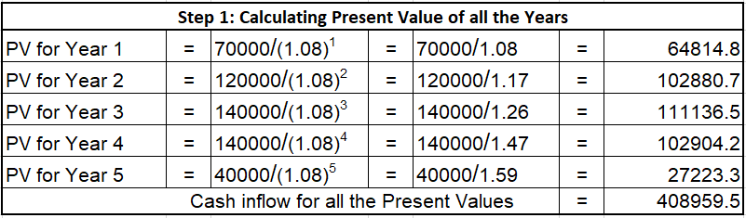
Cash Inflow of all Present Values is : $ 408,959
Present value of Cash outflow is : $400,000
Net Present Value = PV of Cash inflows – PV of Cash Outflows = ($408959 – $400000) = $8959 dollars.
Since NPV is positive, (i.e., $8959, This project can be accepted)
Example1: Calculating NPV

Slide 24
Example2: Calculating NPV
Same example: Calculating NPV however with Discount rate or Opportunity cost of capital at 15%
A sum of $ 400,000 dollars invested today in an IT project may give a series of below cash inflows in future:
$ 70,000 in year 1
$ 120,000 in year 2
$ 140,000 in year 3
$ 140,000 in year 4
$ 40,000 in year 5
If Opportunity cost of capital is 15% per annum, then should we accept or reject the project?
Solution: Calculating NPV
Step 1: Calculate the PV value of year 1, year2, year3, year4, and year5
Step 2: Sum up the PV of all years
Step3: NPV = Present value of all cash inflows – Present value of all cash outflow.
Step 4: If NPV is positive, Accept the project, if not Reject the project.

Slide 25
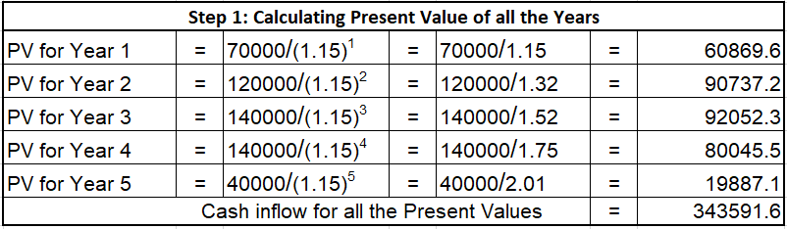
Example2: Calculating NPV
N.B: Though we have the same inflow & outflow of cash as in the previous example, the NPV value changed with the change in the Discount rate of interest.
Therefore, NPV is very much dependent on the Discount rate.
Cash Inflow of all Present Values is : $ 343591
Present value of Cash outflow is : $400,000
Net Present Value = PV of Cash inflows – PV of Cash Outflows =($343591 – $400000) = $ -56408 dollars.
(negative 56408 dollars)
Since NPV is Negative, (i.e., - $56408, This project should be rejected)

Slide 26
Financial Return methods
NPV
  Advantage:
  It considers time value of money.
    Considers the profitability of a project and the timing of the cash flows that are produced.
  Disadvantage:
      1. hard to select an appropriate discount rate
      2. NPV only takes into account the cash inflows and outflows of a particular project. It does not consider any hidden costs, sunk costs, or other preliminary costs incurred about the specific project. Therefore, the profitability of the project may not be highly accurate.
Notes:
sunk cost, in economics and finance, a cost that has already been incurred and that cannot be recovered.

Slide 27
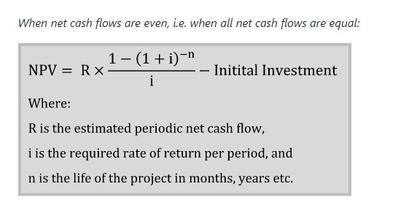
When net cash flows are even, i.e. when all net cash flows are equal:

Slide 28
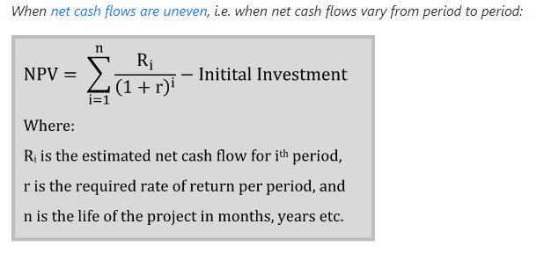
UNEVEN Cash Flows

Slide 29
Even net cash flows
Example 1: Even net cash flows
Calculate the net present value of a project which requires an initial investment of $243,000 and it is expected to generate a net cash flow of $50,000 each month for 12 months. Assume that the salvage value of the project is zero. The target rate of return is 12% per annum.
Notes:
The salvage value of an asset is based on what a company expects to receive in exchange for selling or parting out the asset at the end of its useful life.

Slide 30
Solution
We have,
Initial Investment = $243,000
Net Cash Inflow per Period = $50,000
Number of Periods = 12
Discount Rate per Period = 12% ÷ 12 = 1%
Net Present Value
= $50,000 × (1 − (1 + 1%)⁻¹²) ÷ 1% − $243,000
= $50,000 × (1 − 1.01⁻¹²) ÷ 0.01 − $243,000
≈ $50,000 × (1 − 0.887449) ÷ 0.01 − $243,000
≈ $50,000 × 0.112551 ÷ 0.01 − $243,000
≈ $50,000 × 11.2551 − $243,000
≈ $562,754 − $243,000
≈ $319,754

Slide 31
Example 2: Uneven net cash flows
An initial investment of $8,320 thousand on plant and machinery is expected to generate net cash flows of $3,411 thousand, $4,070 thousand, $5,824 thousand and $2,065 thousand at the end of first, second, third and fourth year respectively. At the end of the fourth year, the machinery will be sold for $900 thousand. Calculate the net present value of the investment if the discount rate is 18%. Round your answer to nearest thousand dollars.

Slide 32
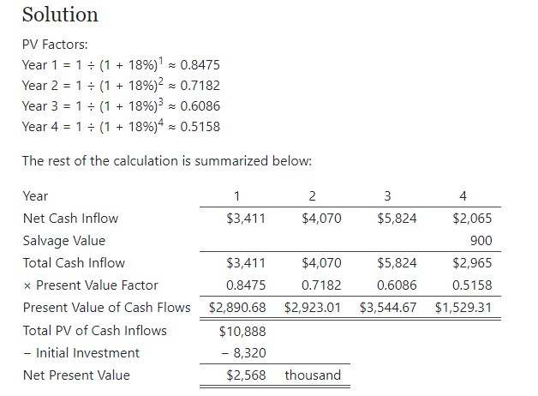
Solution

Slide 33
Financial Return methods
Internal rate of return (IRR) can by calculated by setting the NPV to zero:
  IRR is the discount rate when the present value of the cash inflows equals the original investment.
    This is a complex but accurate calculation.
    You should choose projects with the highest IRR value.

Slide 34
Internal Rate of Return (IRR)
IRR % of Return on investment.
To put it simple: It is the percentage of Return of your investment.
How do we calculate IRR?
  If you remember from NPV example, we mentioned that the NPV is dependent on Discounted rate
    If we increase the discount rate the NPV value decreases and vice versa
  We need to increase /decrease the discount rate to a level where NPV becomes zero
  The discount rate at which NPV becomes zero is the Internal rate of return

Slide 35
IRR
Let’s say at 8%, Discount rate, the NPV is 5000
And
Let’s say at 12%, Discount rate, the NPV is 0
Then 12% is the return, we are getting from the project And
This 12% is called the IRR.
Discount Rate
Net Present Value

Slide 36
Internal Rate of Return (IRR)
Accept the project when Internal rate of return > Discount rate
Reject the project when Internal rate of return < Discount rate
May accept the project when Internal rate of return = Discount rate

Slide 37
  Relationship between IRR, Discount rate and NPV
If IRR > Discount rate ------ The NPV is always Positive.
If IRR < Discount rate --------The NPV is always Negative.
If IRR = Discount rate -------The NPV is Zero.
Note: As long as the NPV is Positive, the project is financially viable.
The moment that NPV becomes Negative, the Project is NOT financially viable.
Notes:
Possible feasible practical

Slide 38
Calculating Internal Rate of Return
Example:
The cost of a project is $1000. It has a time horizon of 5 years and the expected year wise incremental cash flows are:
Year 1 : $200
Year 2 : $300
Year 3 : $300
Year 4 : $400
Year 5 : $500
Compute IRR of the project. If opportunity cost of Capital is 12%, And tell us, should we accept the project?
Solution:
Step 1: Take “K” as 12% and calculate NPV value.
Step 2: If NPV < 0 then Project is NOT financially viable at 12% discount rate.
Step 3: If NPV > 0 then Project is financially viable at 12% however we need to know the actual IRR value, so we need to increase the K value to and calculate the NPV, continue it till you reach a point where the NPV becomes zero or close to zero.
Step 4: The “K” value at which NPV becomes Zero or “Near Zero” is the actual IRR (Internal Rate of Return)

Slide 39
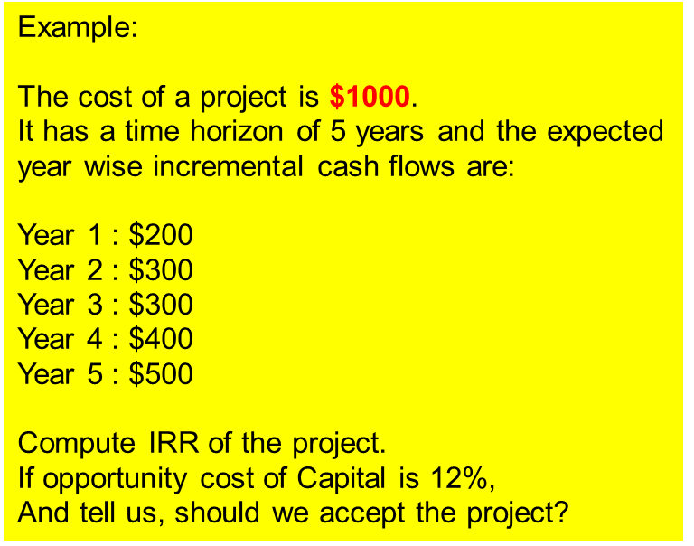
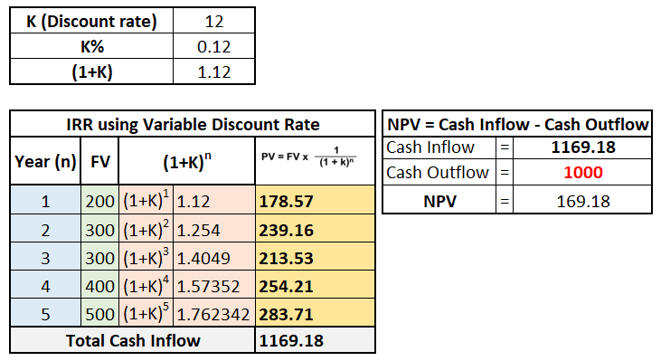

Calculating Internal Rate of Return
At Discount Rate of 12%, the NPV is 169 (positive)
At Discount Rate of 17.7%, the NPV is 0 (Zero), therefore the IRR is 17.7%
Since IRR > Discount rate, Project can be accepted

Slide 40
Return on Investment
Return on investment (ROI) is a financial metric that is widely used to measure the probability of gaining a return from an investment. It is a ratio that compares the gain or loss from an investment relative to its cost.
It is as useful in evaluating the potential return from a stand-alone investment as it is in comparing returns from several investments.

Slide 41
Steps
ROI is calculated by subtracting the initial value of the investment from the final value of the investment (which equals the net return), then dividing this new number (the net return) by the cost of the investment, and, finally, multiplying it by 100.
ROI is relatively easy to calculate and understand, and its simplicity means that it is a standardized, universal measure of profitability.

Slide 42
How to Calculate Return on Investment (ROI)
ROI = Net Income / Cost of Investment

Slide 43
EXAMPLE
An investor purchases property A, which is valued at $500,000. Two years later, the investor sells the property for $1,000,000.
We use the investment gain formula in this case.
ROI = (1,000,000 – 500,000) / (500,000) = 1 or 100%

Slide 44
As mentioned above, one of the drawbacks of the traditional return on investment metric is that it doesn’t take into account time periods. For example, a return of 25% over 5 years is expressed the same as a return of 25% over 5 days. But obviously, a return of 25% in 5 days is much better than 5 years!
To overcome this issue we can calculate an annualized ROI formula.
ROI Formula:
= [(Ending Value / Beginning Value) ^ (1 / # of Years)] – 1

Slide 45
EXAMPLE
An investor has a portfolio with a beginning value of $2,000 and an ending value of $5,000 over a five-year time period.
To calculate the total return rate (which is needed to calculate the annualized return), the investor will perform the following formula: (ending value - beginning value) / beginning value, or (5000 - 2000) / 2000 = 1.5.
This gives the investor a total return rate of 1.5.

Slide 46
Next, the investor will perform the annualized return formula: (1 + Return) ^ (1 / N) - 1. Using the information given, this gives the investor the following formula to calculate: (1 + 1.5) ^ (1 / 5) - 1. The following are the calculations used to get the answer to this formula:
1 + 1.5 = 2.5
2.5 ^ (1 / 5 or .2) = 1.32
1.32 - 1 = .32 or 32%

Slide 47
EXAMPLE
For example, an investor buys a stock on January 1st, 2017 for $12.50 and sells it on August 24, 2017, for $15.20. What is the regular and annualized return on investment?
Regular = ($15.20 – $12.50) / $12.50 = 21.6%
Annualized = ?

Slide 48
Important: Few tips to Remember
Always choose projects with highest NPV.
If NPV is same for the given projects, choose the project with highest IRR.
If NPV, IRR remains the same for the given projects, choose the projects with early pay back period.
NPV = All Cash Inflows – Cash Outflows
IRR = Discount rate at which the NPV becomes zero, this tell us what is the percent of return for the project.
Payback period is a major consideration for every project, business or organization, it tells us how soon we can recover our investment and this investment can be utilized for other business needs/projects later on.

Slide 49
Cash Benefit Analysis-CBA
Year | Project 1 | Project 2 | Project 3 | Project 4
0 | 100,000 | 1000000 | 100000 | 120000
1 | 10,000 | 200000 | 30,000 | 30,000
2 | 10,000 | 200000 | 30,000 | 30,000
3 | 10,000 | 200000 | 30,000 | 30,000
4 | 20,000 | 200000 | 30,000 | 30,000
5 | 100,000 | 300,000 | 30,000 | 75,000
Cash Flow | 150,000 | 1,100,000 | 150,000 | 195,000

Slide 50
Financial Return methods
Year | Project 1 | Project 2 | Project 3 | Project 4
0 | -100,000 | -1,000,000 | -100,000 | -120,000
1 | 10,000 | 200,000 | 30,000 | 30,000
2 | 10,000 | 200,000 | 30,000 | 30,000
3 | 10,000 | 200,000 | 30,000 | 30,000
4 | 20,000 | 200,000 | 30,000 | 30,000
5 | 100,000 | 300,000 | 30,000 | 75,000
Net Profit | 50,000 | 100,000 | 50,000 | 75,000
Payback | 5 | 5 | 4 | 4
Project 2 in Table shows the greatest Net Profit but this is at the expense of a large investment.
if we had Rs: lm to invest, we might undertake all of the other three projects and obtain an even greater net profit.
(negative values represent net expenses, positive values represent net incomes), Assumptions:
1. Cash flow take place at the end of each year.
2. The year 0 figure represents the initial investment made at the start of the project.
Payback favor Project 3 or 4
But Project 3 has shorter payback period

Slide 51
CBA - Payback
Year | Project 1 | Project 2 | Project 3 | Project 4
 | 100,000 | 1000000 | 100000 | 120000
Cash Flow | 150,000 | 1,100,000 | 150,000 | 195,000
Net Profit | 50,000 | 100,000 | 50,000 | 75,000
Payback | 5yrs | 5yrs | 4yrs | 4yrs
Avg Annual Profit | 10000 | 20000 | 10000 | 15000
Net Profit = cash flow – investment
Payback = invested money start profit
Avg Annual Profit = net profit / payback pd

Slide 52
CBA-ROI
Return on investment (ROI) a.k.a accounting rate of return (ARR) provides a way of comparing the net profitability to the investment required.
Year | Project 1 | Project 2 | Project 3 | Project 4
0 | 100,000 | 1000000 | 100000 | 120000
Net Profit | 50,000 | 100,000 | 50,000 | 75,000
Payback | 5yrs | 5yrs | 4yrs | 4yrs
Avg Annual Profit | 10000 | 20000 | 10000 | 15000
ROI (%) | 10 | 2 | 10 | 12.5
There are certain variation in the formula for calculating ROI but straightforward way is
ROI = (Avg Annual Profit / Total investment) x 100

Slide 53
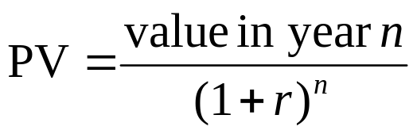
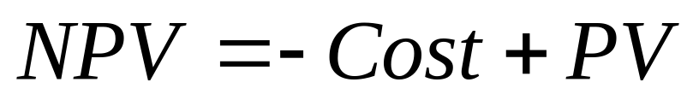
CBA- NPV
Year |  | Project 1 | Project 2 | Project 3 | Project 4
0 |  | 100,000 | 1000000 | 100000 | 120000
Discount Factor | 10% | 100,618 | ? | ? | ?
NPV |  | 618 | ? | ? | ?

Slide 54
CBA
Year | Project 1 | Project 2 | Project 3 | Project 4
0 | 100,000 | 1000000 | 100000 | 120000
Cash Flow | 150,000 | 1,100,000 | 150,000 | 195,000
Net Profit | 50,000 | 100,000 | 50,000 | 75,000
Payback | 5yrs | 5yrs | 4yrs | 4yrs
Avg Annual Profit | 10000 | 20000 | 10000 | 15000
ROI (%) | 10 | 2 | 10 | 12.5
NPV | 618 | ? | ? | ?

