Slide 1
Project Management Processes

Slide 2
Project Management
What is Project Management?
Project management is the application of knowledge, skills, tools, and techniques to project activities to meet project requirements.
Project management is accomplished through the use of the process groups such as:
initiating, planning, executing, monitoring, controlling, and closing
many of the processes within project management are iterative in nature
Notes:
Temporary:
can be years
Result can be lasting
Team can be temporary
Finite duration
Ex: thousands of buildings, but each is unique
Scope s/b constant even as elaboration happens

Slide 3
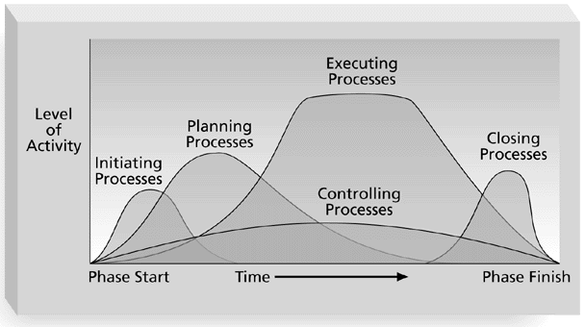

Slide 4
PMI Knowledge Areas
Knowledge areas describe the key competencies that project managers must develop.
Four core knowledge areas lead to specific project objectives (scope, time, cost, and quality).
Four facilitating knowledge areas are the means through which the project objectives are achieved (human resources, communication, risk, and procurement management).
One knowledge area (project integration management) affects and is affected by all of the other knowledge areas.
All knowledge areas are important!
Notes:
The ability to do something successfully.

Slide 5
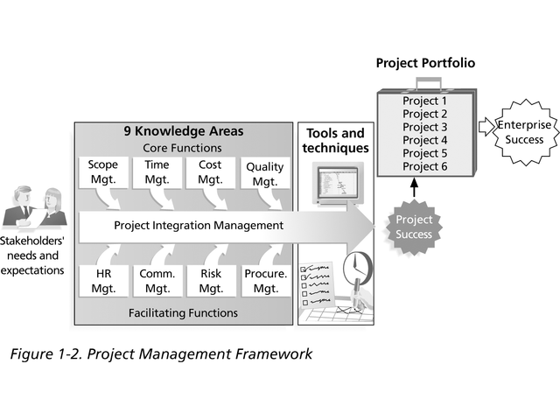

Slide 6
Scope Management
A subset of project management that includes the processes required to ensure that the project includes all the work required, and only the work required, to complete the project successfully.
1. Initiation
Authorizing the project (or phase)
2. Scope planning
developing a written scope statement as the basis for future
project decisions.
3. Scope definition
subdividing the major project deliverables into smaller, more
manageable components.
4. Scope verification
formalizing acceptance of the project scope.
5. Scope change control
controlling changes to project scope.
Notes:
To give permission and approval

Slide 7
Time Management
A subset of project management that includes the
processes required to ensure timely completion of the
project.
1. Activity definition
–identifying the specific activities that must be performed to produce the various project deliverables
2. Activity sequencing
–identifying and documenting interactivity dependencies
3. Activity duration estimating
–estimating the number of work periods which will be needed to complete individual activities

Slide 8
Time Management--cont
4. Schedule development
–analyzing activity sequences, activity durations, and resource requirements to create the project schedule
5. Schedule control
–controlling changes to the project schedule

Slide 9
Cost Management
A subset of project management that includes the processes required to ensure that the project is completed within the approved budget.
1. Resource planning
– Determining resources and what quantities of each should be used
2. Cost Estimating
– Developing approximation of the costs of the resources need
3. Cost budgeting
– Allocating the overall cost estimate to individual work items
4. Cost Control
- Controlling changes to the project budget

Slide 10
Quality Management
A subset of project management that includes the processes required to ensure that the project will satisfy the needs for which it was undertaken.
1. Quality Planning
– Identifying which quality standards are relevant to the project and determining how to satisfy them.
2. Quality Assurance
– Evaluating overall project performance on a regular basis to provide confidence that the project will satisfy the relevant quality standards
3. Quality Control
– Monitoring specific project results to determine if they comply with relevant quality standards and identifying ways to eliminate causes of unsatisfactory performance
Notes:
Since QA is involved during the initial phase of the Software Development and QC is involved during the execution phase of Software Development

Slide 11
Human Resource Management
A subset of project management that includes the
processes required to make the most effective use of the
people involved with the project.
1. Organizational planning
– Identifying, documenting, and assigning project roles, responsibilities, and reporting relationships
2. Staff acquisition
– Getting the human resources
3. Team development
– Developing individual and group skills to enhance project
performance

Slide 12
Communication Management
A subset of project management that includes the processes required to ensure timely and appropriate generation, collection, dissemination, storage, and ultimate disposition of project information.
1. Communications planning
– Determining the information and communication needs of the stakeholders
2. Information distribution
– Making needed information available to project stakeholders in a timely manner
3. Performance reporting
– Collecting and disseminating performance information
4. Administrative closure
– Generating, gathering, and disseminating information to Formalize phase or project completion

Slide 13
Managers VS Leaders
Effective project managers provide leadership by example
A leader focuses on long-term goals and big-picture objectives while inspiring people to reach those goals
A manager deals with the day-to-day details of meeting specific goals
Project managers often take on the role of both leader and manager
“Managers do things right, leaders do the right thing”
“Leaders determine the vision, managers achieve the vision”

Slide 14
Project Management Institute
Founded in 1969 .
It is now the leading membership association for the project management profession around the globe.
PMI is actively engaged in advocacy for the profession, setting professional standards, conducting research and providing access to a wealth of information and resources.
PMI also promotes career and professional development and offers certification, networking and community involvement opportunities.
PMIs Project Management Professional (PMP®) credential is the most widely recognized and the only global certification in the profession.

Slide 15
Project Management Professional
PMI provides certification as a Project Management Professional (PMP)
A PMP has documented sufficient project experience, has agreed to follow a code of ethics, and has passed the PMP exam
Ethics, loosely defined, is a set of principles that guide our decision making based on personal values of what is “right” and “wrong”
Project managers often face ethical dilemmas
Do they ask themselves whether or not they are doing the right thing?
In order to earn PMP certification, applicants must agree to PMI’s Code of Ethics and Professional Conduct
Several questions on the PMP exam are related to professional responsibility, including ethics

Slide 16
Project Management Office- PMO
A PMO is an organizational group responsible for coordinating the project management function throughout an organization.
Possible goals include:
Collect, organize, and integrate project data for the entire organization.
Develop and maintain templates for project documents.
Develop or coordinate training in various project management topics.
Develop and provide a formal career path for project managers.
Provide project management consulting services.

Slide 17
Projects in Controlled Environments (PRINCE2)
Prince2 is an established method for project management
It covers the management, organization and the control of projects of all shapes and sizes.
The methodology itself defines a process based approach to project management, with inputs, outputs and objectives clearly identified.
It also details a stage by stage approach, ensuring that progress can be properly monitored.
Whole project is driven by the business requirements, managers are encouraged to make the process general, often including suppliers and customers.
The intention is that projects should be properly controlled and defined, but with flexibility and good communication.
Notes:
PRINCE2 project management is a process-based approach that focuses on organization and control over the entire project, from start to finish. That means projects are thoroughly planned before kickoff, each stage of the process is clearly structured, and any loose ends are neatly tied up after the project concludes

Slide 18
Elements of PRINCE2
8 Processes
- 8 Components
- 3 Techniques
Processes
SU (starting up a Project)
Research whether it’s useful to start the project and to create a management environment
IP (Initiating a Project)
setup the project environment and planning and get commitment
DP (Directing a Project)
Activities of the board in relation to making decisions
CS (Controlling a Stage)
Daily management of a phase (project manager).
Notes:
The purpose of the directing a project process is to enable the project board to be accountable for the project's success by making key decisions and exercising overall control while delegating day-to-day management of the project to the Project Manager.

Slide 19
Processes
MP (Managing Product Delivery)
Coordination by Team managers of operational activities
SB (Managing Stage Boundaries)
Preparation of decisions of the board by the project manager
CP (Closing a Project)
Controlled finishing of the project
Pl (Planning)
Creation of several plans during the lifecycle of the project.
Notes:
Managing Stage Boundaries (SB) is one of seven processes outlined by PRINCE2. It is a decision point in the continuity of the project, from which the project will be either continued as planned, adjusted or stopped. The process involves reviewing the current stage (is the business case still valid, should we proceed to the next stage^{[1]}), preparing for the next one, and selecting information which can be of use later in the project.

Slide 20
Elements of PRINCE2
8 Processes
- 8 Components
- 3 Techniques
Components
Business case
Justification of the project
Organization
Roles, tasks, responsibilities
Plans
Different kinds of plans that are necessary
Controls
Mechanisms to measure, drive, and splitting up in phases
Notes:
A business case provides justification for undertaking a project, programme or portfolio. It evaluates the benefit, cost and risk of alternative options and provides a rationale for the preferred solution.
These components must be managed for successful project management.

Slide 21
Management of Risk
Analyzing and controlling of risks
Quality in a Project Environment
Making sure that the products have the right quality measures
Configuration Management
Registration and managing the products of the project
Change Control
Managing changes and disruptions

Slide 22
Elements of PRINCE2
8 Processes
- 8 Components
- 3 Techniques
Product based Planning
Change Control Technique
Quality Review Technique

Slide 23
Assignment
Difference between PMBOK and PRINCE2.
Submission date: 10-10-2023

Slide 24
PMBOK Vs PRINCE2
PMBOK | PRINCE2
Comprehensive | Focuses on key risk areas only; does not claim to be complete
Descriptive | Prescriptive
Core and facilitating processes; need to be scaled to needs of project | All processes should be considered; also need to be scaled
Customer requirements driven | Business case driven
Sponsor and stakeholders | Clear project ownership and direction by senior management
US/International Standard | UK Standard

Slide 25
PMBOK Vs PRINCE2
PMBOK Guide Knowledge Area | Comparable PRINCE2 Components
Integration | Combined Processes, Components, Change Control
Scope, Time, Cost | Plans, Business Case
Quality | Quality, Configuration Management
Risk | Risk
Communications | Controls
Human Resources | Organisation (limited)
Procurement | Need to create procurement products
Notes:
Knowledge: what u should know
Method: what u should do.
How when,whom,what

Slide 26
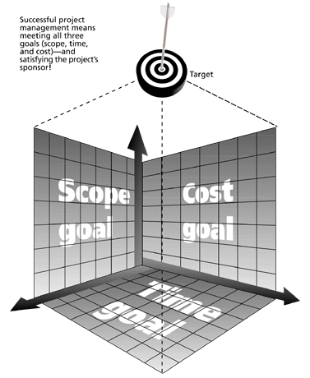
The Triple Constraint
Every project is constrained in different ways by its
Scope goals: What work will be done?
Time goals: How long should it take to complete?
Cost goals: What should it cost?
It is the project manager’s duty to balance these three often competing goals
Successful project management means meeting all three goals (scope, time, and cost) – and satisfying the project’s sponsor!

Slide 27
Time Goals
Time
For analytical purposes,
The time required to produce a deliverable is estimated using several techniques like WBS.
One method is to identify tasks needed to produce the deliverables documented in a work breakdown structure or WBS.
The tasks are also prioritized, dependencies between tasks are identified, and this information is documented in a project schedule.
The dependencies between the tasks can affect the length of the overall project (dependency constrained), as can the availability of resources (resource constrained).

Slide 28
Cost Goals
Cost
Cost to develop a project depends on several variables including:
resource costs, material rates, risk management (i.e. cost contingency), equipment cost escalation, and profit.
Beyond this basic accounting approach to fixed and variable costs, the economic cost that must be considered includes
worker skill and productivity.
Hiring temporary or contract employees or outsource work.
Notes:
a future event or circumstance which is possible but cannot be predicted with certainty. contingency

Slide 29
Scope Goals
Scope
Requirements specified to achieve the end result.
The overall definition of what the project is supposed to accomplish, and a specific description of what the end result should be or accomplish.
A major component of scope is the quality of the final product.
The amount of time put into individual tasks determines the overall quality of the project.
Together, these three constraints have given rise to the phrase "On Time, On Spec, On Budget."

Slide 30
Project Objectives
To have a successful software project, the manager and the project team members must know what will constitute success.
This will make them concentrate on what is essential to project success.
There is a need for well-defined objectives that are accepted by all these people
Objectives are the concrete statements that describe the things a project is trying to achieve.
should be written so that it can be evaluated at the conclusion of a project to see whether it was achieved

Slide 31
SMART criteria
Objectives can be formulated using S.M.A.R.T. technique
Specific,
Measurable,
Achievable (or Acceptable),
Realistic
Time bounded.

Slide 32
Setting Objectives
Where there is more than one user group then a project authority needs to be identified which has overall authority over the project
This authority is often held by a project steering committee (or project board) which has overall responsibility for setting, monitoring and modifying objectives
The project manager has the responsibility for running the project on a day-to-day basis, but has to report to the steering committee at regular intervals
Only the steering committee can authorize changes to the project objectives and resources
Notes:
WHAT IS steering committee?
A steering committee is a group of high-level advisors who have been asked to govern an organization or organizational segment and provide it with direction.

Slide 33
Sub objectives & Goals
Objectives will be broken down into goals or sub-objectives
in order to achieve the objective we must achieve certain goals first
These goals are steps on the way to achieving an objective, just as goals scored in a football match are steps towards the objective of winning the match

Slide 34
Objectives – An Example
An objective statement might be to
"upgrade the helpdesk telephone system by December 31 to achieve average client wait times of no more than two minutes".
The objective seems fairly specific in its statement about upgrading the phone system.
The objective is measurable in terms of the average client wait times the new phone system is trying to achieve.
One can assume that the objective is achievable and realistic by a project team.
The objective is time-bound and should be completed by December 31.
Satisfying S.M.A.R.T technique

Slide 35
Project Life Cycle
Characteristics of Project Life cycle
Projects very in size and complexity but have following :
Starting a Project
Organizing and Preparing
Carrying out Project work
Closing the Project
The stages in a classic life cycle of the project are:
Requirement Analysis
Specification
Coding
Verification and validation
Implementation/installation
Maintenance and support

Slide 36
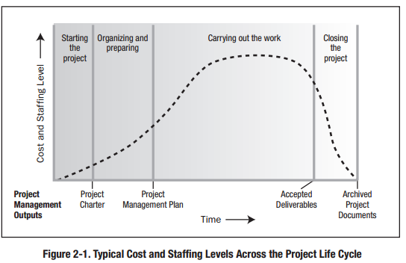

Slide 37
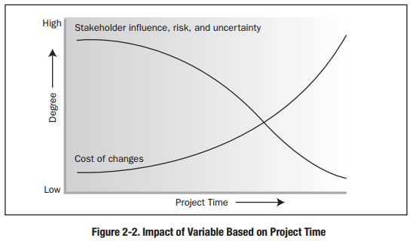

Slide 38
Project Initiating
Initiating a project includes recognizing and starting a new project or project phase.
Some organizations use a pre-initiation phase, while others include items such as developing a business case as part of the initiation.
The main goal is to formally select and start off projects.
Key outputs include:
Assigning the project manager.
Identifying key stakeholders.
Completing a business case.
Completing a project charter and getting signatures on it.
Notes:
A business case provides justification for undertaking a project, programme or portfolio. It evaluates the benefit, cost and risk of alternative options and provides a rationale for the preferred solution.

Slide 39
Project Charter
Project charter is a document that formally recognizes the existence of a project and provides a direction on the project’s objectives and management.
Purpose of the Project Charter
Document the project objectives
Define project infrastructure
Summarize details of project plan
Define roles and responsibilities
Set out project control mechanisms
Notes:
Project Infrastructure refers to the organisational structure, processes, tools, techniques and training an organisation puts in place to make projects more successful
Organizational structure is a way or method by which. organizational activities are divided, organized and coordinated.

Slide 40
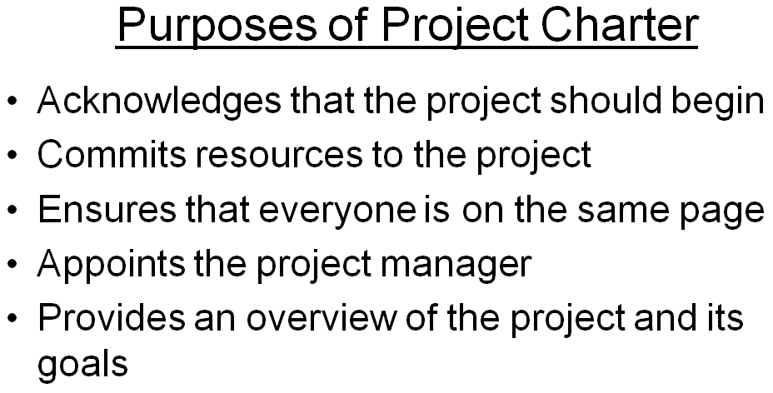

Slide 41
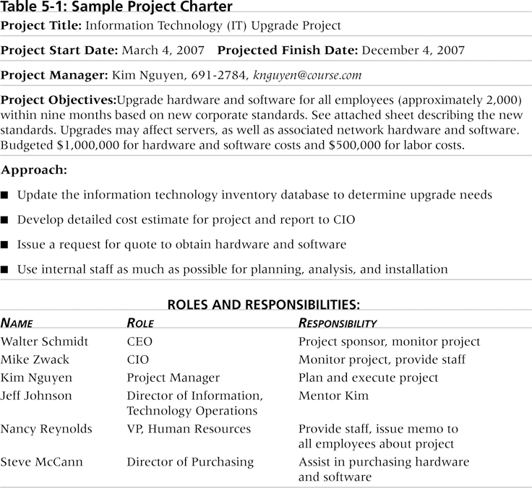
Notes:
Chief info. officer

Slide 42
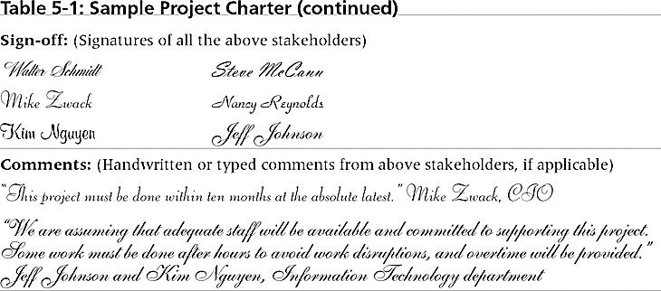

Slide 43
Project Overview Statement (POS)
Purpose:
To secure senior management approval
Size:
Ideally one page; states what is to be done, why it is to be done. What business value it will provide
Five Components:
1) Problem/opportunity
2) Project Goal
3) Project Objectives
4) Success Criteria
5) Assumptions, risks, obstacles
Project Definition Statement (PDS)
PDS is similar to POS but more detailed and for development team (project manger and team) Just like POS is for customer and PM.

Slide 45
Statement of Work (SOW)
• A formal project definition document
• SOW and Project charter are often used interchangeably
• It provides basis for the rest of the formal detailed project plan
• It contains
– The purpose of statement
– The scope statement*
– The project deliverables
– The goals and objectives
– The cost and schedule estimates
– List of stakeholders
– The chain of command
– Assumptions and agreements
– The communication plan
Notes:
What's the difference between an SOW, a scope of work, and a project charter? A statement of work is a highly detailed, legally-binding contract, while a project charter is a shorter, high-level, non-legal overview. You'll often create project charters after the SOW.

Slide 46
Project Kickoff
The project has officially begun.
The charter has been published and distributed, the project manager has been appointed, and you're ready for the next step the project kickoff meeting.
The purpose of the kickoff meeting is to:
Accomplish verbally what you accomplished in writing,
Communicate the objective and purpose of the project,
Gain support and the commitment of resources for the project,
Explain the roles and responsibilities of the key stakeholders.

