Slide 1
Software Project Scope Management

Slide 2
Review
What is the project charter?
The project charter is the first document that exists in the project.
It causes the project to come into existence.
The project charter names the project and briefly describes it.
It names the project manager and causes a cost account to be opened to capture the cost of the project.
Once these essential things have been done, work on the project can proceed.
The project charter is written by the project sponsor, or some senior executive and signed by all relevant stakeholders.

Slide 3
The Project charter is created by:
The project manager
Upper management
The Vice President over a functional management group

Slide 4
Who needs software?
Most software is built in organizations for people with specific needs.
A stakeholder is anyone who has an interest (or stake) in the software being completed
A user is someone who will need to use the software to perform tasks.
Sometimes stakeholders will be users; but often the stakeholder will not use the software.
For example, a senior manager (like a CEO in a company) will usually have a stake in the software that is built, even if they won’t ever use it.

Slide 5
Who builds software?
Software is typically built by a team of software engineers, which includes:
Business analysts or requirements analysts:
Talk to users and stakeholders, plan the behavior of software and write software requirements
Designers and architects:
Plan the technical solution
Programmers:
write the code
Testers:
Verify that the software meets its requirements and behaves as expected

Slide 6
Project Generator
Business need
Market demand
Project
Customer request
Legal requirement
Technological advance
Social need

Slide 7
Project initiation
Project Selection & Prioritization
Request for Project (Document)
Project Requests
Project 1
Feasibility Study
Meeting with Stakeholders
Working with Project Sponsor
Project 2
payback period
Project 3
Cost-benefit analysis
Project Charter
IRR
ROI
Strategic Plan
Risks and Impact
Project n
Constraints
Pre Project Phase
Notes:
The internal rate of return (IRR) of a project is the expected growth rate of a project investment.

Slide 8
Why - Project
Three important criteria for projects:
There is a need for project
There are funds available
There’s a strong will to make project succeed
After deciding what project to work on, it’s important to formalize projects

Slide 9
Identifying Needs
The project manager drives the scope of the project.
The project manager should identify and talk to the main stakeholder
what the project contains or delivers
The effective way to show stakeholders that their needs are understood and that those specific needs will be addressed is with a vision and scope document
The Scope Statement provides a common understanding of the project among stakeholders
Some organizations create a separate Scope Statement Document while others make it a part of the Project Charter or Project Plan.

Slide 10
Project Scope Management?
Scope refers to all the work involved in creating the products of the project and the processes used to create them
A deliverable is a product produced as part of a project,
such as hardware or software, planning documents, or meeting minutes
External deliverables
things the project delivers to the users e.g. screens and reports. Users typically think of a system in these terms. It also includes any hardware or software required by the users or the project team.
Internal deliverables
things the project generates internally e.g. Project Charter, Business Requirement Specification etc.
Project scope management includes
The processes involved in defining and controlling what is or is not included in a project

Slide 11
Scope (most critical step):
Clearly describe the boundaries of your project and get the client's agreement as well.
High level-scope statement (SOW (Statement of Work).
When the project is about to be funded, a set of defined deliveries and objectives must be defined
Project objectives can be used for defining the project scope
Defining the out of scope also helps to understand the scope
Document “IN” and “OUT” of Scope

Slide 12
The knowledge area of Project Scope Management
The knowledge area of Scope Management includes the processes required to ensure that the project includes all the work, and only all the work required to complete the project successfully. It is primarily concerned with controlling what is and what is not in the scope.
Process | Project Group | Key Deliverables
Plan Scope Management | Planning
Collect Requirements | Planning | Requirements document
Define Scope | planning | project scope statement
Create WBS | planning | WBS, WBS dictionary
Validate Scope | Monitoring and Controlling | Acceptance deliverables
Control Scope | Monitoring and Controlling | Change Requests

Slide 13
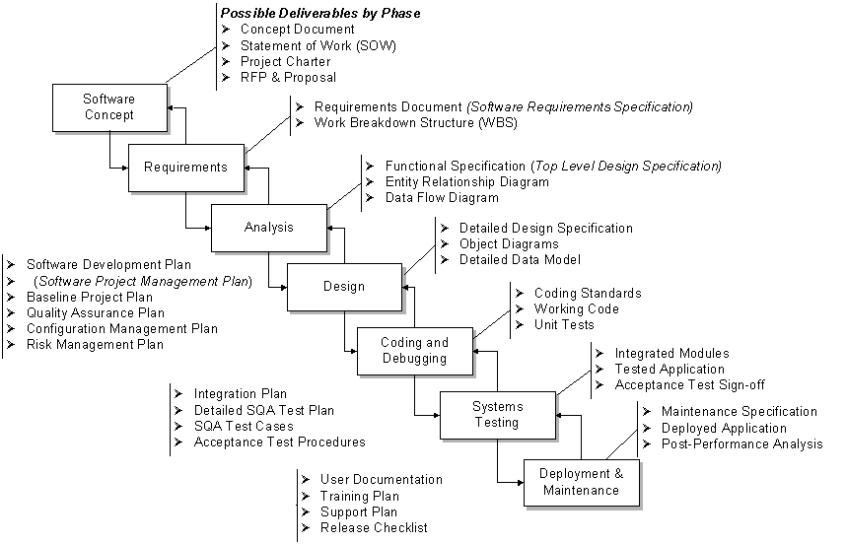
Potential Deliverables by Phase

Slide 14
Each project phase is marked by completion of one or more:
Tasks.
Milestones
Deliverables
Life cycles

Slide 15
Each project phase is marked by completion of one or more:
Tasks.
Milestones
Deliverables
Life cycles
Answer: Deliverables

Slide 16
Deliverables are the actual product which is delivered during the project or a certain period of the project.
It is tangible as well as verifiable.
It must meet the original project requirements, such as specifications.
Milestones mark the accomplishment of a tangible objective of the project such, as the completion of the design phase.
Milestones are defined in the work breakdown structure (WBS).

Slide 17
Project Scope Management Processes
Scope planning:
Deciding how the scope will be defined, verified, and controlled
Scope definition:
Reviewing the project charter and preliminary scope statement and adding more information as requirements are developed and change requests are approved
Creating the WBS:
Subdividing the major project deliverables into smaller, more manageable components
Scope verification:
Formalizing acceptance of the project scope
Scope control:
Controlling changes to project scope

Slide 18
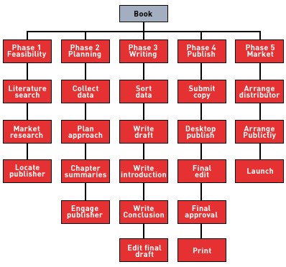

Slide 19
Preliminary Scope Statements
A scope statement is a document used to develop and confirm a common understanding of the project scope
It’s important for preventing scope creep
the tendency for project scope to keep getting bigger
It’s good practice to develop a preliminary or initial scope statement during project initiation and a more detailed scope statement as the project progresses.

Slide 20
Project scope statement
Project scope statement should include
A description of the project
Overall objectives and justification
Detailed description of all project deliverables
The characteristics and requirements of products and services

Slide 21
Scope Management Plan
The scope management plan
A document that includes:
Descriptions of how the team will prepare the project scope statement,
create the WBS,
verify completion of the project deliverables, and
control requests for changes to the project scope
Key inputs include:
The project charter, preliminary scope statement, and project management plan

Slide 22
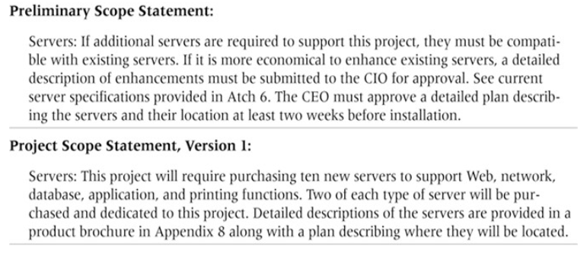
Example

Slide 23
Stakeholder Analysis
A stakeholder analysis documents holds important (often sensitive) information about stakeholders such as
stakeholders’ names and organizations
roles on the project
unique facts about stakeholders
level of influence and interest in the project
suggestions for managing relationships

Slide 24
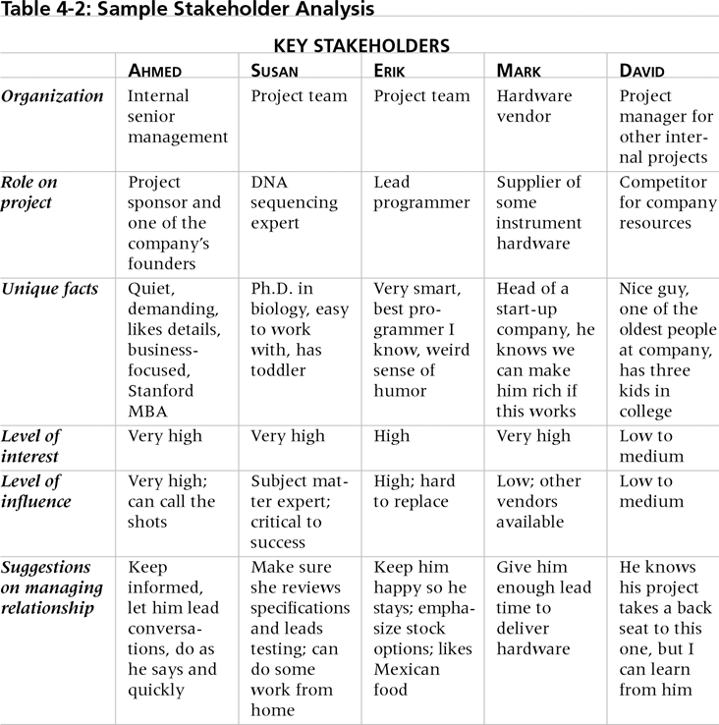
Sample Stakeholder Analysis

Slide 25
Stakeholder Roles and Responsibilities
Stakeholder | Responsibility
Project manager | Manages project, creates project plans, creates various management plans related to the project, measures project performance, takes corrective action, controls project outcomes, manages project team, and reports status
Project sponsor | Executive who initiates and oversees the project. Serves as an advisor to the project manager; can resolve issues and make decisions. Issues the project charter. Serves on project oversight or steering committee.
Functional managers | Responsible for completing project activities and producing deliverables. May serve on project oversight or steering committee to help oversee management of the project.
Customer | Provides project requirements. Approves project deliverables and verifies that they meet requirements. Serves on project oversight or steering committee.
Project team | Responsible for completing the activities of the project.
Suppliers | Provide goods or services to assist project team in completing project.

Slide 26
Work Breakdown Structure: WBS
A WBS is a deliverable-oriented grouping of the work involved in a project that defines the total scope of the project
WBS is a foundation document that provides the basis for:
Planning and managing project schedules, costs, resources, and changes
Decomposition is subdividing project deliverables into smaller pieces

Slide 27
Work Breakdown Structure: WBS
Hierarchical list of project’s work activities
Two Formats
Outline (indented format)
Graphical Tree (Organizational Chart)
Uses a decimal numbering system
Ex: 3.1.5
0 is typically top level

Slide 28
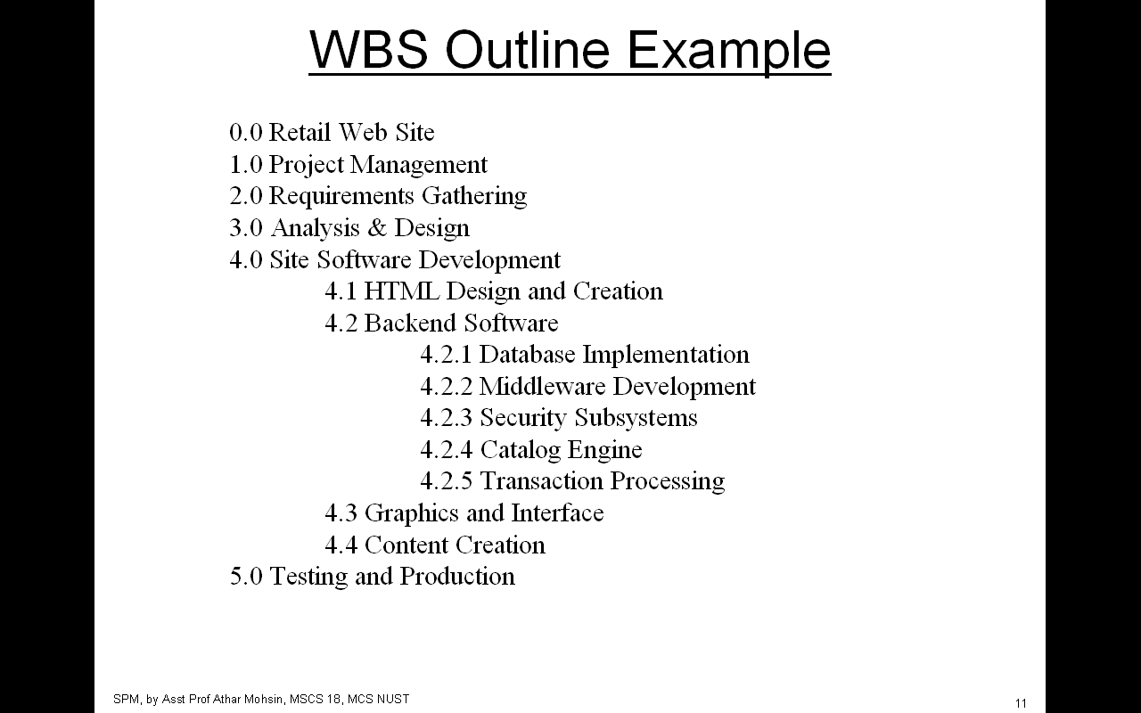
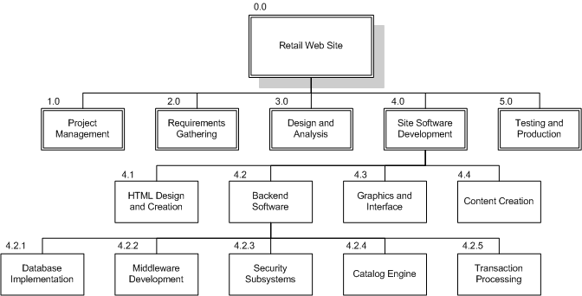
WBS Chart Example

Slide 29
WBS Types
Process WBS (a.k.a Activity-oriented)
Ex: Requirements, Analysis, Design, Testing
Typically used by PM
Product WBS (a.k.a. Entity-oriented)
Ex: Interface system, DB
Typically used by engineering manager

Slide 30
WBS Dictionary
Many WBS tasks are ambiguous and must be explained in more detail so people know what to do and can estimate how long the work will take and what it will cost.
A WBS dictionary is a document that describes detailed information about each WBS item.
The approved project scope statement and its WBS and WBS dictionary form the scope baseline, which is used to measure performance in meeting project scope goals.

Slide 31
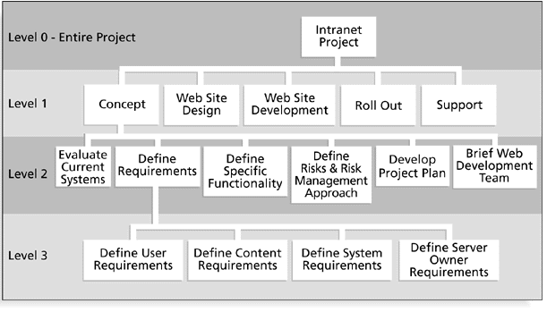

Slide 32
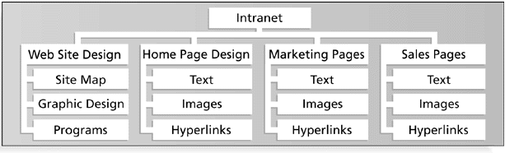

Slide 33
Work Packages
Generic term for discrete tasks with definable end results
Typically the “leaves” on the tree
Basis for monitoring and reporting progress
Ideally shorter rather than longer
Longer makes in-progress estimates needed
2-3 weeks maximum for software projects
1 day minimum (occasionally a half day)

Slide 34
WBS Techniques
Top-down
Start at highest level
Systematically develop increasing level of detail
Best if
The problem is well understood
Technology and methodology are not new
This is similar to an earlier project or problem
But is also applied in majority of situations
Bottom-up
Start at lowest level tasks
Cons
Time consuming
Needs more requirements complete
Pros
Detailed

Slide 35
WBS Techniques
Analogy
Base WBS upon a “similar” project
Use a template
Pros
Based on past actual experience
Cons
Needs comparable project
Notes:
Review WBSs of similar projects and tailor to your project.

Slide 36
WBS Techniques
Brainstorming
Generate all activities you can think of that need to be done
Group them into categories
Both Top-down and Brainstorming can be used on the same WBS

Slide 37
WBS – Basis of Many Things
Network scheduling
Costing
Risk analysis
Organizational structure
Control
Measurement
Notes:
Organizational structure is a way or method by which. organizational activities are divided, organized and coordinated. The organizations created the structures to coordinate the. activities of work factors and control the member performance

Slide 38
Causes of Scope Creep
Scope creep is scope keep getting bigger and bigger
Poor WBS
Underestimating the Complexity of the Project
Over budget and over time
Lack of Change Control
Notes:
Scope creep is what happens when changes are made to the project scope without any control procedure like change requests. Those changes also affect the project schedule, budget, costs, resource allocation and might compromise the completion of milestones and goals

Slide 39
Scope Verification
Scope verification involves formal acceptance of the completed project scope by the stakeholder
Careful procedures must be developed to ensure the customer is getting what they want, and the project team has enough time and money to produce the desired products and services

Slide 40
Scope control
Scope control involves controlling changes to the project scope.
Goals of scope control are to:
Ensure changes are processed according to procedures developed as part of integrated change control.
Manage changes when they occur.
Variance is the difference between planned and actual performance.

