Slide 1
Software Project Planning

Slide 2
‘Step Wise’ - an overview
0.Select
project
1. Identify
project objectives
2. Identify project
infrastructure
3. Analyse
project
characteristics
Review
4. Identify products
and activities
5. Estimate effort
for activity
Lower
level
detail
For each
activity
6. Identify activity
risks
10. Lower level
planning
7. Allocate
resources
9. Execute plan
8. Review/ publicize
plan

Slide 3
Step Wise – An Overview
Step 0: Select project
Aim is to decide whether a project is worth undertaking
Step 1: Identify project scope and objectives
Aim is to have a well-defined project scope and objectives
Step 2: Identify project infrastructure
Aim is to know the precise nature of the project infrastructure
A project is initiated somehow.
This is not a planning activity.
It may need to decide whether the project is worth undertaking.
It may need to evaluate the project.

Slide 4
Step 1.1 Identify objectives and practical measures of the effectiveness in meeting those objectives
Step 1.2 Establish a project authority To ensure the unity of purpose among all persons concerned
Step 1.3 Identify all stakeholders in the project and their interests
Step 1.4 Modify objectives in the light of stakeholder analysis
Step 1.5 Establish methods of communication between all parties

Slide 5
Step 2.1 Identify relationship between the project and strategic planning
To determine the order of related projects (in the organization) being carried out
To establish a framework within which the system fits
To ensure the hardware and software standards are followed
Step 2.2 Identify installation standards and procedures
more appropriate name: “Identify standards and procedures related to the software project”
Step 2.3 Identify project team organization
Notes:
the basic physical and organizational structures and facilities (e.g. buildings, roads, power supplies)

Slide 6
Project Planning
Project planning is one of the first activity in a software Project Process.
Major problem in project planning is the uncertainty of a project plan.
The risks caused by:
Project complexity
Project size
Understanding of the project and system
Changes of requirements
Notes:
not able to be relied on; not known or definite.

Slide 7
Project Plan
The project plan defines the work that will be done on the project and who will do it. It consists of:
A statement of work (SOW):
Describes all work products that will be produced and a list of people who will perform that work
A resource list:
Contains a list of all resources that will be needed for the product and their availability
HW/SW/Developers/Services etc
A work breakdown structure and a set of estimates
Function points etc.
A project schedule
Duration, Dependencies, Critical Activities
A risk plan:
Identifies any risks that might be encountered and indicates how those risks would be handled.

Slide 8
Note: a project manager should not become obsessive about estimation.
Modern software engineering approaches take an iterative view of development.
Revisit the estimation and revise it when the customer makes changes to requirements.

Slide 9
Planning, Estimating, Scheduling
What’s the difference?
Plan: Identify activities. No specific start and end dates.
Estimating: Determining the size & duration of activities.
Schedule: Adds specific start and end dates, relationships, and resources.
Project Planning: A 12 Step Program
9
Set goal and scope
Select lifecycle
Set org. team form
Start team selection
Determine risks
Create WBS
Identify tasks
Estimate size
Estimate effort
Identify task dependencies
Assign resources
Schedule work

Slide 10
Project Planning
When?:
Need for software has already been established;
Stakeholders are on-board; coding is ready to begin
What?:
Project planning spans five major activities:
Estimation, scheduling, risk analysis, quality management planning, and change management planning
Who?:
Software project managers, with information from stakeholders and engineers.
Notes:
Why project planning???

Slide 11
Software scope:
function, performance, constraints, interfaces, and reliability.
delivery deadlines, budgetary restrictions, personnel availability, technical interfaces, and so on.
Without these information, it is impossible
To define reasonable estimates of the cost
To conduct an effective assessment of risk
To do realistic breakdown of project tasks
To come out a manageable project schedule

Slide 12
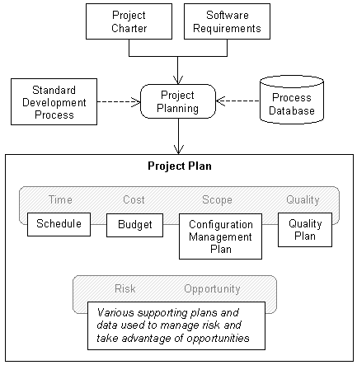
Inputs and Outputs of Project Planning
Notes:
The process database is a permanent repository of the process performance data from projects; it can be used for project planning, estimation, analysis of productivity and quality, and other purposes. The PDB consists of data from completed projects, with each project providing one data record.

Slide 13
Defining Life Cycle Model
Different projects require different approaches
You do not need to know all models by name
You should know how that if given a certain scenario what sort of SDLC would be appropriate
Become familiar with the various models
Review, analyze the type of work: development, enhancement, maintenance, etc.
Review project criteria
Identify a minimum set of phases
Identify phase activities
Establish a minimum set of deliverables
Define templates and content guides for deliverables
Evaluate progress and effectiveness of the life cycle framework
Implement improvements

Slide 14
Requirements
The requirements category consists of questions related to those things which have been requested by the user for the project.
They are sometimes termed as functions or features of the system which will be provided by the project. Consider these questions:
Are the requirements defined and well known?
Can the requirements be defined early in the cycle?
Will the requirements change often in the cycle?
Is there a need to demonstrate the requirements to achieve definition?

Slide 15
Selecting a Life Cycle Model - Project Characteristic Category Matrix Requirements
Requirements
Waterfall
Prototype
Spiral
RAD
Are the requirements easily defined and/or well known?
Yes
No
No
Yes
Can the requirements be defined early in the cycle?
Yes
No
No
Yes
Will the requirements change often in the cycle?
No
Yes
Yes
No
Is there a need to demonstrate the requirements to achieve definition?
No
Yes
Yes
Yes
Is a proof of concept required to demonstrate capability?
No
Yes
Yes
Yes
Notes:
Rapid application development is an agile software development approach that focuses more on ongoing software projects and user feedback and less on following a strict plan. As such, it emphasizes rapid prototyping over costly planning

Slide 16
Selecting a Life Cycle Model - Project Characteristic Category Matrix Project Team
Project Team
Waterfall
Prototype
Spiral
RAD
Are the majority of team members new to the problem domain for the project?
No
Yes
Yes
No
Are the majority of team members new to the technology domain for the project?
Yes
No
Yes
No
Are the majority of team members new to the tools used on the project?
Yes
No
Yes
No
Are the team members subject to reassignment during the life cycle?
No
Yes
Yes
No
Is there training available for the project team if required?
No
No
No
Yes

Slide 17
Whenever possible, select the project team prior to selecting the life cycle model.
The characteristics of this team are important:
1) they are responsible for the successful completion of the cycle
2) they can assist in the selection process.

Slide 18
Consider these questions:
Are the majority of team members new to the problem domain for the project?
Problem domain → The environment within which a problem has been identified.
E.g.: Problem reporting, a help desk, an accounting problem, an inventory control problem, etc.
Are the majority of team members new to the technology domain?
Technology → The environment which is either currently in place or may be added by the project.
E.g.: could consist of a mainframe environment, a mini-computer environment, a client/server environment, the operating system, etc.

Slide 19
Are the majority of team members new to the tools to be used on the project?
Tools are defined as those applications wheat will be used by the project team to assist with the development of the system.
E.g.: Tools such as 4GLs, database application builder, screen painters, configuration management tools, etc.
Are the team members subject to reassignment during the life cycle?
Is there training available for the project team if required?

Slide 20
Selecting a Life Cycle Model - Project Characteristic Category Matrix User Community
User Community
Waterfall
Prototype
Spiral
RAD
Will the availability of the user representatives be restricted, or limited during the life cycle?
Yes
No
Yes
No
Are the user representatives new to system definition?
No
Yes
Yes
No
Are the user representatives experts in the problem domain?
No
Yes
No
Yes
Do the users want to be involved in all phases of the life cycle?
No
Yes
No
Yes

Slide 21
Project Schedule
The project schedule is a calendar that links the tasks to be done with the resources that will do them.
Before a project schedule can be created, the project manager must have a work breakdown structure (WBS) and estimates.
The schedule is part of the project plan.
Project Management
“…the application of knowledge, skills, tools, and techniques to project activities in order to meet stake holder’s needs and expectations from a project.”

Slide 22
Project Schedule
Create a list of tasks that need to be carried out for each deliverable
For each task identify the following:
The amount of effort (hours or days) required to complete the task
The resource who will carryout the task
Once the amount of effort for each task has been established
The effort required for each deliverable and an accurate delivery date has to be worked out
Software tool like MS Project can be used to create project schedule

Slide 23
How To Schedule
Identify “what” needs to be done
RE, Scope
Work Breakdown Structure (WBS)
2. Identify “how much” (the size)
Size estimation techniques
Function/Feature
LOC
CoCoMo
3. Identify the dependency between tasks
Dependency graph, network diagram
AOA, AON, PERT
4. Estimate total duration of the work to be done
The actual schedule
23
Notes:
Program Evaluation and Review Technique (PERT) is a method used to examine the tasks in a schedule and determine a Critical Path Method variation (CPM). It analyzes the time required to complete each task and its associated dependencies to determine the minimum time to complete a project.

Slide 24
Risk Plan
A risk plan is a list of all risks that threaten the project, along with a plan to mitigate some or all of those risks.
The project manager selects team members to participate in a risk planning session:
The team members brainstorm potential risks
The probability and impact of each risk is estimated
A risk plan is constructed
The goal of risk management is to be more proactive and less reactive
A risk is a potential problem – it might happen and it might not
Conceptual definition of risk
Risk concerns future happenings
Risk involves change in mind, opinion, actions, places, etc.
Risk involves choice and the uncertainty
Two characteristics of risk
Uncertainty – the risk may or may not happen, that is, there are no 100% risks (those, instead, are called constraints or issues )
Loss – the risk becomes a reality and unwanted consequences or losses occur

Slide 25
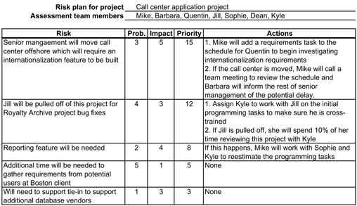
Risk Plan Example

Slide 26
Software Project Time Management

Slide 27
Project Time Management Processes
Activity definition:
identifying the specific activities that the project team members and stakeholders must perform to produce the project deliverables
Activity sequencing:
identifying and documenting the relationships between project activities
Activity resource estimating:
estimating how many resources a project team should use to perform project activities

Slide 28
Project Time Management Processes
Activity duration estimating:
estimating the number of work periods that are needed to complete individual activities
Schedule development:
analyzing activity sequences, activity resource estimates, and activity duration estimates to create the project schedule
Schedule control:
controlling and managing changes to the project schedule

Slide 29
Project Activity Planning
An activity or task is an element of work normally found on the WBS that has an expected duration, a cost, and resource requirements
Effort represents the work required to perform a task.
Effort is measured in person-hours (or person-days, person-weeks, etc.)
It represents the total number of hours that each person spent working on the task.
Duration is amount of time that elapses between the time the task is started and the time it is completed.
Duration is measured in hours (or days, weeks, etc.)
It does not take into account the number of people performing the task

Slide 30
Activity Definition
“A project is a series of activities directed to accomplishment of a desired objective.”
Activity definition involves developing a more detailed WBS and supporting explanations to understand all the work to be done so you can develop realistic cost and duration estimates

Slide 31
Activity Lists and Attributes
An activity list is a tabulation of activities to be included on a project schedule that includes
the activity name
an activity identifier or number
a brief description of the activity
Activity attributes provide more information such as predecessors, successors, logical relationships, leads and lags, resource requirements, constraints, imposed dates, and assumptions related to the activity
Notes:
The photo shoot will take four days and the photo editing will take six days. Instead of waiting until the end of the 4-day photo shoot to begin editing the pictures, we start editing after the first day of shooting. This brings the total duration from ten days down to seven days by leveraging the lead.
The photo proofs are sent to the customer upon completion of the shoot, however, there is a 15-day lag associated with the customer review before the printing of the photos can begin
Leads are the predicted measurement of how long it will take to do something while lags measure how far behind a task or project phase is after it has started.

Slide 32
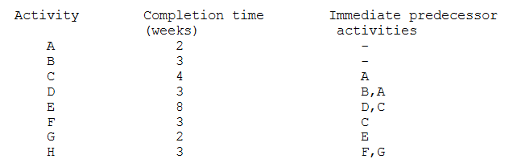

Slide 33
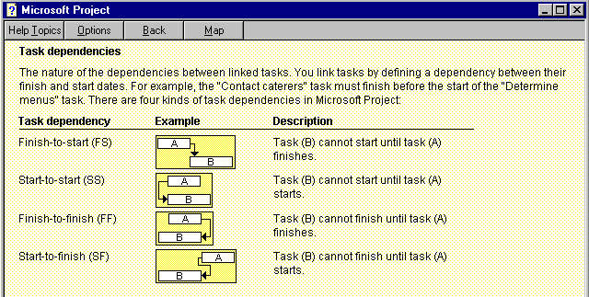

Slide 34
Types of Dependencies
Mandatory dependencies:
inherent in the nature of the work being performed on a project, sometimes referred to as hard logic
Involve physical limitations
Discretionary dependencies:
defined by the project team., sometimes referred to as soft logic and should be used with care since they may limit later scheduling options
Used with care and must be fully documented
External dependencies:
involve relationships between project and non-project activities
Testing activity may be dependent on delivery of HW from external supplier
Notes:
A: Lay Building Foundation; B: Construct a Floor – A floor of a building cannot be constructed until foundation is laid.
A discretionary dependency is one that isn't based on a "have to", but on a "should". These decisions are usually based upon best practices, business knowledge, etc.
A:-Develop System Module X; B: Develop System Module Y – The project team can develop either X first or Y first but they decide to develop X first.
A: Approval of Building Plans; D: Start Construction: Construction of a building cannot be started unless the building plans are approved.

Slide 35
Network Diagrams
Network diagrams are the preferred technique for showing activity sequencing
A network diagram is a schematic display of the logical relationships among, or sequencing of project activities
Two main formats are the arrow and precedence diagramming methods
Activity On Arrow (AOA)
Activity On Node (AON)
Notes:
Precedence Diagram Method (PDM) is a visual representation technique that depicts the activities involved in a project. It is a method of constructing a project schedule network diagram that uses boxes/nodes to represent activities and connects them with arrows that
Schematic plan.

Slide 36
Critical Path Method (CPM)
CPM is a network diagramming technique used to predict total project duration
A critical path for a project is the series of activities that determines the earliest time by which the project can be completed
The critical path is the longest path through the network diagram and has the least amount of slack or float
Slack or float is the amount of time an activity may be delayed without delaying a succeeding activity or the project finish date.
if there are any delays in the critical path sequence, your project will suffer delays as well.

Slide 37
Using Critical Path Analysis to Make Schedule Trade-offs
Free slack or free float:
the amount of time an activity can be delayed without delaying the early start of any immediately following activities
Total slack or total float:
the amount of time an activity may be delayed from its early start without delaying the planned project finish date
A forward pass through the network diagram determines the early start and finish dates
A backward pass determines the late start and finish dates

Slide 38
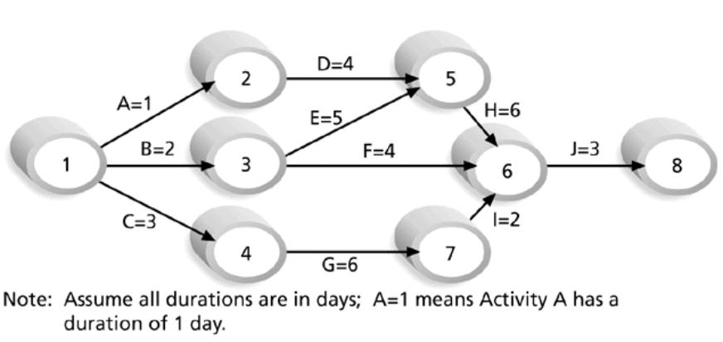
Arrow Diagramming Method (ADM)
Also called activity-on-arrow (AOA) network diagrams
Activities are represented by arrows
Nodes or circles are the starting and ending points of activities
Can only show finish-to-start dependencies

Slide 39
a. How many paths are on this network diagram?
b. How long is each path?
c. Which is the critical path?
d. What is the shortest amount of time needed to complete this project?

Slide 40
Process for Creating AOA Diagrams
Find all of the activities that start at node 1.
Draw their finish nodes and draw arrows between node 1 and those finish nodes.
Put the activity letter or name and duration estimate on the associated arrow
Continuing drawing the network diagram, working from left to right.
Look for bursts and merges.
Bursts occur when a single node is followed by two or more activities.
A merge occurs when two or more nodes precede a single node
Continue drawing the project network diagram until all activities are included on the diagram that have dependencies
As a rule of thumb, all arrowheads should face toward the right

Slide 41
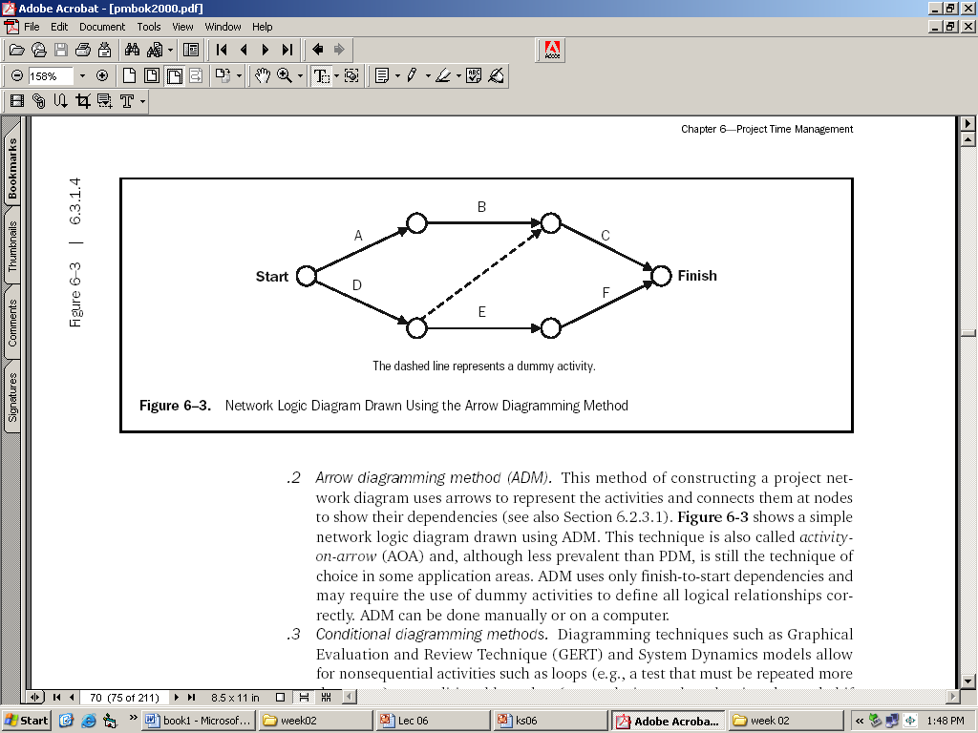
Activity on Arrow (Arrow Diagramming)
Arrow Diagramming Method (ADM)
A.K.A → Activity-on-Arrow (AOA) network diagrams
Activities are represented by arrows
Nodes or circles are the starting and ending points of activities
Can only show finish-to-start dependencies
May require the use of dummy activities
PMBOK Chapter 6

Slide 42
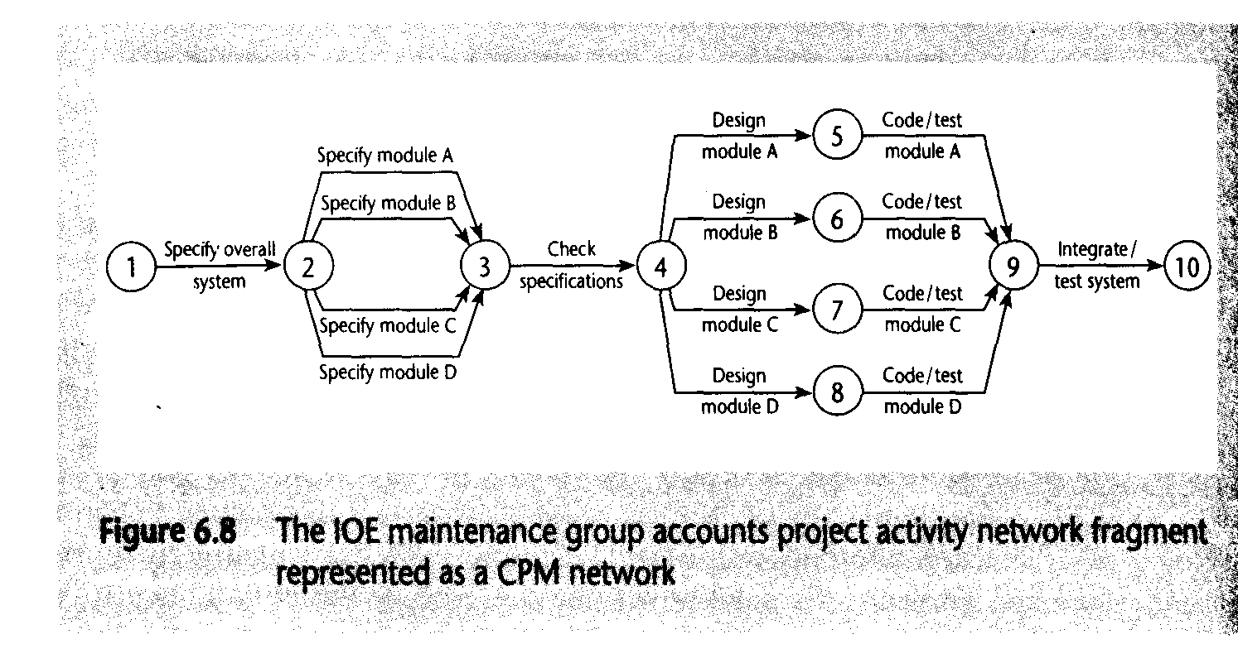
Activity on Arrow

Slide 43
Precedence Diagramming Method (PDM- AON)
Activities are represented by boxes
Arrows show relationships between activities
More popular than ADM method and used by project management software
Better at showing different types of Precedence Relationships (Arrows)
Finish To Start
Finish To Finish
Start To Start
Start To Finish

Slide 44
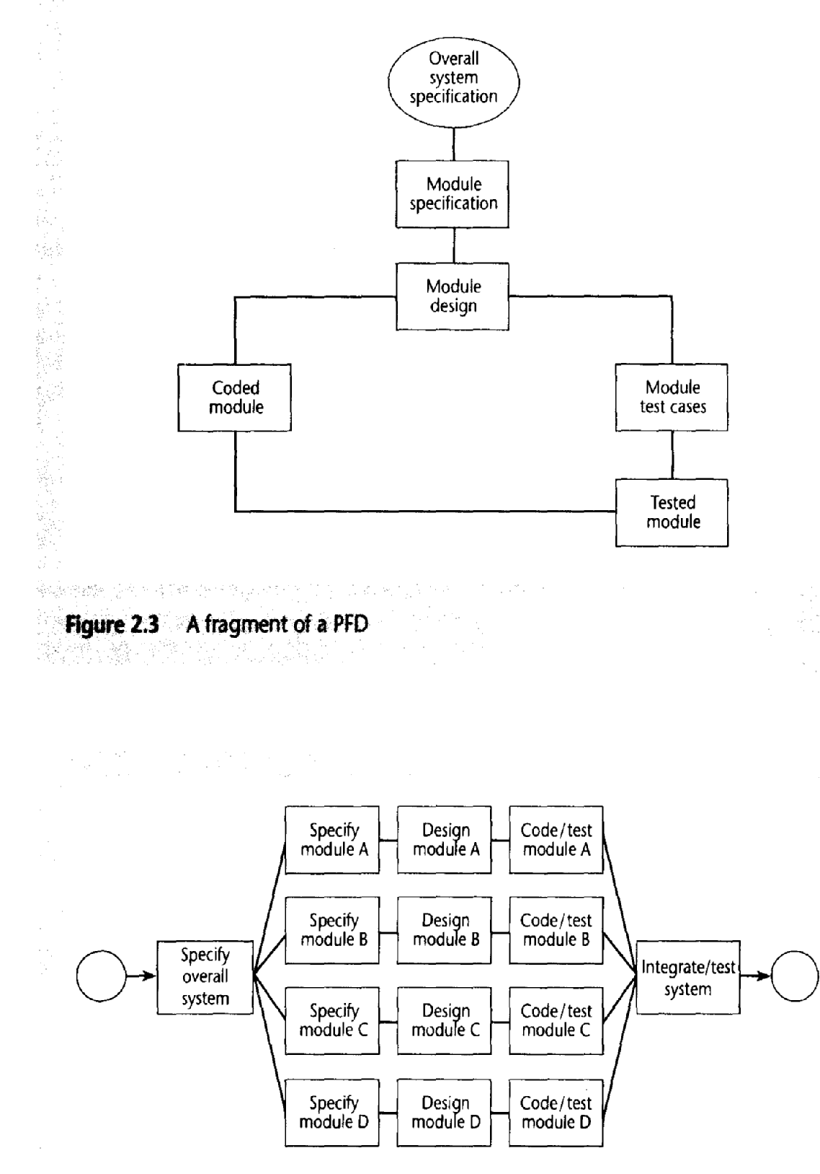
Activity On Node network

Slide 45
Finding the Critical Path
To find the critical path, need to determine the following quantities for each activity in the network
Earliest start time (ES):
the earliest time an activity can begin without violation of immediate predecessor requirements
Earliest finish time (EF):
the earliest time at which an activity can end
Latest start time (LS):
the latest time an activity can begin without delaying the entire project
Latest finish time (LF):
the latest time an activity can end without delaying the entire project

Slide 46
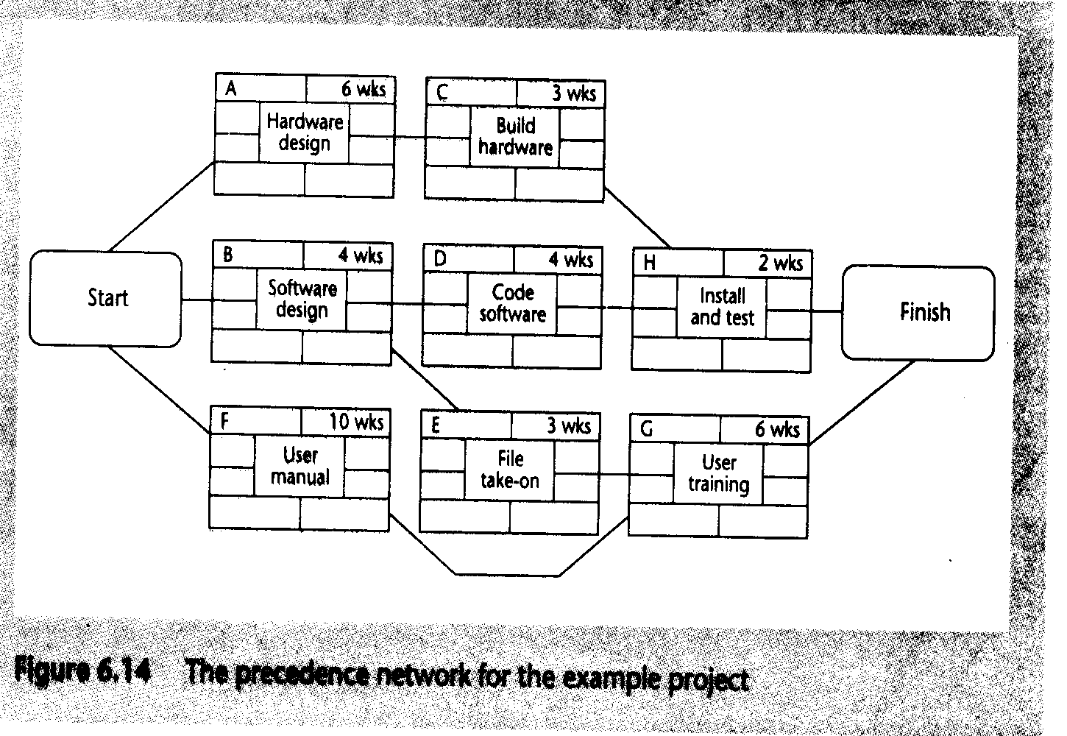
Early and Late Start and Finish Dates
Activity
Duration
Activity
Description
Activity span
Float

Slide 47
Example 1
Activity | Description | Duration | Precedents
A | HW Selection | 6
B | SW Design | 4
C | Install HW | 3 | A
D | Code/test SW | 4 | B
E | File take on | 3 | B
F | Write User Manual | 10
G | User Trg | 3 | E,F
H | Install and Test system | 2 | C,D
Precedent: are immediate preceding activity

Slide 48
Adding time dimension
3

Slide 49
The forward pass
CPM concerned with two primary objectives:
Planning a project so that it is completed ASP
Identify those activities which may cause a delay
The forward pass is carried out to calculate the earliest dates (Es & Ef) on which activity may be started and completed
Where an actual start date is known, the calculations may be carried out using actual dates

Slide 50
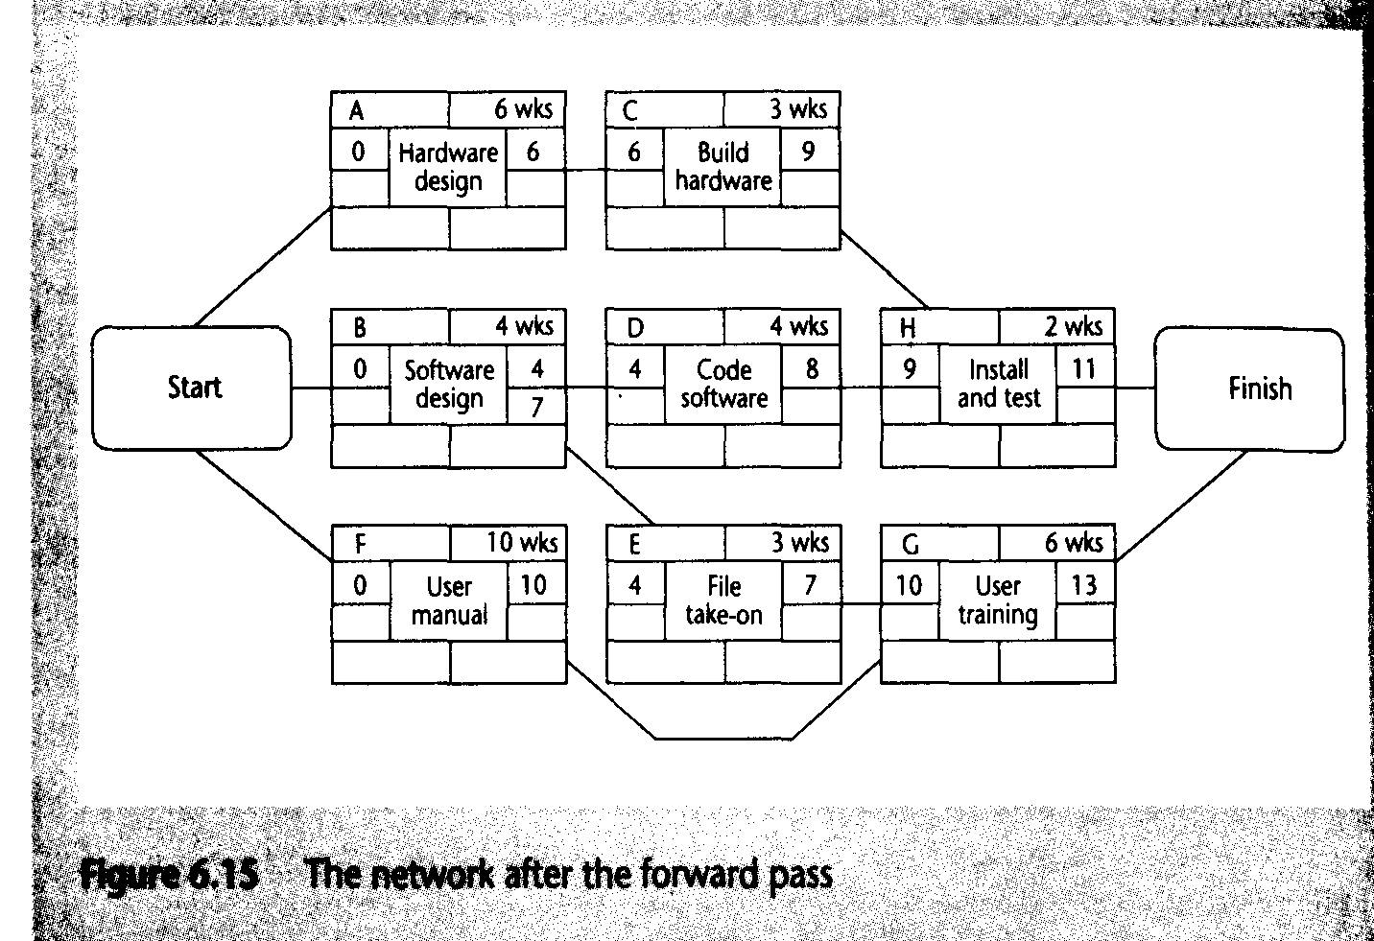
Network After Fwd Pass
3

Slide 51
The backward pass
The second stage in the analysis of a critical path network is to carry out a backward pass
to calculate the latest date at which each activity may be started and finished without delaying the end date of the project
In calculating the latest dates, we assume that the latest finish date for the project is the same as the earliest finish date

Slide 52
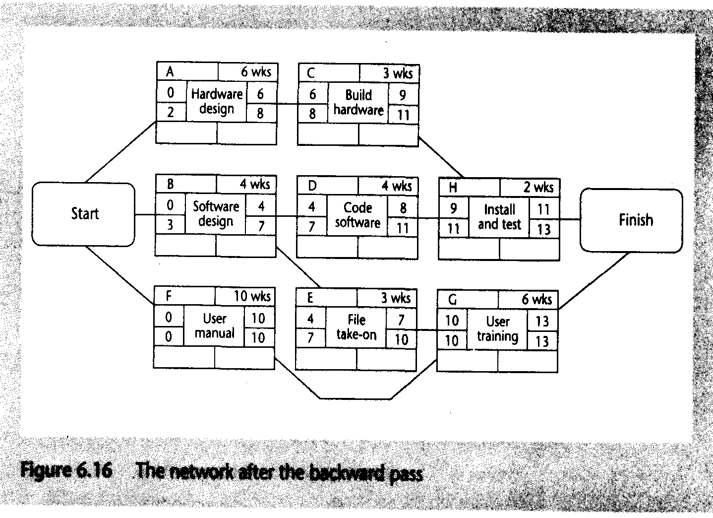
Backward pass
3

Slide 53
Slack or Float
Slack or float is the time an activity may be delayed without delaying a succeeding activity or the project finish date
Slack = LF-EF
LS=LF-Duration
The Slack or Float on critical path is 0
Activity with 0 slack are called the critical activity, these has to be completed on time
Activity Span:
It is the difference between Es date and Lf date
It is the measure of maximum time allowable for the activity

Slide 54
Critical Path?
Float is 2
3
Float is 0

Slide 55
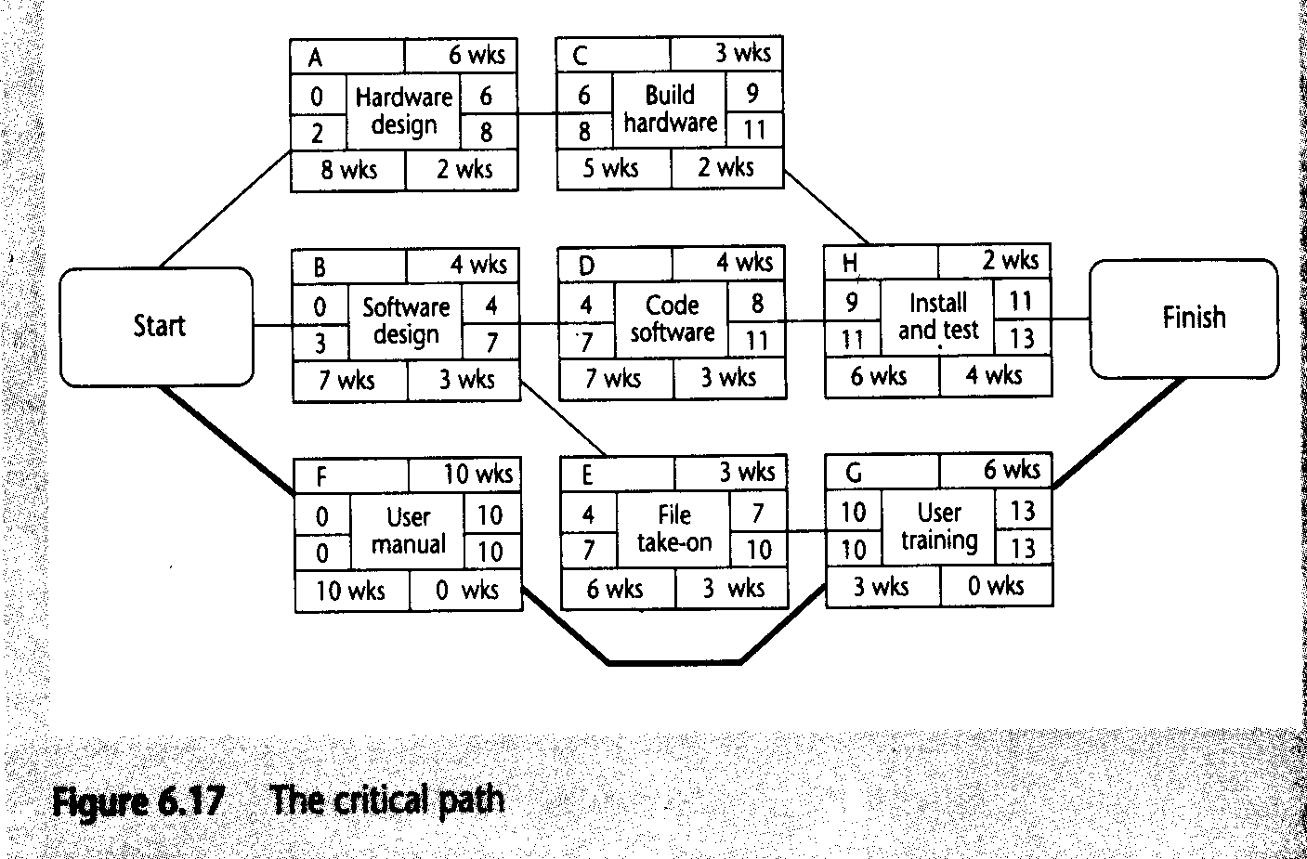
Critical Path
4
2
3
Float
Span

Slide 56
Example- 2
Activity | Description | Required Predecessor | Duration
A | Product design | (None) | 5 months
B | Market research | (None) | 1
C | Production analysis | A | 2
D | Product model | A | 3
E | Sales brochure | A | 2
F | Cost analysis | C | 3
G | Product testing | D | 4
H | Sales training | B, E | 2
I | Pricing | H | 1
J | Project report | F, G, I | 1
Draw the Network diagram

Slide 57
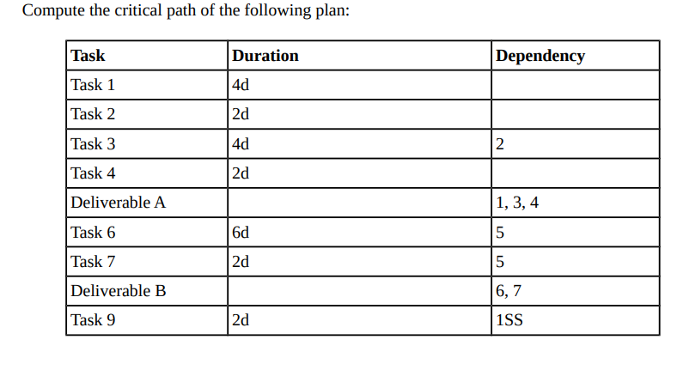
Example 3
1SS is Task 1 and SS is a dummy activity.

Slide 58
Exercise
Time Management

Slide 59
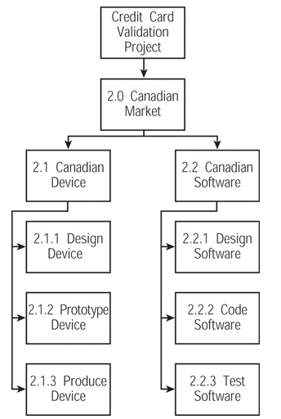
Scenario
Your company, Terrific Project Management Partners (TPMP), has just placed you at SystemsDelivery, Inc. as a temporary project manager.
You’ve been assigned the Credit Card Validation project.
This project is designed to be the next best thing in credit card fraud prevention.
The management of SystemsDelivery believes that this product will be in high demand at every major retailer in the country. Of course the management needs this product to go to market as quickly as possible.
You have been on the project for two weeks now. You have created the work breakdown structure as illustrated for producing the Canadian product.
This WBS was created at the lowest possible level, the activity list.

Slide 60
Exercise
How many activities have been created at the lowest level of the work breakdown structure (the activity list level)?
Analyze the dependencies between the activities.
Are these dependencies mandatory, discretionary, or external?
Analyze the dependencies.
What is the one logical relationship between each activity for the Canadian software?
Determine the best method to diagram these activities.
Will you use the precedence diagramming method or the arrow diagramming method?
Sequence the lowest level activities between a start and finish node. Draw your answer.

Slide 61
Exercise-Sol
How many activities have been created at the lowest level of the work breakdown structure (the activity list level)?
Six activities have been created at the lowest level of the work breakdown structure (the activity list level).
Analyze the dependencies between the activities. Are these dependencies mandatory, discretionary, or external?
Of the six activities, the dependencies are mandatory

Slide 62
Exercise-Sol
Analyze the dependencies.
What is the one logical relationship between each activity for the Canadian software?
Finish to start is the one logical relationship between each activity for the Canadian software.
Determine the best method to diagram these activities.
Will you use the precedence diagramming method or the arrow diagramming method?
Precedence diagramming method is the best method to diagram these activities.

Slide 63
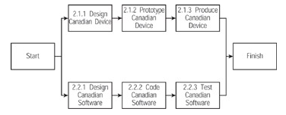
Exercise-Sol
Sequence the lowest level activities between a start and finish node. Draw your answer.
If you sequence the lowest level activities between a start and finish node, your answer should look like:

Slide 64
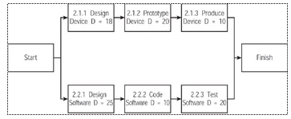
Calculating Critical Path
Do a forward pass on the network diagram.
What is the early start for tasks 2.1.1 and 2.2.1?
What is the early start for task 2.2.2?
Which tasks comprise the critical path?

Slide 65
Calculating Critical Path- Sol
Do a forward pass on the network diagram.
What is the early start for tasks 2.1.1 and 2.2.1?
When you do a forward pass on the network diagram, the early start for tasks 2.1.1 and 2.2.1 is zero.
What is the early start for task 2.2.2?
The early start for task 2.2.2 is 25.

Slide 66
Calculating Critical Path-Sol
Which tasks comprise the critical path?
Tasks 2.2.1, 2.2.2 and 2.2.3 comprise the critical path.

