Slide 1
Software Project Time Management

Slide 2
Practice question-CPM
Activity | Duration | Precedents
A | 3
B | 4 | A
C | 2 | A
D | 5 | B
E | 1 | C
F | 2 | C
G | 4 | D,E
H | 3 | F,G

Slide 3
Importance of Float (Slack) and Critical Path
Slack or Float shows how much allowance each activity has, i.e. how long it can be delayed without affecting completion date of project
Critical path is a sequence of activities from start to finish with zero slack. Critical activities are activities on the critical path.
Critical path identifies the minimum time to complete project
If any activity on the critical path is shortened or extended, project time will be shortened or extended accordingly
So, a lot of effort should be put in trying to control activities along this path, so that project can meet due date. If any activity is lengthened, be aware that project will not meet deadline and some action needs to be taken.
6. If can spend resources to speed up some activity, do so only for critical activities.
7. Don’t waste resources on non-critical activity, it will not shorten the project time.

Slide 4
Project Scheduling
Scheduling is an approximate process in that it tries to predict the future
it is not possible to know with certainty how long a project will take
There are techniques that can increase the likelihood of being close
If you are close in your planning and estimation, you can manage the project to achieve the schedule by accelerating some efforts or modifying approaches to meet required deadlines

Slide 5
Schedule Development:
Analyzing activity sequences, activity durations, and resource requirements to create the project schedule.
There several iterations of Time Management processes before project schedule is finalized

Slide 6
Tools & Technique:
Gantt Chart
- display schedule information
PERT Analysis
- schedule risk on project
CPM (critical path method)
- develop & control project schedule
CCS (critical chain schedule)
-accounts for resource constraints
Notes:
Program Evaluation and Review Technique

Slide 7
Creating a Good Estimate
There are techniques for estimating the duration and effort of an Activity like:
Similar activities
Historical data
Expert advice
Delphi technique
Three-point technique
Wide-band Delphi technique

Slide 8
Creating a Good Estimate
Similar Activities
This just means estimate an activity based on similar activities in the past
If you’ve developed lots of web pages, you can safely estimate how long it’ll take to develop similar pages
Historic Data
If you can find data from similar projects developed by your organization, they can form the basis for a good estimate
This assumes the project uses similar technology as previous projects
Expert Advise
If you don’t know anything about the task, ask someone who does!
Could find experts within your organization, outside consultants, vendors, academia, etc.
Notice all three estimation methods depend on someone having experience doing the task before

Slide 9
Creating a Good Estimate
Delphi technique
The Delphi technique is a formal way to get group consensus on a wild guess for the estimate
Get a group of people together
Tell them about the project and its tasks
Get them to all estimate the duration of each task
Tabulate the guesses in a histogram called First Pass
For estimates in the outer quartile (<25% and >75%), ask them for their rationale
Have everyone guess again, and retabulate the results: Second Pass
Have the outer quartile defend their choices again
Make a third set of guesses, and use the average value for the task’s estimate
“Though it sounds a bit goofy, this method actually works pretty well”
Notes:
reason

Slide 10
Creating a Good Estimate
Three Point Estimate
The actual duration of a task could vary, depending on many factors
Hence there could be a distribution of possible values for the duration
Based on best judgment, determine the
Optimistic, Most likely, and Pessimistic values for the duration, then use
Estimate = (O+ 4*M+ P)/6
Notes:
the expected time is the average time the task would require if the task were repeated on a number of occasions over an extended period of time.
What is optimistic pessimistic and most likely time?
Optimistic time – The least amount of time it can take to complete a task. Pessimistic time – The maximum amount of time it should take to complete a task. Most likely time – Assuming there are no problems, the best or most reasonable estimate of how long it should take to complete a task.

Slide 11
NETWORK TECHNIQUES
PERT
CPM
Program Evaluation and
Review Technique
developed by the US Navy - on the Polaris Missile/Submarine
program 1958
Critical Path Method
Developed for Chemical Plant Shutdown Project- about same time as PERT
Both use same calculations, almost similar
Program Evaluation and Review Technique, Based on idea that estimates are uncertain. Therefore:
uses duration ranges, And the probability of falling to a given range
Uses an “expected value” (or weighted average) to determine durations

Slide 12
Comparison Between CPM and PERT
 | CPM | PERT
1 | Uses network, calculate float or slack, identify critical path and activities | Same as CPM
2 | Uses one value of activity time | Requires 3 estimates of activity time Calculates mean and variance of time
3 | Used where times can be estimated with confidence, familiar activities | Used where times cannot be estimated with confidence. Unfamiliar or new activities
4 | Minimizing cost is more important | Meeting time target or estimating percent completion is more important
5 | Example: construction projects, building ships, etc. | Example: Involving new activities or products, research and development etc.

Slide 13
PERT For Dealing With Uncertainty
Times can be estimated with relative certainty, confidence but for many situations this is not possible, e.g Research, development, new products and projects etc.
Use 3 time estimates
m= most likely time estimate-The completion time having the highest probability
a = optimistic time estimate--The shortest time in which the activity can be completed.
b = pessimistic time estimate--the maximum possible time required to accomplish a task, assuming everything goes wrong (but excluding major catastrophes).

Slide 14
Expected Value (TE) = (a + 4m + b) /6
Variance (V) = ( ( b – a) / 6 ) ²
Std Deviation (δ) = SQRT (V)
The size of the variance reflects the degree of uncertainty associated with the activity’s time. The larger the variance, the greater the uncertainty.
Standard Deviation of a path can also be computed to know the uncertainty of a particular path.
Notes:
Most likely time (M): the best estimate of the time required to accomplish a task, assuming everything proceeds as normal.
Expected time (T_{E}): the best estimate of the time required to accomplish a task, assuming everything proceeds as normal (the implication being that the expected time is the average time the task would require if the task were repeated on a number of occasions over an extended period of time).
Standard deviation measures how far apart numbers are in a data set. Variance, on the other hand, gives an actual value to how much the numbers in a data set vary from the mean.

Slide 15
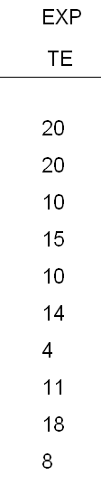

Precedence And Project Activity Times
Activity | Predecessor | Optimistic Time | Most likely Time | Pessimistic Time
A | - | 10 | 22 | 22
B | - | 20 | 20 | 20
C | - | 4 | 10 | 16
D | A | 2 | 14 | 32
E | B,C | 8 | 8 | 20
F | B,C | 8 | 14 | 20
G | B,C | 4 | 4 | 4
H | C | 2 | 12 | 16
I | G,H | 6 | 16 | 38
J | D,E | 2 | 8 | 14

Slide 16
Critical Path Analysis (PERT)
Activity | LS | ES | Slacks | Critical ?
a | 0 | 0 | 0 | Yes
b | 1 | 0 | 1
c | 4 | 0 | 4
d | 20 | 20 | 0 | Yes
e | 25 | 20 | 5
f | 29 | 20 | 9
g | 21 | 20 | 1
h | 14 | 10 | 4
i | 25 | 24 | 1
j | 35 | 35 | 0 | Yes

Slide 17
The complete network
2
d
(15,25)
6
j
(8,4)
a
(20,4)
e
(10,4)
1
3
f
(14,4)
7
CRIT. TIME = 43
b
(20,0)
c
(10,4)
g
(4,0)
i
(18,28.4)
4
h
(11,5.4)
5

Slide 18
Probability
The probability that a project will be completed in a specified length of time can be determined using the following formula:
Z = Specified Time – Expected time
Standard Deviation
The Z-Score (z) is the difference between the desired completion time and the project's expected time divided by the standard deviation for the project

Slide 19
Assume, PM promised to complete the project in the fifty days.
What are the chances of meeting that deadline?
Calculate Z, where
Z = (D-S) / √V
Example, D = 50; S (Scheduled date) = 20+15+8 =43;
V = (4+25+4) =33
Z = (50 – 43) / 5.745
= 1.22
The probability value of Z = 1.22, is 0.888
1.22

Slide 20
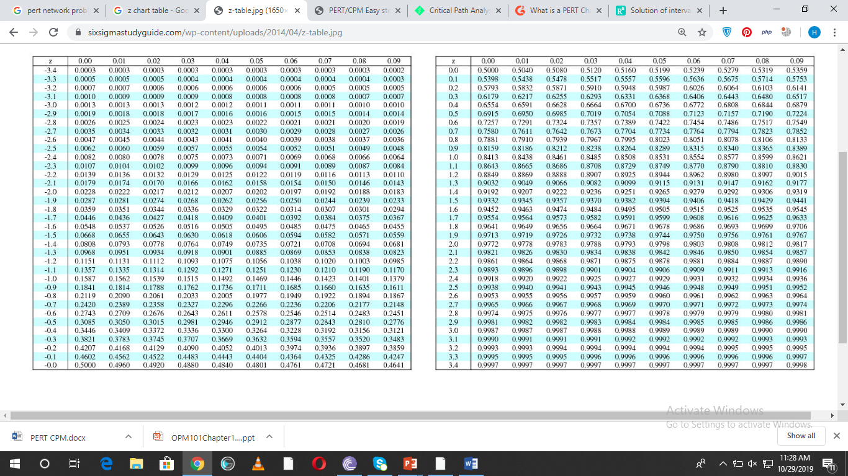

Slide 22
What is the probability of completing project atleast 4 days earlier than expected time?
Expected: 43 days
Specified time: 39 days
What is the probability of completing project no more than 4 days later than expected time?
Notes:
25.49%

Slide 23
What deadline are you 95% sure of meeting
Z value associated with 0.95 is 1.645
D = S + 5.745 (1.645)
= 43 + 9.45
= 52.45 days
Thus, there is a 95 percent chance of finishing the project by 52.45 days.

Slide 24
Steps
This is the step-by-step process:
Step 1: Calculate the expected completion time (T_{E}) using PERT
T_{E} = (O+4M+P)/6
Step 2: Calculate the variance of the project by calculating the variance of each task
Task Variance = [(P-O)/6]²
Step 3: Calculate the standard deviation
Standard Deviation = √ Task Variance1 + Task Variance2 + Task Variance3… .

Slide 25
Steps
Step 4: Calculate the Z-Score
Z = (T-T_{E})/σ
Step 5: Calculate the probability of success now that you have figured out the Z-Score.
Translate that score (sigma value) into an actual percentage. This translation is done using a Z-Score table. Note that a Z-Score table is not calculated by the project manager—it is a pre-existing table that statisticians have already calculated for use with Z-Scores.

Slide 26
A PERT Activity time estimate Exercise
Activity | Optimistic (a) | Most Likely (m) | Pessimistic (b)
A | 5 | 6 | 8
B | 3 | 4 | 5
C | 2 | 3 | 3
D | 3.5 | 4 | 5
E | 1 | 3 | 4
F | 8 | 10 | 15
G | 2 | 3 | 4
H | 2 | 2 | 2.5
Calculate:
T(E) =?
V =?
S =?

Slide 27
A PERT Activity time estimate
Activity | (a) | (m) | (b) | Te | v | (s)
A | 5 | 6 | 8 | 6.17 | 0.25 | 0.50
B | 3 | 4 | 5 | 4.00 | 0.108 | 0.33
C | 2 | 3 | 3 | 2.83 | 0.028 | 0.17
D | 3.5 | 4 | 5 | 4.08 | 0.062 | 0.25
E | 1 | 3 | 4 | 2.83 | 0.25 | 0.50
F | 8 | 10 | 15 | 10.50 | 1.36 | 1.17
G | 2 | 3 | 4 | 3.00 | 0.108 | 0.33
H | 2 | 2 | 2.5 | 2.08 | 0.006 | 0.08
Te = a+4m+b/6
V = (b-a/6)²
S = sqrt (v)

Slide 28
GANTT Chart:
Standard format to display project schedule information
Developed by Henry Gantt in WWI
Shows start and end date of project in calendar format
Normally do not show relationships among project activities

Slide 29
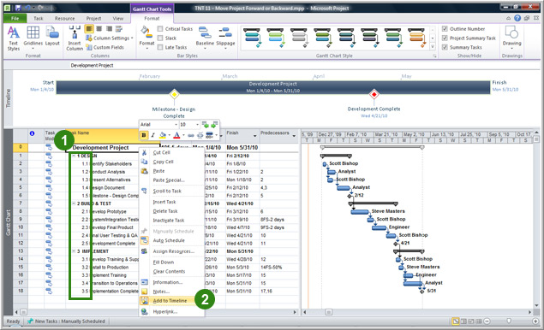
GANTT Chart:

Slide 30
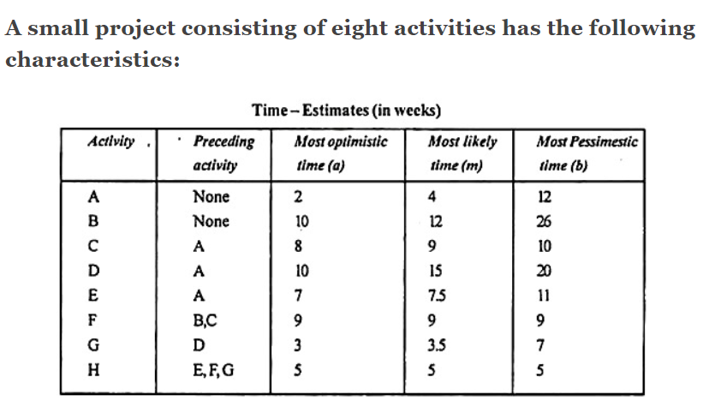
Exercise
Notes:
https://www.engineeringenotes.com/networking/network-analysis/top-4-problems-on-pert-network-analysis-networking/15725

Slide 31
Draw the PERT network for the project.
(ii) Prepare the activity schedule for the project.
(iii) Determine the critical path.
(iv) If a 30-week deadline is imposed, what is the probability that the project will be finished within the time limit?
(v) If the project manager wants to be 99% sure that the project is completed on the scheduled date, how many weeks before that date should he start the project work?
Notes:
The expected time is the duration.

