Slide 1
Software Project Risk Management

Slide 2
Definition of Risk
A risk is a potential problem – it might happen and it might not
An event that poses a potential threat or potential opportunity.
A dictionary definition of risk is “the possibility of loss or injury”
Negative risk involves understanding potential problems that might occur on the project and how they might delay project success
Positive risks are risks that result in good things happening; sometimes called opportunities
Project Risk
Factors that cause a project to be delayed or over-budget

Slide 3
Definition of Risk
A more general definition of project risk is an uncertainty that can have a negative or positive effect on meeting project objectives
The goal of project risk management is to minimize potential negative risks while maximizing potential positive risks
Two characteristics of risk
Uncertainty – the risk may or may not happen, that is, there are no 100% risks (those, instead, are called constraints)
Loss – the risk becomes a reality and unwanted consequences or losses occur
Notes:
unpredictable

Slide 4
Potential Negative Risk Conditions Associated With Each Knowledge Area
Knowledge Area | Risk Conditions
Integration | Inadequate planning; poor resource allocation; poor integration management; lack of post-project review
Scope | Poor definition of scope or work packages; incomplete definition of quality requirements; inadequate scope control
Time | Errors in estimating time or resource availability; poor allocation and management of float; early release of competitive products
Cost | Estimating errors; inadequate productivity, cost, change, poor maintenance, security, purchasing, etc.
Quality | Poor attitude toward quality; substandard design/materials/workmanship; inadequate quality assurance program
Human Resources | Poor conflict management; poor project organization and definition of responsibilities; absence of leadership
Communications | Carelessness in planning or communicating; lack of consultation with key stakeholders
Risk | Ignoring risk; unclear assignment of risk; poor insurance management
Procurement | Unenforceable conditions or contract clauses; adversarial relations
Notes:
If you describe something as adversarial, you mean that it involves two or more people or organizations who are opposing each other.

Slide 5
Project Risk Management
Risk management is a multi step process
First identify the risks
Then analyze the risks and make a determination about the impact of the risk event
Determine the probability of the risk occurring
Finally, combine the impact analysis with the probability analysis to determine which of the identified risks need a risk response plan
And then monitor
The main output of risk management planning is a risk management plan:
A plan that documents the procedures for managing risk throughout a project
The project team should review project documents and understand the organization’s and the sponsor’s approach to risk

Slide 6
Project Risk Management Processes
Risk management planning:
Deciding how to approach and plan the risk management activities for the project
Risk identification:
Determining which risks are likely to affect a project and documenting the characteristics of each
Qualitative risk analysis:
Prioritizing risks based on their probability and impact of occurrence
Quantitative risk analysis:
Numerically estimating the effects of risks on project objectives
Risk response planning:
Taking steps to enhance opportunities and reduce threats to meeting project objectives
Risk monitoring and control:
Monitoring identified and residual risks, identifying new risks, carrying out risk response plans, and evaluating the effectiveness of risk strategies throughout the life of the project

Slide 7
Contingency, Fallback Plans and Contingency Reserves
Contingency plans:
Predefined actions that the project team will take if an identified risk event occurs
Fallback plans:
Developed for risks that have a high impact on meeting project objectives, are put into effect if attempts to reduce the risk are not effective
Contingency reserves or allowances:
Provisions held by the project sponsor or organization to reduce the risk of cost or schedule overruns to an acceptable level
Notes:
A fallback plan is the backup plan to a contingency plan. Think of it as a plan C that acts as the backup for plan B. If your initial plan falls through, then your backup plan - your contingency plan - will kick in. Now, if this contingency plan falls through, then your fallback plan kicks in.
A contingency reserve is retained earnings that have been set aside to guard against possible future losses

Slide 8
Risk Response
Four actions can be done about a risk. The strategies are:
Avoid the risk.
Do something to remove it. Use another supplier for example.
Transfer the risk.
Make someone else responsible. Perhaps a Vendor can be made responsible for a particularly risky part of the project.
Mitigate the risk.
Take actions to lessen the impact or chance of the risk occurring. If the risk relates to availability of resources, draw up an agreement and get sign-off for the resource to be available.
Accept the risk.
The risk might be so small the effort to do anything is not worth while

Slide 9
Risk Identification
It is important to distinguish between specific risk events that may occur,
which more precisely, known as ‘hazards’ and their outcomes, which are known as ‘problems’
Problems, when they occur will, if we do not have successful contingency plans, put the success of the project at risk
Identify the hazards that might affect the duration or resource costs of the project
Hazard → Problem → Risk

Slide 10
A hazard is an event that might occur and will create a problem for the successful completion of the project, if it does occur
Examples of hazard: a team member is ill; late delivery of a hardware component; system down
Hazard, Problem, and Risk
Hazard: A Team member is ill
Problem: Modules P and Q will have no coder
Risk: Milestone 7 will be delayed, or extra budget will be needed to hire another coder

Slide 11
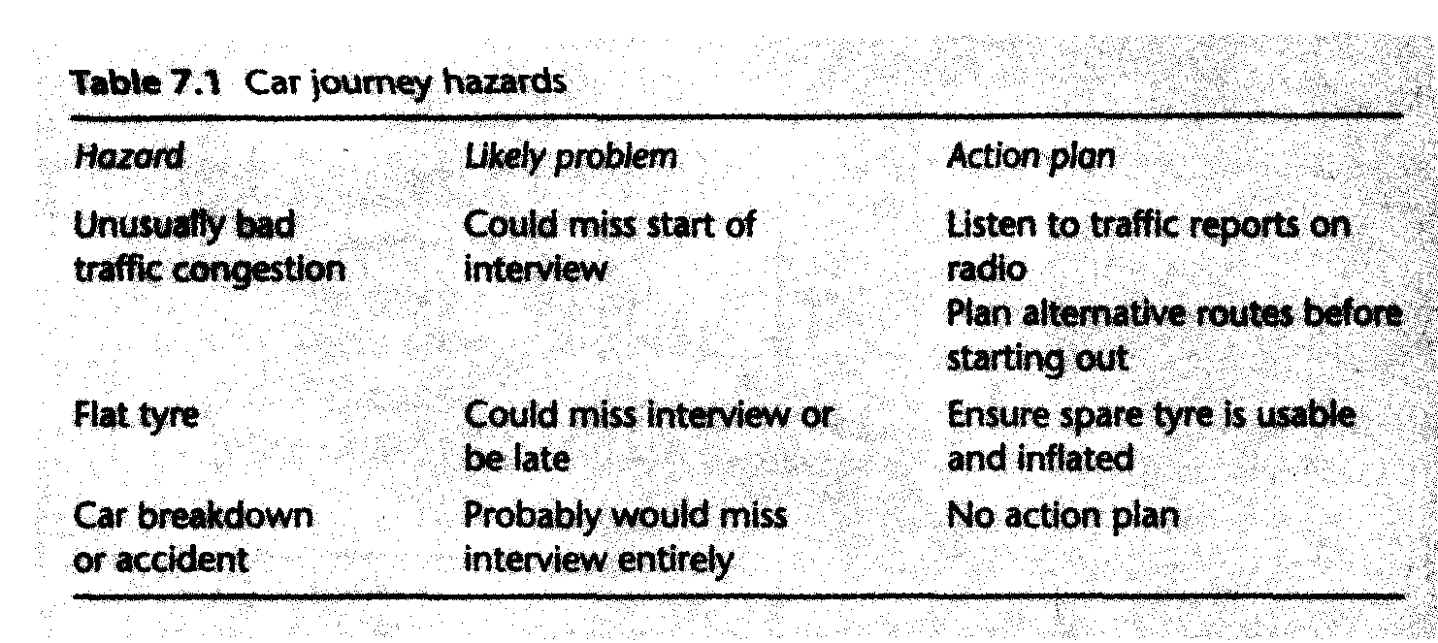

Slide 12
Is This A Risk?
We just started integrating the software and we found out that:
COTS products A and B just can’t talk to each other
We’ve got too much tied into A and B to change
Our best solution is to build wrappers around A and B to get them to talk via CORBA
This will take 3 months and $300K
It will also delay integration and delivery by at least 3 months
No, it is a problem
Being dealt with reactively
Risks involve uncertainties
And can be dealt with pro-actively
Notes:
(CORBA) is a standard defined by the Object Management Group (OMG) that enables software components written in multiple computer languages and running on multiple computers to work together

Slide 13
A and B are our strongest COTS choices
But there is some chance that they can’t talk to each other
Probability of loss P(L)
If we commit to using A and B
And we find out in integration that they can’t talk to each other
We’ll add more cost and delay delivery by at least 3 months
Size of loss S(L)
We have a risk exposure of
RE = P(L) * S(L)

Slide 14
How Can Risk Management helps to Deal With Risks?
Buying information
Risk avoidance
Risk transfer
Risk reduction
Risk acceptance

Slide 15
Let’s spend Rs 30K and 2 weeks prototyping the integration of A and B
This will buy information on the magnitude of P(L) and S(L)
If RE = P(L) * S(L) is small, we’ll accept and monitor the risk
If RE is large, we’ll use one/some of the other strategies

Slide 16
Other Risk Management Strategies
Risk Avoidance
COTS product C is almost as good as B, and it can talk to A
Delivering on time is worth more to the customer than the small performance loss
Risk Transfers
If the customer insists on using A and B, have them establish a risk reserve.
To be used to the extent that A and B can’t talk to each other
Risk Reduction
If we build the wrappers and the CORBA corrections right now, we add cost but minimize the schedule delay
Risk Acceptance
If we can solve the A and B interoperability problem, we’ll have a big competitive edge on the future procurements
Let’s do this on our own money, and patent the solution
Notes:
If you want to use functions or code blocks of another programming language within a program, you can encapsulate them using a wrapper. The main program communicates exclusively with the wrapper, which forwards the commands to the wrapped program and returns the results. The wrapper itself is the only component that communicates directly with both parts of the program.

Slide 17
Software Risk Management
Risk
Identification
Checklists
Decision driver analysis
Assumption analysis
Decomposition
Risk
Assessment
Risk
Analysis
Performance models
Cost models
Network analysis
Decision analysis
Quality factor analysis
Risk
Prioritization
Risk exposure
Risk leverage
Compound risk reduction
Risk
Management
Risk mgmt
Planning
Buying information
Risk avoidance
Risk transfer
Risk reduction
Risk element planning
Risk plan integration
Risk
Control
Risk
Resolution
Prototypes
Simulations
Benchmarks
Analyses
Staffing
Risk
Monitoring
Milestone tracking
Top-10 tracking
Risk reassessment
Corrective action

Slide 18
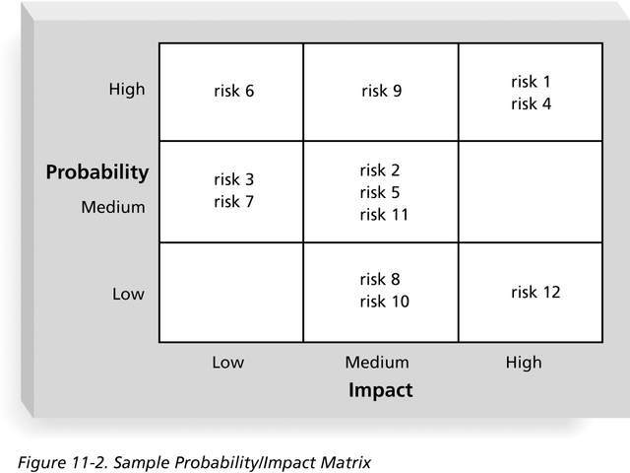
Risk Analysis
Probability/Impact Matix

Slide 20
Risk Identification
Type of risks
Generic risk (common to all projects)
Standard checklist can be modified based on the risk analysis of previous projects
Examples are misunderstanding of the requirements and key staff being ill.
Specific risk (only applies to individual projects)
Team members of the project are the frontline of identifying these potential risks.
Need to set up an encouraging risk-identification environment so that team members are willing to share their findings.
“Assuming that the problems will not occur does not prevent their occurrence.”
More difficult to find
Need to involve project team members
Need an environment that encourages risk assessment

Slide 21
Risk Categorization – Approach #1
Project risks
They threaten the project plan
If they become real, it is likely that the project schedule will slip and that costs will increase
Technical risks
They threaten the quality and timeliness of the software to be produced
If they become real, implementation may become difficult or impossible
Business risks
They threaten the viability of the software to be built
If they become real, they jeopardize the project or the product
Notes:
Capability, The noun viability means the quality of being able to happen or having a reasonable chance of success.

Slide 22
Risk Categorization – Approach #1
Sub-categories of Business risks
Market risk – building an excellent product or system that no one really wants
Strategic risk – building a product that no longer fits into the overall business strategy for the company
Sales risk – building a product that the sales force doesn't understand how to sell
Management risk – losing the support of senior management due to a change in focus or a change in people
Budget risk – losing budgetary or personnel commitment

Slide 23
Risk Categorization – Approach #2
Known risks
Those risks that can be uncovered after careful evaluation of the project plan, the business and technical environment in which the project is being developed, and other reliable information sources (e.g., unrealistic delivery date)
Predictable risks
Those risks that are extrapolated from past project experience (e.g., past turnover)
Unpredictable risks
Those risks that can and do occur, but are extremely difficult to identify in advance
Notes:
Extrapolated- deduce

Slide 24
Reactive vs. Proactive Risk Strategies
Reactive risk strategies
Nothing is done about risks until something goes wrong
The team then comes into action to correct the problem rapidly (fire fighting)
The majority of software teams and managers rely on this approach ("Don't worry, I'll think of something“)
Proactive risk strategies
Primary objective is to avoid risk and to have a contingency plan in place to handle unavoidable risks in a controlled and effective manner

Slide 25
Identify high level project risks
At the beginning of a project, management might expect elaborate plans even though they are ignorant of many important factors affecting the project
For example, until we investigate in detail the users’ requirements we cannot estimate the effort needed to build a system to meet those requirements
The greater the uncertainties at the beginning, the greater the risk that the project will be unsuccessful
Once we recognize a particular area of uncertainty we can, take steps to reduce its uncertainty

Slide 26
Project Risks
Factors that cause a project to be delayed or over-budget
Nature of Project Risks
Planning assumptions
Why assumptions
Uncertainties in early stage of the project
“Everything will go smoothly”
Environment is reliable and fixed
Design will be perfect first time
Coding will be ‘nearly perfect’
Guidelines
List all the assumptions
Identify the effects of these assumptions on the project if they are no longer valid

Slide 27
Nature of Project Risks
Estimation Errors
Difficult to have accurate size or time estimations
Estimation can be improved by analyzing historic data for similar tasks and similar projects
Keep historic data of your estimation and the actual performance
Compare your estimation and the actual value
Classify the tasks that are easy or difficult to give accurate estimation
Notes:
Lack of experience of similar tasks
Lack of historical data
Nature of the task

Slide 28
Nature of Project Risks
Eventualities
Unexpected and unimaginable events
Common unexpected events
Hardware cannot be delivered on time
Requirement specification needs to be rewritten
Staffing problem

Slide 29
Common Risk Factors
Application factors
Staff factors
Project factors
Hardware and software factors
Changeover factors
Supplier factors
Environment factors
Health and safety factors

Slide 30
Application Factors
Nature of the application (A critical factor to the success of the project)
A data processing application or a life-critical system (e.g. X-ray emission system)
Expected size of the application
(The larger is the size, the higher is the chance of errors, communication and management problems)
Notes:
.

Slide 31
Staff Factors
Experience and skills
Experienced programmers are less likely to make errors.
Appropriateness of experience
Experience in coding C++ or Java may not be related to coding in some other programming language.
Staff satisfaction
Dissatisfied or Unmotivated staff may cause a project to fail.
Staff turn-over rates
Key personnel leaving unexpectedly would cause a project to fail.
High turn-over rate would cause much communication overhead and may delay a project.
Notes:
the employee turnover rate is a way to measure how often employees leave a company and are replaced by new ones.

Slide 32
Project Factors
Project objectives:
Unclear to every team member and user
Project methods:
Unstructured methods

Slide 33
Hardware and Software Factors
New hardware
Stability of the new hardware system
Usually, new hardware systems are not so stable at their early stage.
Cross platform development
Development platform is not the operation platform
Does the language used support cross platform development?
Platform Issue:
Normally, the development platform and the operation platform are not exactly the same.
Adjustment is needed to cater for the operation platform. This leads to extra time and effort.
Problems may only occur in the operation platform.
Language Issue:
Availability of languages in the development platform as well as the operation platform
High portability languages should be used such as C, C++, and Java.
This also relates to the skills of the staff.
Integration issues of different development off-the-shelf components such as VB, ODBC, Java, and JDBC.
Notes:
Open Database Connectivity (ODBC) is an open standard Application Programming Interface (API) for accessing a database. By using ODBC statements in a program, you can access files in a number of different common databases.
Java™ database connectivity (JDBC) is the JavaSoft specification of a standard application programming interface (API) that allows Java programs to access database management systems

Slide 34
Changeover Factors
‘All-in-one’ changeover
Too risky.
The new system is put into operation
Incremental or gradual changeover
Adding new components to the system by phases
Not always practical because it involves too many issues such as
the order of integration of the components,
the scheduling of the components,
the interface between the replaced components and the replacing components, and
training of operation personnel.
Parallel changeover
Both the existing system and the new system are used in parallel
Too costly. Sometimes, it is impossible.

Slide 35
Supplier Factors
Late delivery of hardware
Instability of hardware
Late completion of building sites

Slide 36
Environment Factors
Changes in environment such as hardware platforms
Changes in government policies
Changes in business rules
Restructuring of organizations

Slide 37
Health and Safety Factors
Health and safety of staff and environment
Staff sickness, death etc.
Any tragic accident to staff

