Slide 1
Software Project Communication & Conflict Management

Slide 2
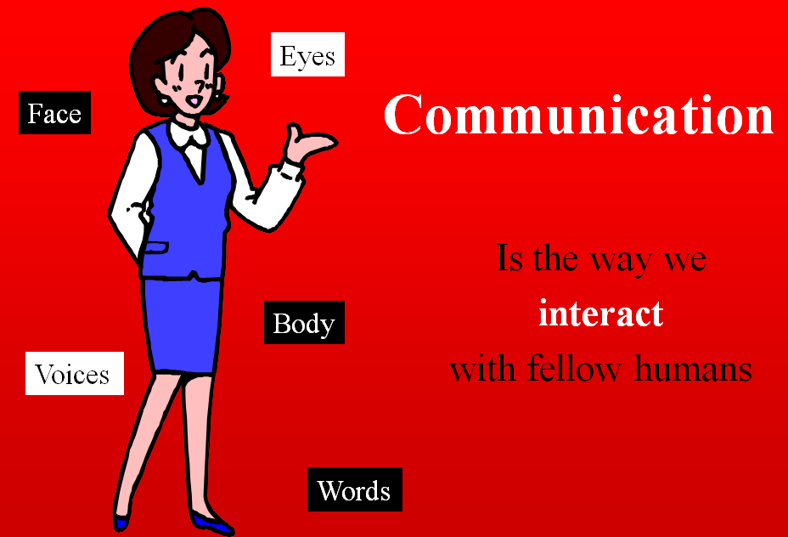

Slide 3
Communication
The way we interact with fellow humans, the way we get our message across.
  We communicate with our eyes, faces and bodies as well as our words and voices.
    “Poor” communication is the cause of feuds and fights.
    “Good” communication and the ability to manage conflict effectively is a skill—one that all of us can learn—and that we must learn if we are to be effective Managers.
The ability to interact successfully and “get along with” people is a critical ingredient to excellence in “people skills.”

Slide 4
The Role of Perception
Difference of understanding in regular communication.
  Even after explanation, the other person cannot see or accept our viewpoint.
Perception has a critical role in our interpretation of any given situation.
  Has considerable influence over our reactions to the situation.
  Perception develops, through a variety of influences
    such as our family background, our ethnic background, our age, work experiences, values, and spiritual outlook.
    Almost everything affects our perception.
Notes:
feelings

Slide 5
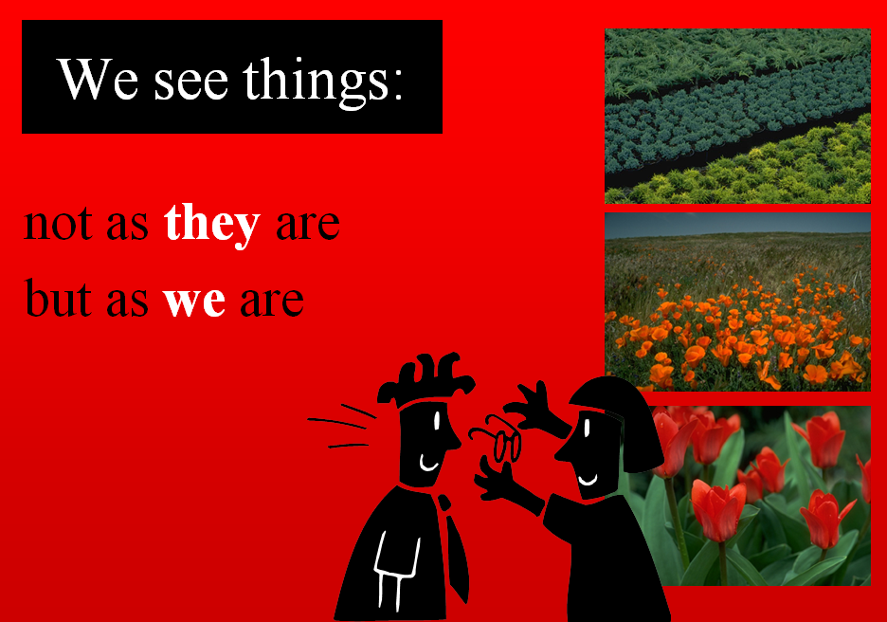

Slide 6
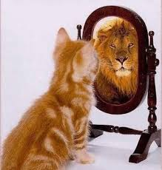


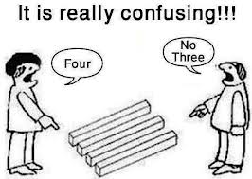
Perception

Slide 7
Perception
A significant factor in improving our communication, reducing conflict and understanding the other person’s point of view, is the recognition that our perceptions are always incomplete to some extent, and perhaps even inaccurate.
Our Perception of Reality is Not Necessarily Reality
  Recognizing our limitations is the basis for taking responsibility for how we think.

Slide 8
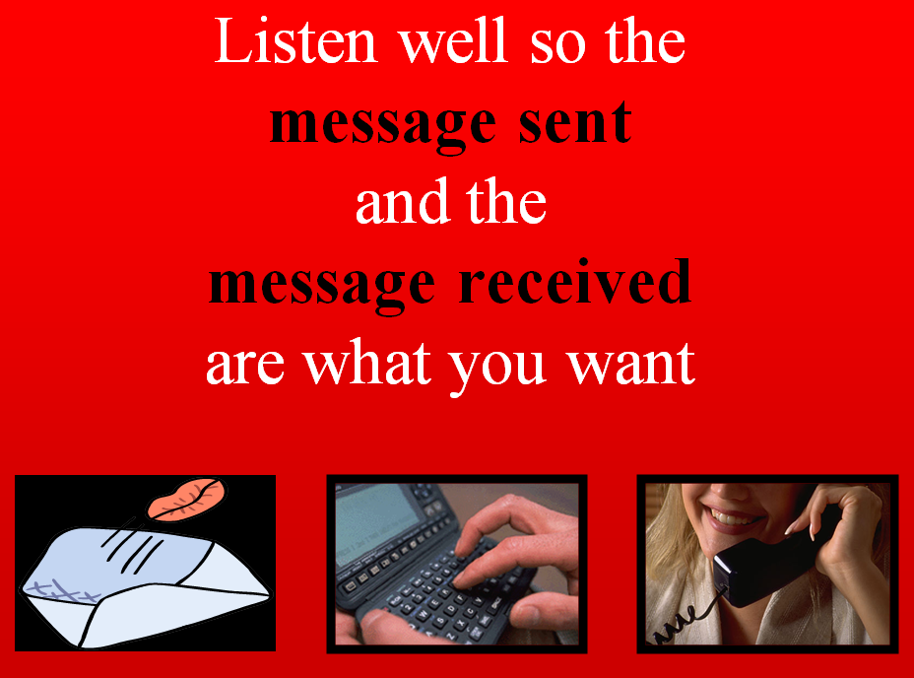

Slide 9
Communication styles
We each develop a particular style of communication.
  Recognizing different styles of communication will help us interact and communicate with people who have very different styles of communication from our own.
  Communication styles can be divided into several different groups. Consider these brief descriptions:

Slide 10
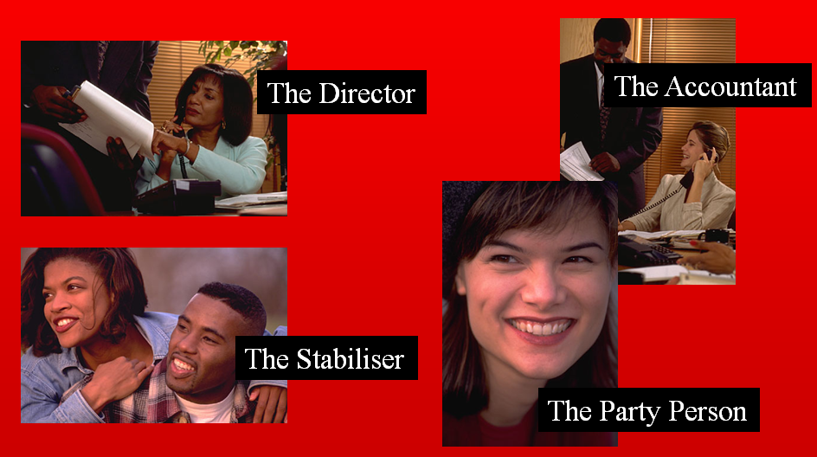

Slide 11
Communication styles
The Director:
  You know this type of person, they are:
    Impatient, they want everything done yesterday.
    They even speak quickly, often using short forms of language such as “ASAP” .
    They are direct in their communication and are often to be found in leadership positions.
  Keep in mind that this person thinks in terms of projects that need to be completed
  “The Director” often does without even being aware that they may be hurting or stepping on someone.

Slide 12
Communication styles
The Party Person
  These people are friendly, optimistic and informal.
  They enjoy life and they communicate clearly.
  They are energetic and creative—give them opportunity to establish their goals and visions and don’t dampen their enthusiasm.

Slide 13
Communication styles
The Stabilizer.
  A quieter person; shy, but friendly.
  A wonderful support person, loyal and caring—they have difficulty in saying no.
  Give them space to speak and don’t interrupt. Because they are quiet don’t ignore them or assume they have nothing to contribute. Involve them with requests for comments or their help.

Slide 14
Communication styles
The Accountant
  Every team needs this quiet, meticulous person.
    They are systematic and attend to the details involved with finances and filing. As with the stabilizer, involve this person and give them the opportunity to share their knowledge and ideas.
    This person will respond best when they can sense that there is structure and framework to what you are trying to accomplish.
Notes:
showing great attention to detail.

Slide 15
THE COMMUNICATION PROCESS
Research says in a face-to-face interaction
  7% VERBAL—What you said (the message itself)
  38% VOCAL—How you said it (the intonation, projection and resonance of the voice…)
  55% VISUAL—body language / non verbal
    A motto that many specialists in communication use: It’s not what you say – it’s how you say it!
Pay attention to more than just the actual words someone is saying
  A person’s tone of voice and body language say a lot about how they really feel
  Short, frequent meetings are often very effective on IT projects
  Stand-up meetings force people to focus on what they really need to communicate

Slide 16
Importance of Good Communications
The greatest threat to many projects is a failure to communicate
Research shows that IT professionals must be able to communicate effectively to succeed in their positions
  Strong verbal skills are a key factor in career advancement for IT professionals
Most project managers would admit that around eighty percent of their time is spent communicating in one form or another with the various members and groups within the project team.
  Related issue have to be addressed is:
    the screening of communications
    Collection and distribution of information

Slide 17
Project communications management
It is about appropriate generation, collection, storage and distribution of project information.
  During the project planning it requires determining the information and communications needs of stakeholders
  During execution it is about distributing the information in a timely manner, doing status reporting and progress measurement,
  During closure it is about gathering information to formalize project completion.
Project communications management needs to be planned for:
  Who needs what project information?
  When do they need it?
  How will the information be given?
  By whom?
  How will information be distributed?

Slide 18
Project Communications Management Processes
Communications planning:
  determining the information and communications needs of the stakeholders
Information distribution:
  making needed information available to project stakeholders in a timely manner
Performance reporting:
  collecting and disseminating performance information, including status reports, progress measurement, and forecasting
Managing stakeholders:
  managing communications to satisfy the needs and expectations of project stakeholders and to resolve issues

Slide 19
Communications Planning
Every project should include some type of
  communications management plan - a document that guides project communications
Creating a stakeholder analysis for project communications also aids in communications planning
  Stakeholder communications requirements
  Information to be communicated, including format, content, and level of detail
  Who will receive the information and who will produce it
  Suggested methods or technologies for conveying the information
  Frequency of communication
  Escalation procedures for resolving issues
  Revision procedures for updating the communications management plan
  A glossary of common terminology

Slide 20
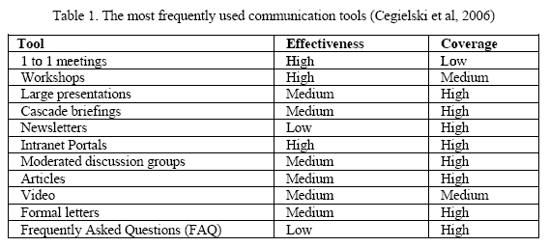
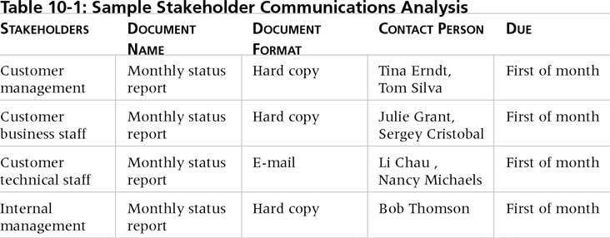
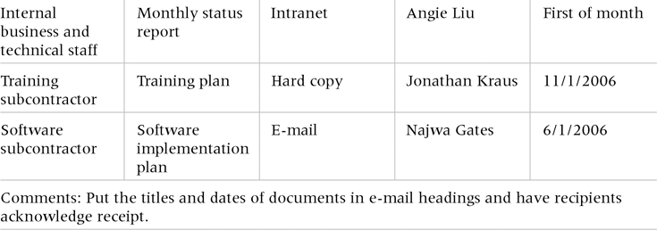
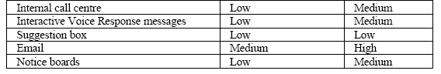
Sample Stakeholder Analysis for Project Communications

Slide 21
Communication Blockers
Accusing
  Never accuse or blame unless is it highly required
Judging
  if one person is suspecting that you judge him, he will not open up to you
Insulting
  takes you nowhere in communication
Diagnosis
  other person maybe reluctant to provide you all the information he/she has.
Sarcasms
  show respect to others. If you show no respect, you get no information.
Globalizing
  Do not use words such as "always" or "never".
Threats or Orders
  Overpowering rather than understanding the other person, has many negative consequences
Interrupting
  people interrupt another person to express their own views and to oppose what has been said.
Notes:
When you try to diagnose something without a proper background to do so, others understand as if you are trying to show your expertise over the other person.

Slide 22
Conflict
Dictionary :
  To come into collision or disagreement;
    be contradictory, or in opposition;
    clash: The account of one eyewitness conflicted with that of the other.
Conflict management is the process of limiting the negative aspects of conflict while increasing the positive aspects of conflict.
  The aim of conflict management is to enhance learning and group outcomes, including effectiveness or performance in organizational setting (Ra him, 2002, p. 208).

Slide 23
Reducing Conflict
Overview
  Lose-lose methods:
    parties to the conflict episode do not get what they want
  Win-lose methods:
    one party a clear winner; other party a clear loser
  Win-win methods:
    each party to the conflict episode gets what he or she wants

Slide 24
Reducing Conflict
Lose-lose methods
  Avoidance
    Withdraw, stay away
    Does not permanently reduce conflict
  Compromise
    Bargain, negotiate
    Each loses something valued
  Smoothing: find similarities

Slide 25
Reducing Conflict
Win-lose methods
  Dominance – Forcing
    Overwhelm other party
  Authoritative command: decision by person in authority
  Majority rule: voting
    This is when you force the issue to get the decision you want, usually for safety or ethical/ moral/legal issues.
    Sometimes it is a good strategic move to ask the group to go away and think about the decision, and then meet again to make the decision.

Slide 26
Reducing Conflict
Win-win methods
  Problem solving: find root causes
  Integration: meet interests and desires of all parties
  Superordinate goal: desired by all but not reachable alone
Summary
  Lose-lose methods: compromise
  Win-lose methods: dominance
  Win-win methods: problem solving
Notes:
Superordinate goals are goals that get people from opposing sides to come together and work toward a common end result.

Slide 27
Reducing Conflict (Yet another)
Avoid → Wait & See
  When the issues are trivial, or circumstances dictate that a solution is better left until later.
  Maybe until you or the other people have calmed down, or reinforcements have arrived.
  Perhaps it is better to avoid decision making when you are so tired / stressed that your judgment may not be sound
  When moral or safety issues are involved.
  Not to be used just because you are afraid to deal with conflict! Issues will only build up and become more complicated.

Slide 28
Managing Conflict - STAR
In situations of crisis and potential conflict always remember star
S T A R
We need to: STOP (Don’t panic – don’t react!)
THINK (gather information)
ANALYSE (using gathered information decide how you can best empathize with this person)
RESPOND (respectfully communicate your understanding of the situation and what would work for you)
Notes:
Situation, task, action, result.

Slide 29
