Slide 1
Software Project Estimations
Cost Management

Slide 2
Project Estimation
The project manager must set expectations about the time required to complete the software among the stakeholders, the team, and the organization’s management.
If those expectations are not realistic from the beginning of the project, the stakeholders will not trust the team or the project manager.

Slide 3
Elements of a Sound Estimate
To generate a sound estimate, a project manager must have:
  A work breakdown structure (WBS), or a list of tasks which, if completed, will produce the final product
  An effort estimate for each task
  A list of assumptions which were necessary for making the estimate
  Consensus among the project team that the estimate is accurate

Slide 4
Software estimates- steps
The software estimation process begins with the project's functional requirements
  Without defining the requirements, it is impossible to determine the cost and schedule for the software project
Once the functional requirements are known, personnel can then be assigned to develop the estimate

Slide 5
Software estimates- steps
The next step in the process is to develop the size estimate
  The traditional definition of size is Source Lines of Code (SLOC)
  Other methods exist for calculating size, such as function or feature points
It is advisable to use more than one method to calculate size, so that results can be compared

Slide 6
Source Line of Code
Used to measure the size of a software program by counting the number of lines in the text of the program's source code.
  Typically used to predict the amount of effort that will be required to develop a program,
  To estimate programming productivity or effort once the software is produced.
SLOC is defined such that:
  Only Source lines that are DELIVERED as part of the product are included -- test drivers and other support software is excluded
  SOURCE lines are created by the project staff -- code created by applications generators is excluded
  One SLOC is one logical line of code
    A single SLOC may be several physical lines.
      For example, an "if-then-else" statement would be counted as one SLOC
  Declarations are counted as SLOC
  Comments are not counted as SLOC

Slide 7
Function Point
A language independent approach to estimating software development effort
  The technique is a measure of the size of computer applications and the projects that build them ( function point measures the size)
    The size is measured from a functional, or user, point of view
  It is independent of
    the computer language,
    development methodology
  counting lines of code measures software from the developers' point of view
  Since function points are based on screens, reports and other external objects, this measure takes the users' view

Slide 8
Function Point Analysis
Idea: Software system consists of five major components
  External input types
    Input transactions that update internal computer files
  External output types
    Transactions that output data to user such as report printing.
  Logical internal file types
    The standing file used by the system.
      A group of data that is usually accessed together. It may have one or more record types.
      Example: A PurchaseOrder may contain one or more PurchaseItems.
  External interface file types
    Input and output that may pass from and to other computer applications.
    Files shared among applications would also be counted.
      Example: the transmission of accounting data from an order processing system to the main ledger system.
  External inquiry types
    Transactions initiated by the user that provide information but do not update the internal files.
Notes:
Ledger—keep track of debit credit

Slide 9
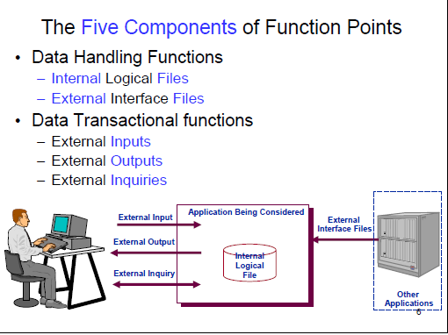


Slide 10
Software estimates- steps
Once the size has been determined, the next step is to calculate the effort, cost, and schedule of the project using the size estimate that was calculated previously
  Effort is usually calculated in person months, which can be translated into cost by using the applicable labor rates
Software effort, cost and schedule are all interrelated and a change to one will affect the other two
Notes:
Effort refers to the number of labor units required to complete a task, activity or project, and are often called 'man-hours’.
This effort is traditionally measured in the hours worked by a person, or the money needed to pay for this work.

Slide 11
Problems related to size estimation
Nature of software
  about its complexity
Novel application of software
  each time the software to be developed has some unique features.
Fast changing technology and Lack of homogeneity of project experience
  technology changes very fast, how well the personnel can manage the new technology is still not known yet.
Political implications within the organization
  The marketing director tends to push the product to be on the market at an early stage. Project manager may then have a tighter schedule as planned.

Slide 12
Assumptions Make Estimates More Accurate
Team members make assumptions about the work to be done in order to deal with incomplete information
  Any time an estimate must be based on a decision that has not yet been made, team members can assume the answer for the sake of the estimate
  Assumptions must be written down so that if they prove to be incorrect and cause the estimate to be inaccurate, everyone understands what happened
  Assumptions bring the team together very early on in the project so they can make progress on important decisions that will affect development

Slide 13
Wideband Delphi
Wideband Delphi is a process that a team can use to generate an estimate
  The project manager chooses an estimation team, and gains consensus among that team on the results
  Wideband Delphi is a repeatable estimation process because it consists of a straightforward set of steps that can be performed the same way each time

Slide 14
Some project data- effort in work month and %age of total effort
 | Design |  | Coding |  | Testing |  | Total
Project | Wm | % | Wm | % | Wm | % | Wm | SLOC
A | 3.9 | 23 | 5.3 | 32 | 7.4 | 44 | 16.7 | 6050
B | 2.7 | 12 | 13.4 | 59 | 6.5 | 26 | 22.6 | 8363
C | 3.5 | 11 | 26.8 | 83 | 1.9 | 6 | 32.2 | 13334
D | 0.8 | 21 | 2.4 | 62 | 0.7 | 18 | 3.9 | 5942
E | 1.8 | 10 | 7.7 | 44 | 7.8 | 45 | 17.3 | 3315
F | 19.0 | 28 | 29.7 | 44 | 19.0 | 28 | 67.7 | 38988
G | 2.1 | 21 | 7.4 | 74 | 0.5 | 5 | 10.1 | 38614
H | 1.3 | 7 | 12.7 | 66 | 5.3 | 27 | 19.3 | 12762
I | 8.5 | 14 | 22.7 | 38 | 28.2 | 47 | 59.5 | 26500
Notes:
Productivity is a measure of labor productivity for a project or program.

Slide 15
Productivity rate
Project | Wm | SLOC | Productivity SLOC/month
A | 16.7 | 6050 | 362
B | 22.6 | 8363 | 370
C | 32.2 | 13334 | 414
D | 3.9 | 5942 | 1524
E | 17.3 | 3315 | 192
F | 67.3 | 38988 | 576
G | 10.1 | 38614 | 3823
H | 19.3 | 12762 | 661
I | 59.5 | 26500 | 445
overall | 249.3 | 153868 | 617
Notes:
Productivity=output/working hours
P=sloc/hours
P=fp/hours

Slide 16
When are estimates done?
Estimates are carried out at various stages of a software project
  Strategic planning:
    The costs and benefits of potential applications might need to be estimated to help decide what priority to give to each project
    Such estimates might also influence the numbers of various types of development staff to be recruited
  Feasibility study
    This ascertains that the potential system will justify the costs
    Estimates at the design stage will also confirm that the feasibility study is still valid, taking into account all that has been learnt during detailed requirements analysis
  System specification
    The effort needed to implement different design proposals will need to be estimated

Slide 17
When are estimates done?
  Evaluation of suppliers’ proposals
    A bid need to scrutinize the system specification and produce estimates on which to base proposals
    question a proposal that seems too low
      whether the proposer had properly understood the requirements
    If, the bids seem too high, reconsider
  Project planning
    As the planning and implementation of the project progresses to greater levels of detail, more detailed estimates of smaller work components will be made.

Slide 18
over- and under-estimates
A project leader will need to be aware that the estimate, if known to the development team, will influence the time required to implement the application
  An over-estimate might cause the project to take longer than it would otherwise
  This can be explained by the application of two ‘laws’.
Parkinson’s Law ‘Work expands to fill the time available’, which implies that given an easy target staff will work less hard.
Brooks’ Law ‘putting more people on a late job makes it later’
  As the project team grows in size so will the effort that has to go into management, coordination and communication
an over-estimate of the effort might lead to more staff being allocated than are needed and managerial overheads will be increased
The under-estimate effect on quality

Slide 19
Size of Software Project
Relative Size Size Code Function Point Size (IFPUG)
  Extra-extra-small XXS => 0 and <10
  Extra-small XS => 10 and <30
  Small S => 30 and <100
  Medium1 M1 => 100 and <300
  Medium2 M2 => 300 and <1000
  Large L => 1,000 and < 3,000
  Extra-large XL => 3,000 and < 9,000
  Extra-extra-large XXL => 9,000 and < 18,000
  Extra-extra-extra-large XXXL => 18,000

Slide 20
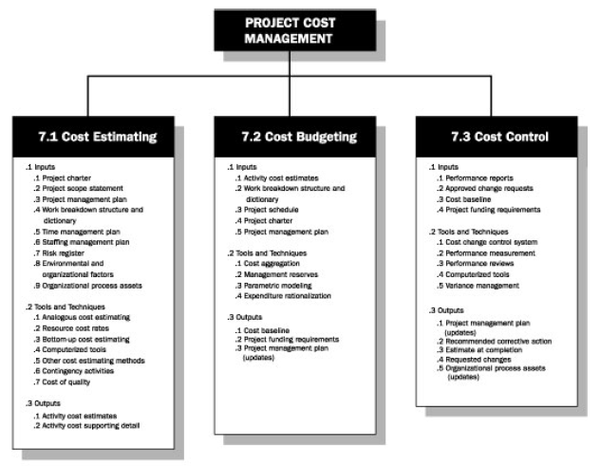
Project Cost Management Processes
Cost is a resource sacrificed to achieve a specific objective or something given up in exchange
There are three project cost management processes:
  Cost estimating: developing an approximation or estimate of the costs of the resources needed to complete a project
  Cost budgeting: allocating the overall cost estimate to individual work items to establish a baseline for measuring performance
  Cost control: controlling changes to the project budget

Slide 21
Software cost components
Estimates are made to discover the cost, to the developer, of producing a software system
The major Cost Components:
  Hardware and software costs
  Travel and training costs
  Effort costs (the dominant factor in most projects)
    Salaries of engineers involved in the project
    Insurance costs etc.
  Effort costs must take overheads into account
    Costs of building, heating, lighting
    Costs of networking and communications
    Costs of shared facilities (e.g library, staff restaurant, etc.)

Slide 22
Software Cost & efforts Estimation Tools and Techniques
The Basic tools and techniques for cost estimates & deriving estimates of software development effort are:
  Analogous or top-down estimates: use the actual cost of a previous, similar project as the basis for estimating the cost of the current project
  Bottom-up estimates: involve estimating individual work items or activities and summing them to get a project total
  Parametric modeling uses project characteristics (parameters) in a mathematical model to estimate project costs
  Computerized tools: tools such as spreadsheets and project management software

Slide 23
Analogous
  Less costly but less accurate also
  Depends on expertise of people involved (if new s/w used then not suitable)
Bottom-up
  More accurate as in WBS( work involved calculated by ppl who are doing the work)
  Time consuming and difficult to develop

Slide 24
Compute FP
FP= UFP * CAF
UFP– Unadjusted functional point
CAF-- Complexity adjustment factor
Notes:
i.e. the number of functionalities delivered to the users

Slide 25
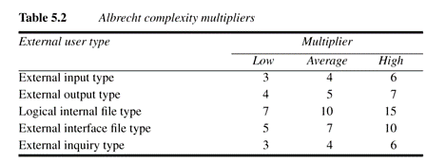
Albrecht Complexity Multipliers
• After trial and error, empirical weighting factors were developed for the five items

Slide 26
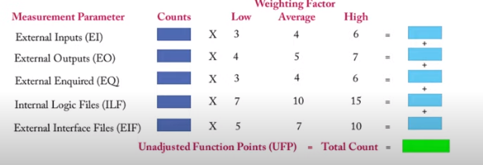

Slide 27
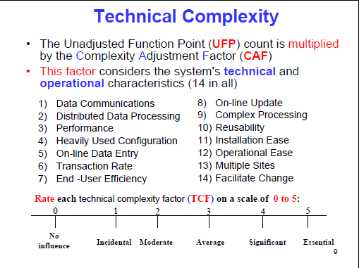

Slide 28
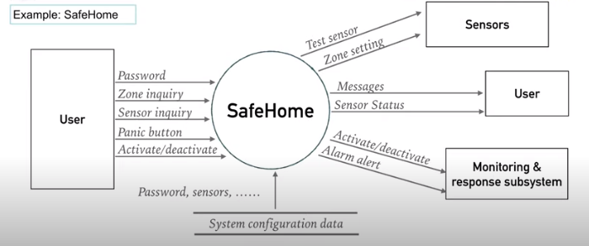
Notes:
Number of developer hours per FP.
Number of total hours per FP.
Cost per FP.
Number of FPs per month/week/day.
Number of bugs/defects per FP.
Number of bug/defect hours per FP.
Productivity increases (or decreases) due to technology changes.

Slide 29
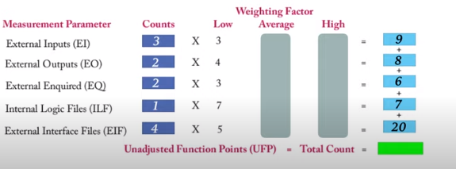

Slide 30
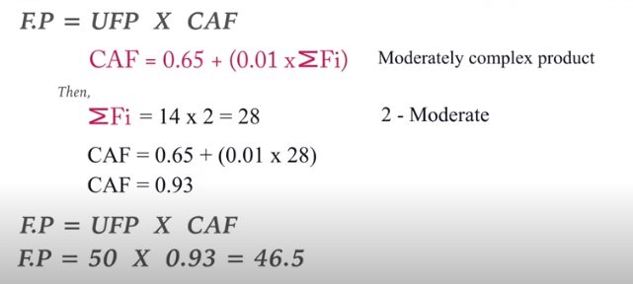
Notes:
Fi Is total complexity adjustment value.
Degree of influence based on responses to standard questions.

Slide 31
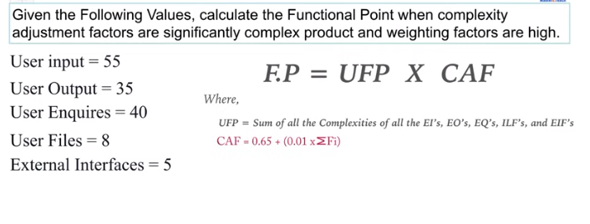
Example
Notes:
High weighting factor.
Significantly complex all 14

Slide 32
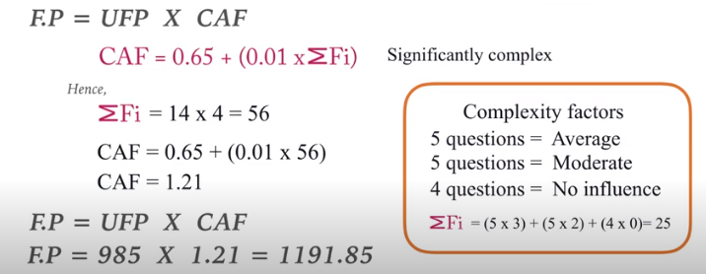
Solution

Slide 33
Based on the FP measure of software many other metrics can be computed:
  Errors/FP
  $/FP.
  Defects/FP
  Pages of documentation/FP
  Errors/PM.
  Productivity = FP/PM (effort is measured in person-months).
  $/Page of Documentation.
LOCs of an application can be estimated from FPs.
Notes:
Language Factor (LF) for Java assumed as = 38
· Source Lines of Code (SLOC) = FP * LF = 4636

Slide 34
Example
Compute the function point, productivity, documentation, cost per function for the following data:
Number of user inputs = 24
Number of user outputs = 46
Number of inquiries = 8
Number of files = 4
Number of external interfaces = 2
Effort = 36.9 p-m
Technical documents = 265 pages
User documents = 122 pages
Cost = $7744/ month
Various processing complexity factors are: 4, 1, 0, 3, 3, 5, 4, 4, 3, 3, 2, 2, 4, 5.

Slide 35
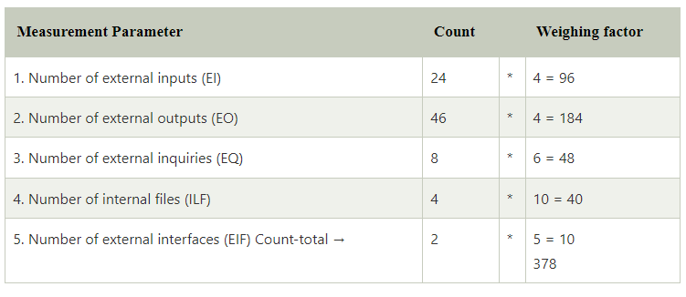
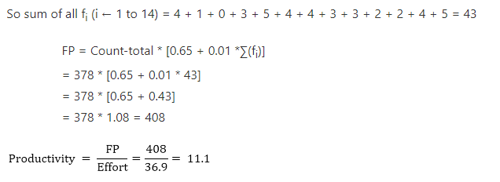

Slide 36
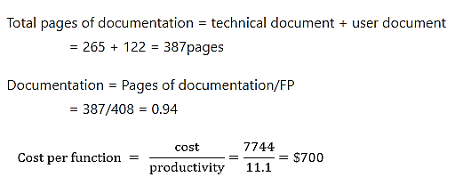

Slide 37
Object Points
• Object metrics involve estimating the size of the application in terms of the number of objects required to deliver the desired functionality
• Objects only – 3.G.L. components, reports, screens

Slide 38
Object Point Analysis – Steps
Identify the number of screens, reports and 3GL components
Classify each object as Simple, Medium and Difficult
Assign the weight accordingly
Calculate the total object points
  Total OP = sum of individual OP × weighting
Notes:
3GL: 3rd Generation Language
Objects:- screens, reports and 3GL components
It is assumed that these objects are defined in a standard way as part of an integrated CASE environment.
The 3GL components are used to supplement the 4GL code.
Classifying the level of objects and assigning the complexity weightings is done according to some guidelines (see tables below)

Slide 39
Object Point Analysis – Steps (cont’d)
Deduct the reused objects (r% reused)
  NOP = OP × (1 – r%)
Identify the productivity rate of both developer and CASE
Productivity rate = average of the two PRs
Calculate the effort
  Effort = NOP / Productivity Rate
Notes:
NOP: New Object Point
The productivity rate of developer’s experience and capability and CASE maturity and capability is the average of the two values from the table.

Slide 40
Object Point Analysis – Screens
 | Number and source of data tables
Number of views contained | Total < 4 (<2 server, <2 client) | Total < 8 (2-3 server, 3-5 client) | Total 8+ (>3 server, >5 client)
< 3 | Simple | Simple | Medium
3 – 7 | Simple | Medium | Difficult
8+ | Medium | Difficult | Difficult

Slide 41
Object Point Analysis – Reports
 | Number and source of data tables
Number of sections contained | Total < 4 (<2 server, <2 client) | Total < 8 (2-3 server, 3-5 client) | Total 8+ (>3 server, >5 client)
< 2 | Simple | Simple | Medium
2 or 3 | Simple | Medium | Difficult
> 3 | Medium | Difficult | Difficult

Slide 42
Object Point Analysis – Complexity Weightings
 | Complexity
Type of object | Simple | Medium | Difficult
Screen | 1 | 2 | 3
Report | 2 | 5 | 8
3GL component | N/A | N/A | 10
Notes:
Note that: All 3GL components may be of different size. But, according to OBA, they are the same.

Slide 43
Object Point Analysis – Productivity Rate
 | Very low | Low | Nominal | High | Very High
Developer’s experience and capability | 4 | 7 | 13 | 25 | 50
CASE maturity and capability | 4 | 7 | 13 | 25 | 50

Slide 44
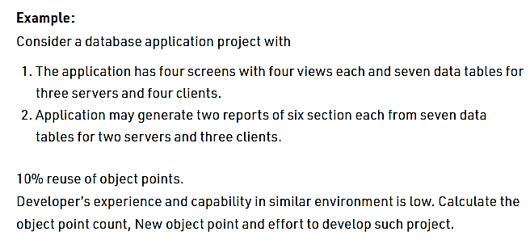
Example

Slide 45
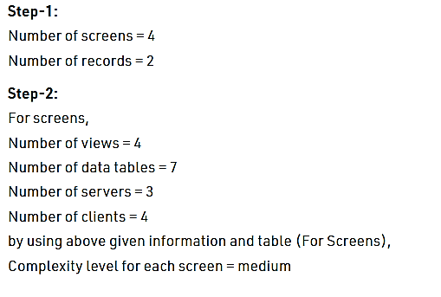
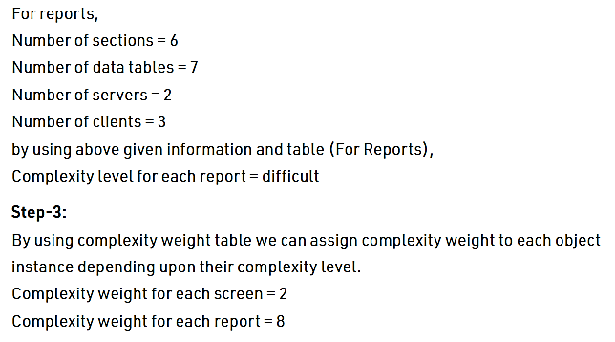

Slide 46
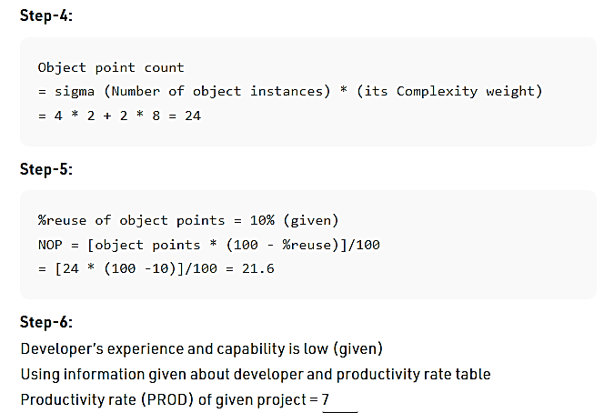

Slide 47
