Slide 1
Project Estimation
Contd.

Slide 2
COnstructive COst MOdel
It was proposed by Barry Boehm in 1970 and is based on the study of 63 projects, which make it one of the best-documented models.
The key parameters which define the quality of any software products, which are also an outcome of the CoCoMo are primarily Effort & Schedule:
Effort: Amount of labor that will be required to complete a task. It is measured in person-months units.
Schedule: Simply means the amount of time required for the completion of the job, which is, of course, proportional to the effort put. It is measured in the units of time such as weeks, months.
Notes:
Allows to estimate for the type of application, size, and Cost.
COCOMO predicts the efforts and schedule of a software product based on the size of the software.

Slide 3
In COCOMO, projects are categorized into three types:
Organic: A development project can be treated of the organic type, if the project deals with developing a well-understood application program, the size of the development team is reasonably small, and the team members are experienced in developing similar methods of projects. Examples of this type of projects are simple business systems, simple inventory management systems, and data processing systems.

Slide 4
In COCOMO, projects are categorized into three types:
Semidetached: A development project can be treated with semidetached type if the development consists of a mixture of experienced and inexperienced staff. Team members may have finite experience in related systems but may be unfamiliar with some aspects of the order being developed. Example of Semidetached system includes developing a new operating system (OS), a Database Management System (DBMS), and complex inventory management system.

Slide 5
In COCOMO, projects are categorized into three types:
Embedded: A development project is treated to be of an embedded type, if the software being developed is strongly coupled to complex hardware, or if the stringent regulations on the operational method exist. For Example: ATM, Air Traffic control.
Notes:
Strict.

Slide 6
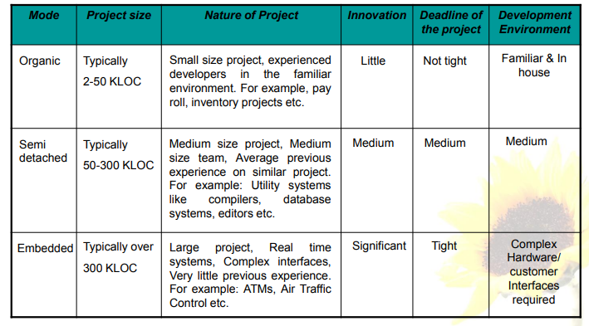
Comparison of three COCOMO modes

Slide 7
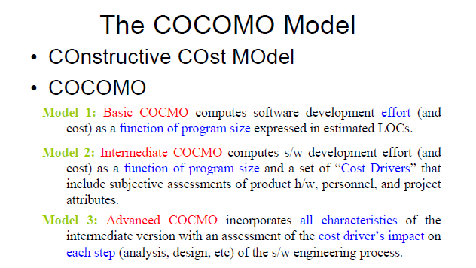
Notes:
The first level, Basic COCOMO can be used for quick and slightly rough calculations of Software Costs. Its accuracy is somewhat restricted due to the absence of sufficient factor considerations.

Slide 8
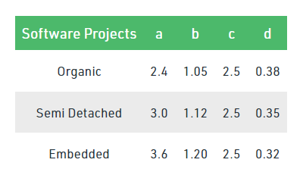
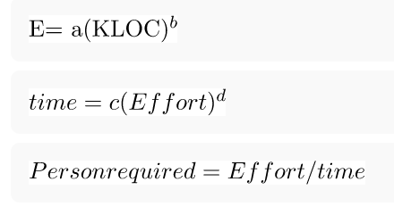
Basic COCOMO
The constant values a,b,c and d for the Basic Model for the different categories of system:

Slide 9
An Example
We have determined our project fits the characteristics of Semi-Detached mode.
We estimate our project will have 32,000 Delivered Source Instructions. Using the formulas, we can estimate:
Effort = 3.0*(32) ^{1.12} = 146 person-months
Schedule = 2.5*(146) ^{0.35} = 14 months
Productivity = 32,000 DSI / 146 = 219 DSI/pm
Average Staffing = 146 MM /14 months = 10
Productivity = DSI / EFFORT
Average staffing = Effort / Schedule

Slide 10
Question
Suppose a project was estimated to be 400 KLOC. Calculate the effort and development time for each of the three model i.e., organic, semi-detached & embedded.

Slide 11
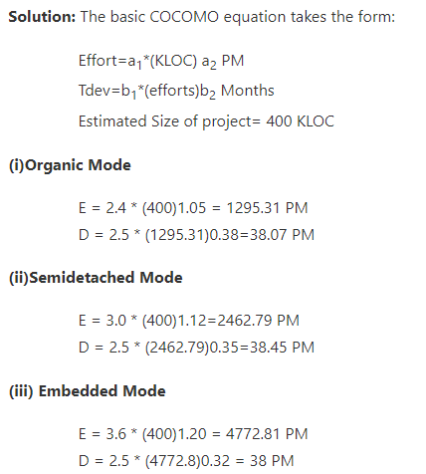
Solution

Slide 12
Intermediate COCOMO
The basic Cocomo model assumes that the effort is only a function of the number of lines of code and some constants evaluated according to the different software system. However, in reality, no system’s effort and schedule can be solely calculated on the basis of Lines of Code. For that, various other factors such as reliability, experience, Capability. These factors are known as Cost Drivers and the Intermediate Model utilizes 15 such drivers for cost estimation.

Slide 13
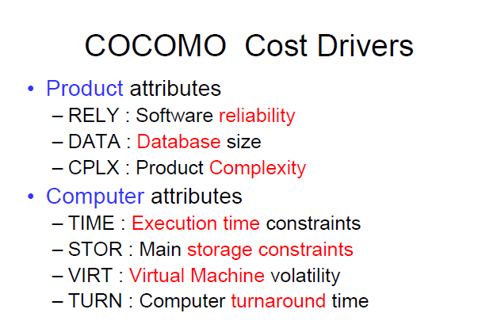
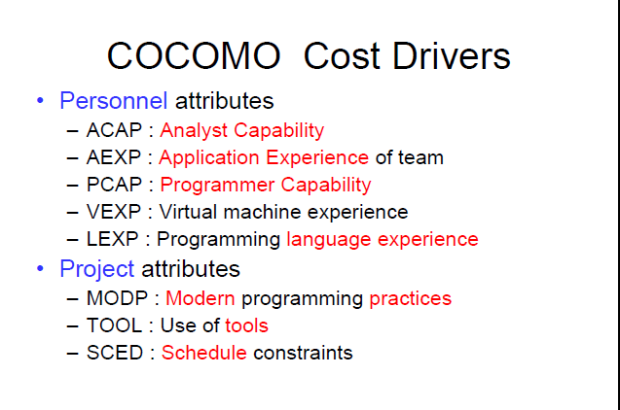
Cost drivers

Slide 14
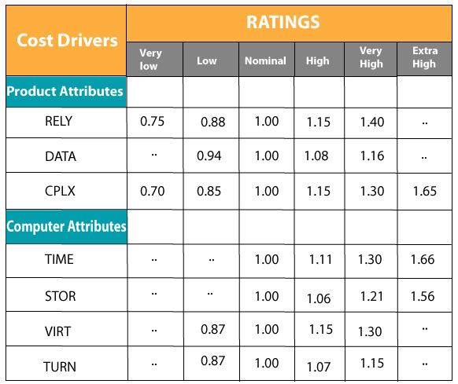
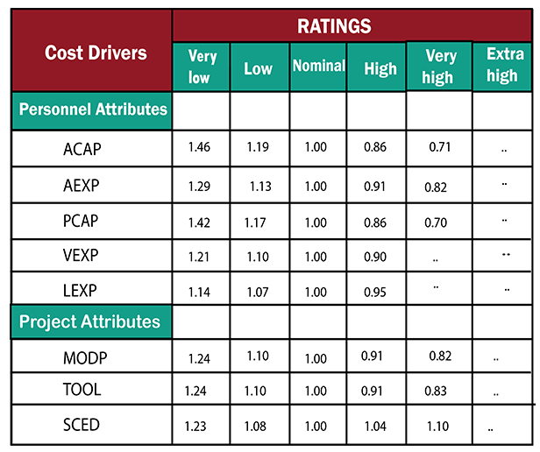

Slide 15
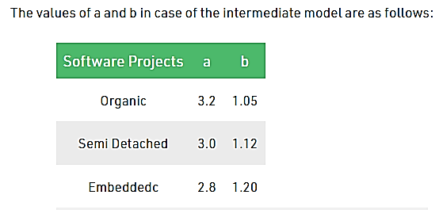

Contd.
The project manager is to rate these 15 different parameters for a particular project on a scale of one to three. Then, depending on these ratings, appropriate cost driver values are taken from the above table. These 15 values are then multiplied to calculate the EAF (Effort Adjustment Factor).
EAF = It is an Effort Adjustment Factor, which is calculated by multiplying the parameter values of different cost driver parameters.

Slide 16
Example
A project was estimated with a size of 300 KLOC. Calculate the Effort, Scheduled time for development by considering developer having very high application experience and very low experience in programming.
Scheduled Time (D) = c*(E)^{d} Months(M)

Slide 17
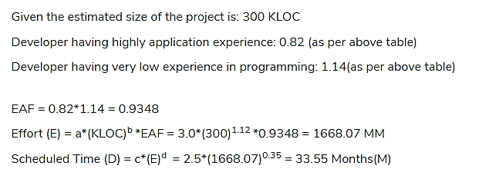
Solution

Slide 18
Project Quality Management

Slide 19

Project Quality management:
International Standard of Organization ISO defines quality as:
“The totality of characteristics of an entity that bear on its ability to satisfy stated or implied needs”
“Conformance to requirements and fitness for use.
Conformance to requirement means: Project processes and products meet written specifications.
fitness for use: product can be used as intended.

Slide 20
Main Processes in Project Quality Management
The main purpose of quality management is to ensure that the project will satisfy the needs for which it was undertaken.
Quality management involves establishing effective relationships with the stakeholders to meet their stated and implied needs.
MAIN Processes involved in Quality management are:
Quality Planning
Quality Assurance
Quality Control

Slide 21
Quality Planning:
Includes which quality standards are relevant to the project and how to satisfy them.
Incorporating quality standards into project design is a key part.
E.g., how long it would take to get reply from helpdesk or how long it should take to ship a replacement part of h/w under warranty? or response time of a system or consistent or accurate information is produced.
Quality Assurance:
Involves periodically evaluating project performance to ensure the project will satisfy the relevant quality standards.
It involves taking responsibility of quality during and at the end of the project.

Slide 22
Quality Control:
Comply with the relevant quality standards while identifying ways to improve over all quality.
This method is associated with tools and techniques such as Pareto charts, quality control charts and statistical sampling.

Slide 23
Quality assurance vs quality control
One of the major points of quality control vs QA is that assurance of quality is done before starting a project whereas the quality control begins once the product has been manufactured.
Assurance of quality is a proactive or preventive process to avoid defects whereas quality control is a corrective process to identify the defects in order to correct them.

Slide 24
Quality control tool: Pareto Chart
Involves identifying the vital few contributors that account for most quality problems. It is sometimes referred as 80-20 rule (80 % of problems due to 20% of causes)
Notes:
Pareto are bar graphs.

