Slide 1
The Importance of Parents Being Involved in Their Children's Lives
DATA230 : Group - 4
Edward Montoya
Saumya Sinha
Maharsh Soni
Aayush Srivastava
Rashmi Shree Veeraiah

Slide 2
Motivation
Parents play a crucial role for development of their children, and a stable relationship between parent and child is vital.
The lack of proper guidance and involvement from the parents can have serious negative effects on a child's life and can lead to delinquent behavior.

Slide 3
Literature Review
THE RELATIONSHIP BETWEEN JUVENILE DELINQUENCY AND FAMILY
This study examined whether a child living in a non-intact household is more susceptible to becoming a delinquent youth.
Research had found that parental absence has been linked to a child’s susceptibility toward juvenile delinquency for years.
THE DIFFERENTIAL INFLUENCE OF ABSENT AND HARSH FATHERS ON JUVENILE DELINQUENCY
The paper investigates the role of fathers in fostering their children's delinquent behaviors, focusing on two issues: the quality of the father-child relationship and father absence.
The results show that children with harsh fathers were more likely to commit crimes and use a wide array of substances than children with absent fathers.
The difference between children with absent or harsh father persisted with the mother-child relationship taken into account, which is in line with studies that found the father-child relationship to be a reliable predictor of delinquency when maternal behavior was accounted for.

Slide 4
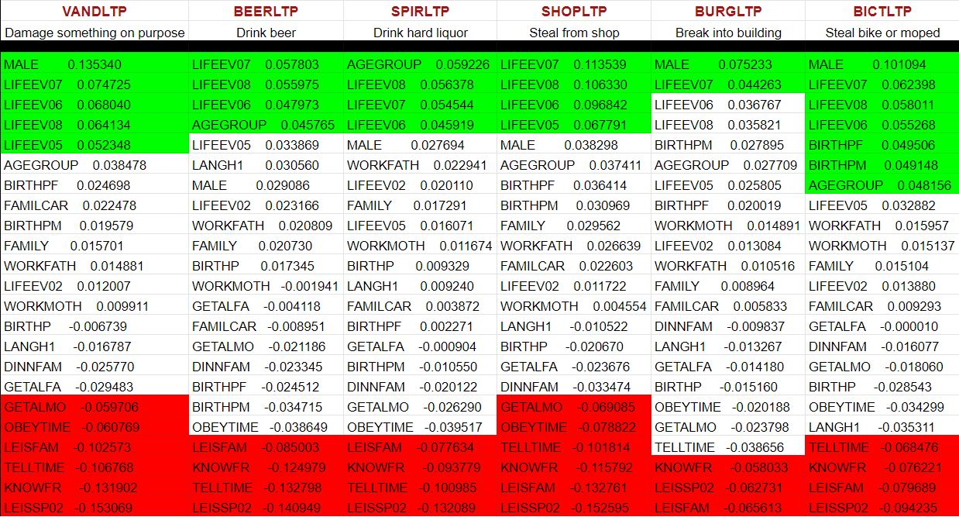

Slide 5
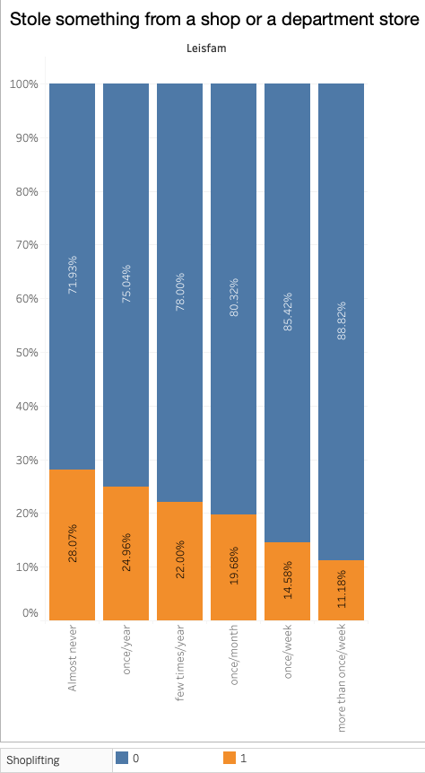
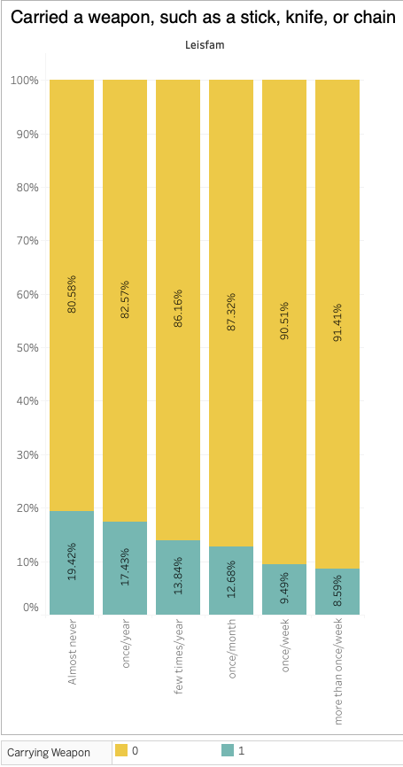
How often do you and your parents (or the adults you live with) do something together, such as going to the movies, going for a walk or hike, visiting relatives, attending a sporting event, and things like that?

Slide 6
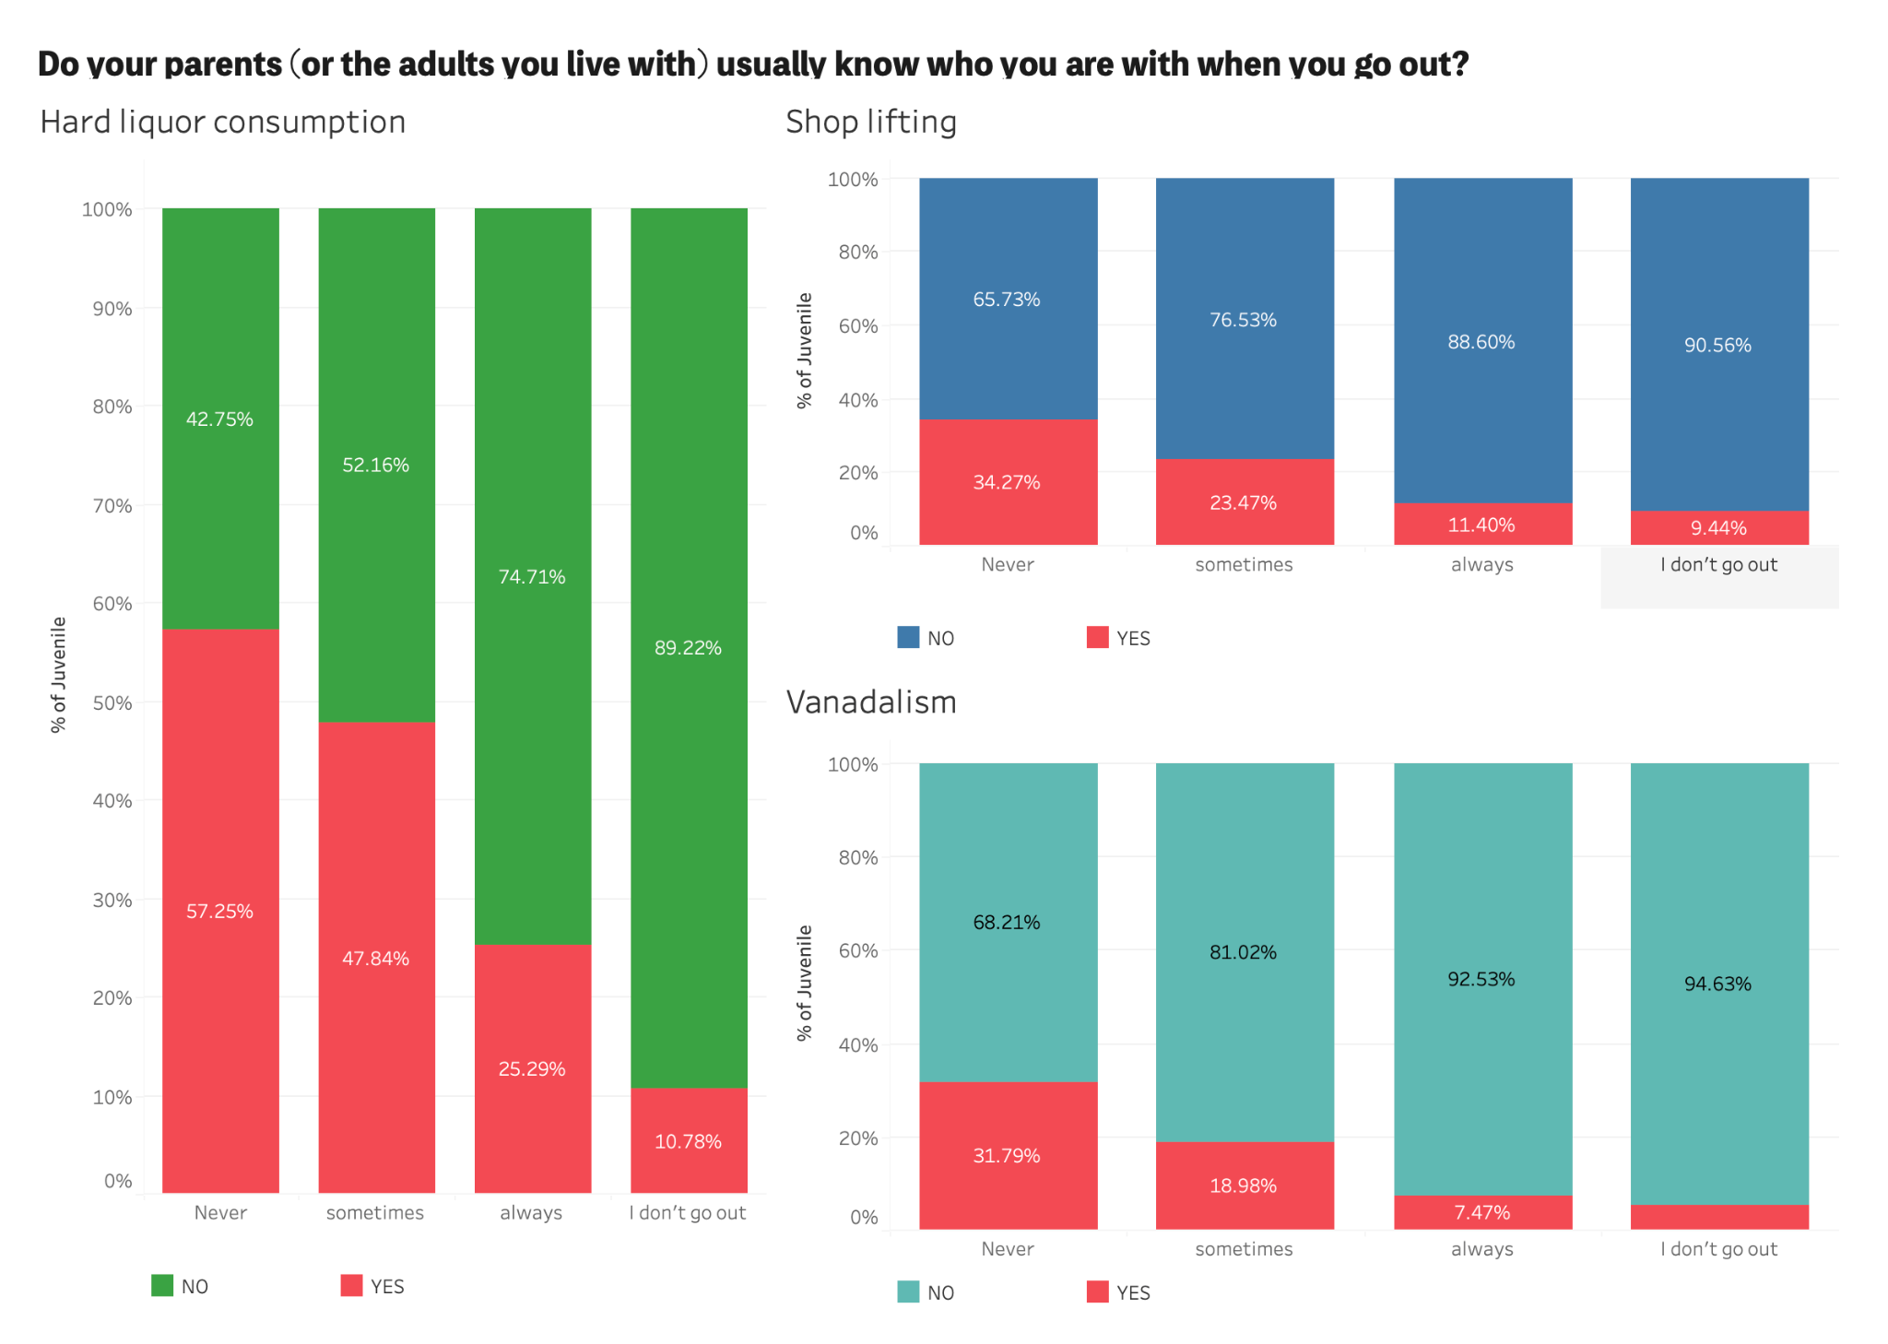

Slide 7
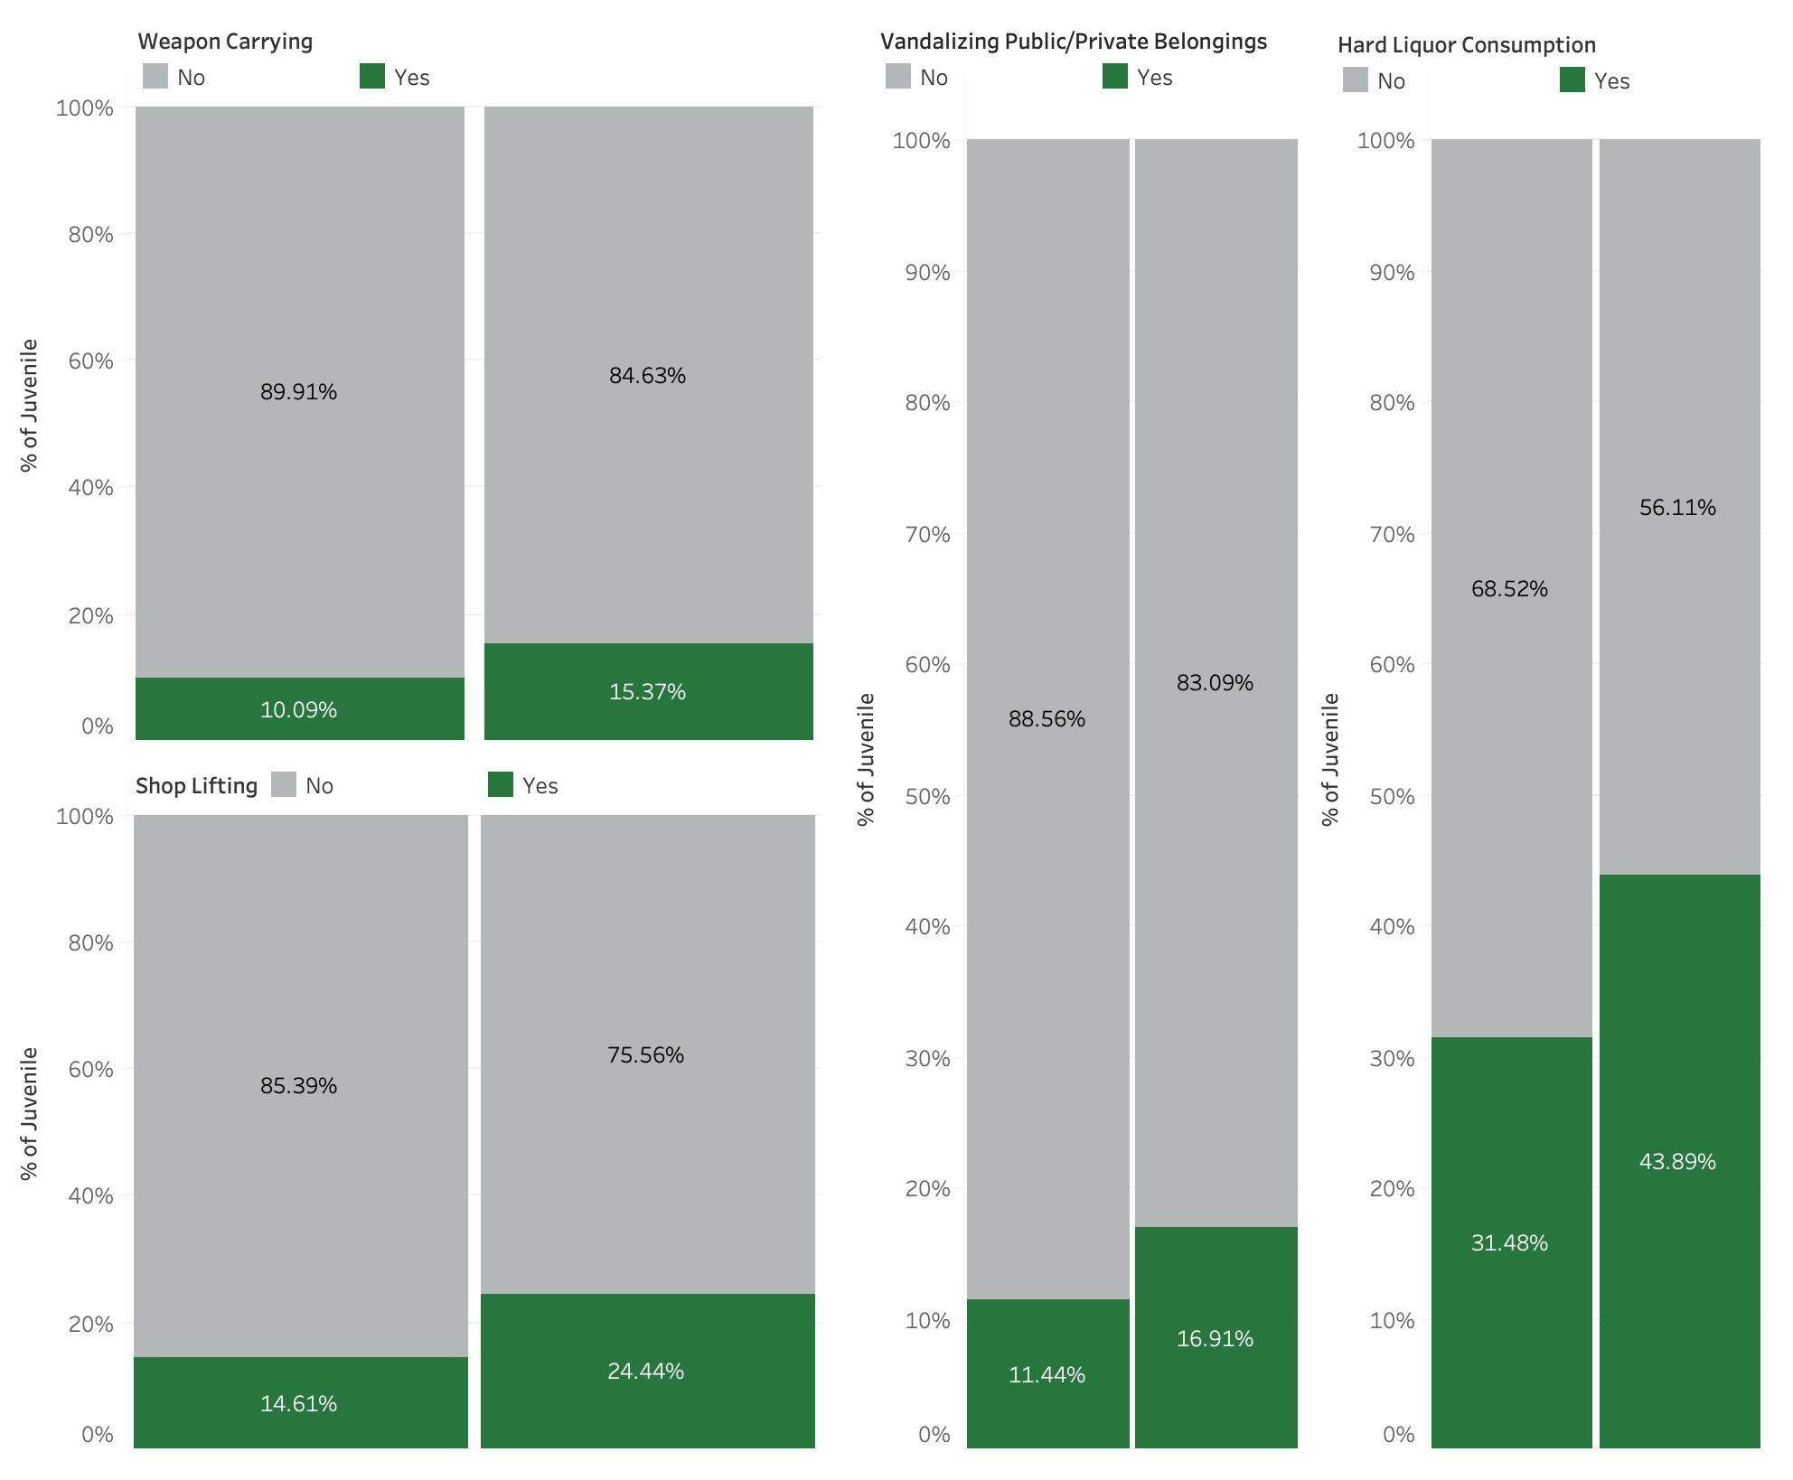
Parents separation on Juveniles can leads to Delinquent Act

Slide 8
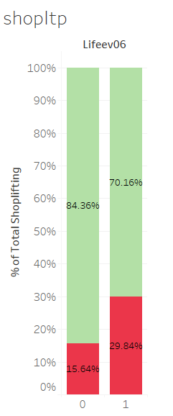
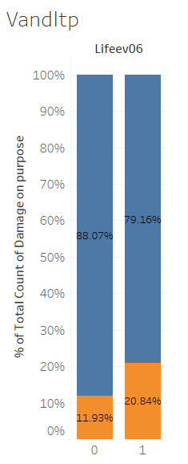
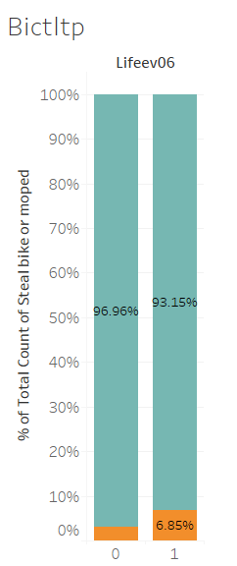



Have you ever experienced problems of one of your parents with alcohol or drugs?

Slide 9
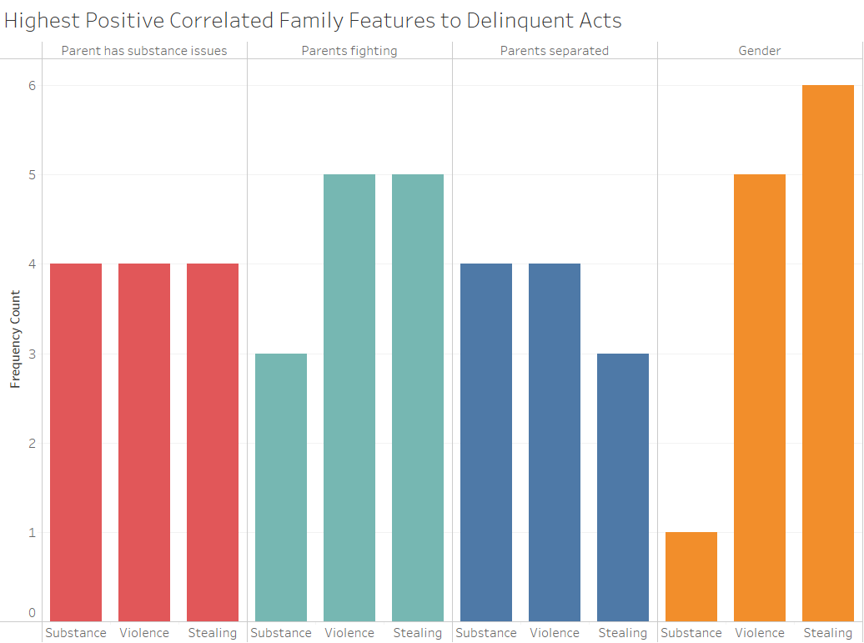

Slide 10
Conclusion
If children are spending time with family, then they are less likely to do delinquent acts
If parents know where their children are at and with whom, then they are less likely to do delinquent acts.
If the parents are partaking in substance abuse, then their children are more likely to do delinquent acts.
If parents are divorced / separated, it can lead to increase in Juvenile Delinquency.

Slide 11
Thank you!

Slide 12
Questions?

