Slide 1
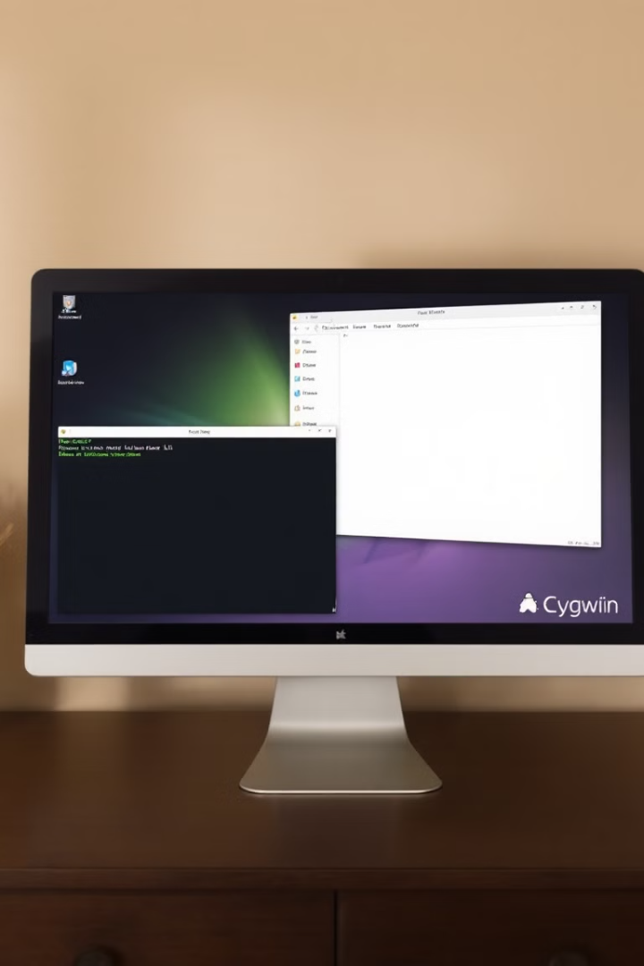
Cygwin: A Windows-Friendly Linux Environment
by Maha Sheikh

Slide 2
Cygwin: Overview and Key Features
What is Cygwin?
Key Features
Cygwin is a Unix-like environment for Windows. It provides a robust set of command-line tools, libraries, and utilities, enabling users to execute Linux programs and scripts on Windows systems.
Cygwin offers compatibility with POSIX standards, allowing users to access a wide range of open-source software. It features a powerful shell environment and package management tools for easy installation and updates.

Slide 3



Using Cygwin: Command Line and Scripting
Command Line
Cygwin provides a familiar command-line interface (CLI) for interacting with the system, enabling tasks like file management, system administration, and software development.
Scripting
Users can write scripts using languages like Bash, Python, and Perl to automate repetitive tasks, streamline processes, and enhance system efficiency.

Slide 4

Cygwin's Role in a Windows Environment
Cross-Platform Development
System Administration
Cygwin empowers system administrators with powerful tools for managing and troubleshooting Windows systems, enhancing security and performance.
Cygwin facilitates cross-platform development by providing a consistent environment for building and testing applications across Windows and Linux.
Open Source Access
It provides access to a vast repository of open-source software, fostering innovation and collaboration in the Windows environment.

