Slide 1
MANAGER’S HANDBOOK
2022

Slide 2
ABOUT ACCIONLABS

Slide 3
We are an innovation engineering company committed to help transform customer’s business using emerging technologies. We are engineers, designers, thinkers, product managers, problem solvers, and more. We are bound by our commitment to help teams succeed by our culture of innovation.
Our prime customers come from various domains like Hi-Tech, Healthcare, eCommerce, Fintech, Media & Entertainment and many more.
Our 11 years journey has been exciting wherein we have been recognised on various platforms and magazines. The Accion group CEO was featured in Business Intelligence Group magazine and was awarded 2021 Stratus Award for Cloud Computing in their annual business award program.

Slide 4
CORE VALUES

Slide 5
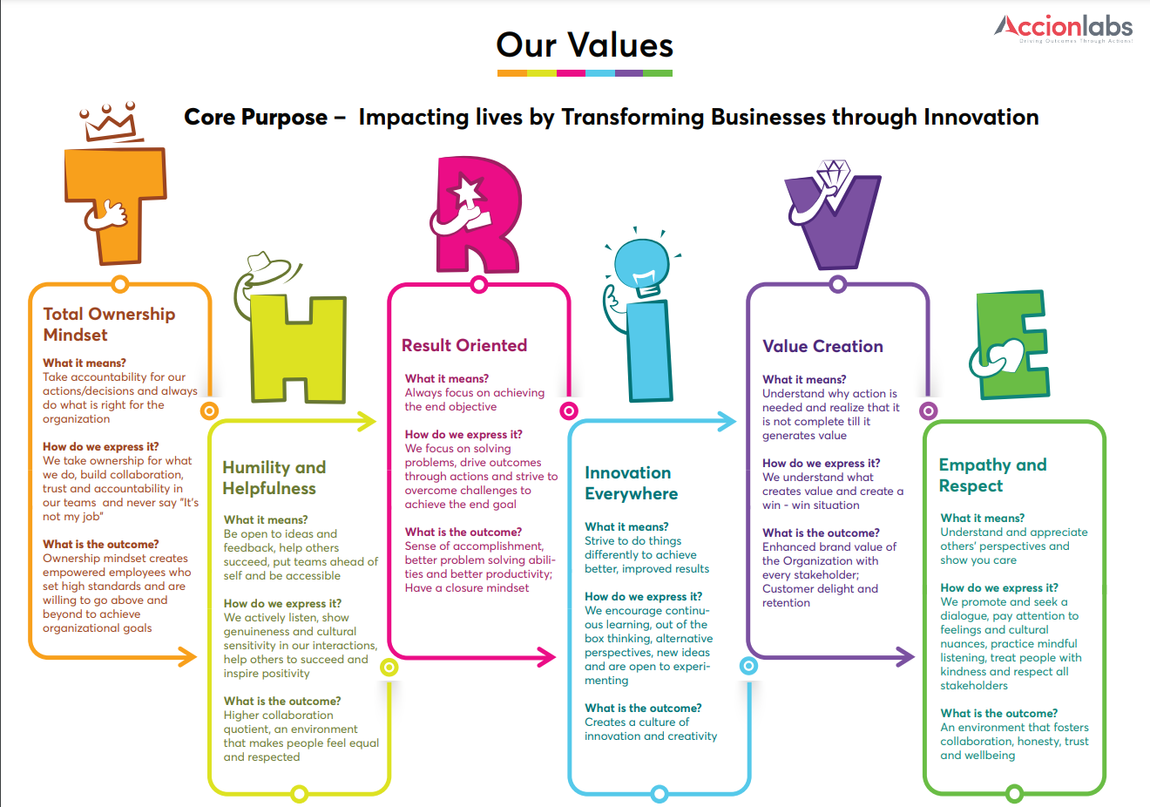

Slide 6

Our Values
Our values are the part of who we are, what we stand for and how we act.
THRIVE is our core value which stands for:
Takes responsibility for outcomes.
Takes initiative to bring about positive results.
Builds collaboration, accountability trust in the teams they work with
Open to ideas, thoughts and feedback from others.
Actively listens and shows genuineness in his/her interactions.
Inspires positivity through helpful attitude.
Accessible and approachable to all colleagues.
Focuses on solving problems.
Sees the big picture and works towards collective success.
Drives outcomes through actions.
TOTAL OWNERSHIP MINDSET
HUMILITY & HELPFULNESS
RESULT ORIENTED
Takes actions differently to achieve better results.
Strives to continuously learn and grow to innovate.
Practices culture of innovation and creativity.
Understands what creates value and creates a win-win situation.
Delivers solutions above and beyond
Cultivates compassion and pays attention to the feelings.
Practices mindful listening and treats people with kindness.
Respects all stakeholders.
INNOVATION EVERYWHERE
VALUE CREATION
EMPATHY AND RESPECT

Slide 7
TABLE OF CONTENT
ADDING A RESOURCE & HIRING
PRE-ONBOARDING & INDUCTION
TIMESHEETS & ATTENDANCE
TRAINING & CERTIFICATIONS
GOAL SETTING AND PERFORMANCE REVIEW
CONTINUOUS CONNECTS AND FEEDBACK
APPRECIATIONS & REWARDS
ORGANISATIONAL CITIZENSHIP
PERFORMANCE IMPROVEMENT PLAN
EXITING A RESOURCE
tHRive PATHS
IMPORTANT CONTACTS & LINKS

Slide 8
ADDING A RESOURCE TO YOUR TEAM
EXTERNAL HIRES
Receive Resource Rqmt
Collect & Shortlist Profiles
1st Level Screening by TA
Online Code Test
2nd Level Screening (Tech Round)
3rd Level Screening (Managerial Round)
Client Interview
(On Need Basis)
Offer Shortlisted Candidates
UPDATE ON tHRive
Create a position on tHRive under your Team
Raise requisition
Complete the approval process
FROM THE BENCH POOL
Access the available resources on bench
Review skills, previous feedback
Technical Screening
Managerial Discussion
Email to RMG notifying the feedback & status

Slide 9

HIRING PROCESS
Sourcing | Sourcing Channels
Pre - Screening | Technical JD, Skills, communication, Employment & Gap, Qualifications, Affordability
Technical Assessment | Determine Role Category
 | Code Test / Assessment Channel
 | Technical Panel Interview
 | Screenshot of the Video call & complete feedback to be shared for the next round
Managerial Discussion | Project, Role, Client Domain, Screenshot of the Video call & complete feedback to be shared for the next round
MANAGERIAL DISCUSSION
Project
Client Domain & Business
Role
Team
Reporting
Work timings
Client Round | Client Assessment
 | Screenshot of the Video call & complete feedback to be shared for the next round

Slide 10
PRE-ONBOARDING
Connect with the offered candidate
Introduction with the techlead/buddy
Project updates
Intro with the BU
POST ONBOARDING - 5P INDUCTION MODEL
Products
People
Projects
Company Overview
Product portfolio / Business values
Clients
Product overview/demo/journey
Domain model
Review of User roles/ documentation
Self Review of the Demo environment
Intro meetings:
Existing product team
Peripheral teams (security, networking, providers etc.)
Product management team
Business Team
Org Chart Review
Culture Introduction and Initiation
Workstreams
Key Initiatives
Application Specific Domain Knowledge Transition
Past and Current projects
Projects roadmap
Process
Platforms
Agile SDLC process - changes, bugs, enhancements
QA process - manual
QA process - automation
Version control process
Build process
Deployment / release process
Status/Time Reporting process
Tools training
Project Repository - review
Environments setup
Architecture review/discussion
Code Walkthroughs - Collaborative
Code Review - Self Paced
Review API Documentation
Programming Guidelines/Best Practices
Self review of all technical documents/code, etc
Test framework review
Test cases/Test plans review
Infrastructure and CI/CD Review

Slide 11
BUDDY FOR THE NEW JOINEES
IDENTIFYING & GROOMING
Identify 10% of the team as designated buddies
Groom and train to discuss details with the new joinee
Continuous connect
Introduction and induction
• Pre-joining, buddy to meet the new joiner for self intro and offer to answer any questions as a colleague.
• About Accionlabs, project, people, what they are currently working on, exciting points.
Dos:
➢ Self-introduction
➢ Accion office culture
➢ Partnering for buddy lunch if in office
➢ Introduction to support teams
➢ Helping with stationary items/particular software installation (if any).
➢ Ensure asset allocation is done timely (if any).
➢ Helping with access card and attendance.
➢ Crisp introduction of project and organisational culture information.
Dont’s:
1. Avoid discussing compensation, organisational or project related sensitive information.
(same can be conveyed by managers if required).
2. Avoid negative feedback

Slide 12
BACKGROUND VERIFICATION & TAT
TYPES OF CHECKS | DETAILS | TAT FOR THE INTERIM REPORT | TAT FOR THE FINAL REPORT
Education Check | Post-Graduation/ Graduation | 9 working days | 14 Working Days
 | Graduation / Pre-University | 9 working days | 14 Working Days
 | SSLC | 9 working days | 14 Working Days
Employment Check | All employment | 9 working days | 14 Working Days
Criminal Verification | Westlaw India (Written Confirmation) | 5 working days | 7 Working Days
Current Address | Physical Verification | 3 working days | 5 Working Days
Permanent Address | Postal Department | 9 working days | 14 Working Days
Emergency Contact Verification | Telephonic | 1 working day | 2 Working Days
Drug Test | 10 Panel | 3 working days | 4 Working Days
ID Check | PAN Card | 3 working days | 5 Working Days

Slide 13
LEAVE & ATTENDANCE
Attendance to be updated every week on tHRive
Verified and approved by Manager
Payroll linked with the TS. Absences calculated as LOP
Leaves to be updated as per the absence
AS A TEAM MANAGER:
Team’s availability planning
Advance application of leaves with a back up planned for the absence
Planned and unplanned back up for continuity of work
Lapsable leaves to be utilised in time to avoid accumulation
Team & supervisor always to be informed about availability & absence
Leave and holiday planning of all team members to ensure Business Continuity
Salary hold information to HR in case of long absence of team member (leaves not applied on tHRive)

Slide 14
ABSCONDING / NON-RESPONSE FROM TEAM MEMBER
more than 48 hours
Identify (DM/TL):
When an individual is not available on the communication channels / calls with no prior notice - call on their phone, drop a text or an email.
Action:
In case of lack of response. Stop the salary and drop an email communicating the same to the employee.
Inform:
In case there is no response, communicate about the same to HR over the email.
Acquire Assets:
HR to speak with the admin team to seek help to recover assets.
Contact:
HR to connect with the employee on their alt/emergency contact number / drop an email on personal email ID. the intention should be to check if things are fine.
Legal Action:
To be initiated by the HR with help of Legal Team

Slide 15
TRAINING & CERTIFICATIONS- tHRive LMS system - Accion University:
Accionlabs has recently developed a well-defined policy for people development and sponsors seminars / conferences, external certifications and inhouse learning platforms through Udemy to encourage learning. AccionLabs has an extensive list of technical and soft skills learnings. Some of the flagship programs that we offer are:
TECHNICAL LEARNING:
Udemy
Pluralsight
Tech of the Month Recordings
Reimbursement for technical certifications
Project-linked technical trainings
Upskilling / Cross-skilling
MANDATORY TRAININGS:
Policies
Compliance
IT Security
Code of Conduct
POSH / Grievance
Project-linked compliance training
SOFT-SKILLS:
GROW
FTM
EAGLE
Personal Effectiveness
Managerial effectiveness
Competency assessments & evaluation
Business communication

Slide 16
GOAL SETTING, CONTINUOUS FEEDBACK & PERFORMANCE REVIEW
Goals setting based on KRAs
Quarterly review and Feedback
Performance Review
Salary Revisions
Outcome Focused
Achievement Orientation
Taking accountability
Quality of Output
Collaborating with Others
Impact & Influence
Networking
Change & Innovation
Adaptability to Change
Innovative / Creative thinking
INTERPERSONAL
BUSINESS
Leading & Developing Others
Managing & Leading teams
Developing others
Business Acumen
Technical/Business Know-how
Commercial Acumen /Entrepreneurial Mind-set
Customer Centricity
Understanding & Responding to Customer needs
Building customer relationships
Analytical Thinking & Decision Making
Analyzing & Interpreting Information
Ability to make decisions
CUSTOMER
SELF

Slide 17
STAGES OF CONTINUOUS CONNECTS & ENGAGEMENT
Managerial round of Interview
Pre-onboarding interaction
Project Induction
Goal setting & KRA Review
Quarterly one-on-one Connects
Rewards Ceremony
Skip level team meetings
MVP Connects
Monthly ARI evaluation
Fun Connects

Slide 18
APPRECIATIONS & REWARDS
Award | Voucher Details (For Indian Employees) | Other Geos
Star of the Quarter | ₹ 5000 | $ 100
Customer Appreciation | ₹ 2000 | $ 50
Accion ACE | ₹ 1000 | $ 25
Accion ACE (Senior Manager) | ₹ 2000 | $ 50
Trainer (Influencers) | ₹ 2000 | $ 50
Interviewers | ₹ 2000 | $ 25
Team Marvel | ₹ 10000 per team | $ 50 per team member
Accion ACE (Team) | ₹ 10000 per team | $ 50 per team member
BRAVO | ₹ 2500 | $ 50

Slide 19
CRITERIAS - REWARDS & APPRECIATION
CUSTOMER DELIGHT
TEAM MARVEL
ACCION ACE
STAR OF QUARTER
This award is given to each employee who receives a customer appreciation email /letter for their exemplary performance and continued commitment towards the client's success
This award is given to the teams that get appreciated by the clients for their teamwork and results in the accomplishment of extraordinary tasks . To receive this award the project team must receive an appreciation mail from client , which should be dedicated to the entire team and not to specific person
This award is special appreciation that can be shared by any manager for a team member ( also applicable for the support as well as cross project team members ). Managers are requested to use this platform to appreciate and motivate the good performers and action oriented individuals who may or may not get recognized by the clients
Organizational citizenship –How is the team contributing to Accion ? Are they acting as a mentor ,working on POCs, taking technical Interviews , helping other teams etc.
Client Engagement : How involved are they in their project ?Quality of deliverables , timelines , customer focus , team player etc
Desired Skills : Proactive approach , takes ownership , innovative thinker , future leader
Find more information on rewards & criterias on :
https://docs.google.com/presentation/d/1weyvOlhBYkTSqF-ciD0AF3IcSjsOEaKC/edit#slide=id.p21

Slide 20
ORGANISATIONAL CITIZENSHIP
Train on Tech of the month
Attend weekly Thursday Demos
Speak at / organise Tech Talk / Meetup
Technical Article for Monthly Magazine
White papers / Blogs on AIC
Accathon
Project Reviews
Encourage to be a part of tech interview panel
Speak at Welcome meet
Participate in Fun connects & Events

Slide 21
PERFORMANCE IMPROVEMENT PLAN
Review the performance - share feedback with areas of improvement
Observe, support, enable for 1 month
Share feedback over the email marking HR
Assign a mentor agreed by the individual, set goals and timelines (4-8 weeks)
HR to send the communication on PIP initiation
Review once every 2 weeks
If the performance improves, assign regular tasks
If not, convey the feedback and shortcomings in the written email
HR to help close the PIP process after assigned time
Exit and release from Accionlabs

Slide 22
EXITING A RESOURCE
RESIGNATION
Connect one-on-one within 24 hours; identify reason
Offer opportunity
Approve / Reject resignation, inform BHR
Identify Replacement
KT & Release from Project (60 Days)
PERFORMANCE / COMPLIANCE / BEHAVIOURAL
Convey one-on-one
Written feedback
Issue notice with BHR help
Release from Accion
PROJECT RAMP-DOWN / SKILLSET CHANGE
Convey one-on-one
Email to RMG with resume and performance feedback
KT & Transition
Release from Project

Slide 23
THRIVE PATHS
DOWNLOAD REPORT
tHRive home page
Select ‘Reporting’ from the ‘Home’ dropdown
‘Absence Overview’ = Applied leaves by your team
‘Complete info report’ = list of your entire team with other information
Export to excel
UPDATE BILLING STATUS
‘Company Info’ in ‘Home’ dropdown to view your reportees
Click on the name & select ‘Actions’ option
Select ‘Change Job and Compensation Info’
select ‘Job Information’ & ‘Job Relationships’ – mention today’s date
select ‘Event’ & ‘Event Reason’ as ‘Data Change’ & ‘Extension’
‘Job Information, ‘Show more’ - update ‘Billable Status’ & Save
POLICY DOCUMENTS
‘Let’s Thirva’ in ‘Home’ dropdown
‘Groups’ dropdown - ‘Accionlabs India’
Scroll down to find ‘Folders’
‘Accion global policies’ - ‘content’
‘Company Policies’

Slide 24
IMPORTANT CONTACTS
Background Verification : Corp_hr@accionlabs.com
Business HR : biz_hr@accionlabs.com
Learning : learning@accionlabs.com
Head HR : tribhuvan.thakur@accionlabs.com
TA Head : Roshni.das@accionlabs.com
Payroll : payroll@accionlabs.com
Accounts : india_accounts@accionlabs.com
HRMS : tHRive_india@accionlabs.com
Insurance : narendra.ryali@accionlabs.com
Travel : travel_desk@accionlabs.com
Resource & Bench Mngmt : rmg@accionlabs.com
Appreciation & Rewards : rewards@accionlabs.com
Employee referral : referrals@accionlabs.com
IT Helpdesk : helpdesk@accionlabs.com
Admin : admin.india@accionlabs.com

Slide 25
IMPORTANT LINKS
AccionLabs Website: https://www.accionlabs.com/
tHRive Login Link: https://hcm44.sapsf.com/sf/start?_s.crb=v1ESNYyRnMdosVZOgoGeqCcCOhik4EtyEt2jU1EEfG0%253d#Shell-home
tHRive MANAGER MANUAL - VIDEO: https://drive.google.com/file/d/1dciTpdVPLQYTBIoBTl2yitG9tAGRIRxf/view?usp=sharing
tHRive MANAGER MANUAL - HANDBOOK: https://drive.google.com/drive/folders/1riwx7R18WNT4CESaiInhVEKpUfnl02sP?usp=sharing
Weekly Demo Dashboard: https://intranet.accionlabs.com/presales/#/user
Let’s tHRive Page : https://jam44.sapjam.com/home

Slide 26
THANK YOU

Slide 27
APGAR : A quick checklist that helps you assess an employee and recommend them for a counselling session
A is for Absence (Frequent, Impromptu)
P is for Performance issues
G is for Growth is not seen or stunted
A is for Affect control is Poor
R is for Relationships Deterioration

Slide 28
Process Flow for Counselling Sessions
Sign the Informed Consent form
Reach out to rithika.h@accionlabs.com
Session commencement
Receive Post session Guidelines
Receive post session summary

Slide 29
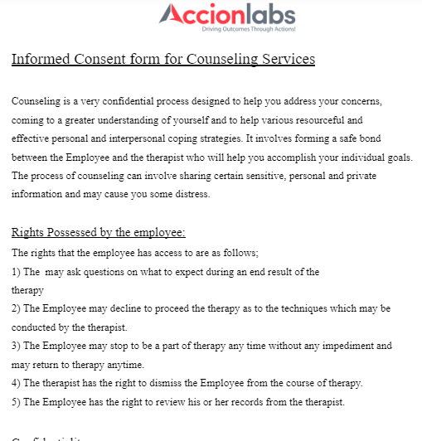
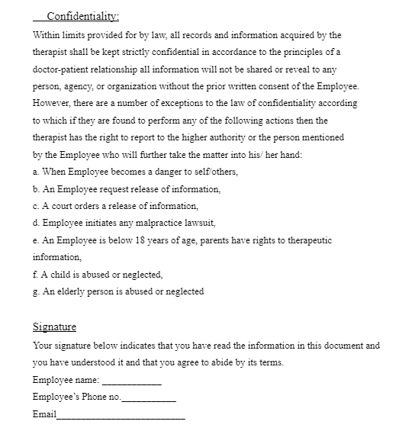

Slide 31
TEAM ENGAGEMENT BUDGET - GUIDELINES
DESCRIPTION
OBJECTIVE
SCOPE
Team Engagement Budget is the defined amount which can be utilized by the Delivery Leader for the purpose of team building/recreational activities/individual or team motivation.
To give clarity on the team engagement budget to the Delivery Leaders.
To ensure optimal utilization of the engagement budget within appropriate regulations.
This policy is applicable to all employees who are part of India geo.
The scope of this budget ranges from individual reward intended for motivation, to Annual events like annual gift and AccionNite. Also includes Wellness Events, RnR, Fun Event & Festival Celebrations.
The Delivery Leaders have an access to an amount of Rs. 500/- per person per quarter each calendar year.
This amount could be used for various motivational/engagement activities for the team or individual.
Few examples like: Team lunch, Team outing, Team gift etc.
Delivery leaders have the freedom to creatively utilise the collective budget in any manner they deem fit & if they intend to reward a set of individuals for their good work, out of box thinking, team spirit, wow customer experience, key players etc, can adjust the team’s budget to purpose the same.
An additional budget of approx 2000/- per person will be budgeted for engagement/motivation which will be in the form of Annual Day & Annual Gift to be managed at the org-level.
INR 500/- per Quarter per Team Member
DM raise reimbursement
Reimbursement request moves to DD for Approval
Finance/Accounts approve
Reimbursement credited with salary

Slide 35
HR Discussion | Risks assessment, attitude, competencies based eval | 24 Hours from the HR Interview Request Sent.
 | Culture, AccionPitch, Learning, Tech & innovation
 | CTC Negotiation
Offer | Offer Letter Release | 24 Hours from the HR Interview feed.
 | Clarification of Queries
 | Acceptance
Pre-Onboarding (https://docs.google.com/spreadsheets/d/1DgYKNU02bR_8zbcsr9xbsIBb3Wmysk9mQA2XUDbv_bQ/edit#gid=947810602) | Pre-Onboarding process | Immediately after offer acceptance
 | Sharing of Spectrum, Company Info, Day 1 Agenda Event as they happen | Over the span from acceptance to joining
 | Connect with the candidate (DM, HR & TA spoc) | Once in week
 | Welcome Meet | Once before joining
Onboarding | Documentation & Form Filling | On the day of joining
 | Laptop Request/EmpCode/EmailID/BGV initiation | On the day of joining. Laptop configured and sent out for delivery on the same day. Received based on the location.
 | Orientation | On the day of joining
 | Introduction with the Team | On the day of joining
 | Welcome to Accion Call | On the day of joining

Slide 36
HR/ Delivery Sample Questions
Competencies
Business Understanding | 1. How does a project get estimated? 2. When does a project go in loss? 3. What are the penalty clauses of a contract? 4. How will you reduce the cost of an on-going project? 5. Why is scope definition important to profitability? 6. How do you go about estimating expenses and budgets? 7. What recent decision have you made that had an impact on finances? How did you assess its impact? Tell me about a time you used your knowledge to get an idea/business model approved. 2. Tell me about a time you used financial data to support a successful project. A brief explanation of it. 3. Have you ever been over budget? Why? How did you handle this?
Project Management | 1. Tell me about your current top priorities. How did you determine that they should be your top priorities? 2. Using a specific example of a project, tell how you kept those involved informed of the progress. 3. Walk me through a recent project or assignment you completed and tell me the process you used to ensure it was complete and accurate. 4. Give me an example of a time when you were effective in doing away with the "constant emergencies" and "surprises" in your work environment. 5. What are the typical phases / steps in managing a Project Management?
Business Communication | 1. Tell me about a time when you had to explain complicated material. How did you clarify if the other person made sense of your explanation? 2. When do you use Verbal communication over written and when do you use Written over Verbal? Please provide examples. (Respondent to provide personal response) 3. Describe a Technical Solution that you have worked on / designed to me in 5 lines? 4. How do you feel writing a report differs from preparing an oral presentation? 5. Tell me about a job experience when you had to speak up in order to be sure that others knew what you thought or felt. 6. Describe how you have convinced your boss to grant you additional resources (or funds) for some purpose? 7. How often do you believe it is necessary to withhold information from your team who report to you? Would you say you do this regularly, not often, or never? Under what circumstances do you limit communication in your experience?

Slide 37
Interpersonal Effectiveness | 1. Describe how you developed relationships with others when you join a new team? 2. Describe a time when you had problems with a supervisor and had to communicate your unhappy feelings or difficult disagreements. Tell me what you did and what happened 3. When you are dealing with co-workers or customers, what really tries your patience and how do you deal with that? 4. Describe some of the most unusual people you have known - what was different about them and how did you work with them? 5. Describe a situation when one of your decisions was challenged by higher management; what did you do and how did you react? 6. Describe how you changed the opinion of someone who seemed to have a very negative opinion of you. 7. What are the three most important factors that make you an effective, valued team member in your role? What would your Manager say are the three most important factors?
Strategic Thinking | 1. Describe a challenge or opportunity you identified based on you industry knowledge, and how you developed a strategy to respond to it. 2. Describe a time you created a strategy to achieve a longer-term business objective 3.Describe a time when you proactively identified and addressed an org strategic issue. 4Describe a time when you failed to achieve your goals and had to follow a different approach. What Strategy did you use?
Team Leadership | 1. You have two subordinates who do not like working with each other - How will you manage that? 2. Describe a situation when you were working with a sub-optimal team and how you managed it? 3. Describe an incident where you changed your decision - based on the inputs of your subordinates? 4. Describe a situation when you helped a subordinate through a problem? 5. How would you handle a Sexual harassment Complaint from one of your subordinates?
Decision Making | 1. Describe the process you typically follow to make a decision about a plan of action. 2. Describe two examples of effective workplace decisions you have made in the last six months. 3. Describe a recent unpopular decision you made. What was the result? 4. Give an example of a time you had to make a difficult decision. 5. How do you typically handle yourself under pressure or stress? Describe a difficult situation you encountered with a supervisor or co-worker and how you handled it.
Outcome Focused | 1 How do you set long-term goals for your team? How often do you check and review these goals? 2 what are the key customer groups and market segments of the BU? What are their unique attributes? how (s)he sees business evolve in next couple of years, for the portfolio that significant change management initiative driven in the past. 3.What are the key motivation drivers of employee? How would you device intrinsic motivation and employee engagement? key lead and lag indicators usually managed in the role.Ask for how s(he) will take ownership of deliveries in a likely Cross BU team

Slide 38
Problem Solving and Leadership skills | . Tell me about a situation where you had to solve a difficult problem. 2. What’s the most innovative new idea that you have implemented? 3. Describe a time when you anticipated potential problems and developed preventive measures.
Relevant Functional/Domain and Industry knowledge to provide effective Business solutions | . Can you tell a success story of any recent customer/project which was a very new area/concept for us as an organization, but you could come up with a solution? Deep understanding of industry trends that enables thought leadership and mentoring to teams 1.Can you tell me how you established yourself as a thought leader by stepping back from your business agenda, clarifying your area of expertise, listening to others and continuing your education? Have you inspired others to work on innovation and influenced them to do so?
Generic | Ask what (s)he will look for in next level leadership. Focus on key traits.
 | Ask for steps that will be taken to ensure a cross BU collaboration
 | Ask what his idea of customer relationship management is. Does it complement with / overlap with Sales role?
 | Ask to explain top three areas (s)he would like to focus to maintain / improve ESAT and create more MoTs
 | Ask what his/her idea of customer centricity is and how it would affect his organization.
 | Ask to articulate how (s)he sees business evolve in next couple of years, for the portfolio that (s)he will be managing
 | Ask what strategic choices it offers to us and which (s)he would choose and why
 | Ask what the risks are involved and how can they be mitigated
 | Ask how (s)he would execute strategy. Cover delegation, monitoring and control mechanism.
 | Ask which operational parameters (s)he would like to consider manage the operations. What will be limits within business operations can be managed and rational behind the same
 | What mechanism you use to follow-through the actions.

Slide 39
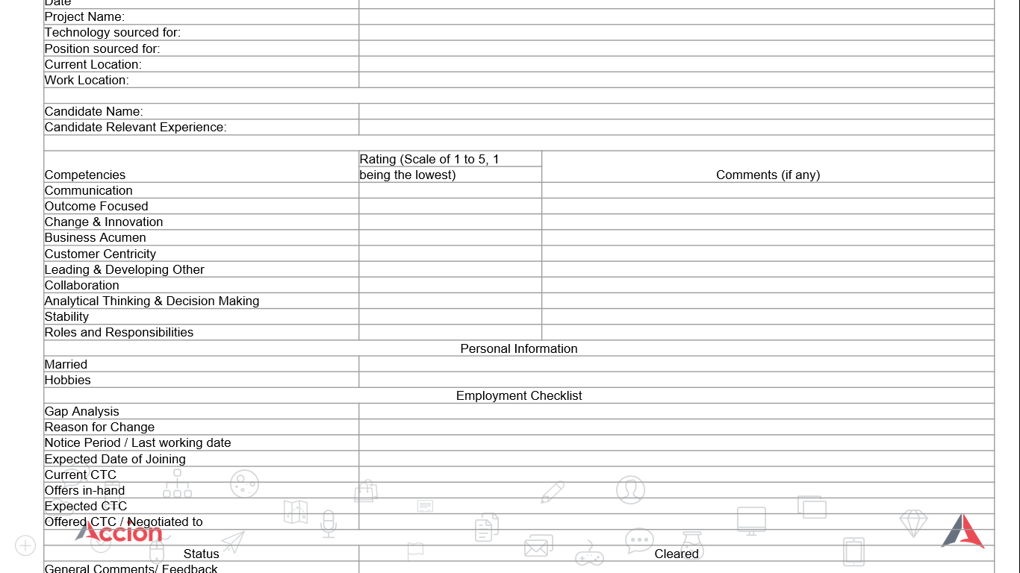
FEEDBACK FORM

Slide 40
ANNUAL AWARDS -
DELIVERY MANAGERS & DIRECTORS
The Best performing Delivery Unit of the year- Recognizing DD’s
The Best performing Emerging Business of the year Recognizing DM’s
Award Classification | Data Based
Award Type | Individual
No. of Awards | 1
Units Eligible
Evaluation Criteria
Delivery of projects across multiple competencies
New Business from existing customers / Large Deals
EBIDTA (% improvement)/Margins
Employee Retention
Customer Feedback & Referrals
Utilization /Identified as a strategic vendor - Preferred Vendor Status
Award Classification | Data Based
Award Type | Individual
No. of Awards | 1
Units Eligible
Evaluation Criteria
Better CSAT
Unique Solutions – Domain
Identified as a strategic vendor - Preferred Vendor Status
Actual Revenue Growth
Employee Retention/ Better ESAT
Growth
Innovation
Operational Excellence
Relationships
Solutions

