Slide 1
INSTAGRAM A/B TESTING
NAME:MAHASRI V
ROLL NO:CB.EN.U4CSE20235

Slide 2
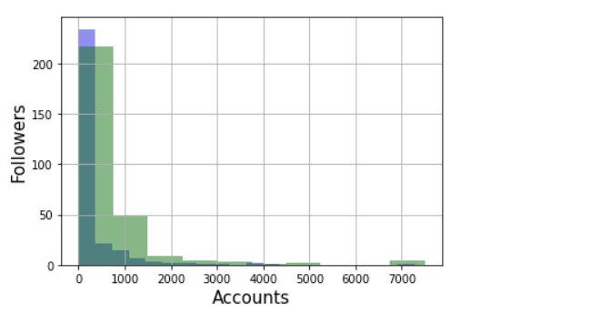
The dataset fake_Instagram_accounts.csv contains the following variables for 576 Instagram accounts: length fullname , name==username, description length, external URL, private, #posts, #followers, #follows, fake.
The aim of this study is to see whether fake accounts are associated with followers.
Distribution:

Slide 3

INFERENCE:
The distribution of followers of fake accounts appears to be shifted slightly to the left of the distribution corresponding to genuine accounts. The followers of fake account seem to be lower on average than the genuine accounts.
OBSERVED STATISTIC:
NULL HYPOTHESIS:
In the population, the distribution of followers for fake accounts is same as that of genuine accounts.
ALTERNATE HYPOTHESIS:
In the population, the distribution of followers for fake accounts is lower than that of genuine accounts.

Slide 4
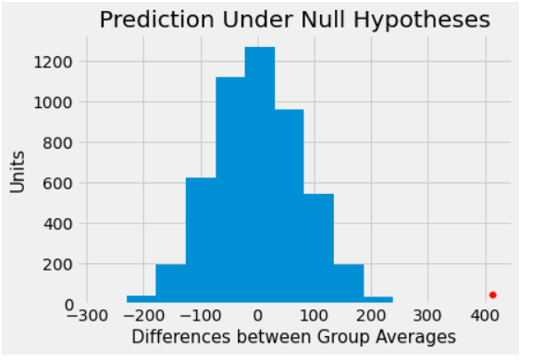
TEST STATISTIC:
We will do the subtraction in the order "average followers of fake account - average followers of genuine account". Small values of this statistic will favor the alternative hypothesis.
PREDICTING THE STATISTIC UNDER NULL HYPOTHESIS:

Slide 5
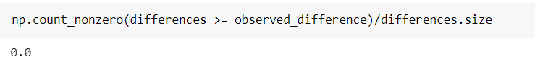
INFERENCE:
The distribution is centered around 0, because under the null hypothesis the two groups should have roughly the same average.
The observed difference in the original sample is about 412.4305555555555, which doesn't even appear on the horizontal scale of the histogram. The observed value of the statistic and the predicted behavior of the statistic under the null hypothesis are inconsistent.
The conclusion is that the distribution of followers is less than the average followers of genuine accounts.
EMPIRICAL P VALUE:

Slide 6
CONCLUSION:
Taking level of significance or α value as 0.05 or 5%, obtained empirical-p value 0.0 is less than the α value, so we can reject the null hypothesis. So we can say that there is more evidence to support the alternative hypothesis, in other words, the average number of followers for fake accounts is less than the genuine accounts.

