Slide 1
Weekly Sales Analysis
Supermarket Operations Management Agent
Generated on 07-09-2026

Slide 2
Sales Summary
Overall supermarket sales performance
Total Sales: ₹42.00
Total Bills: 2
GST Collected: ₹0.00
Average Bill Value: ₹21.00

Slide 3
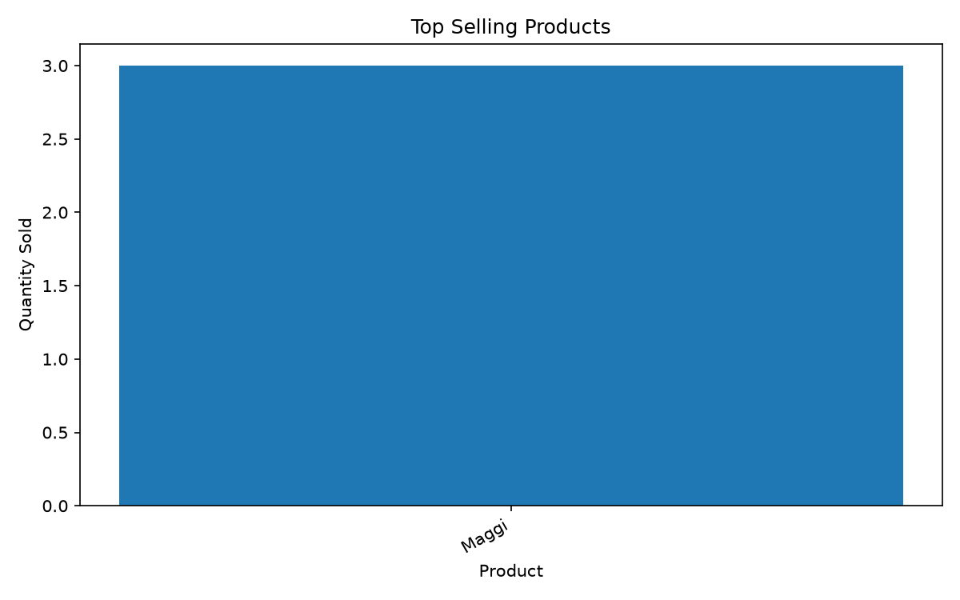
Top Selling Products
Products with highest quantity sold

Slide 4
Product Sales Details
Top selling products and revenue
Product | Qty Sold | Sales
Maggi | 3 | ₹42.00

Slide 5
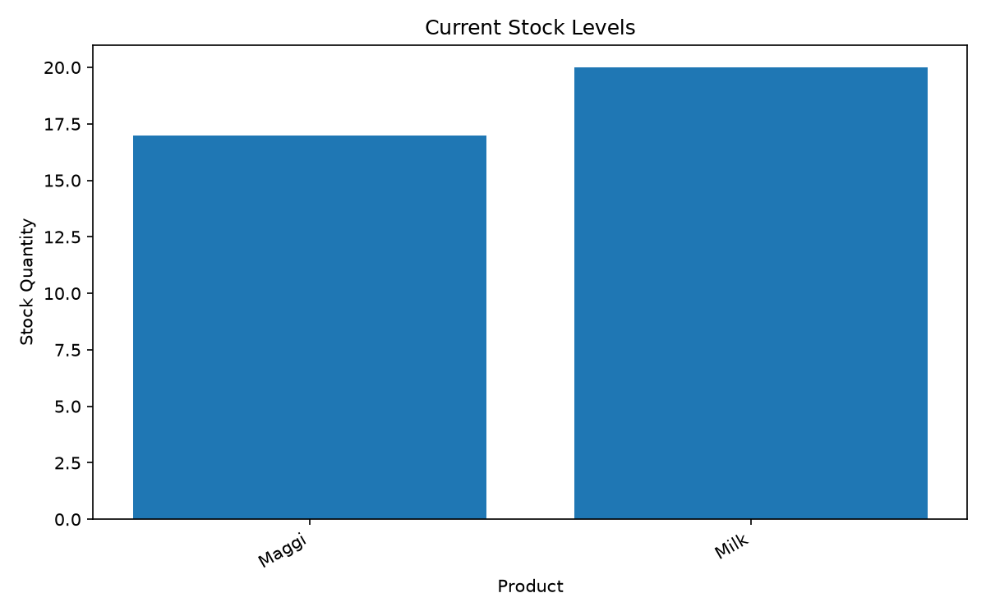
Stock Health
Current inventory levels

Slide 6
Low Stock Alert
Products requiring attention
✅ No low-stock products detected.

Slide 7
Business Insights
Key observations from sales and inventory data
• Total recorded sales are ₹42.00.
• 2 bills have been recorded.
• Average bill value is ₹21.00.
• Best-selling product by quantity: Maggi (3 units).
• No products are currently below the low-stock threshold.

