Slide 1


Department of Information Technology
V R Siddhartha Engineering College
DEEP LEARNING AND TRANSFORMER-BASED APPROACHES FOR METASTATIC CANCER DETECTION
Bachelor of Technology in Information Technology
MAJOR Project Review Presentation
PRESENTED BY
Ms. Mahathi Puppala (228W1A1252)
Mr. Kiran Kumar Cherukuri (228W1A1213)
Under the guidance of
Dr.T.ANURADHA
PROFESSOR

Slide 2
AGENDA
Introduction and Problem statement
Objectives and Outcomes of the project
Literature Review and Summary
Datasets and Requirements
Algorithms used
Architecture Diagram
Implementation Steps and Execution
Results obtained
Result Analysis
Conclusion & Future Work
References

Slide 3
INTRODUCTION
• Metastatic cancer is a dangerous disease in which cancer spreads from its main site to other parts of the body, often through lymph nodes.
• Histopathology image analysis is very important for finding cancer early on.
• Traditional diagnosis depends on pathologists doing manual examinations, which take a long time and can vary.
•Recent improvements in deep learning have made it possible to automatically analyze medical images with great accuracy.
•EfficientNet and DenseNet are two examples of convolutional neural networks that are commonly used to find complex tissue features.

Slide 4
PROBLEM STATEMENT
The identification of metastatic cancer through histopathological images is not an easy task because of its intricate tissue structures and differences between normal and tumor areas.
CNN-based approaches are useful for local features, but there are challenges in their ability to handle global context relations.
Models based on the transformer architecture like Vision Transformer (ViT) and Swin Transformer can learn global contexts but may suffer from high computational demands and overhead.
These diverse models exhibit different levels of effectiveness, thereby posing a challenge to find the ideal architecture for the task at hand.
It is imperative to conduct a comparative analysis of various architectures to determine the most appropriate model for metastatic cancer detection.

Slide 5
OBJECTIVES
Create deep learning architectures to detect metastatic cancers from histopathological images.
Deploy various models such as CNN, Vision Transformer (ViT), Swin Transformer, EfficientNet, and DenseNet.
Conduct experiments for comparative analysis on the PCam dataset.
Analyse model performance based on accuracy, precision, recall, F1 score, and AUC.
Determine the best performing model.
OBJECTIVES
Designed a multi-model deep learning approach to classify cancer.
Evaluated CNN, transformer, and advanced CNN models.
Obtained performance assessment using several criteria.
Noticed the compromise between accuracy, speed, and complexity.
Found the optimal model for accurate cancer detection.

Slide 6
LITERATURE REVIEW
S.NO | PUBLICATION DETAILS | DATASETS USED | ALGORITHMS USED AND RESULTS | REMARKS
1. | Deep Learning Applications in Breast Cancer Histopathological Imaging: Diagnosis, Treatment, and Prognosis, Bitao Jiang, Lingling Bao, Songqin He, Xiao Chen, Zhihui Jin, Yingquan Ye, Breast Cancer Research, 2024. | PatchCamelyon (PCam), Histopathology Image Dataset (lymph node sections), TensorFlow Datasets (TFDS) | CNN-based architectures (ResNet, VGG, U-Net) effectively extracted features, while Transformers captured global dependencies in images. | The study demonstrates that deep learning models significantly improve accuracy and efficiency in breast cancer diagnosis using histopathology images. The use of multiple architectures and datasets improves model robustness and generalization.
2. | Transformer-Based Explainable Deep Learning for Breast Cancer Detection in Mammography: The MammoFormer Framework, Ojonugwa Oluwafemi Ejiga Peter, Daniel Emakporuena et al., American Journal of Computer Science and Technology, 2025. | CBIS-DDSM (Curated Breast Imaging Subset of Digital Data`base for Screening Mammography) | MammoFormer framework combining CNNs (ResNet) and Transformers (ViT) with HOG feature enhancement. Achieved 99.9% accuracy (CNN) and 99.0% accuracy (ViT + HOG) on the CBIS-DDSM dataset. | Effectively integrates CNNs and Transformers to improve mammography-based breast cancer detection. Emphasizes explainability, making the framework suitable for clinical adoption. Demonstrates strong performance through architecture-specific feature enhancement.
3. | Breast Cancer Prediction by Ensembling Machine Learning Algorithms and Explainable AI, M. Sobhana, Anil Kumar Palaketi, Ramya Nalabothu, Conference Publication, 2024. | The model utilized the Wisconsin dataset for training and testing. This dataset contains: 569 unique patient records,357 cases of benign tumor cells, 212 cases of malignant tumor cells. | -Individual Classifier Accuracies: RandomForest: 94.41% GradientBoosting:92.31% AdaBoost: 91.61% DecisionTree: 81.82% - | • It incorporates Explainable AI (SHAP) to provide crucial transparency into feature importance, enhancing interpretability and fostering user/clinician trust in the model's predictions. • This approach focuses on minimizing false positive diagnoses and provides a predictive tool for early detection.
4. | An Explainable Artificial Intelligence Model to Detect Breast Cancer, Israt Jahan Mokta, Shovito Barua Soumma, Conference Publication, 2025. | The model used the Wisconsin Breast Cancer Diagnostic dataset | Utilizes Support Vector Machine (SVM) and Logistic Regression (LR) on the Wisconsin Breast Cancer Diagnostic dataset. | Effectively integrates Explainable AI techniques to interpret model decisions. Enhances feature-level transparency, supporting clinician trust and decision-making.

Slide 7
LITERATURE SUMMARY
Deep learning models, particularly Convolutional Neural Networks (CNNs), have shown strong performance in histopathology image classification for cancer detection tasks.
EfficientNet architectures improve classification performance by using compound scaling of depth, width, and resolution, achieving better accuracy with fewer parameters.
DenseNet models enhance feature reuse through dense connectivity, allowing efficient gradient flow and improved learning of complex tissue patterns.
Previous studies have demonstrated that CNN-based approaches can achieve high accuracy in detecting metastatic cancer from histopathology images, making them suitable for automated diagnostic systems.
However, selecting the most effective architecture for balancing accuracy and computational efficiency remains an open challenge, motivating comparative analysis between models like EfficientNet and DenseNet.

Slide 8
DATASETS AND REQUIREMENTS
DATASET:
PatchCamelyon (PCam) Dataset
Purpose: Used for detecting metastatic cancer in histopathological images.
This dataset consists of 96×96 pixel image patches extracted from whole-slide images of lymph node sections.
PCam contains over 327,680 images, providing a diverse and high-quality dataset for training deep learning models.
SOURCE : Kaggle - https://www.kaggle.com/datasets/andrewmvd/metastatic-tissue-classification-patchcamelyon
SOFTWARE REQUIREMENTS:
Programming Language: Python
Deep Learning Framework: TensorFlow
Libraries:
Core: scikit-learn, NumPy, Pandas, Matplotlib, Seaborn, OpenCV
Deep Learning: TensorFlow/Keras or PyTorch
XAI Libraries
Visualization: Matplotlib, Seaborn, Plotly (for interactive explanation maps)
HARDWARE REQUIREMENTS:
GPU: High-performance GPU
RAM: Minimum 16 GB
Storage: At least 20 GB free

Slide 9
ALGORITHMS USED
Multiple deep learning models were implemented for cancer detection:
CNN (Baseline Model)
Vision Transformer (ViT)
Swin Transformer
EfficientNet (B0 & B4)
DenseNet121
These models capture:
Local features → CNN, EfficientNet, DenseNet
Global context → ViT, Swin Transformer
Goal: Perform comparative analysis to identify the best model

Slide 10
VISION TRANSFORMER (VIT)
Input: Image patches (16×16)
Key Steps:
The input image is divided into smaller patches, which are flattened and converted into embeddings.
Positional encoding is added to preserve spatial information of patches.
Multi-head self-attention is applied to capture global relationships across all patches.
The encoded features are passed through transformer layers and a classification head.
Output: Cancer / Non-Cancer classification
SWIN TRANSFORMER
Input: Image (divided into windows)
Key Steps:
The image is partitioned into fixed-size windows for localized attention computation.
Shifted window mechanism is applied to enable cross-window interaction.
Hierarchical feature maps are generated by progressively merging patches.
The extracted features are passed through classification layers for prediction.
Output: Classification result

Slide 11
EFFICIENTNET (B0 & B4)
Input: Image (224×224×3)
Key Steps:
The model extracts features using MBConv blocks designed for efficient computation.
Compound scaling is applied to balance depth, width, and resolution of the network.
Global Average Pooling is used to reduce feature maps into a single vector.
The final dense layer performs binary classification.
Output: Cancer / Non-Cancer classification
DENSENET121
Input: Image
Key Steps:
Each layer receives inputs from all previous layers, enabling feature reuse.
Dense blocks help in capturing fine-grained and complex features.
Transition layers reduce feature map size and improve efficiency.
Global pooling and fully connected layers produce the final prediction.
Output: Classification result

Slide 12
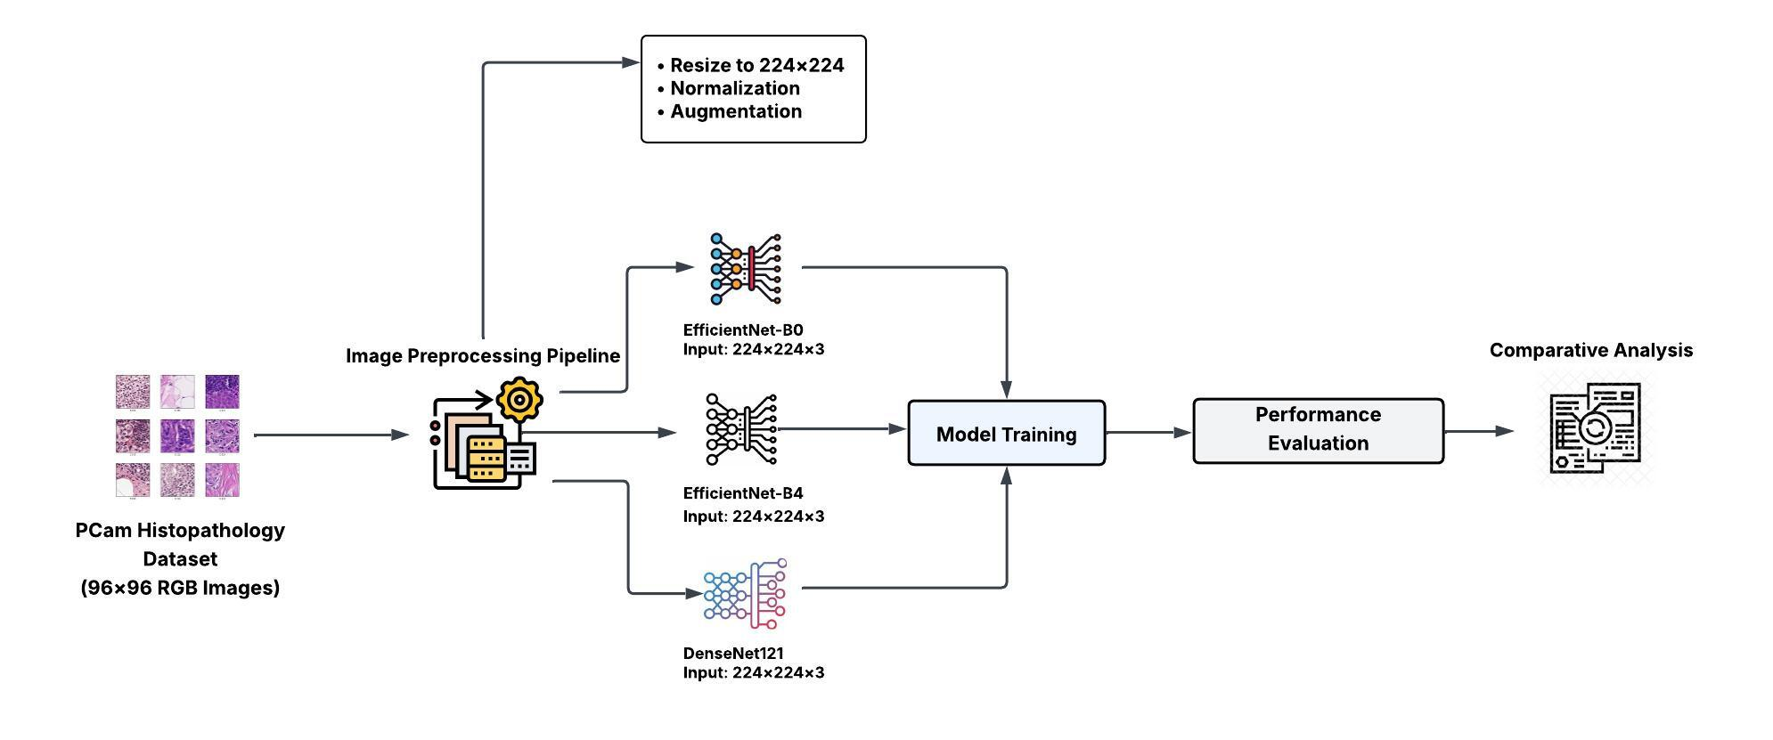
ARCHITECTURE DIAGRAM

Slide 13
IMPLEMENTATION STEPS AND EXECUTION
IMPLEMENTATION STEPS:
STEP-1 : The PCam dataset is loaded and prepared for training
STEP-2 : Images are preprocessed by resizing (224×224) and normalizing pixel values [0,1]
STEP-3 : Data is organized into training, validation, and testing sets
STEP-4 : Deep learning models EfficientNet-B0, EfficientNet-B4, and DenseNet121 are implemented
STEP-5 : Models are compiled using Adam optimizer and binary cross-entropy loss
STEP-6 : Training is performed using a GPU-enabled environment for efficient computation

Slide 14
EXECUTION & EVALUATION
Models are trained over multiple epochs with monitoring of accuracy and loss
Performance is validated using the validation dataset
Final evaluation is done on the test dataset
Evaluation metrics include:
Accuracy
Precision, Recall, F1-score
AUC (Area Under Curve)
Results are visualized using accuracy and loss graphs
Model predictions are analyzed to compare performance of EfficientNet and DenseNet

Slide 15
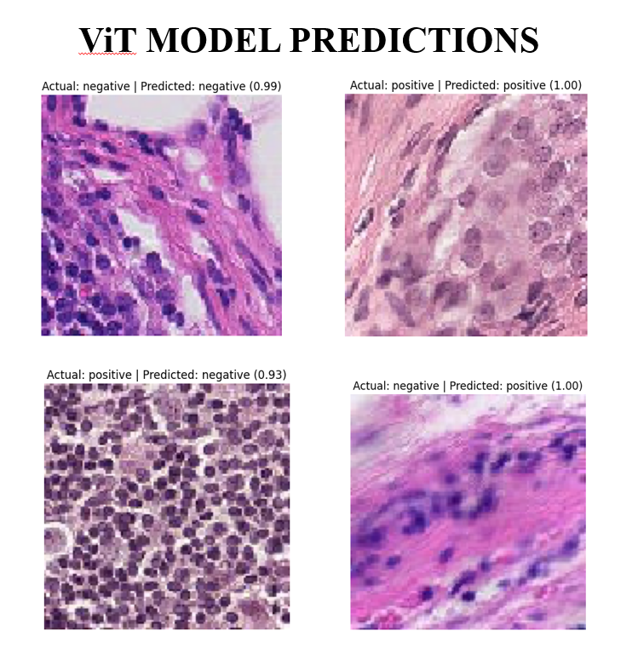
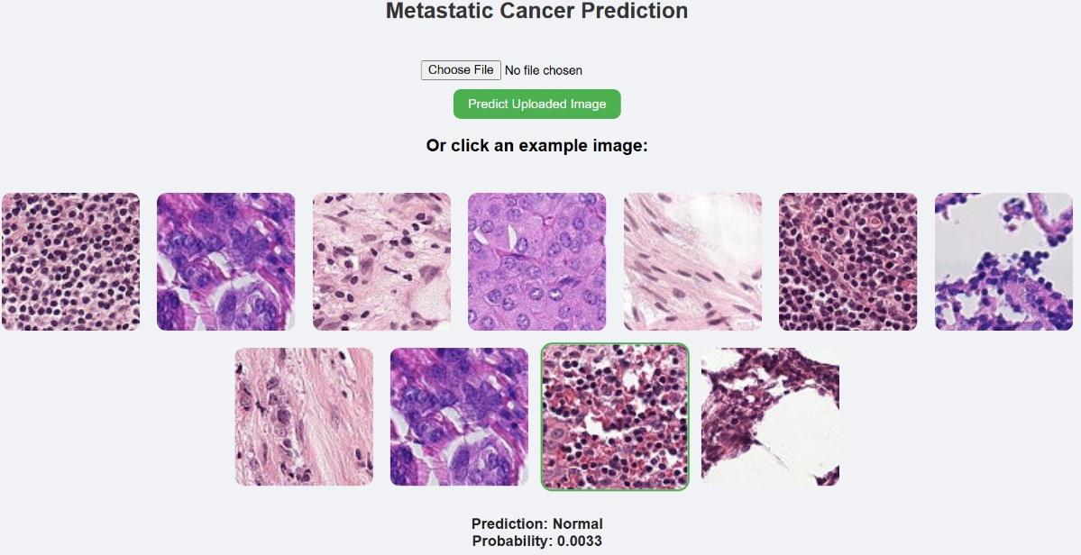
RESULTS

Slide 16
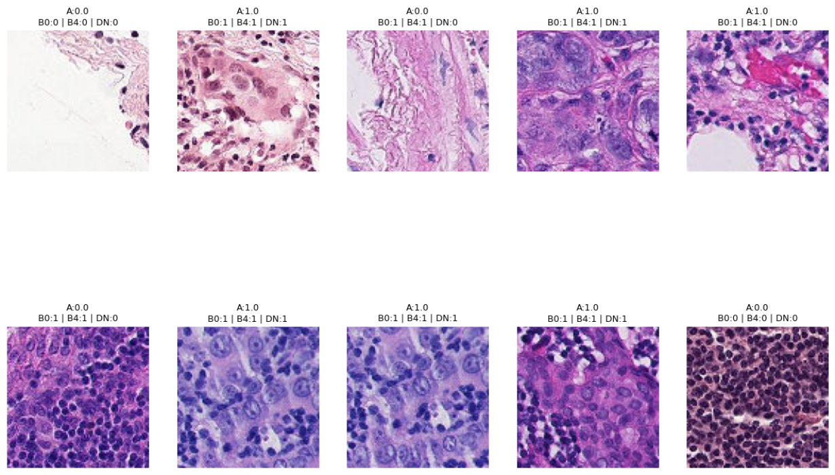

Slide 17
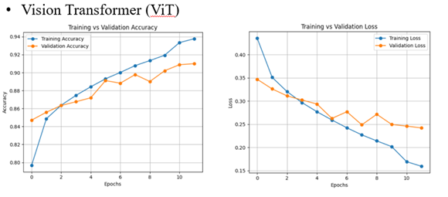
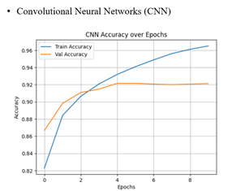
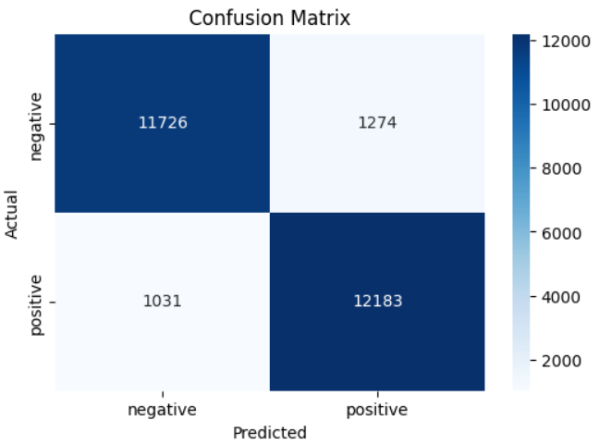
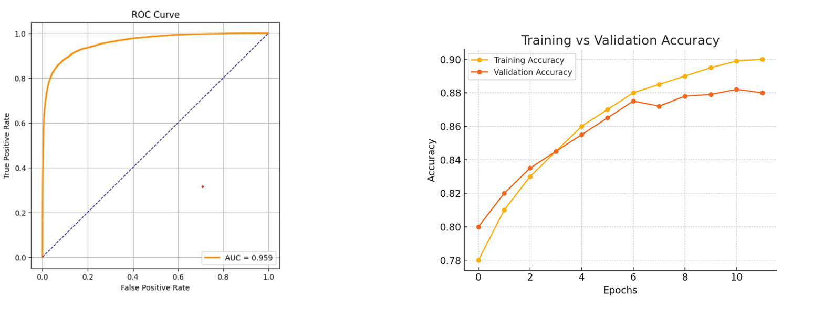
RESULTS ANALYSIS
Swin Transformer

Slide 18
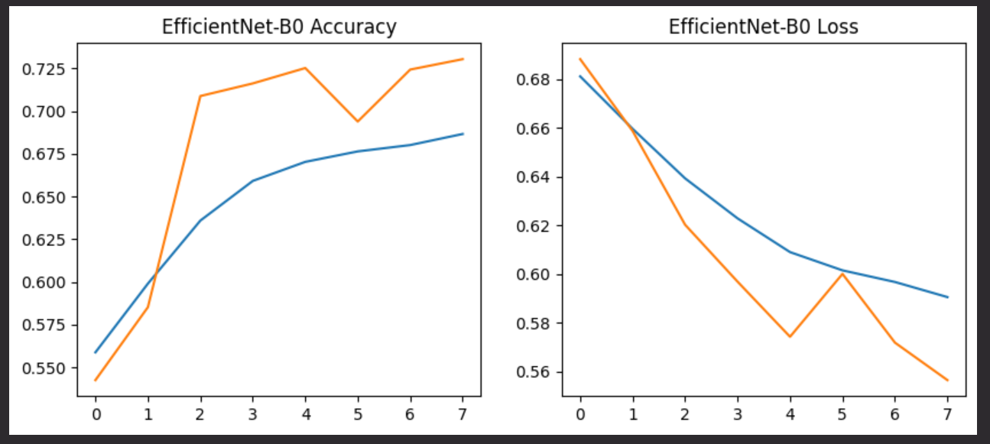
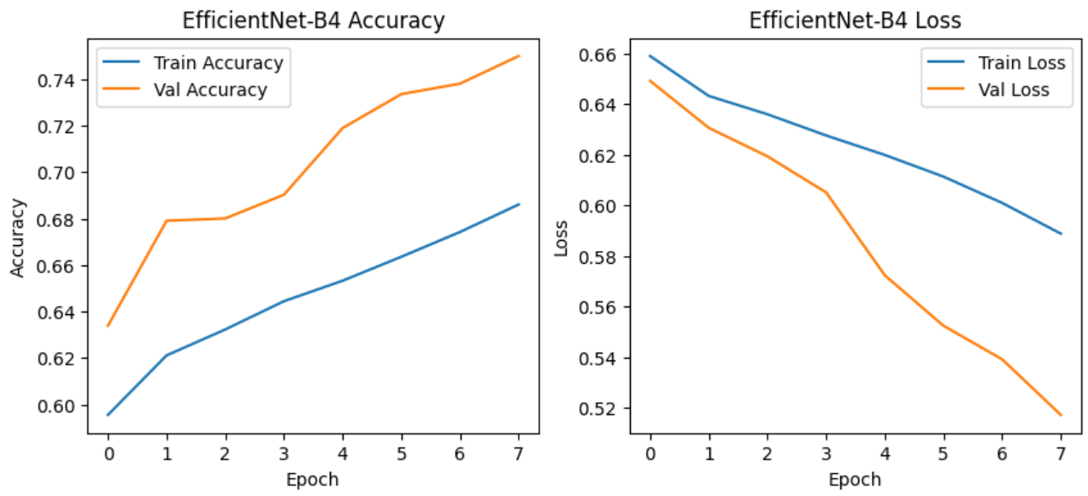
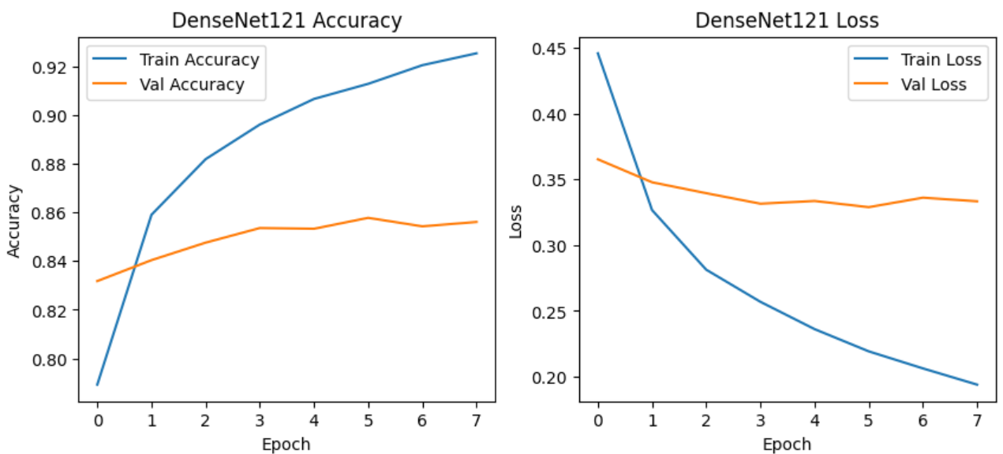
Shows the comparison of different deep learning algorithms based
on their accuracy along with references from related research works.
Algorithm | Precision | Recall | F1-Score | Accuracy | AUC
Vision Transformer (ViT) | 0.91 | 0.91 | 0.91 | 91% | 0.96
Convolutional Neural Network (CNN) | 0.78 | 0.77 | 0.77 | 77% | 0.85
Swin Transformer | 0.89 | 0.88 | 0.88 | 88% | 0.94
EfficientNet-B0 | 0.76 | 0.75 | 0.74 | 75% | 0.83
EfficientNet-B4 | 0.78 | 0.77 | 0.77 | 77% | 0.86
DenseNet121 | 0.85 | 0.84 | 0.84 | 84% | 0.92
Ensemble ML Models | 0.96 | 0.96 | 0.96 | 96% | 0.98
Boosting Models (XGBoost, LightGBM) | 0.95 | 0.95 | 0.95 | 95% | 0.97

Slide 19
CONCLUSION & FUTURE WORK
CONCLUSION
A deep learning framework was developed for metastatic cancer detection using histopathology images
EfficientNet-B0, EfficientNet-B4, and DenseNet121 were implemented and compared
DenseNet121 achieved the best performance, effectively capturing complex tissue patterns
EfficientNet models provided good accuracy with better computational efficiency
The system demonstrates that deep learning can support accurate and reliable cancer diagnosis
Helps reduce manual effort and diagnostic variability in clinical analysis
FUTURE WORK
Extend the system to multi-class classification for detecting cancer stages or subtypes
Integrate Explainable AI (Grad-CAM, SHAP) for better model interpretability
Train models on larger and more diverse datasets to improve generalization
Develop hybrid models combining CNN and advanced architectures
Deploy the system as a real-time clinical decision support tool.

Slide 20
REFERENCES
[1] Jiang, B., Bao, L., He, S., Chen, X., Jin, Z., & Ye, Y. (2024). Deep learning applications in breast cancer histopathological imaging: diagnosis, treatment, and prognosis. Breast Cancer Research, 26(1), 137.
[2] Wang, H., Wei, L., Liu, B., Li, J., Li, J., Fang, J., & Mooney, C. (2025). Transformer-Based Explainable Model for Breast Cancer Lesion Segmentation. Applied Sciences, 15(3), 1295.
[3] Sobhana, M., Palaketi, A. K., & Nalabothu, R. (2024, March). Breast cancer prediction by ensembling machine learning algorithms and explainable AI. In 2024 3rd International Conference for Innovation in Technology (INOCON) (pp. 1-6). IEEE.
[4] Khedr, O. S., Wahed, M. E., Al-Attar, A. S. R., & Abdel-Rehim, E. A. (2023). The classification of the bladder cancer based on Vision Transformers (ViT). Scientific Reports, 13(1), 20639.
[5] Mokta, I. J., & Soumma, S. B. (2025, March). An Explainable Artificial Intelligence Model to Detect Breast Cancer. In 2025 International Conference on Advanced Computing Technologies (ICoACT) (pp. 01-05). IEEE.

Slide 21
[6] Abbasniya, M. R., Sheikholeslamzadeh, S. A., Nasiri, H., & Emami, S. (2022). Classification of breast tumors based on histopathology images using deep features and ensemble of gradient boosting methods. Computers and Electrical Engineering, 103, 108382.
[7] Arravalli, T., Chadaga, K., Muralikrishna, H., Sampathila, N., Cenitta, D., Chadaga, R., & Swathi, K. S. (2025). Detection of breast cancer using machine learning and explainable artificial intelligence. Scientific Reports, 15(1), 26931.
[8] Yagin, B., Yagin, F. H., Colak, C., Inceoglu, F., Kadry, S., & Kim, J. (2023). Cancer metastasis prediction and genomic biomarker identification through machine learning and eXplainable artificial intelligence in breast cancer research. Diagnostics, 13(21), 3314.
[9] Nalela, P., Rao, D., & Rao, P. (2025). Predicting Survivability of Cancer Patients with Metastatic Patterns Using Explainable AI. arXiv preprint arXiv:2504.06306.
[10] Štifanić, J., Štifanić, D., Anđelić, N., & Car, Z. (2025). Explainable AI for oral cancer diagnosis: Multiclass classification of histopathology images and Grad-CAM visualization. Biology, 14(8), 909.
[11] Springenberg, M., Frommholz, A., Wenzel, M., Weicken, E., Ma, J., & Strodthoff, N. (2023). From modern CNNs to vision transformers: Assessing the performance, robustness, and classification strategies of deep learning models in histopathology. Medical image analysis, 87, 102809.
[12] Durgam, R., Panduri, B., Balaji, V., Khadidos, A. O., Khadidos, A. O., & Selvarajan, S. (2025). Enhancing lung cancer detection through integrated deep learning and transformer models. Scientific Reports, 15(1), 15614.

Slide 22
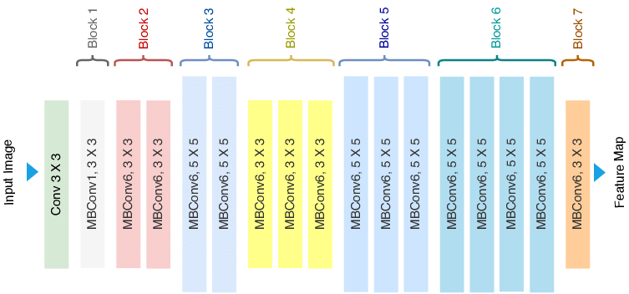
EFFICIENTNET

Slide 23
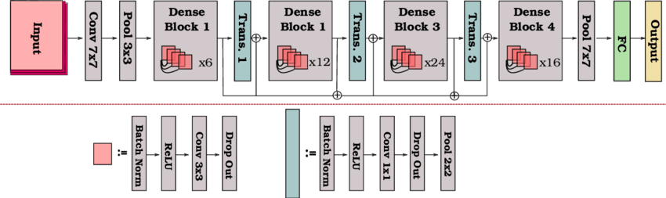
DENSENET121

