Slide 1
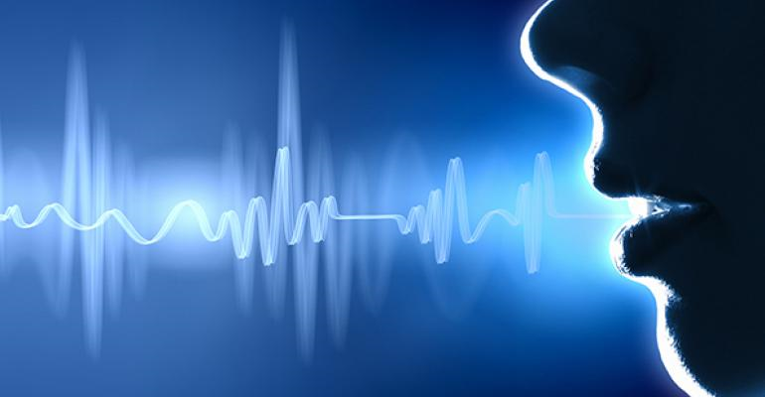
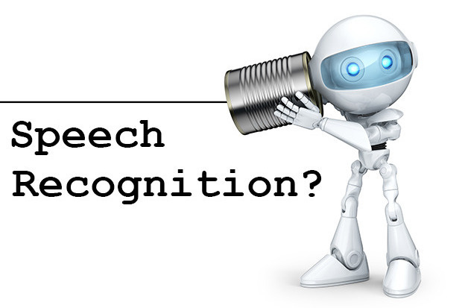
SPEECH RECOGNITION
GUIDE - Prof. VANI K
R15CS140 – J BHARAT
R15CS184 – ADITYA LINGANGARI
R15CS193 – MAHAVEER PINCHA
R15CS547 – SK SHAREEF
6th SEM CSE “C” Section

Slide 2
CONTENTS
Introduction
Approaches to speech recognition
How does it work??
Advantages
Disadvantages
Applications
Requirements
Conclusion

Slide 3
INTRODUCTION
Speech Recognition = “WHAT SOMEONE SAID”
What is it mean??
Speech recognition is the ability of a machine or program to identify words and phrases in spoken language and convert them to a machine-readable format.
The recognized words can be an end in themselves, as for applications such as commands & control, data entry, and document preparation.

Slide 4
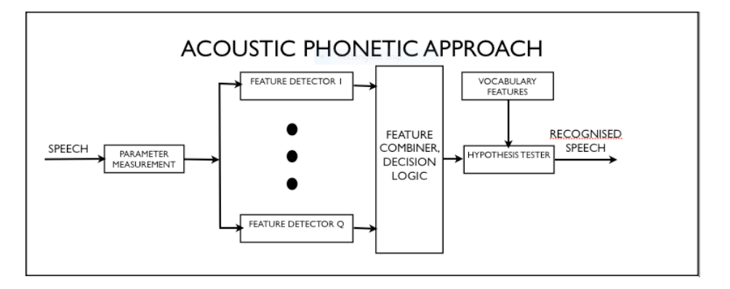
APPROACHES TO SPEECH RECOGNITION
Acoustic - Phonetic Approach

Slide 5
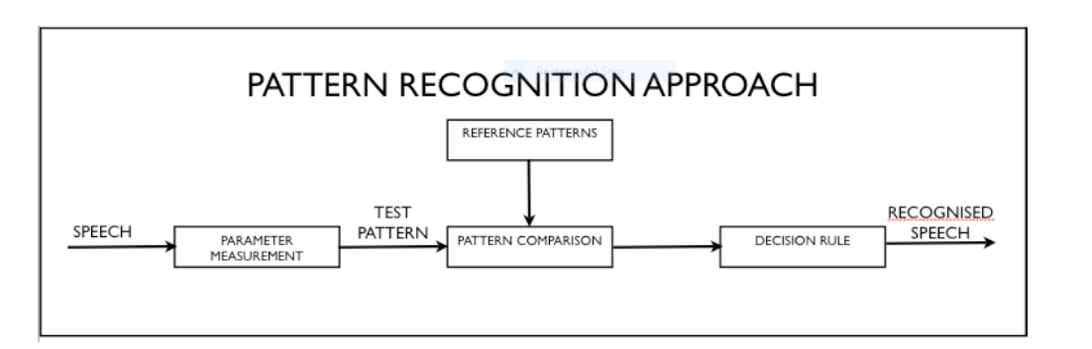
Pattern Recognition Approach

Slide 6
Artificial Intelligence Recognition Approach
The artificial intelligence approach coordinate the recognition procedure according to the person who applies it.
The intelligence of a person such as visualizing, analyzing etc are used for making a decision on the measured acoustic features.
Hybrid of acoustic-phonetic approach and pattern recognition approach.
Expert system or self-organizing(learning) system, implemented by neural network.

Slide 7
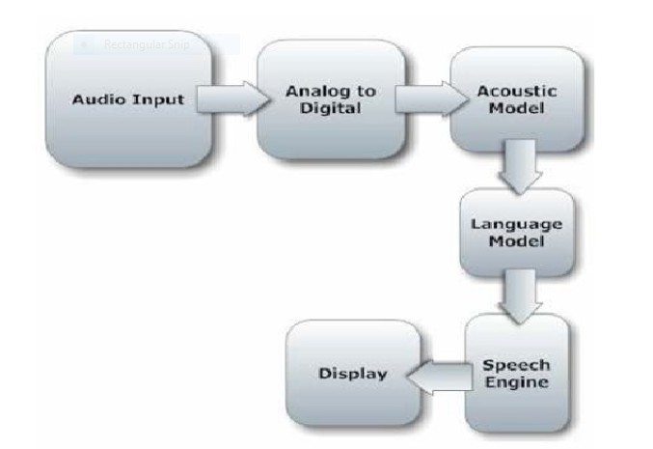
HOW DOES IT WORK??

Slide 8
Components of Speech recognition System Voice Input
Digitization
Acoustic Model
Language Model
Speech Engine

Slide 9
ADVANTAGES
People with disabilities
Organizations - Increases productivity, reduces costs and errors.
Lower operational Costs
Easy to search anything without typing.
Advances in technology will allow consumers and businesses to implement speech recognition systems at a relatively low cost.
• Cell-phone users can dial pre-programmed numbers by voice command.
• Speech recognition technology can also replace touch-tone dialing resulting in the ability to target customers that speak different languages

Slide 10
DISADVANTAGES
• Difficult to build a perfect system.
• Conversations
– Involves more than just words (non-verbal communication, stutters etc.
– Every human being has differences such as their voice, mouth, and speaking style.
• Filtering background noise is a task that can even be difficult for humans to accomplish.

Slide 11
APPLICATIONS
Education
Writing texts
Security
Medicine
Customer support
Legal industry
PC control

Slide 12
REQUIREMENTS
Software Requirements:
OS : Windows 7/8/10/Mac OS X 10.0 or higher/Linux : GNOME or KDE Desktop
PYTHONIDLE : 3.6.5+
PROGRAMMING LANGUAGE : Python
LIBRARY : Speech Recognition ,GTTS ,Web Browser etc.
Hardware Requirements:
RAM : At least 1 Gigabytes
STORAGE : At least10 Gigabytes
PROCESSOR : Intel Core i3or above
EXTERNAL MIC or INTERNAL MIC

Slide 13
CONCLUSION
This Thesis/Project work of speech recognition started with a brief introduction of the technology and its applications in different sectors.
The project part of the Report was based on software development for speech recognition.
At the later stage we discussed different tools for bringing that idea into practical work.
After the development of the software finally it was tested and results were discussed, few deficiencies factors were brought in front.
After the testing work, advantages of the software were described and suggestions for further enhancement and improvement were discussed.

Slide 14


