Slide 1

Government Polytechnic Dahod
Computer Department
5th Sem
RAKTBINDU
Blood Donation Management System
Guided by:
Prof. Paresh Patel
Submitted by: Shivani Chauhan(186300307512)
Ajab Khanrahim(186300307524)

Slide 2

Justification
Our tittle (RAKTBINDU) is that to help the needy person those who needs blood ,to save their lives.
We choose this topic to help those people who actually needed the blood in any case of emergency.
Our moto is to save the life of our precious once and spread happiness throughout the world.

Slide 3
Introduction
"Blood" The lifeline of the world.
The entire project has been developed keeping in
Admin is the main authority who can do addition, deletion, and modification if required .
The application takes care of different modules and their associated reports.

Slide 4
Scope of our Project
A very short span, it provides user with many facilities.
It Provides an elegant management of blood, list of hospitals, blood banks and donors online.
To interconnect all the blood banks, hospitals, donors into a single network.

Slide 5
Literature survey of our project
Existing system(red cross blood donation)
Cannot Upload and Download the latest updates.
Less Security.
No proper coordination between different Applications and Users.
Fewer Users – Friendly.

Slide 6
System Flow Diagram
Admin
Blood
Donors
Organization
Registration
Donor
Search
Check Organization
Contacts
Emergency
Services
Contact Organization
General
Information
Contact
Support
Blood Group
Inquiry

Slide 7
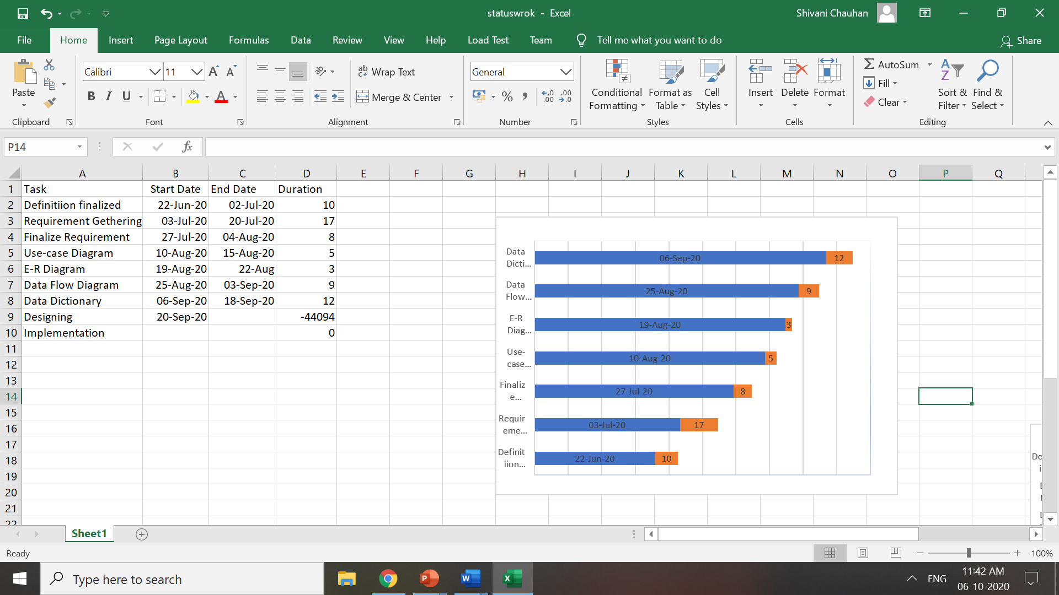
Status of Work(Done Till 5th October)

Slide 8
Conclusion
It has been a great pleasure for us to work on this exciting and challenging project.
This project proved good for us as it provided practical knowledge of extend web application.
I thank our guide for his valuable contribution in guiding me through out the project.

Slide 9
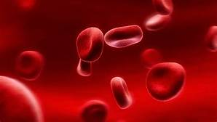
THANK YOU
RAKTBINDU

