Slide 1




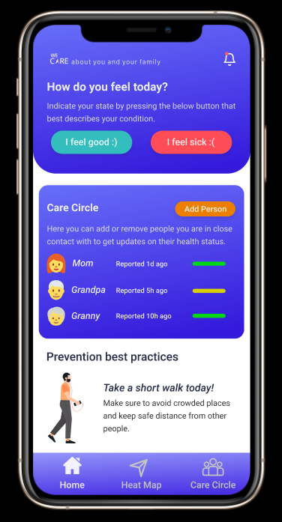
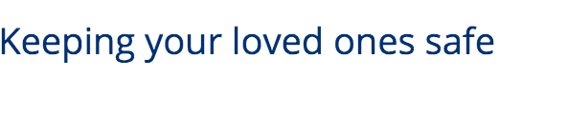

Slide 2

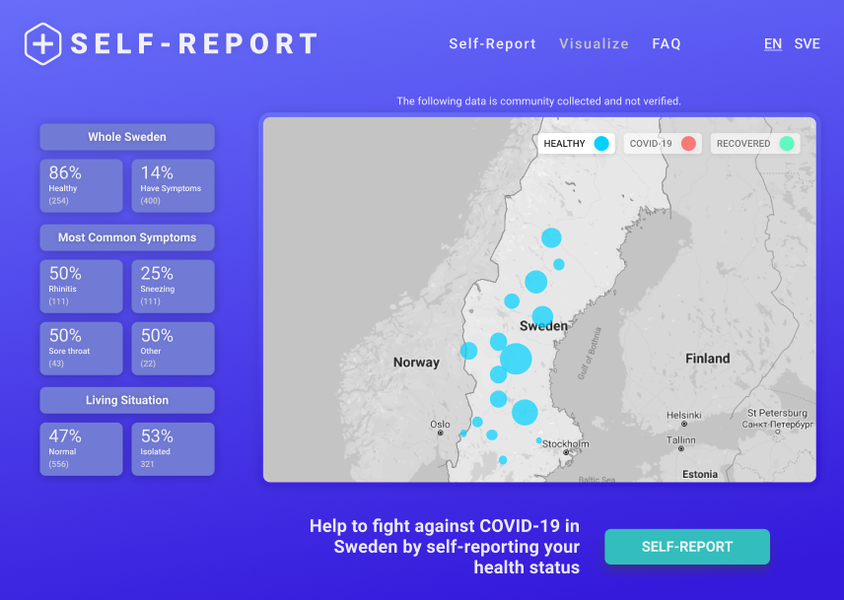
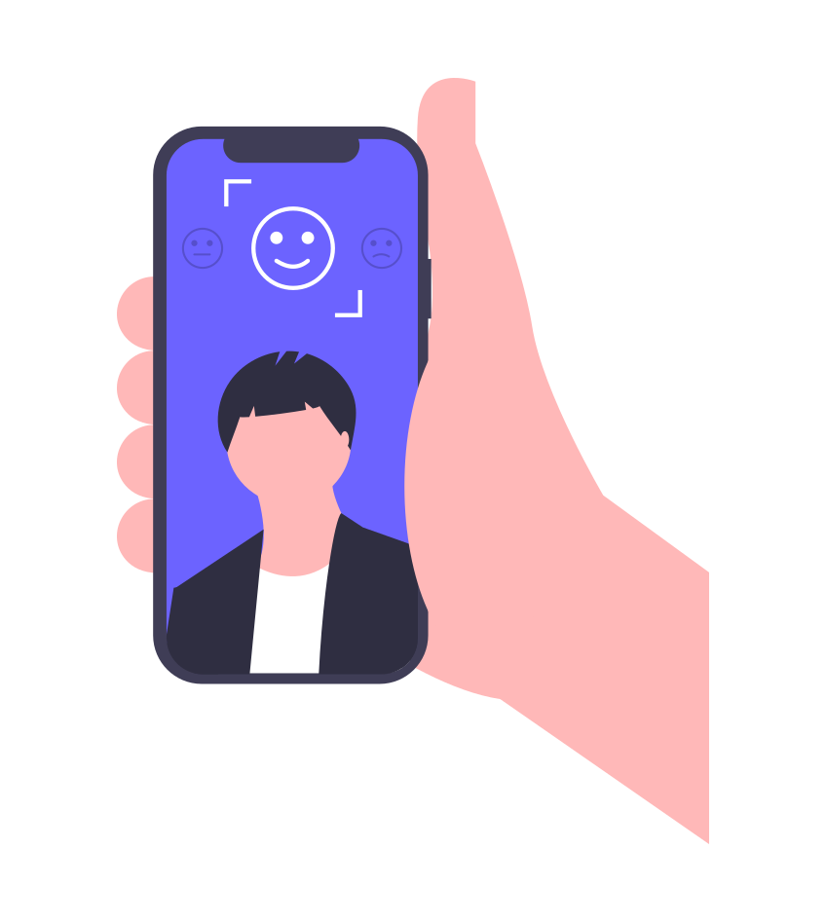
gives
Individuals
Track health status of your Care Circle (family & friends)
Risk in your neighborhood
Safe walk and exercise
Governmental agencies:
Better coordination
More informed decision making

Slide 3
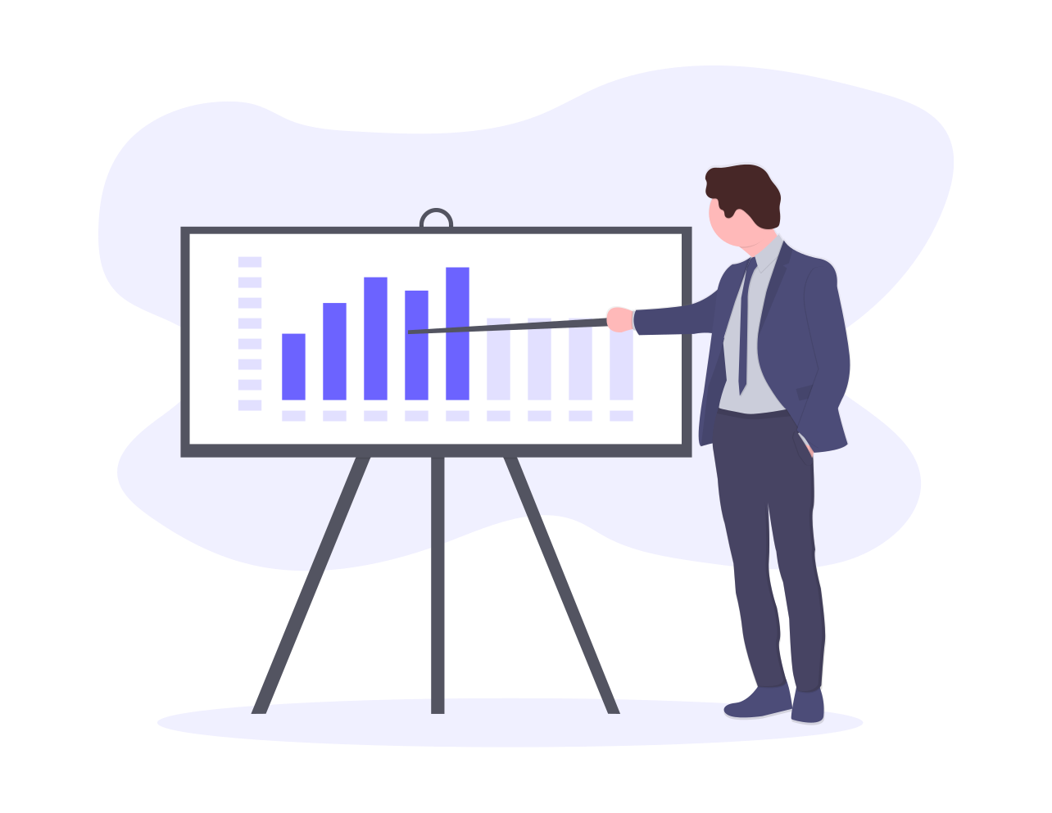
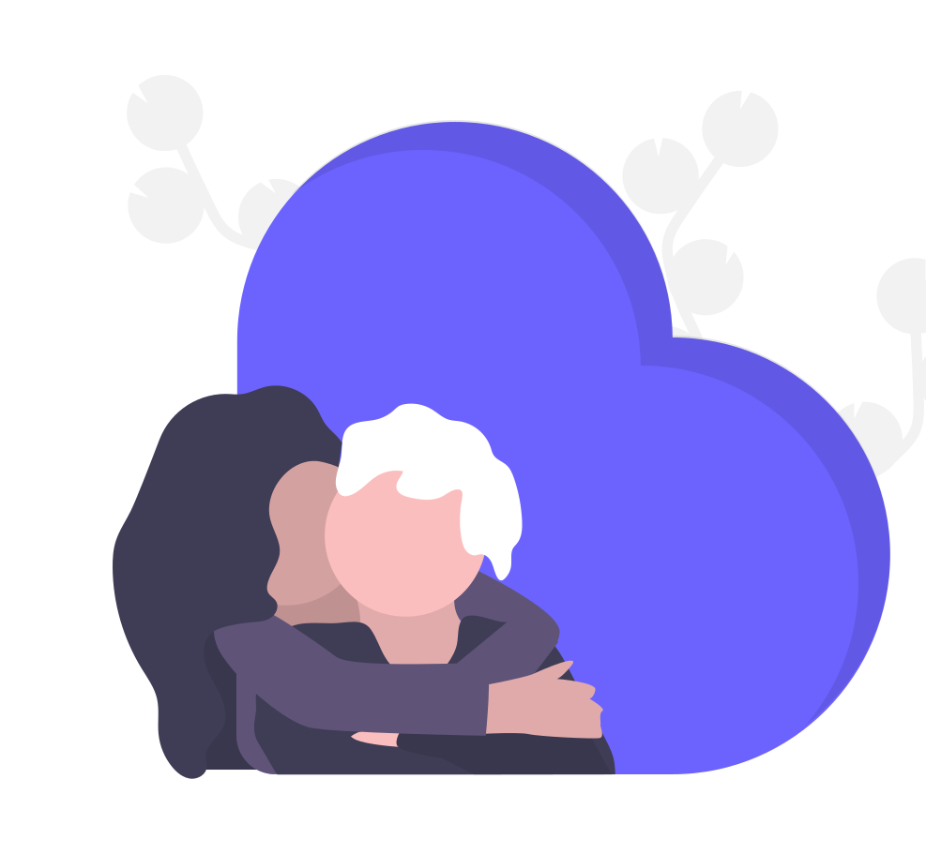
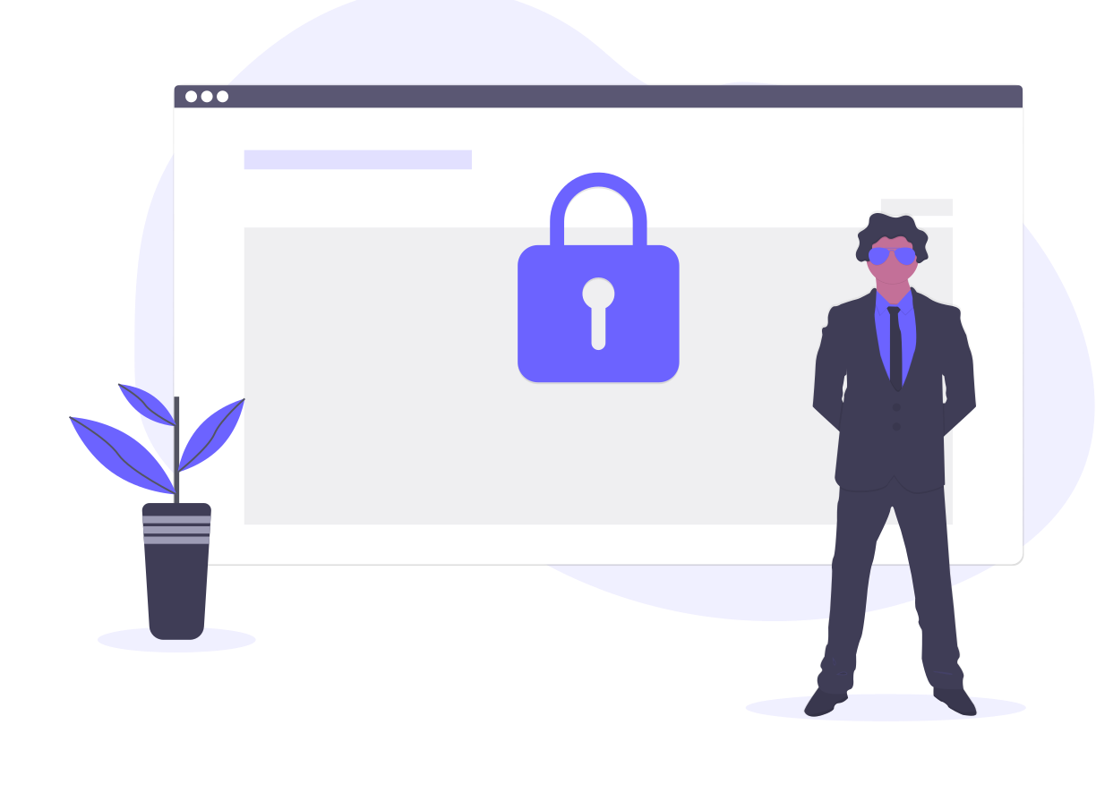
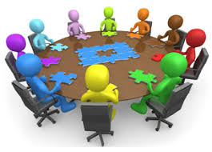
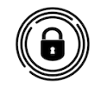
is different
Brings diverse data sources & stakeholders together
Governmental inputs
Public/user input
NGO
Focus on you and
Your loved ones
High risk groups
User anonymity and privacy
Technologies that protects privacy

Slide 4
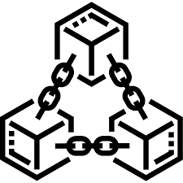
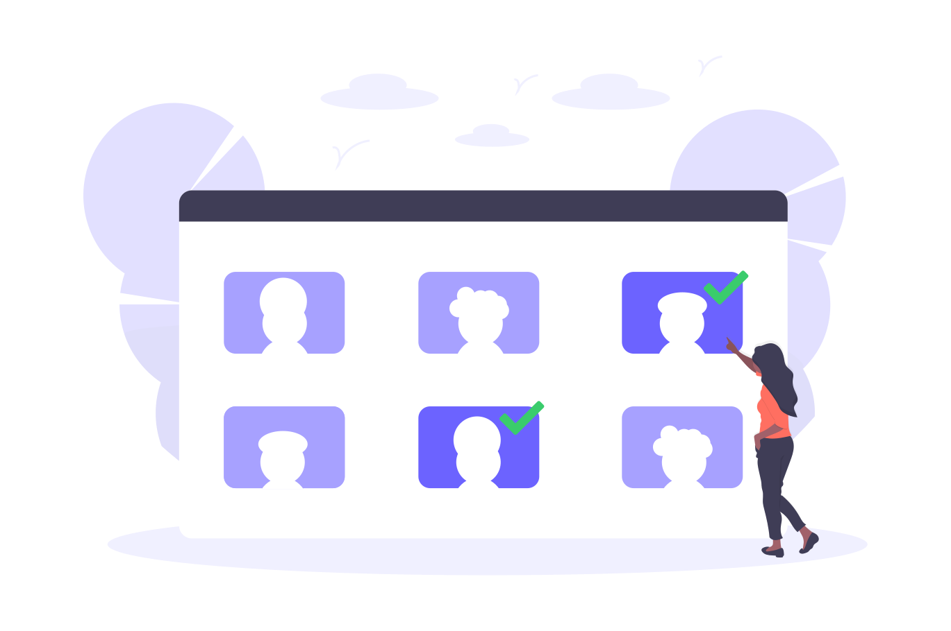
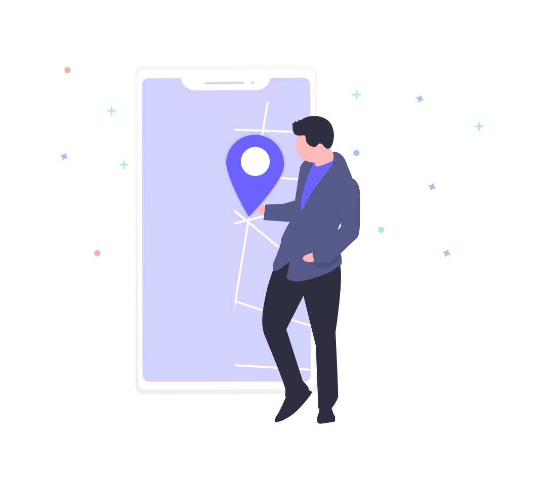
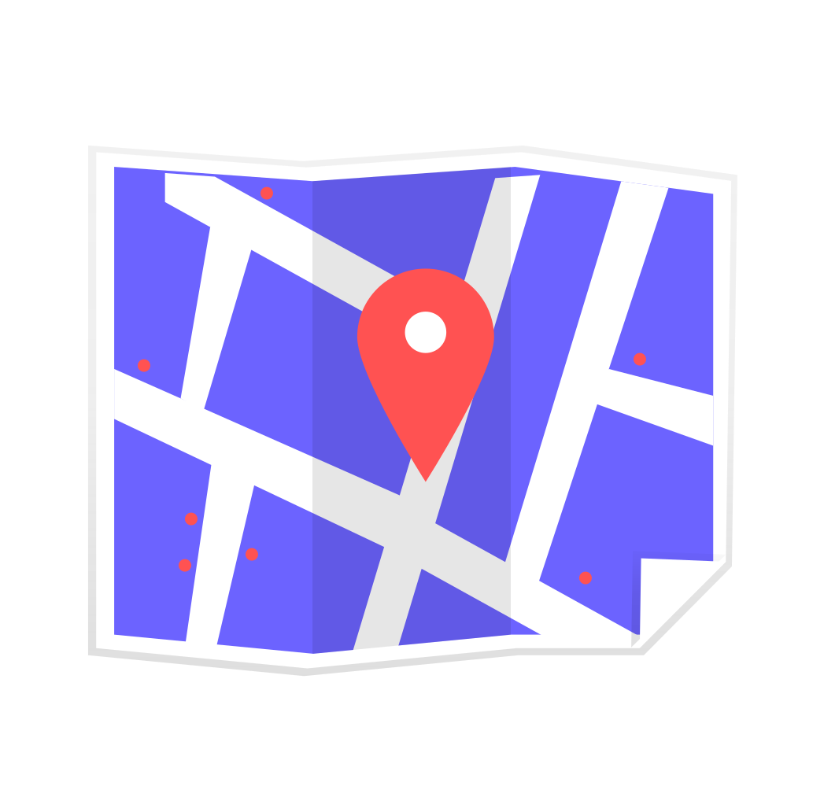
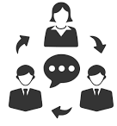
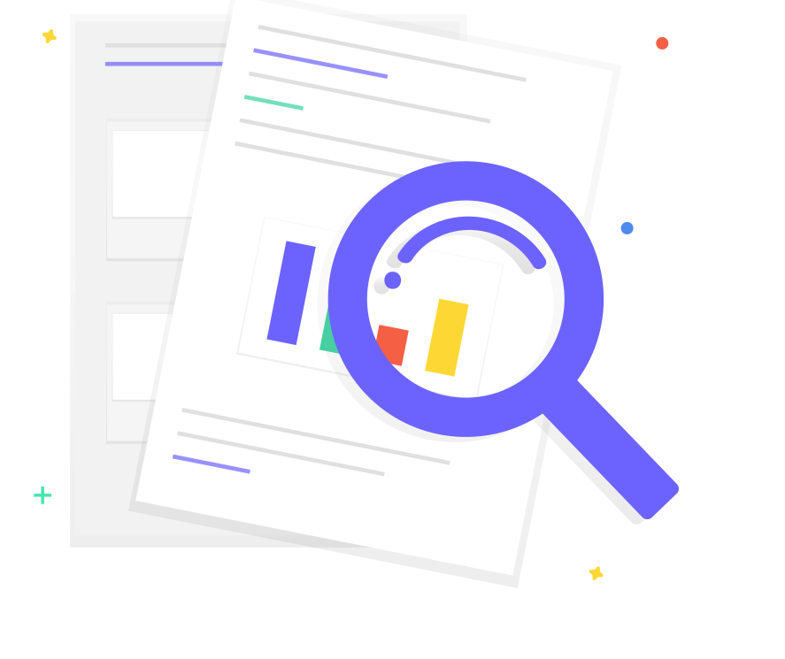

How does it Work?
Data aggregation from different sources
Data Intelligence platform
One tap crisis management tool (risk maps, statistics, risk communication)

Slide 5

App
Notes:
Self-report with key symptoms.

Slide 6
Web
Notes:
Self-report with key symptoms.

Slide 7
WeCare App
User Interface
User data input
General health query
Care circle response
Daily tips for general health and prevention

Slide 8
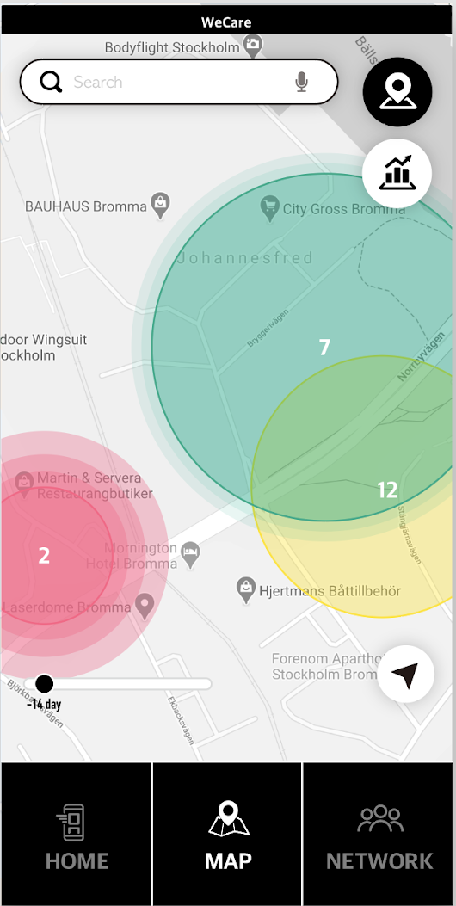
WeCare App
Live Hotspot Visualisation
Hotspots developed through 2D Kriging model interpolation
Realtime user-derived and official government services datasets

Slide 9
Video

Slide 10
The response start with you and your loved ones because, WeCare!

