Slide 1
Couponia (Couponic website of India)
Date: 10/07/2018
Mahavir Rathod

Slide 2
Problem Statement
To help users in saving money through various coupons, offers, deals and discounts. Providing coupons for various categories such as Food & Dining, Fashion, Recharge, Beauty & Health, Mobile & Tablets, Computers, Laptop & Gaming, Home Furnishing, TV / Audio / Video and Entertainment. To provide deals for Smart Shopping

Slide 3
Project Description
An Online Portal which provide Coupon codes for various categories.
Providing various features to enhance user interaction such as Searching, Sorting, Filtering, easy to use Navigation, Interesting visual Facts and Figures, Blogs and User Login.
Providing features for Admin operations such as admin login, add coupon, remove coupon, write blogs and Visual charts.

Slide 4
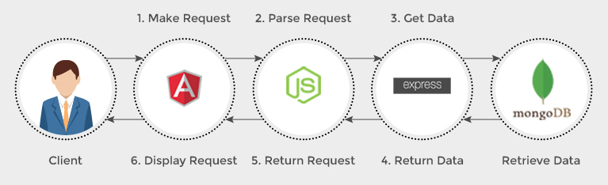
Technologies Used
Mongo DB -NoSQL Database
Node JS-Backend Scripting
Express JS- Middleware
Angular- Frontend Framework

Slide 5
Utilization Report
Maximum input

Slide 6
Methodology
Scrum-4
Angular Integration
Scrum-2
Developing RESTful APIs
Scrum-1
MongoDb
Couponia
Scrum-3
User interface
(Nodejs & Expressjs)
(Unit Testing with Mocha-Chai)

Slide 7
App Flow
Couponia
Home
Contact
Contact details
Categories
Users Login
Product Listing
Contact Us Form
Premium coupons
Category Menu
Best Offers
Top Brands
Coupon Facts
Blog
Admin Login
Graphs
Add Coupon
Remove Coupon
Write Blog

Slide 8
Functional Features
Search for Coupons on Listing Page.
Sign Up to get access for premium coupons
Best Offer and Top Brands based on highest reviews and top offers like 90% discount, Free offers, etc.
Multiple Views: Grid and List views of Coupons
Filter Coupons on different parameters:
Coupon Category ( Entertainment, Fashion, etc.)
Coupon Types (Cashback, % discount, etc.)
Blog posts and filter posts based on categories
Couponia Facts based on Number of coupons with respect to categories
6. Sort products on different parameters:
Default(by product name)
Rating
7. Admin Operations:
View Graph of number of coupons used
Add new Coupon
Remove coupon
Write Blog Post
View Subscribed users email Id’s with pagination
8. Subscription:
Users can subscribe by entering their Email Id

Slide 9
Technical Overview Libraries Used
Angular:
ng2-search-filter- Ng2SearchPipeModule
ngx-pagination- NgxPaginationModule
angular-6-social-login- SocialLoginModule, AuthServiceConfig, GoogleLoginProvider
Node js:
node-sentiments
mongojs
cors

Slide 10
Future Scope
Admin Update Coupon.
Location based Coupon Suggestion.
Auto Coupon delete when date Expires
Coupon Recommendation.
Refer and Earn Feature.
Coupon Reviews and Comments
Shopping Assistant Extension to Browser

Slide 11
THANK YOU

