Slide 1
Your Voice, Your Control
A voice-controlled Web App

Slide 2


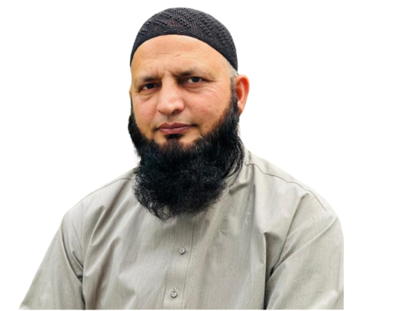
Supervisor
Group Members
Maha Waqar
21011519-085
Urba Naeem
21011519-155
Fazila Awan
21011519-164

Slide 3



Problem
Challenges faced by disabled people
Technically use some basic softwares
Dependent on others to do their work
socially exclusive
low opportunity for growth
Not much contribution in the society

Slide 4
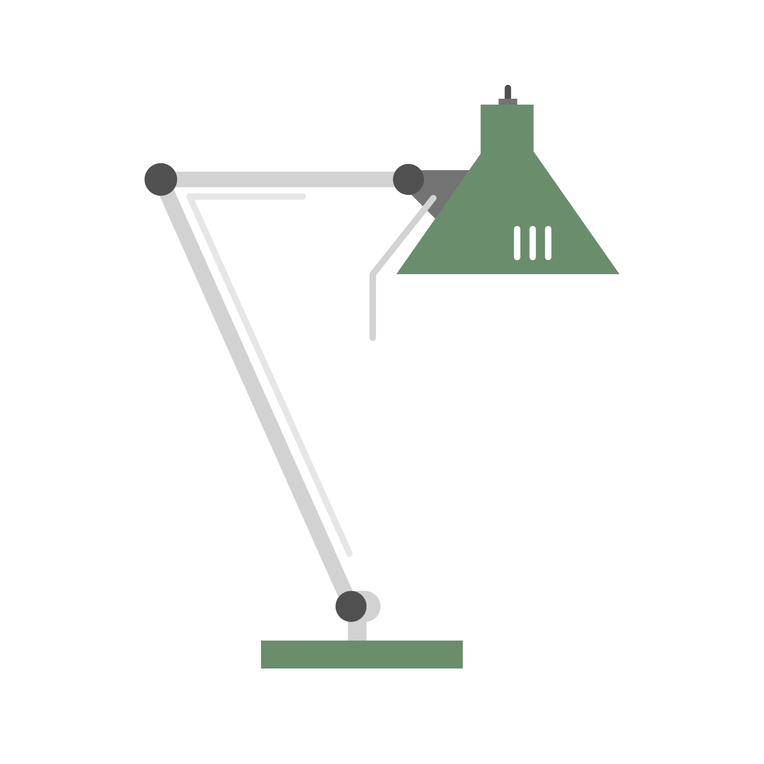



Solution
Develop a web app fully controlled by voice commands
Enable seamless navigation and interaction without mouse or touchpad

Slide 5
Target Audience
Primary: Disabled students without hand mobility. Secondary:
People with Parkinson's Disease.
Educators & caregivers
Developers & researchers in accessibility tech
Professionals needing hands-free solutions

Slide 6

Modules
Module 1 - Portfolio Builder
Create an interface with three templates and a customizable templating engine.
Module 3 - CV Builder
Design an interface with three templates and implement backend PDF conversion.
Module 2 - Text Editor
Develop an interface with navigation markers and a backend for data parsing.
Module 4 – Voice Commands
Register voice commands and utilize APIs for speech-to-text conversion.

Slide 7
Tools & Technologies
Frontend
React for dynamic UI. Backend
Node.js (Express) for server-side logic. Database
MongoDB for flexible data management. Voice Recognition
APIs (e.g., Google Speech-to-Text). Development Environment
VS Code, CI tools like Jenkins, GitHub for version control.

Slide 8
Thankyou

