Slide 1
Numerical Methods for Ordinary Differential Equations The Curious Case of Cauchy Problem
M. A. Hayat
Graduate Assistant
Electrical Engineering
University of Arkansas

Slide 2
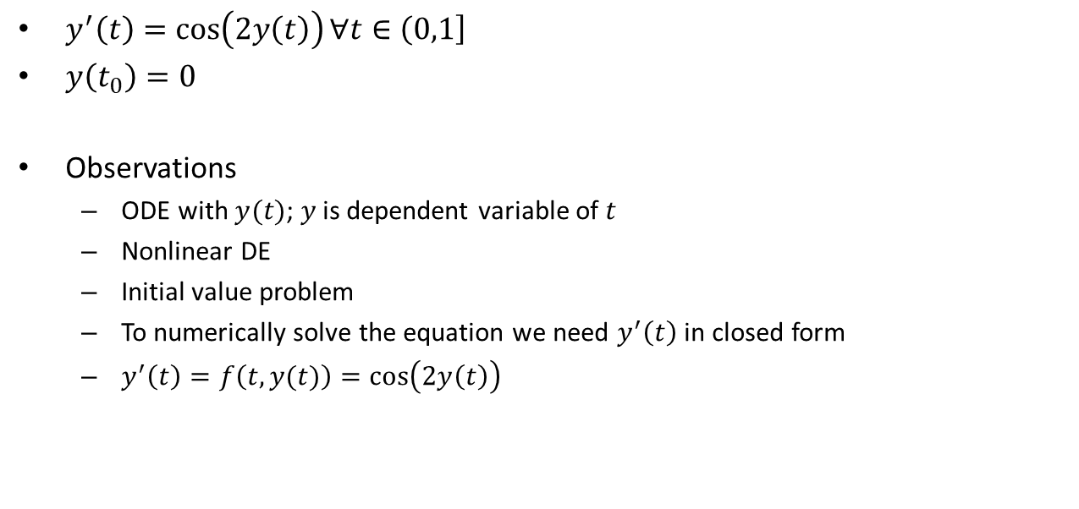
Cauchy Problem
$y^{′}\left(t\right)=\cos\left(2y\left(t\right)\right)∀t∈\left(0,1\right]$
$y\left(t_{0}\right)=0$
Observations
ODE with $y(t)$; $y$ is dependent variable of $t$
Nonlinear DE
Initial value problem
To numerically solve the equation we need $y^{′}\left(t\right)$ in closed form
$y^{′}\left(t\right)=f\left(t,y(t)\right)=\cos\left(2y\left(t\right)\right)$

Slide 3
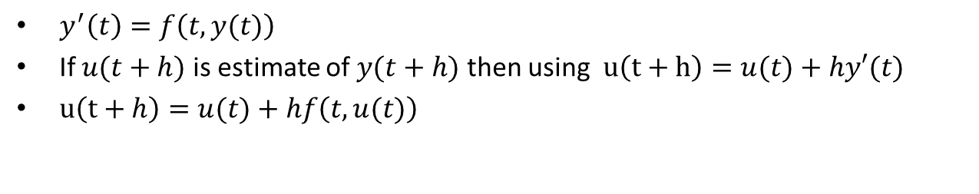
Numerical Methods
Forward Euler Method
$y^{′}\left(t\right)=f\left(t,y(t)\right)$
If $u(t+h)$ is estimate of $y(t+h)$ then using $u\left(t+h\right)=u(t)+hy′(t)$
$u\left(t+h\right)=u(t)+hf\left(t,u(t)\right)$
Backward Euler Method
Similarly, $u\left(t+h\right)=u\left(t\right)+hf\left(t+h,u(t+h)\right)$
Crank-Nicolson Method
Similarly, $u\left(t+h\right)=u\left(t\right)+\frac{h}{2}[f\left(t,u\left(t\right)\right)+ f\left(t+h,u\left(t+h\right)\right)]$

Slide 4

MATLAB Coding
function [t,ufe]= feuler(f, tspan, y0, Nh)
span = tspan(2)-tspan(1);
h = span/Nh;
t = tspan(1):h:tspan(2);
ufe = zeros(1,length(t));
ufe(1)=y0;
for i = 1:(length(t)-1)
ufe(i+1)=ufe(i)+h*f(t(i),ufe(i));
end
end
$$u\left(t+h\right)=u(t)+hf\left(t,u(t)\right)$$

Slide 5
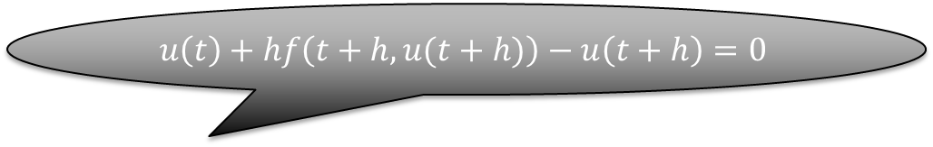
MATLAB Coding
function [t,ube] = beuler(f, tspan, y0, Nh)
span = tspan(2)-tspan(1);
h = span/Nh;
t = tspan(1):h:tspan(2);
ube = zeros(1,length(t));
ube(1)=y0;
for i = 1:(length(t)-1)
new_f=@(x)ube(i)+h*f(t(i+1),x)-x;
ube(i+1)= fzero(new_f,ube(i));
end
end
$$u\left(t\right)+hf\left(t+h,u(t+h)\right)−u\left(t+h\right)=0$$

Slide 6
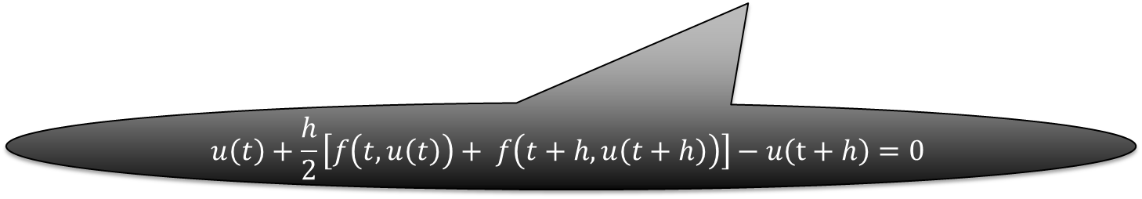
MATLAB Coding
function [t,ucn] = cranknic(f, tspan, y0, Nh)
span = tspan(2)-tspan(1);
h = span/Nh;
t = tspan(1):h:tspan(2);
ucn = zeros(1,length(t));
ucn(1)=y0;
for i = 1:(length(t)-1)
new_f=@(x) ucn(i)+0.5*h*(f(t(i),ucn(i))+f(t(i+1),x))-x;
ucn(i+1)= fzero(new_f,ucn(i));
end
end
$$u\left(t\right)+\frac{h}{2}\left[f\left(t,u\left(t\right)\right)+ f\left(t+h,u\left(t+h\right)\right)\right]−u\left(t+h\right)=0$$

Slide 7

Solution
Three solutions match with the given closed form exact solution
Here, $Nh=2^{10}=1024$

Slide 8
Solution
You can find the codes here:
https://github.com/mahayat/SCVW

Slide 9
Questions?
Thanks for listening
☺

