Slide 1
Benefits of Transfer Learning
Namitha Guruprasad, Lucia Rhode, Mahban Gholijafari

Slide 2
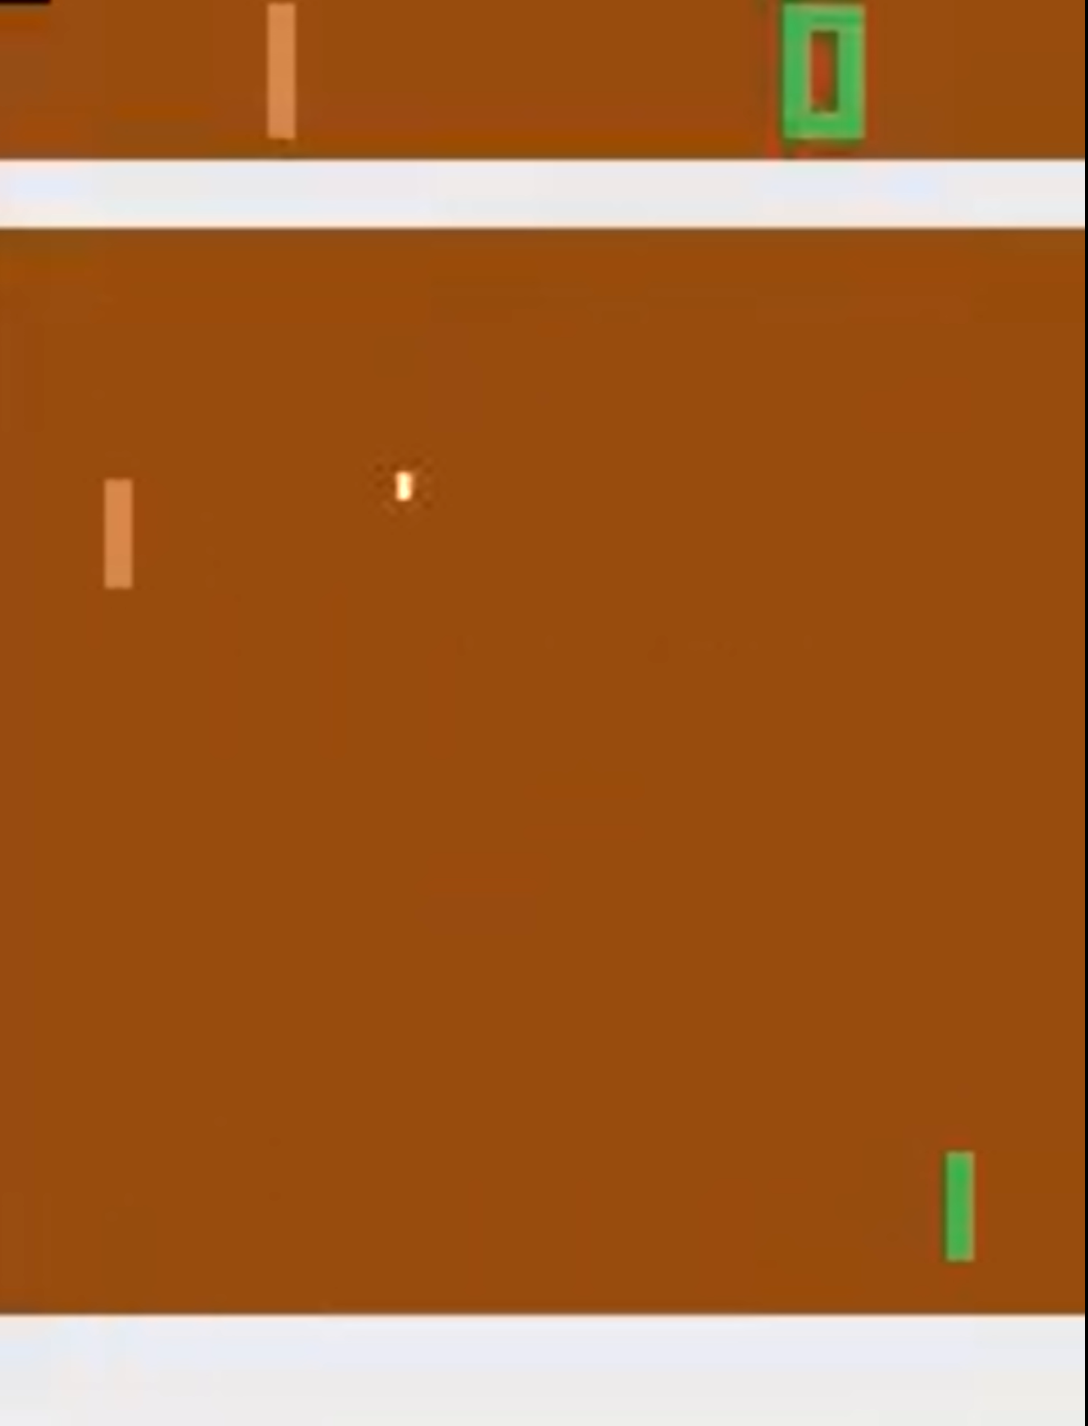
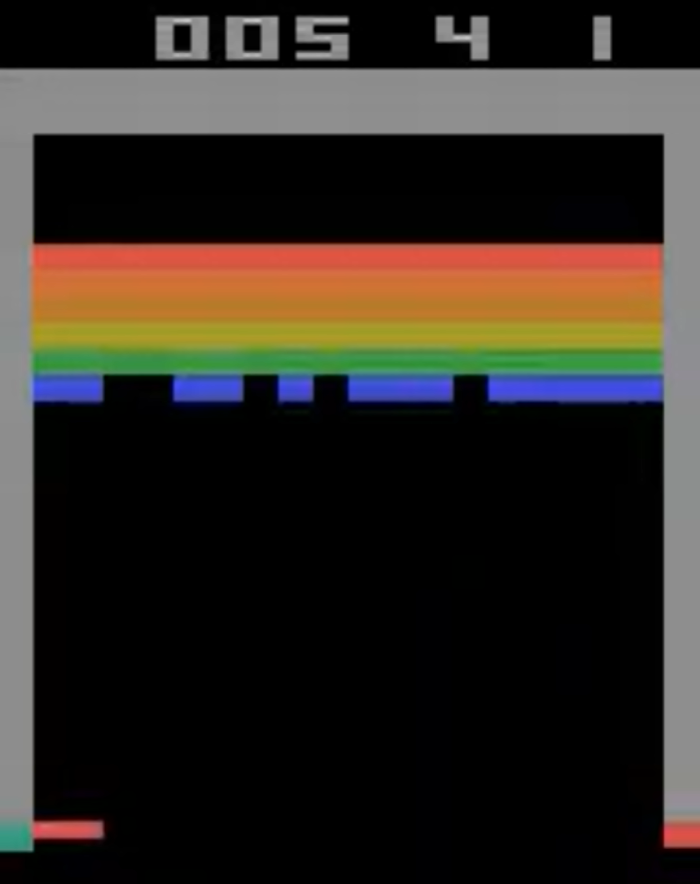
Motivation - Transfer Learning
Explore transfer learning by first training an agent on Pong and then transfer the learned knowledge to Breakout.
[1] Mnih. Playing atari with deep reinforcement learning. arXiv preprint arXiv:1312.5602, 2013

Slide 3
Atari Environment
 | Breakout | Pong
Environment | (210,160,3)
State Space | Stack of 4 frames
State Transition | T(s,a), Ball trajectory | T(s,a), Ball reflection in different angles
Action Space | Discrete(4): Noop, Left, Right, Fire | Discrete(6): Noop, Left, Right, Fire, Left Fire, Right Fire
Reward | Score points by destroying bricks | Score points by ball passing the opponent’s paddle, lose points if ball passes paddle
[2] Weitkamp, Laurens, Elise van der Pol, and Zeynep Akata. "Visual rationalizations in deep reinforcement learning for atari games." Springer International Publishing, 2019.

Slide 4
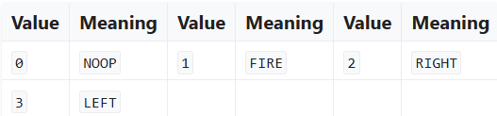
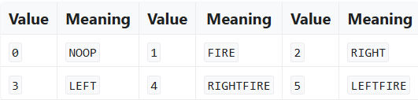
Adjustments for Transfer Learning
Transfer learning requires the state and action spaces to match.
Breakout and Pong share the same state space, however, Pong, by default, has a larger action space.
To match the Breakout and Pong action spaces, Left Fire and Right Fire and matched to Left and Right respectively, as they are redundant actions.
Breakout
Pong

Slide 5
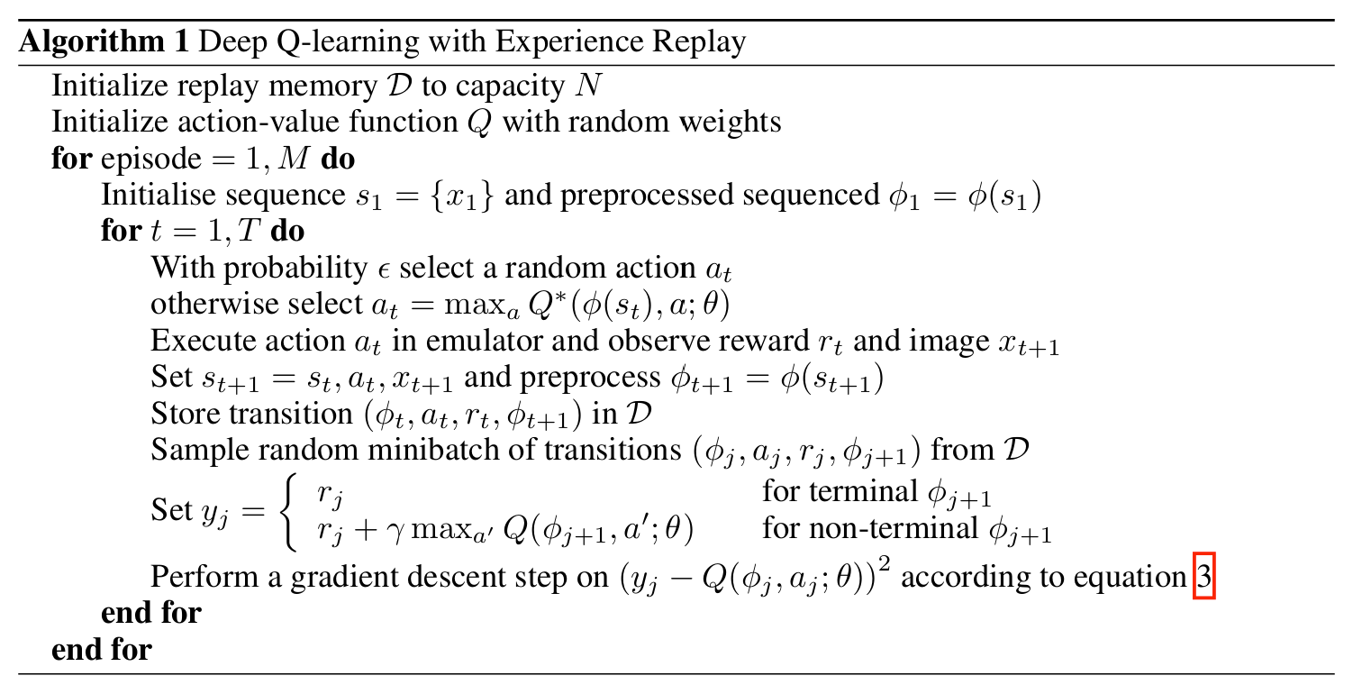
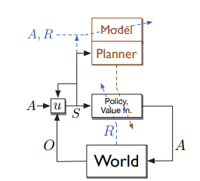
RL Method - Deep Q Network
DQN - uses a deep neural network to approximate Q-values for action-state pair [1]:
Sampling
Training
Agent Training [Sutton & Barton]
Notes:
https://huggingface.co/learn/deep-rl-course/en/unit3/deep-q-algorithm

Slide 6
RL Method - Deep Q Network
DQN - uses a deep neural network to approximate Q-values for action-state pair [1]:
Experience Replay

Slide 7
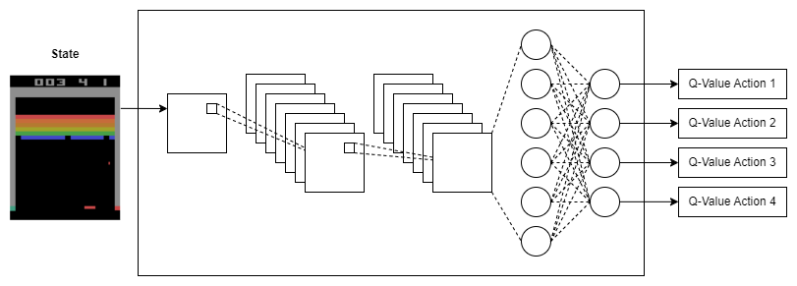
Deep Q CNN Network Implementation

Slide 8
Transfer Learning Setup
Pretrained Weights: Initialize breakout DQN model with weights from Pong-trained network
Fine-Tuning Layers: Freeze breakout-specific conv layers and update only the FC layers to adapt to breakout action space and gameplay dynamics
Why fine-tune? allows adaptation to breakout-specific features while retaining generalized knowledge from pong

Slide 9
Evaluation
Compare two scenarios:
Training breakout from scratch.
Training breakout with Pong-pretrained weights with varying confidence
Metrics: mean reward
Challenges
Breakout and Pong differ in structure (paddle positioning, objectives) - we use wrappers to rotate and accommodate action space accordingly

Slide 10
DQN Training Results
Vanilla Breakout
Vanilla Pong

Slide 11
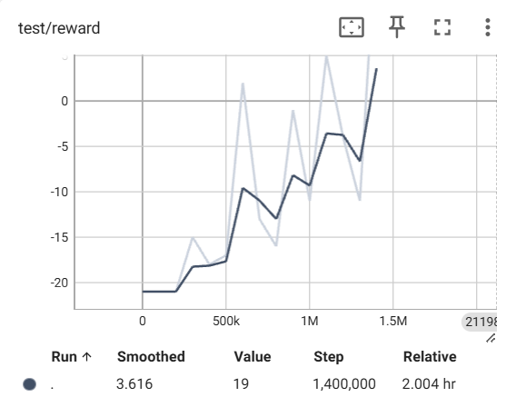
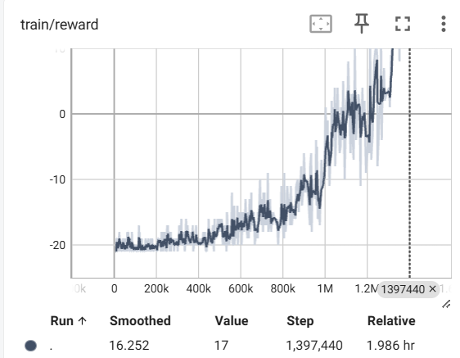
Vanilla Pong

Slide 12
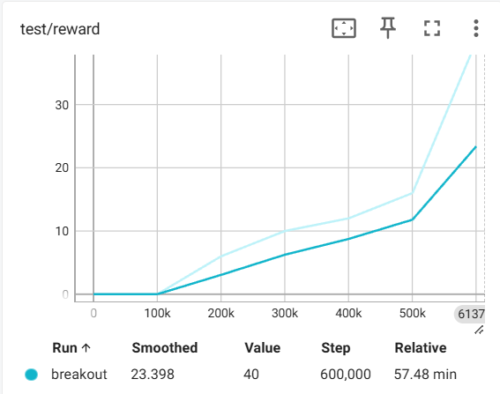
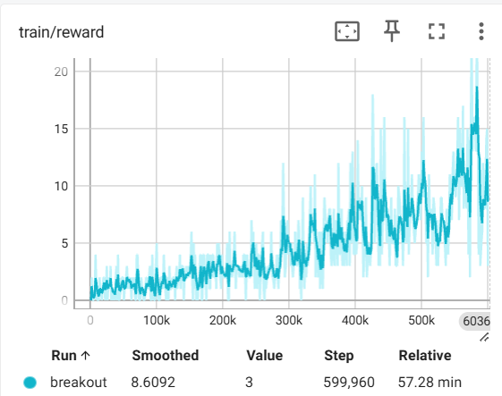
Vanilla Breakout

Slide 13
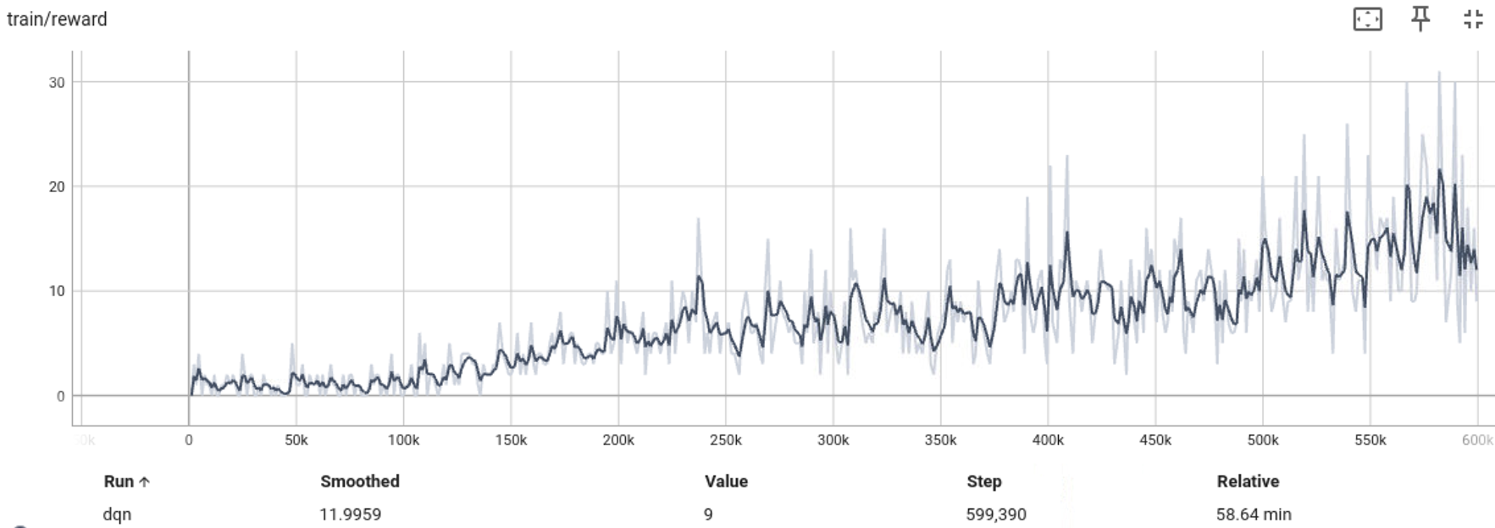
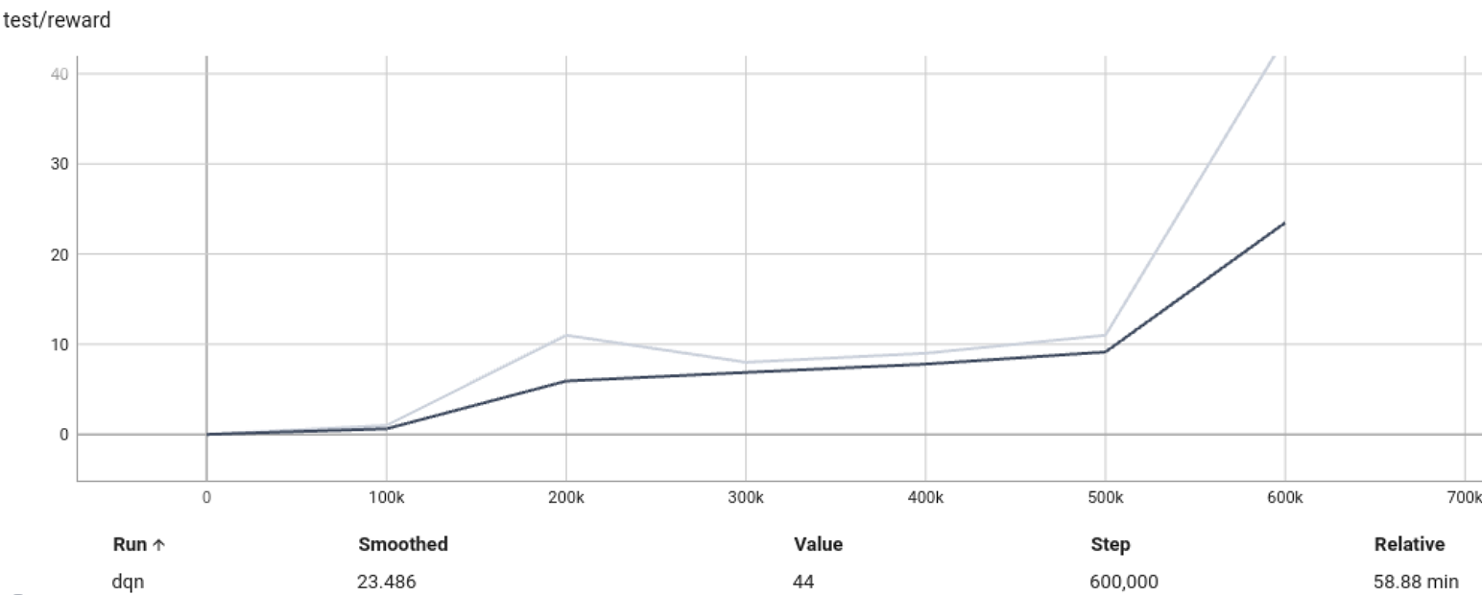
Experimental Transfer Learning Results
Training Breakout on Pong Model

Slide 14
DQN Transfer learning Results
Vanilla Breakout (max rew = 40)
Breakout with pretrained pong (max rew = 44)

Slide 15
Takeaways
We implemented the DQN to play Pong and Breakout game.
We find that we were able to successfully use transfer learning to improve performance of breakout
In the future, we are interested in seeing if we can successfully transfer learn weights to other games to improve performance and stability – this would more definitively show that transfer learning is viable more broadly in deep reinforcement learning in the context of games.
We will explore models more complex than DQN for training.

Slide 16
Acknowledgement
We would like to thank the instructor, Prof. Enrique Mallada, the TAs, specially Agustin Castellano, and our fellow classmates for intuitive discussions.

